Slide 1
FOODFIT
SUBMITTED BY,
ATHUL ABRAHAM
22PMC119

Slide 2
ABSTRACT
The Calorie Tracker is a software application that helps individuals monitor and manage their daily calorie intake. It aims to promote healthier eating habits and provide users with a tool to achieve their nutrition goals. The project involves developing a user-friendly web-based application with a comprehensive food database and features such as goal setting and progress tracking. The project has the potential to benefit individuals interested in maintaining a balance and nutritious diet.

Slide 3
REQUIRMENTS
Registration and Login Page
Select_Food
Add Food
Update Food
Delete Food
Profile Page
Calorie Calculations

Slide 4
Features and highlight
User login
user Registration
User-Friendly Interface
Food Database.
Custom Food Entry.
Calorie Calculation .
Goal Setting.
Privacy and Security

Slide 5
Architecture
Presentation Layer:
User Interface (UI): This layer includes the components that interact with users, such as web pages or mobile app screens.
Django Templates: Django's built-in template engine allows you to define HTML templates that render dynamic content and interact with the back-end.
Application Layer:
Django: Django serves as the back-end framework, handling HTTP requests, routing, and managing the application's business logic.
Django Views: Views receive requests from the user interface, process data, and generate appropriate responses. They interact with models, services, and external APIs as needed.
Django Forms: Forms handle user input validation and data submission, allowing users to input and update travel-related information.
Third-Party APIs: Integrate with external services such as package booking APIs, to retrieve travel-related information or make bookings

Slide 6
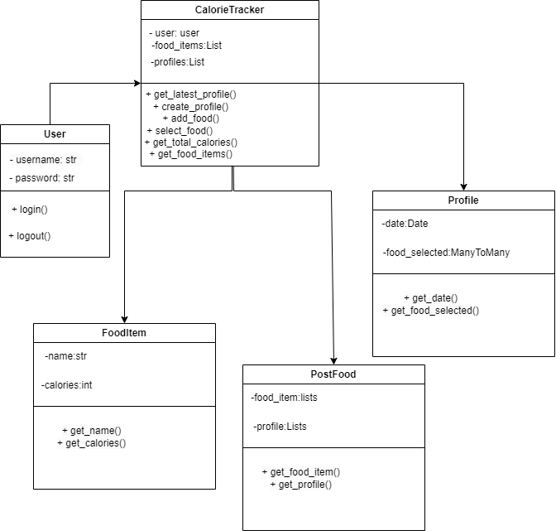
Class Diagram

Slide 7
Challenges..
Data Entry and Updating: Incorporating new food items and keeping the database up to date can be time-consuming. It may involve manual data entry, sourcing information from trusted sources, and verifying the accuracy of nutritional data regularly.
User Experience Design: Creating an intuitive and user-friendly interface is crucial for the success of the application. Designing an interface that is easy to navigate, visually appealing, and accommodates different device screens and resolutions can be a complex task.
Calorie Calculation Accuracy: Accurately calculating calories from various food items, considering portion sizes, cooking methods, and nutritional variations, can pose a challenge. Ensuring accurate and reliable calorie calculations is essential for providing users with trustworthy information.

Slide 8
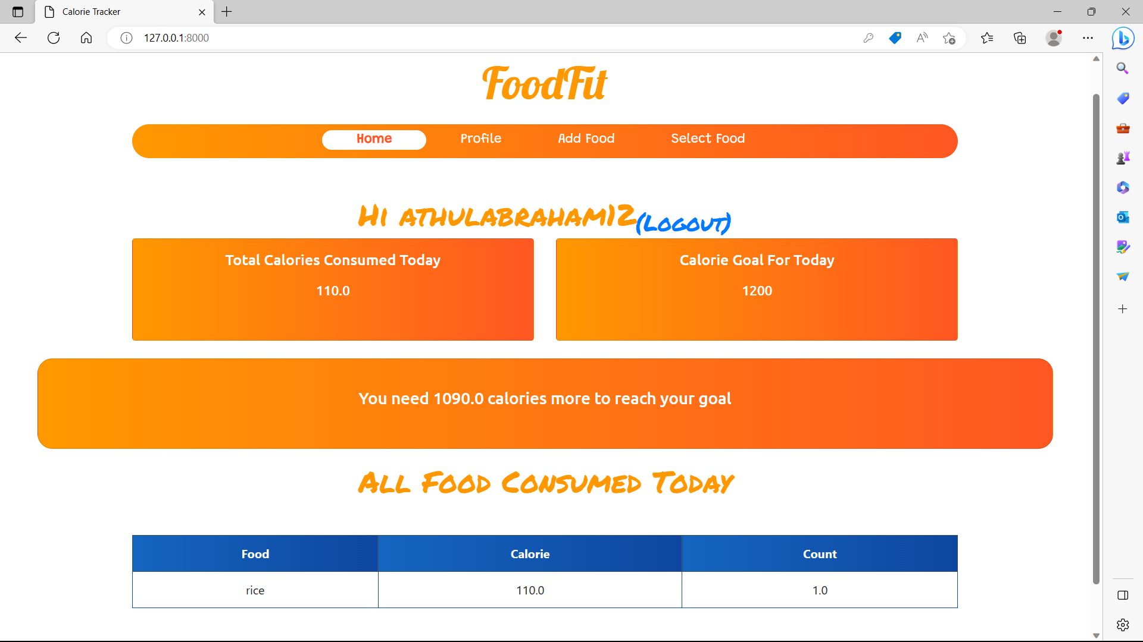
HOME PAGE
The user become login then it redirect to the users home page.

Slide 9
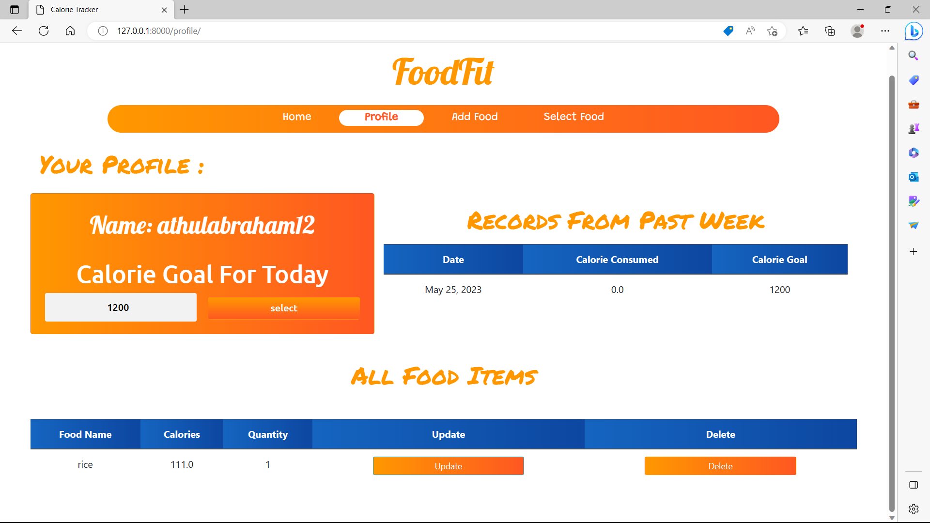
PROFILE

Slide 10
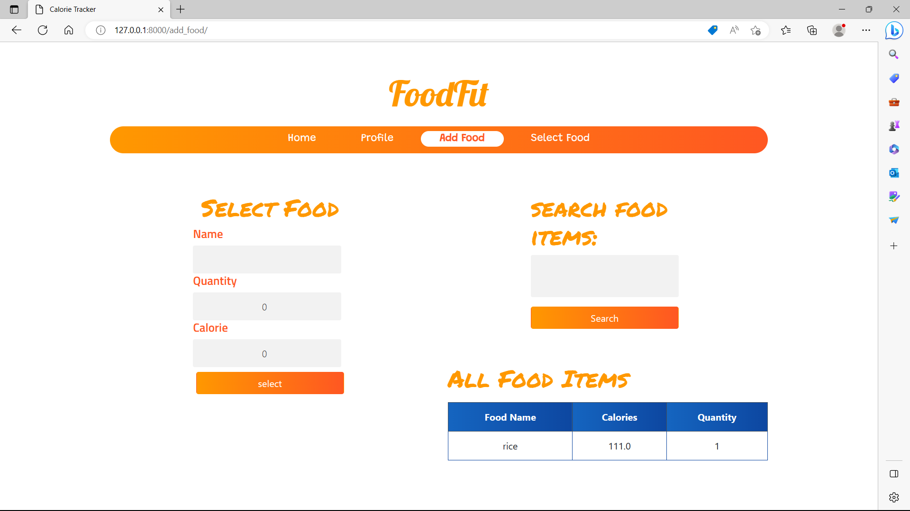
ADD FOOD

Slide 11
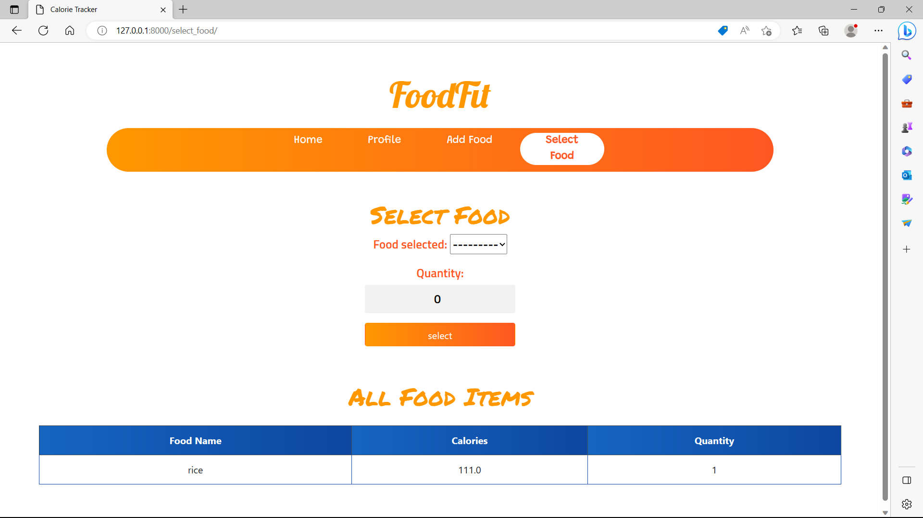
SELECT FOOD

Slide 12
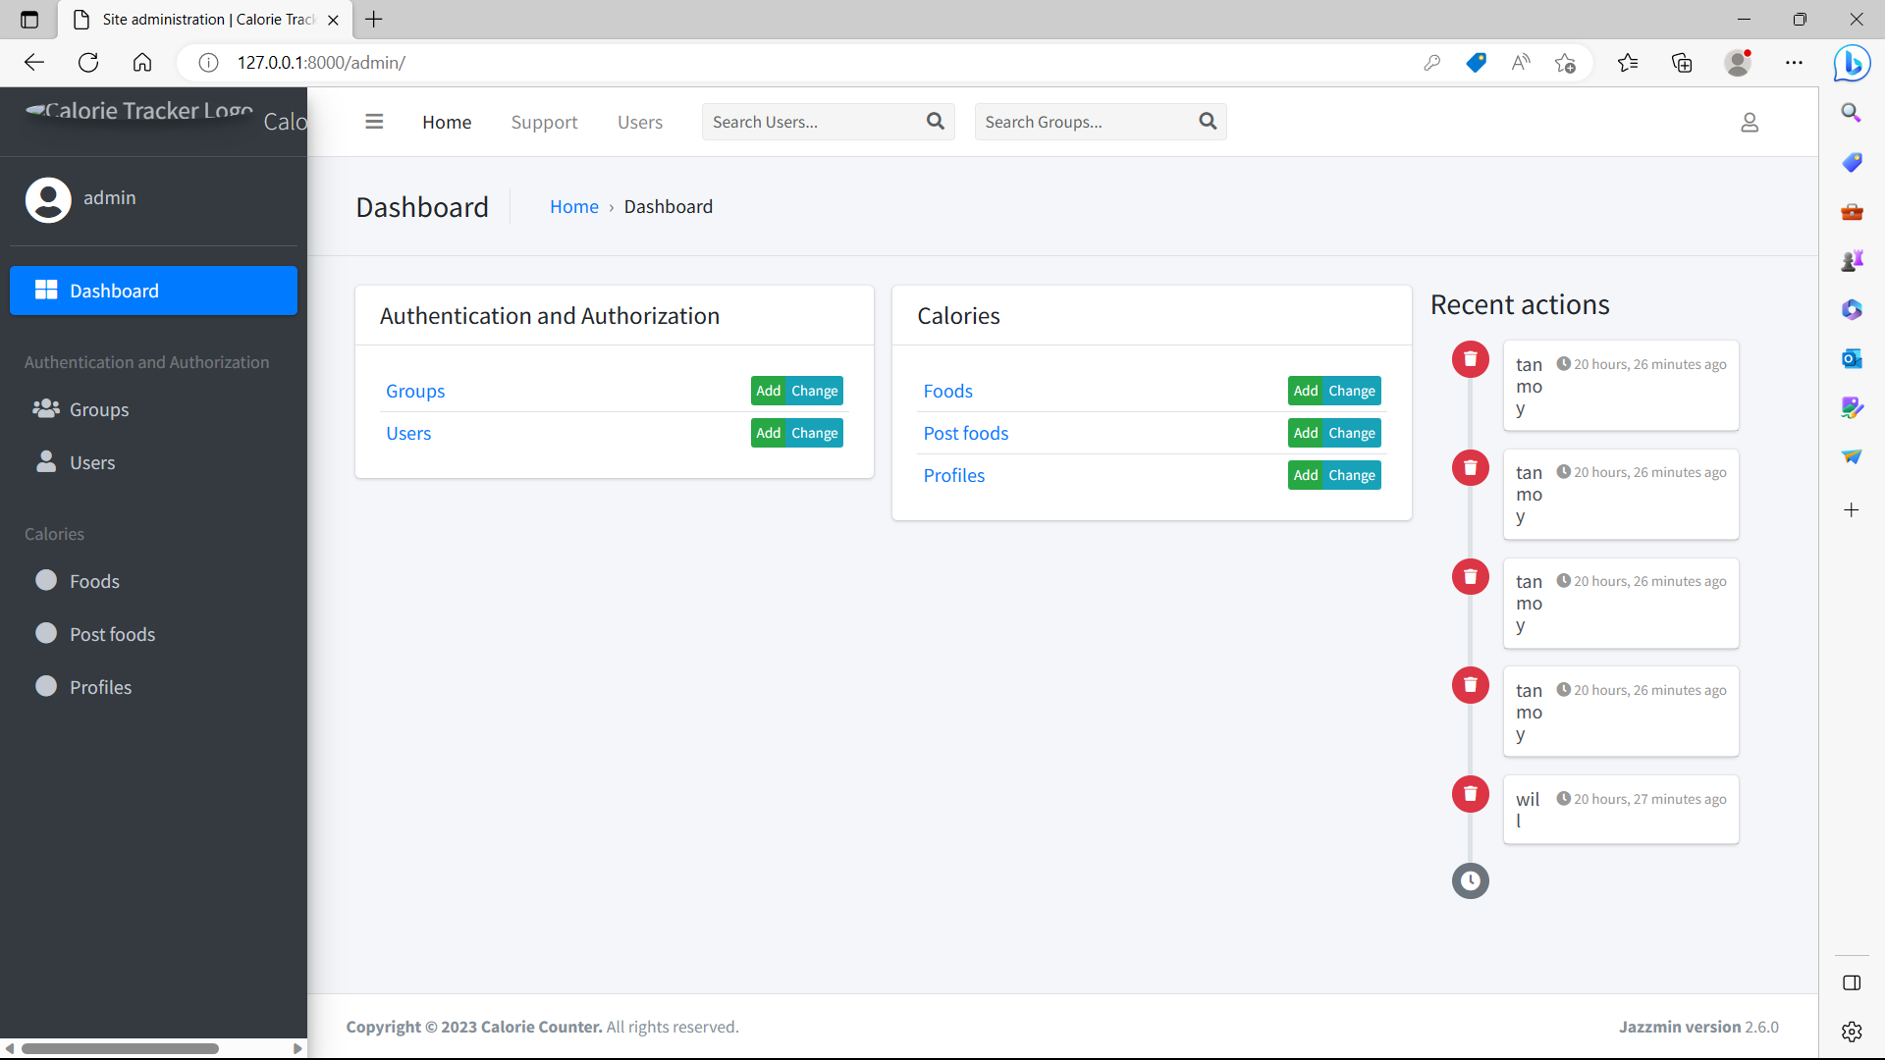
Admin interface

Slide 13
Future enhancement
Integration with Fitness Apps: Integrating the calorie tracker with popular fitness apps or platforms would allow users to have a holistic view of their health and wellness journey. This integration could provide insights into the correlation between calorie intake and exercise, offering a more comprehensive understanding of overall health and fitness.
Enhanced Data Analytics: Implementing advanced data analytics capabilities, such as predictive analysis and trend identification, would enable users to gain deeper insights into their eating patterns, identify potential areas for improvement, and receive proactive recommendations for maintaining a healthy diet.

Slide 14
conclusion
In conclusion, the Calorie Tracker Project is a user-friendly software application designed to track and manage daily calorie intake. It aims to promote healthier eating habits and assist users in achieving their nutrition goals. With features like a comprehensive food database, accurate tracking, goal setting, and personalized recommendations, the project offers a valuable tool for individuals seeking to adopt a balanced and nutritious diet. The future enhancements further enhance the user experience and provide comprehensive support for health and wellness goals. The project is focused on improving overall health and well-being by empowering users to make informed food choices and monitor their calorie intake effectively.

Slide 15
REFRENCES
Mayo Clinic - https://www.mayoclinic.org/
https://www.cdc.gov/

