Slide 1
JQUERY

Slide 2
JQuery is a very powerful and lightweight javascript library created by John Resig in 2006. jQuery means "write less do more".Its a cross-plateform library.
.

Slide 3
Jquery code structure
<html>
<head>
<script src="https://ajax.googleapis.com/ajax/libs/jquery/3.5.1/jquery.min.js"></script>
<script>
$(document).ready(function(){
alert(“the document is ready”);
});
</script>
</head>
<body>
<p>Welcome</p>
</body>
</html>

Slide 4
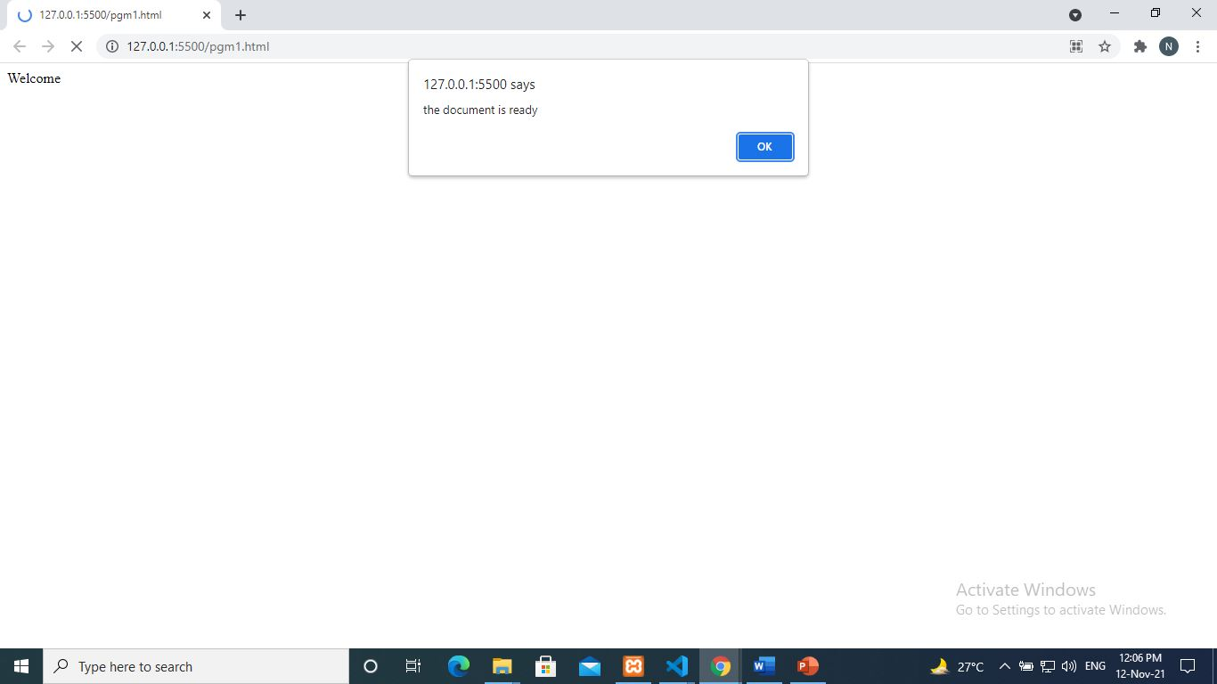
Output

Slide 5
Connecting html elements with Jquery
By Id:
<html>
<head>
<script src="https://ajax.googleapis.com/ajax/libs/jquery/3.5.1/jquery.min.js"></script>
<script>
$(document).ready(function(){
$("#p1").html("its 1st p tag");
$("#p2").html("its 2nd p tag");
});
</script>
</head>
<body >
<p id="p1">Welcome</p>
<p id="p2">Good Wishes</p>
</body>
</html>

Slide 6
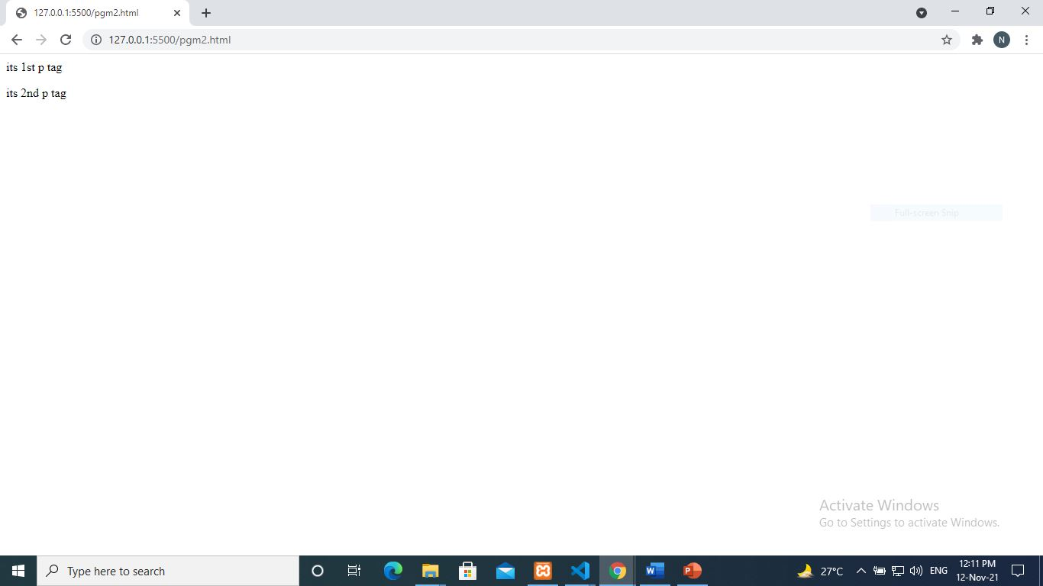
Output

Slide 7
Connecting html elements with Jquery
By class name:
<html>
<head>
<script src="https://ajax.googleapis.com/ajax/libs/jquery/3.5.1/jquery.min.js"></script>
<script>
$(document).ready(function(){
$(".p1").html("its 1st p tag");
$(".p1").html("its 2nd p tag");
});
</script>
</head>
<body>
<p class="p1">Welcome</p>
<p class="p1">Good Wishes</p>
</body>
</html>

Slide 8
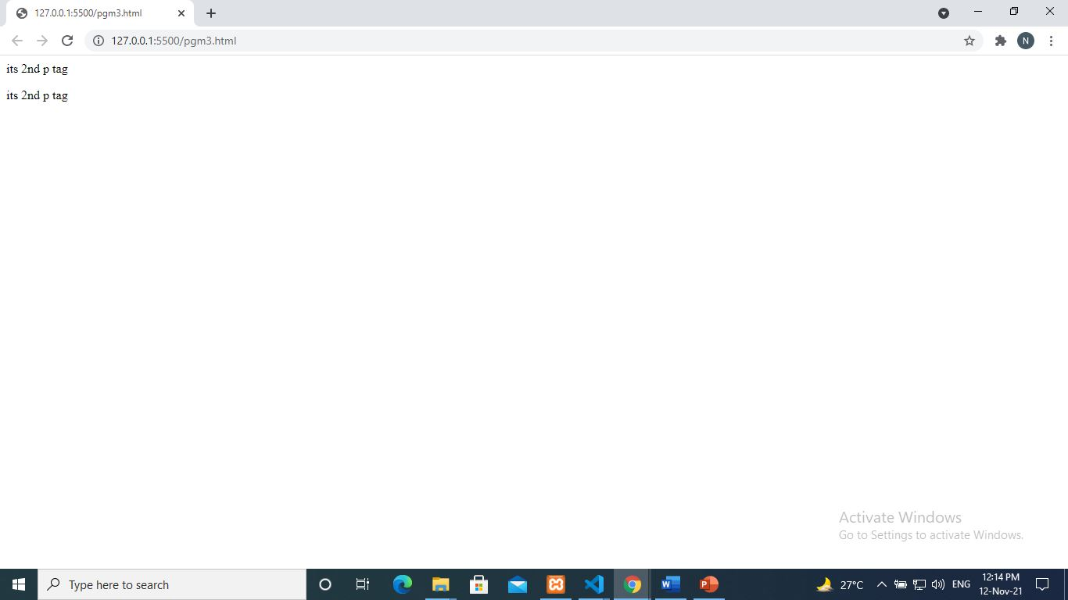
Output

Slide 9
Connecting html elements with Jquery
By Tag:
<html>
<head>
<script src="https://ajax.googleapis.com/ajax/libs/jquery/3.5.1/jquery.min.js"></script>
<script>
$(document).ready(function(){
$("p").html("its p tags");
});
</script>
</head>
<body>
<p >Welcome</p>
<p >Good Wishes</p>
</body>
</html>

Slide 10
Jquery events
Common events;
click (fires on mouse click on an element) | keypress (fires on pressing of alphanumeric keys on an element) | focus (fires on focuses on an element) | resize (fires when browser window resizes)
dblclick (fires on mouse dblclick on an element) | keydown (fires on pressing of any keys on an element) | blur (fires on focus losses from an element) | scroll (fires when user scrolls on a specified element)
mouseenter (fires on mouse enters on an element) | keyup (fires on releasing a key after pressing on an element) | change (fires on focus losses from an element after typing)
mouseleave (fires on mouse leaves from an element)

Slide 11
Jquery events
Click,dblclick,mouseenter,mouseleave:
<html>
<head>
<script src="https://ajax.googleapis.com/ajax/libs/jquery/3.5.1/jquery.min.js"></script>
<script>
$(document).ready(function(){
$(“#p1”).click(function(){
$(“#p1").html(“clicked inside me");
});
$(“#p1”).dblclick(function(){
$(“#p1").html(“doubleclicked inside me");
});
$(“#p1”). mouseenter (function(){
$(“#p1").html(“mouseentered inside me");
});
$(“#p1”). mouseleave (function(){
$(“#p1").html(“mouseleaved inside me");
});
});
</script>
</head>

Slide 12
Jquery events
Click,dblclick,mouseenter,mouseleave:
<body>
<p id=“p1”>Welcome</p>
</body>
</html>

Slide 13
Jquery events
Focus,blur,change:
<html>
<head>
<script src="https://ajax.googleapis.com/ajax/libs/jquery/3.5.1/jquery.min.js">
</script>
<script>
$(document).ready(function(){
$("#txt2").focus(function(){
alert("focused on textbox2");
});
$("#txt1").blur(function(){
alert("leaved from textbox1");
});
$("#txt2").change(function(){
alert("change from textbox2");
});
});
</script>
</head>

Slide 14
Jquery events
Focus,blur,change :
<body>
<input type="text" id="txt1" placeholder="textbox1">
<input type="text" id="txt2" placeholder="textbox2">
<input type="text" id="txt3" placeholder="textbox3">
</body>
</html>

Slide 15
Jquery events
Keypress,keydown,keyup:
<html>
<head>
<script src="https://ajax.googleapis.com/ajax/libs/jquery/3.5.1/jquery.min.js">
</script>
<script>
$(document).ready(function(){
$("#txt1").keypress(function(){
alert("keypressed");
});
$("#txt2").keydown(function(){
alert("keydown");
});
$("#txt3").keyup(function(){
alert("keyup");
});
});
</script>
</head>

Slide 16
Jquery events
Keypress,keydown,keyup :
<body>
<input type="text" id="txt1" placeholder="try keypress here">
<input type="text" id="txt2" placeholder="try keydown here">
<input type="text" id="txt3" placeholder="try keyup here">
</body>
</html>

Slide 17
Jquery variables
In jquery ,variables can be created using the $ symbol.
Eg:
$number=10;
$myword=“hello”;
$myname=$(“#txtname”).val();

Slide 18
Jquery functions
.val():the ‘.val()’ function is using to get/set the value to and from the form control.
Eg:-
$myname=$(“#txt1”).val();
$(“#txt2”).val($myname);
.html():the ‘.html()’ function is using to get/set the inner-content of an html tag.
Eg:-
$mytxt=$(“#p1”).html();
$(“#p2”).html($mytxt);

Slide 19
Jquery functions
.append():the ‘.append()’ function is using to append contents to an html tag.
Eg:-
$mytxt=“hello”;
$(“#p1”).append($mytxt);
.empty():the ‘.empty()’ function is using to remove the inner-content of an html tag.
Eg:-
$(“#p1”).empty();

Slide 20
Jquery functions
.hide():the ‘.hide()’ function is using to hide an html tag from the screen. The tag and its content will be disappeared from the screen.
Eg:-
$(“#p1”).hide();
.show():the ‘.show()’ function is using to show an html tag which is already in hidden.
Eg:-
$(“#p1”).show();

Slide 21
Jquery functions
.attr():the ‘.attr()’ function is using to set attribute to an html tag.
Eg:-
$(“#p1”).attr(“width”,”500”);
.prop():the ‘.prop()’ function is using to set the property to an html tag.
Eg:-
$(“#txt1”).prop(“value”,”my html”);

Slide 22
Jquery functions
<html>
<head>
<script src="https://ajax.googleapis.com/ajax/libs/jquery/3.5.1/jquery.min.js">
</script>
<script>
$(document).ready(function(){
$("#btn1").click(function(){
$mytext= $("#txt1").val();
$("#txt2").val($mytext);
});
});
</script>
</head>

Slide 23
Jquery functions
<body>
<input type="text" id="txt1" placeholder=“Enter text">
<input type="text" id="txt2" >
<input type=“button" id=“btn1“ value=“click me” >
</body>
</html>

Slide 24
Jquery functions
<html>
<head>
<script src="https://ajax.googleapis.com/ajax/libs/jquery/3.5.1/jquery.min.js">
</script>
<script>
$(document).ready(function(){
$("#btn1").click(function(){
$("#p1").append(“Thanks for append”);
});
$("#btn2").click(function(){
$("#p1").empty();
$("#p2").html(“bye. First p-tag is empty”);
});
});
</script>
</head>

Slide 25
Jquery functions
<body>
<p id=“p1”>Welcomes You..</p>
<p id=“p2”>am the 2nd p-tag</p>
<input type=“button" id=“btn1“ value=“append me” >
<input type=“button" id=“btn2“ value=“make me empty” >
</body>
</html>

Slide 26
Jquery functions
<html>
<head>
<script src="https://ajax.googleapis.com/ajax/libs/jquery/3.5.1/jquery.min.js">
</script>
<script>
$(document).ready(function(){
$("#btn1").click(function(){
$("#p1").hide();
});
$("#btn2").click(function(){
$("#p1").show();
});
});
</script>
</head>

Slide 27
Jquery functions
<body>
<p id=“p1”>Welcomes You..</p>
<input type=“button" id=“btn1“ value=“click to hide” >
<input type=“button" id=“btn2“ value=“click to show” >
</body>
</html>

Slide 28
Jquery functions
<html>
<head>
<script src="https://ajax.googleapis.com/ajax/libs/jquery/3.5.1/jquery.min.js">
</script>
<script>
$(document).ready(function(){
$("#btn1").click(function(){
$("#txt1").prop(“value”,”welcome”);
});
$("#btn2").click(function(){
$("#txt2").attr(“placeholder”,”number please”);
});
});
</script>
</head>

Slide 29
Jquery functions
<body>
<input type=“text" id=“txt1“ >
<input type=“text" id=“txt2“ >
<input type=“button" id=“btn1“ value=“check prop” >
<input type=“button" id=“btn2“ value=“check attr” >
</body>
</html>

