Slide 1
Quality in Scientific Research
Gangan Prathap
CSIR-NIIST, Thiruvananthapuram

Slide 2
Science as a source of progress
During the 18th century, scientists convinced governments to finance their work:
1) science inculcates intellectual virtues like objectivity, logic and rationality in individuals
2) science drives socio-economic progress
Also, universities have for many centuries (Bologna 1088, Oxford 1096) been autonomous institutions, committed to teaching and research.
Outline for a History of Science Measurement, Benoît Godin

Slide 3
GERD?
J. D. Bernal was the first to perform a measurement of science in a Western country. In The Social Function of Science (1939), Bernal estimated the money devoted to science in the United Kingdom using existing sources of data: government budgets, industrial data
(from the Association of Scientific Workers) and University Grants Committee reports. He was also the first to suggest a type of measurement that became the main indicator of science and technology: Gross Expenditures on Research and Development (GERD) as a percentage of GDP.
He compared the UK’s performance (0.1%) with that of the United States (0.6%) and USSR (0.8%) and suggested that Britain should devote (0.5-1.0%) of its national income to research.

Slide 4
FTERs?
“The ceiling on research and development
activities is fixed by the availability of trained personnel, rather than by the amounts of money available. The limiting resource at the moment is manpower”.
US science adviser J.R. Steelman, in 1947

Slide 5
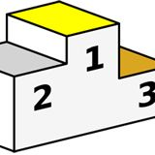
Can we measure excellence?

Slide 6

Origin of EXCEL
Middle English excellen, from Latin excellere, from ex- + -cellere to rise, project; akin to Latin collis hill — more at hill First Known Use: 15th century

Slide 7
Measurement:
Assignment of numbers to objects or processes
Theory of measurement?

Slide 8



Slide 9

“Life is not about quantity. It is about quality.”
Socrates said over 30 years ago

Slide 10
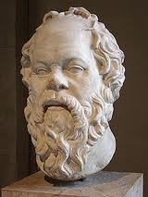
"And what is good, Phaedrus, And what is not good - Need we ask anyone to tell us these things?"
is the Socratic (and Platonic) wisdom …
2300 years ago
http://www.moq.org/forum/Prathap/prathap1.html

Slide 11
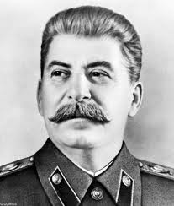
“Quantity has a quality all of its own.”
Stalin

Slide 12
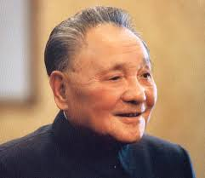
“First quantity, then quality.”
Deng Xiaoping

Slide 13
Excellence = E(Quantity, quality)

Slide 14
The assessment of Indian science

Slide 15

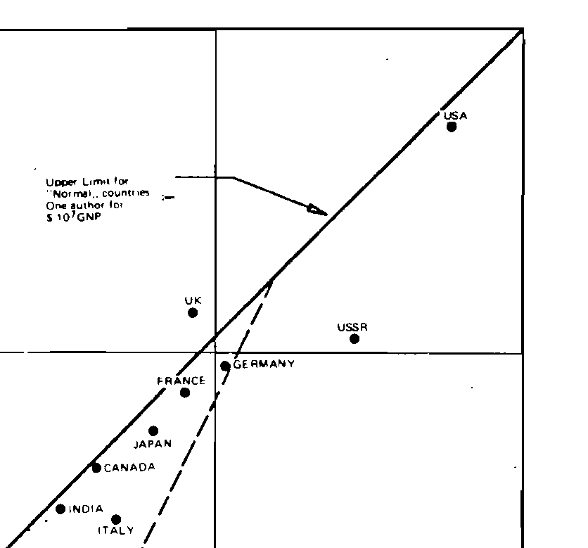
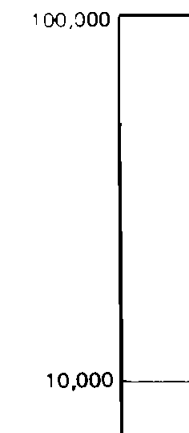


Slide 16
Top 30 in All Fields 2002-2012 GDP wise
Rank | quality indicator |  | Zeroth order indicator |  | First order indicator |  | Second order indicator
 | Country | Citations Per Paper | Country | Papers | Country | Citations | Country | X
1 | SWITZERLAND | 16.66 | USA | 3199249 | USA | 50208701 | USA | 787970444
2 | DENMARK | 15.73 | PEOPLES R CHINA | 996935 | GERMANY | 11038202 | ENGLAND | 164455081
3 | USA | 15.69 | GERMANY | 831676 | ENGLAND | 11001142 | GERMANY | 146501647
4 | NETHERLANDS | 15.63 | JAPAN | 793163 | JAPAN | 8188434 | FRANCE | 91103126
5 | SCOTLAND | 15.61 | ENGLAND | 735916 | FRANCE | 7354022 | JAPAN | 84535526
6 | ENGLAND | 14.95 | FRANCE | 593631 | PEOPLES R CHINA | 6420348 | CANADA | 84511364
7 | SWEDEN | 14.75 | CANADA | 485580 | CANADA | 6406015 | NETHERLANDS | 66465443
8 | BELGIUM | 13.91 | ITALY | 462968 | ITALY | 5534428 | ITALY | 66159850
9 | FINLAND | 13.50 | SPAIN | 375263 | NETHERLANDS | 4252011 | SWITZERLAND | 54722857
10 | GERMANY | 13.27 | AUSTRALIA | 332527 | AUSTRALIA | 3976977 | AUSTRALIA | 47564096
11 | CANADA | 13.19 | INDIA | 327924 | SPAIN | 3960297 | SPAIN | 41794561
12 | AUSTRIA | 13.02 | SOUTH KOREA | 318539 | SWITZERLAND | 3283869 | PEOPLES R CHINA | 41347599
13 | NORWAY | 12.64 | NETHERLANDS | 272015 | SWEDEN | 2773025 | SWEDEN | 40901182
14 | ISRAEL | 12.56 | RUSSIA | 271611 | SOUTH KOREA | 2311340 | BELGIUM | 28895779
15 | FRANCE | 12.39 | BRAZIL | 239055 | BELGIUM | 2077628 | SCOTLAND | 28002468
16 | AUSTRALIA | 11.96 | TAIWAN | 199135 | INDIA | 1994057 | DENMARK | 26080375
17 | ITALY | 11.95 | SWITZERLAND | 197062 | SCOTLAND | 1794156 | ISRAEL | 18318297
18 | NEW ZEALAND | 10.99 | SWEDEN | 188006 | DENMARK | 1658499 | AUSTRIA | 17458873
19 | SPAIN | 10.55 | TURKEY | 171883 | BRAZIL | 1533297 | FINLAND | 17085514
20 | JAPAN | 10.32 | POLAND | 167132 | ISRAEL | 1457925 | SOUTH KOREA | 16771236
21 | SINGAPORE | 10.22 | BELGIUM | 149383 | TAIWAN | 1441074 | NORWAY | 12656411
22 | GREECE | 9.12 | ISRAEL | 116034 | AUSTRIA | 1340896 | INDIA | 12125564
23 | SOUTH KOREA | 7.26 | SCOTLAND | 114954 | RUSSIA | 1337782 | TAIWAN | 10428575
24 | TAIWAN | 7.24 | DENMARK | 105467 | FINLAND | 1265994 | BRAZIL | 9834556
25 | POLAND | 6.75 | AUSTRIA | 102985 | POLAND | 1127867 | SINGAPORE | 7777696
26 | PEOPLES R CHINA | 6.44 | FINLAND | 93807 | NORWAY | 1001427 | POLAND | 7611253
27 | BRAZIL | 6.41 | GREECE | 90902 | TURKEY | 946496 | GREECE | 7557961
28 | INDIA | 6.08 | NORWAY | 79237 | GREECE | 828875 | NEW ZEALAND | 7547552
29 | TURKEY | 5.51 | SINGAPORE | 74396 | SINGAPORE | 760677 | RUSSIA | 6589058
30 | RUSSIA | 4.93 | NEW ZEALAND | 62536 | NEW ZEALAND | 687018 | TURKEY | 5212003

Slide 17
R&D Personnel
 | FTERs per million of population | PhDs in Engg Annually
USA | 4628 | 8110
China | 715 | 15073
India | 119 | 1058
E C Subba Rao, CURRENT SCIENCE, VOL. 104, NO. 1, 10 JANUARY 2013

Slide 18
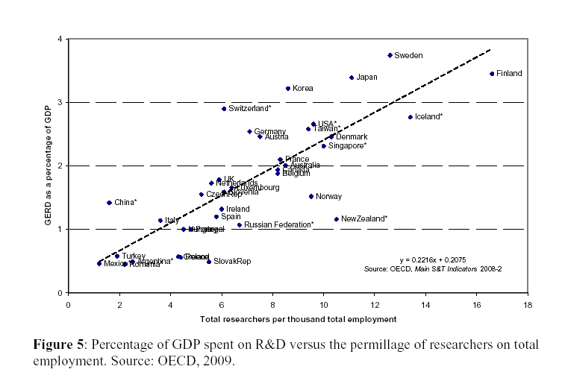
India
Research Funding and Research Output: A Bibliometric Contribution to the US Federal Research Roadmap
Loet Leydesdorff & Caroline Wagner

Slide 20
In the present exercise, the scientific output measured in terms of articles published from the various states of India as registered by the Web of Science over a 3 year period (2007-2009) P, is taken as the output term.
The GDP of each state, in billions of dollar in 2009 ($Bn) is taken as the proxy for the input term
(http://www.economist.com/content/indian-summary accessed on 22 July 2011).

Slide 21
quality of scientific activity, the ratio of Output to Input,
q = P/$Bn.
This indicator usually favours small states at the expense of larger states where the law of diminishing returns sets in. Indeed, there will always be cases of high input but low output and therefore low quality, or low input and medium output but of high quality, etc.
It is therefore desirable to assess overall performance in terms of a single indicator.
output or outcome (O),
an input of size Q,
to combine quality q with quantity Q and/or output O to yield a single indicator that is the best proxy for performance.

Slide 22
given an input (for quantity)
Q
output or outcome (for quasity),
O
quality, is defined as quasity/quantity
q = O/Q
indicator for performance becomes
X = qO = q²Q.

Slide 23
Q = $Bn (billion dollars of GDP),
and
O = P (papers published during 2007-2009).
q = P/$Bn
X = P²/$Bn.
X is a product of the quality and the quasity term and perhaps best represents the “performance” of each state on a per GDP basis.

Slide 24
State | Number of Papers P
Tamil Nadu | 17507
Maharashtra | 16577
Uttar Pradesh | 15843
Karnataka | 15156
West Bengal | 14471
Delhi | 14157
Andhra Pradesh | 9494
Kerala | 4559
Gujarat | 4094
Madhya Pradesh | 3835
Punjab | 3151
Rajasthan | 2814
Chandigarh | 2640
Haryana | 2555
Assam | 2210
Orissa | 2105
Uttarakhand | 1223
Himachal Pradesh | 1137
Bihar | 1019
Jammu & Kashmir | 988
Pondicherry | 875
Jharkhand | 698
Goa | 626
Meghalaya | 364
Chhattisgarh | 238
Arunachal Pradesh | 195
Manipur | 156
Sikkim | 124
Tripura | 96
Mizoram | 84
Andaman & Nicobar Islands | 77
Nagaland | 68
Lakshadweep | 2
Total | 125619
TABLE I
TAMIL NADU IS RANKED FIRST ON THE BASIS OF THE NUMBER OF PAPERS PUBLISHED DURING 2007-09.
Kerala ranks 8th in India in raw output

Slide 25
TABLE II
ON A QUALITY BASIS (PAPERS PER BILLION DOLLARS OF GDP),
CHANDIGARH RANKS FIRST.
ON THE SECOND-ORDER INDICATOR BASIS, DELHI EMERGES FIRST.
States/UTs | GDP $Billion | q = P/$Bn | Exergy X = P x P/$Bn
Chandigarh | 4.1 | 643.90 | 1699902.44
Delhi | 36.1 | 392.16 | 5551818.53
Puducherry | 2.8 | 312.50 | 273437.50
Karnataka | 62.9 | 240.95 | 3651897.23
Tamil Nadu | 80 | 218.84 | 3831188.11
Sikkim | 0.6 | 206.67 | 25626.67
Arunachal Pradesh | 1 | 195.00 | 38025.00
West Bengal | 76.9 | 188.18 | 2723144.88
Meghalaya | 2.1 | 173.33 | 63093.33
Andaman & Nicobar Islands | 0.5 | 154.00 | 11858.00
Uttar Pradesh | 103.5 | 153.07 | 2425127.04
Goa | 4.2 | 149.05 | 93303.81
Jammu & Kashmir | 7.6 | 130.00 | 128440.00
Himachal Pradesh | 8.9 | 127.75 | 145254.94
Uttarakhand | 9.9 | 123.54 | 151083.74
Assam | 18.6 | 118.82 | 262586.02
India | 1081.8 | 116.12 | 14586922.87
Manipur | 1.4 | 111.43 | 17382.86
Andhra Pradesh | 85.7 | 110.78 | 1051762.38
Kerala | 41.2 | 110.66 | 504477.69
Mizoram | 0.8 | 105.00 | 8820.00
Madhya Pradesh | 37.3 | 102.82 | 394295.58
Maharashtra | 175.3 | 94.56 | 1567580.88
Punjab | 40.5 | 77.80 | 245155.58
Orissa | 31.8 | 66.19 | 139340.41
Rajasthan | 46.3 | 60.78 | 171027.99
Haryana | 44.2 | 57.81 | 147692.87
Gujarat | 80.1 | 51.11 | 209248.89
Nagaland | 1.5 | 45.33 | 3082.67
Jharkhand | 17.5 | 39.89 | 27840.23
Tripura | 2.6 | 36.92 | 3544.62
Bihar | 32.7 | 31.16 | 31754.16
Chhattisgarh | 22.7 | 10.48 | 2495.33
Lakshadweep | 0.3 | 6.67 | 13.33
Delhi contributes 38% of India’s scientific output, while on GDP terms, it accounts for only 3.3% of India’s GDP.
Kerala ranks 19th in India in per GDP output

Slide 26
The assessment of Indian universities

Slide 27
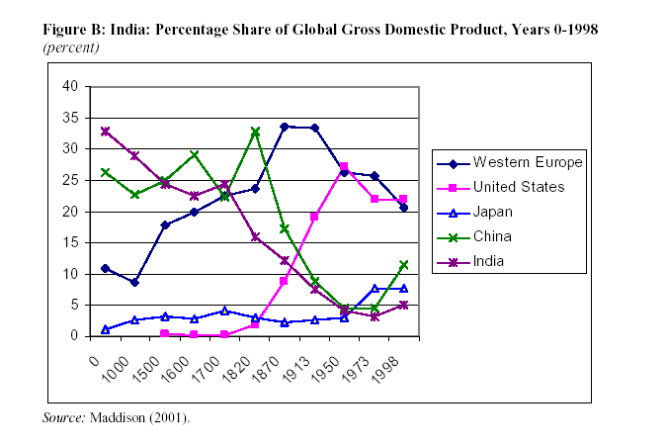
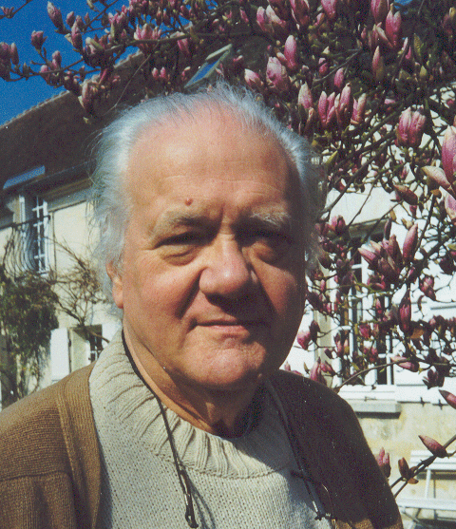
In economic terms, India was the world’s largest economy in the first millennium, producing a third of global GDP. By 1500 its share had declined to 25 percent, as China overtook it and Western Europe’s share began to expand rapidly. India’s share continued to fall after 1700.

Slide 28


Higher Education in Europe
Bologna in 1088
Oxford in 1096
Europe adds 70 universities in 500 years
i.e. 1 university/million population around 1500AD
India and China? 0

Slide 29
India, Kerala and Scandinavia
 | India | Kerala | Scandinavia
Population | 1238 million | 33 million | 26 million
No of Univ in ARWU Top 500 | 1 | 0 | 24

Slide 30
Universities per million of population
Division | Population 2001 Census | Universities | Uni/M of Pop
Delhi (UT) | 13,850,507 | 17 | 1.23
Himachal Pradesh | 6,077,900 | 7 | 1.15
Uttarakhand | 8,489,349 | 9 | 1.06
Jammu & Kashmir | 10,143,700 | 9 | 0.89
Tamil Nadu | 62,405,679 | 41 | 0.66
Karnataka | 52,850,562 | 27 | 0.51
Rajasthan | 56,507,188 | 25 | 0.44
Maharashtra | 96,878,627 | 42 | 0.43
Haryana | 21,144,564 | 9 | 0.43
Punjab | 24,358,999 | 10 | 0.41
Orissa | 36,804,660 | 15 | 0.41
Madhya Pradesh | 60,348,023 | 21 | 0.35
Andhra Pradesh | 76,210,007 | 25 | 0.33
West Bengal | 80,176,197 | 26 | 0.32
Kerala | 31,841,374 | 9 | 0.28
Assam | 26,655,528 | 7 | 0.26
Uttar Pradesh | 166,197,921 | 41 | 0.25
All India | 830,940,785 | 340 | 0.41

Slide 31
Scimago Institutions Rankings (SIR 2014)
Two output dimensions, quantity and quality.
The quantity or size dimension is given simply by the number of articles published during the five-year window, normalized on the 0-100 scale. We indicate this normalized quantity indicator by Output O. For this entire cycle from 2009 to 2014, the Centre National de la Recherche Scientifique (CNRS) of France was listed as the top ranking institution in the world with the score of 100.
The second dimension is quality. SIR gives several field-normalized size-independent indicators which are in varying ways proxies for this but we shall restrict attention to only one – Excellence Rate, which is the proportion (in %) of an institution’s scientific output that is included into the set of the 10% of the most cited papers in their respective scientific fields and is a measure of high quality output of research institutions. Again, for each year, these values are normalized so that the highest ranking performer has a score of 100. We indicate this normalized quality indicator by q.

Slide 32
Scimago Institutions Rankings (SIR 2014)
One size-dependent input indicator, the Scientific talent pool (STP) which is the total number of authors from an institution in the total publication output of that institution during a particular period of time as a meaningful measure of the input into research activities.
This is also normalized in the same manner as above and again for the period from 2009 to 2014, CNRS of France was listed as the largest institution in the world with the score of 100.We indicate this normalized input indicator by STP.

Slide 33
For a single-valued composite outcome indicator, we computed the second-order indicator called the exergy term from the quantity and quality indicators,
X = q²O.
Productivity is then computed as
X²/STP
and this becomes a plausible performance indicator.
Input – STP
Output – O
Excellence- Exc = q
Outcome – X = q²O
Productivity – X/STP.

Slide 34
The ranking of the seven HEIs from Kerala out of the 156 from India from SIR 2014 using the second-order outcome indicator X.
Rank | Higher Educational Institution | X
1 | Indian Institute of Science | 2135.29
37 | Amrita University | 185.65
67 | National Institute of Technology Calicut | 94.62
68 | Cochin University of Science and Technology | 90.71
73 | University of Kerala | 82.11
78 | Sree Chitra Tirunal Institute for Medical Sciences and Technology | 69.35
105 | Mahatma Gandhi University | 37.50
156 | Kerala Veterinary and Animal Sciences University | 0.16

Slide 35
Kerala, Slovenia and the University of Ljubljana
The Republic of Slovenia, is a small nation state on the Adriatic Sea, bordering Italy to the west, Austria to the north, Croatia to the south and southeast, and Hungary to the northeast. It had a population of 2.06 million in 2013. It is therefore smaller than each of the nine most populous districts of Kerala (Malappuram with a population of 4.11 million according to the 2011 Census was the largest and Alappuzha with 2.13 million was the ninth largest district). Slovenia has one university in the ARWU Top 500, namely the University of Ljubljana. It is the oldest, the largest (61,000 students) and the best ranked university in Slovenia.

Slide 36
The seven HEIs from Kerala in SIR 2014 benchmarked against the University of Ljubljana for 2014
Benchmarking against U of Ljubljana for 2014 | STP | OUTPUT | Excellence | X | O/STP | X/STP
Amrita University | 0.90 | 0.37 | 22.40 | 185.65 | 0.41 | 206.28
Cochin University of Science and Technology | 0.86 | 0.68 | 11.55 | 90.71 | 0.79 | 105.48
Kerala Veterinary and Animal Sciences University | 0.48 | 0.18 | 0.94 | 0.16 | 0.38 | 0.33
Mahatma Gandhi University | 0.37 | 0.26 | 12.01 | 37.50 | 0.70 | 101.36
National Institute of Technology Calicut | 0.35 | 0.27 | 18.72 | 94.62 | 0.77 | 270.34
Sree Chitra Tirunal Institute for Medical Sciences and Technology | 0.57 | 0.42 | 12.85 | 69.35 | 0.74 | 121.67
University of Kerala | 0.55 | 0.39 | 14.51 | 82.11 | 0.71 | 149.29
Kerala 7 | 4.08 | 2.57 | 14.76 | 560.11 | 0.63 | 137.28
University of Llubljana | 4.71 | 5.55 | 20.07 | 2235.57 | 1.18 | 474.64

Slide 37
During the period 2004-2013, this single university published 18,445 publications according to the Web of Science Core Collection; that is more than all the instititutions in Kerala put together (15,519 records), and nearly twice as much as all higher educational institutions in Kerala (Kerala 7) taken together (9397 records).
How do the seven HEIs from Kerala in SIR 2014 fare in comparison with the University of Ljubljana for the latest year in the SIR time series.
We see that Ljubljana has a scientific talent pool that is comparable to Kerala 7, but an output productivity that is nearly twice and an outcome productivity that is nearly three and a half times as much.

Slide 38

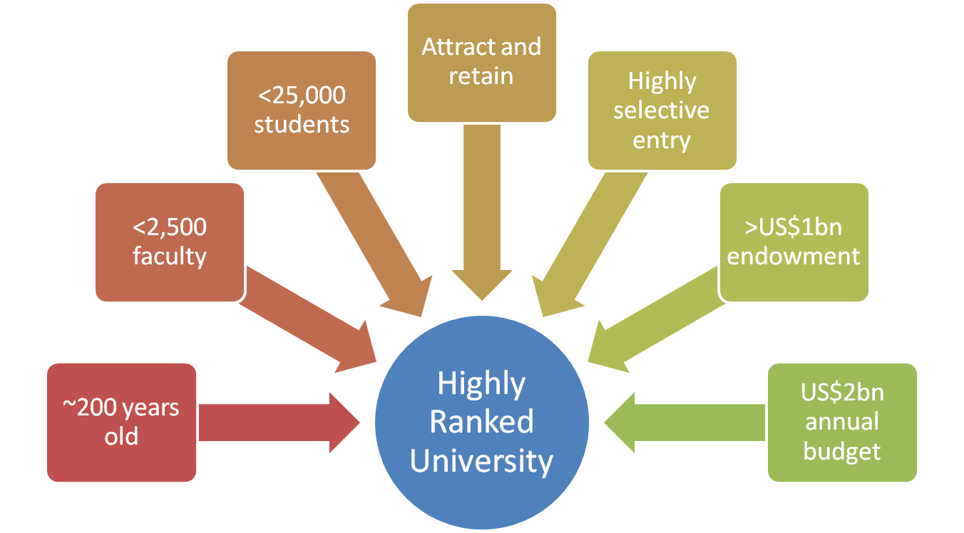
Profile of a leading university*
* Sowter, 2008

Slide 39
Profile of a leading university* compared with IISc
<5000
students
<500
faculty
US$0m endowment
~100
years old
US$50m annual budget
* Sowter, 2008

