Slide 1
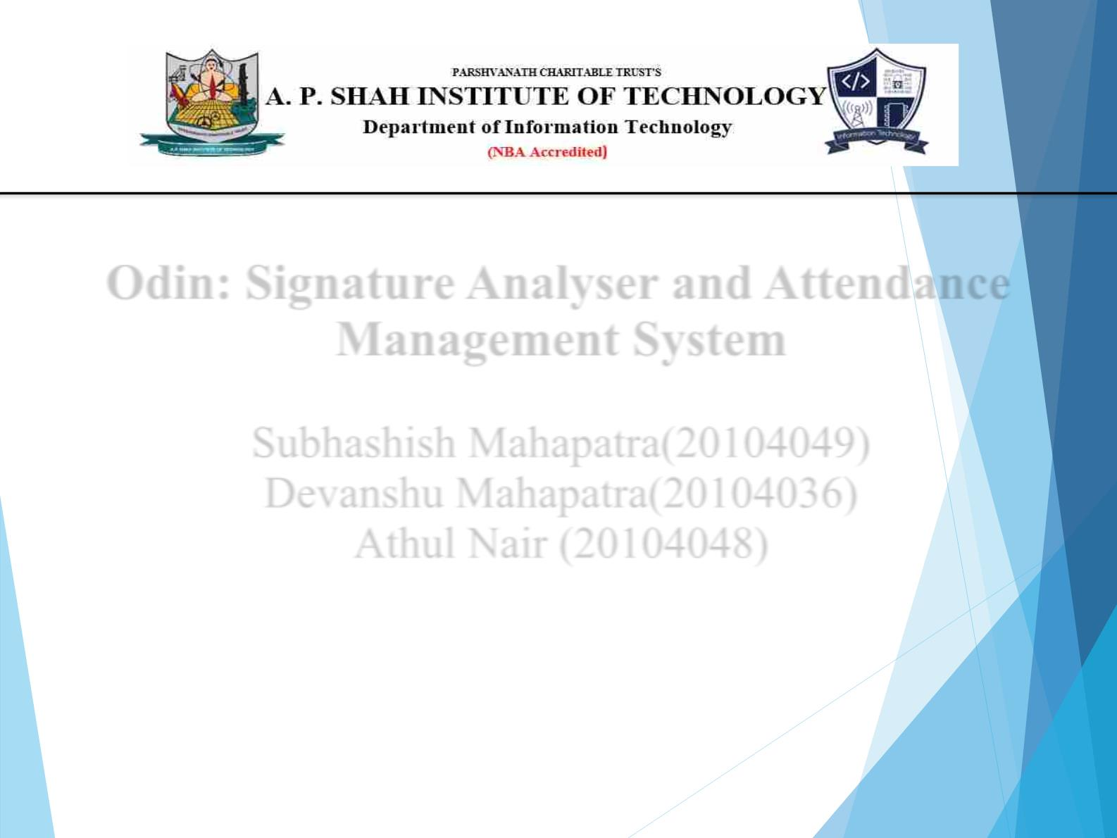
Odin: Signature Analyser and Attendance
Management System
Subhashish Mahapatra(20104049)
Devanshu Mahapatra(20104036)
Athul Nair (20104048)
Project Guide
Ms. Jayshree Jha

Slide 2

Contents
●
●
●
●
●
●
●
●
●
●
Introduction
Objectives
Scope
Literature Survey
Proposed System
Project Outcomes
Block Diagram
Work Flow Diagram
Technology Stack
References

Slide 3

1. Introduction
Odin: Signature Analyzer and Attendance Management
System is an application developed using various Machine
Learning Algorithms and an interactive framework .
This project is designed to automate the process of attendance
management and signature verification for an educational
institute or an organization.
This system has the capability of detecting the individual
signatures and verifying signatures against a pre-trained model
and exporting the generated reports.

Slide 4

2. Objectives
• To create a system that is user friendly and intuitive for the
users.
• To provide the user with a platform where they can upload
attendance sheet and verify the individual signatures in a
more streamlined and effective way.
• To save time and reduce workload for teachers and
administrators by automating attendance management and
signature verification.
• To provide a generated report that can be exported as a .csv
file and then imported into the college LMS
• To provide a Proxy detection system.

Slide 5

3. Scope
The system is designed to be used in various organizations
such as schools, colleges, and corporate organizations. It can
be used by teachers, professors, HR managers, and
administrators to manage attendance and verify signatures.
The system can detect and verify signatures for a large number
of students or employees at a time.
The system can be also be connected to the college LMS and
then used to monitor the attendance patterns of individual
students or employees and identify potential issues or trends.
The system can be accessed remotely from any location with
an internet connection.
The system will have a Proxy Detection feature to identify
between fake and genuine password

Slide 6
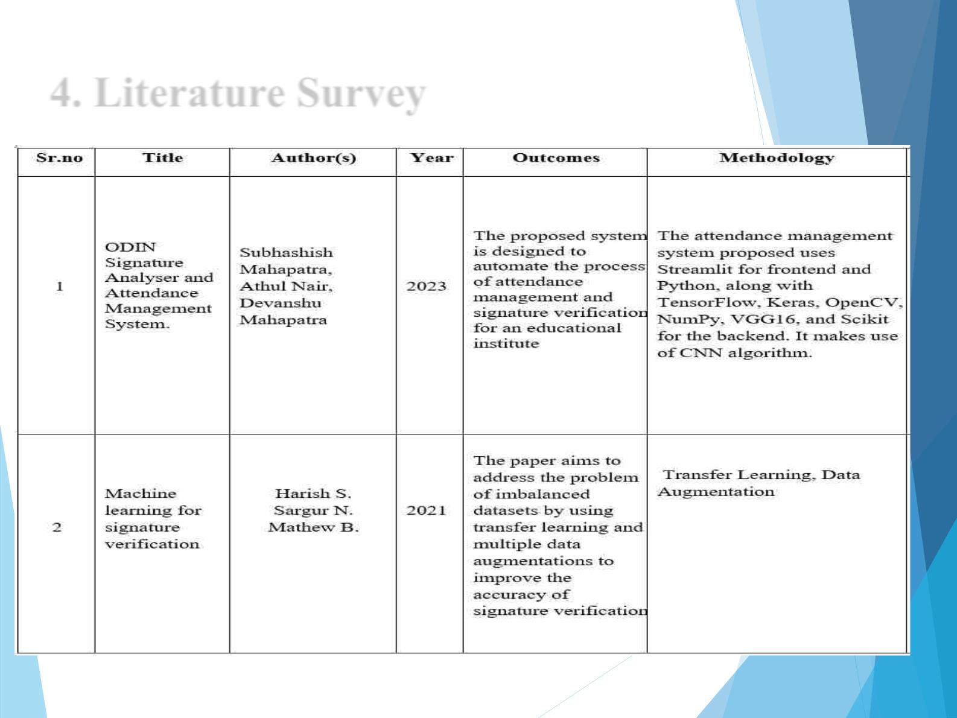
4. Literature Survey

Slide 7
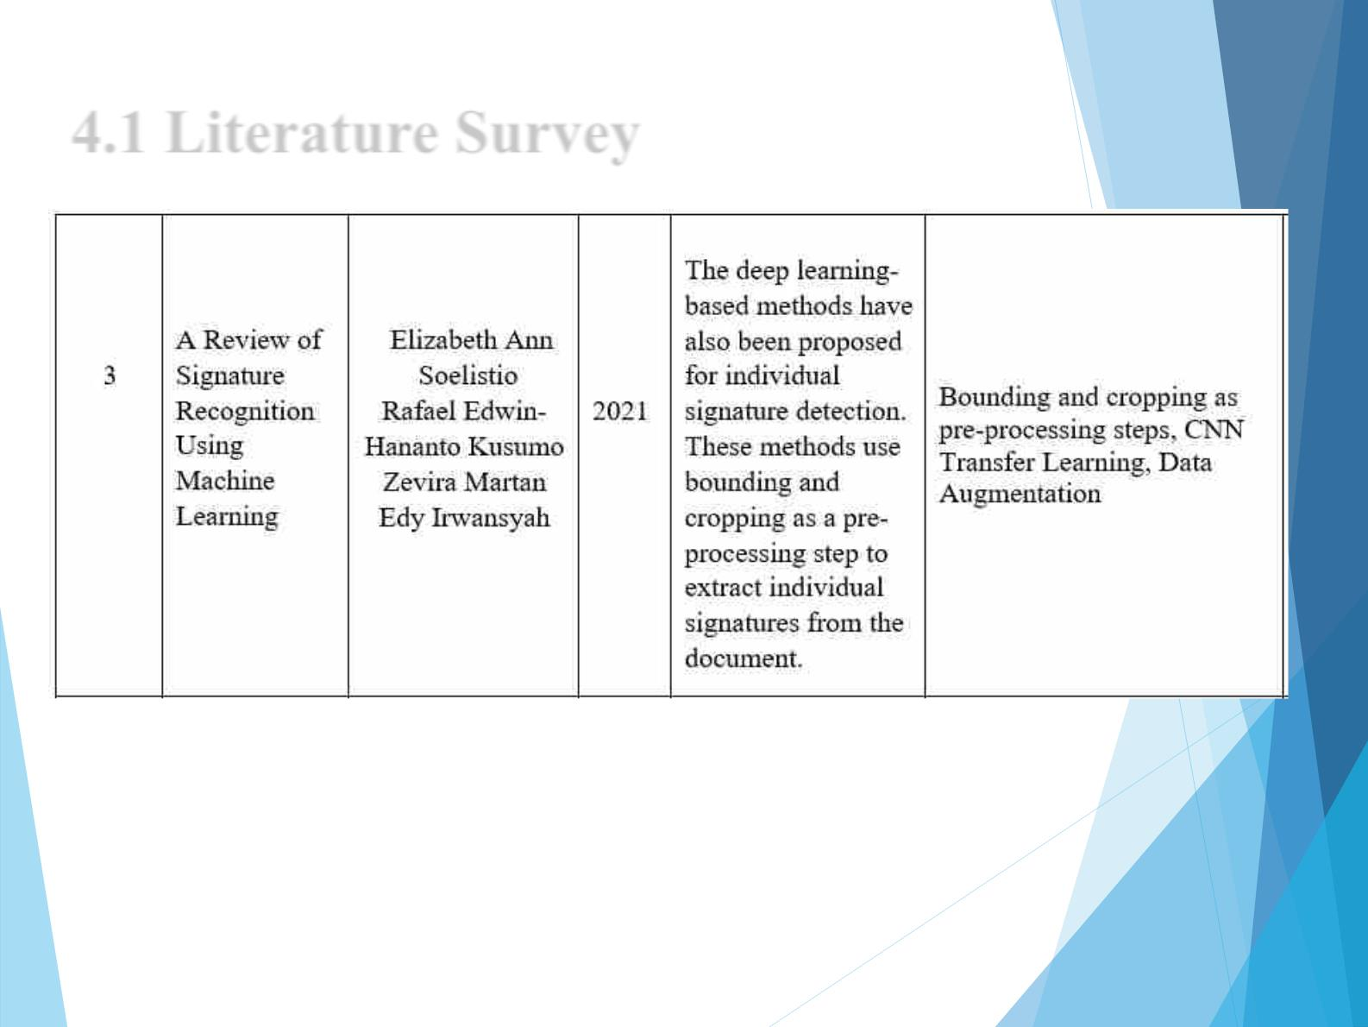
4.1 Literature Survey

Slide 8

5. Proposed System
The proposed system consists of a web-based application that will allow
the user to upload the document and verify the signature. The user can
also manage attendance of the students or employees. The system will
store the data in a database and generate reports for the user.
The system will allow for the secure storage and retrieval of attendance
records.
The system will use image processing and machine learning techniques
to verify signatures and ensure the authenticity of documents.
The system will generate comprehensive reports that can be used for
decision-making, analysis and other purposes.
The system will be customizable to meet the specific requirements of
each organization and can be integrated with other systems.

Slide 9

6. Outcome of Project
The Signature Analyser and Attendance Management System will bring
a lot of benefits to the user. It will reduce the time and effort required to
manage attendance and verify signatures. It will also reduce the errors
and increase the accuracy of the data.
• The use of image processing and machine learning techniques for
signature verification will improve the security of important
documents and prevent fraud.
• The system will generate comprehensive reports that can be used for
decision-making, analysis and other purposes.
• The system will reduce the risk of unauthorized access to sensitive
data and provide a range of security features to protect data.
• The system will be customizable to meet the specific requirements of
each organization, providing a tailored solution.

Slide 10
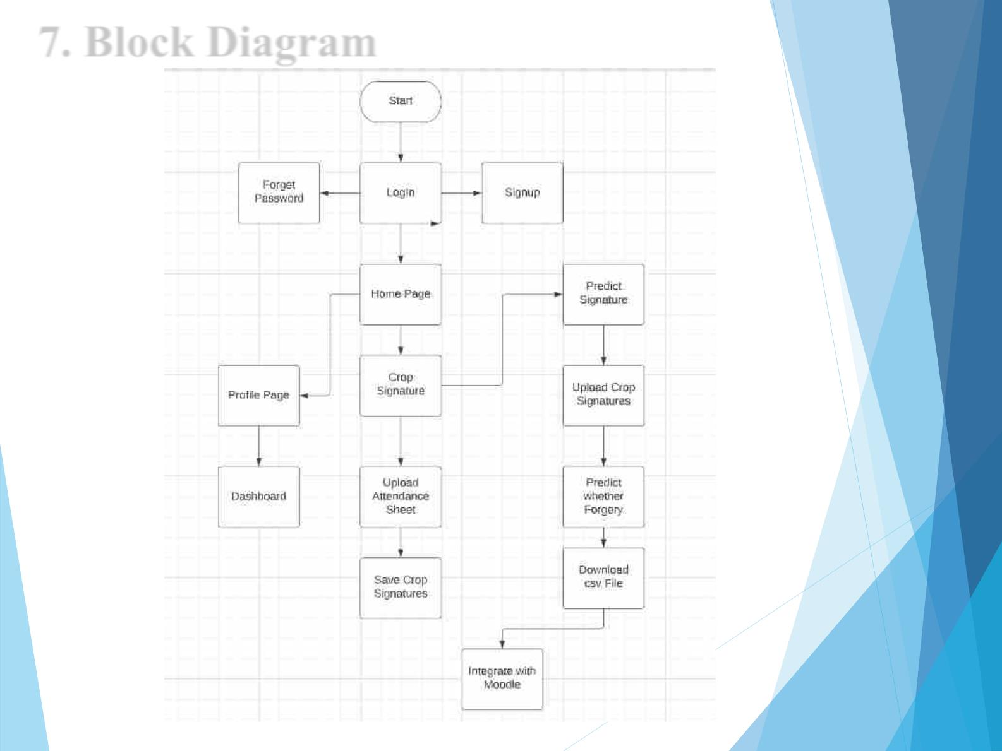
7. Block Diagram

Slide 11
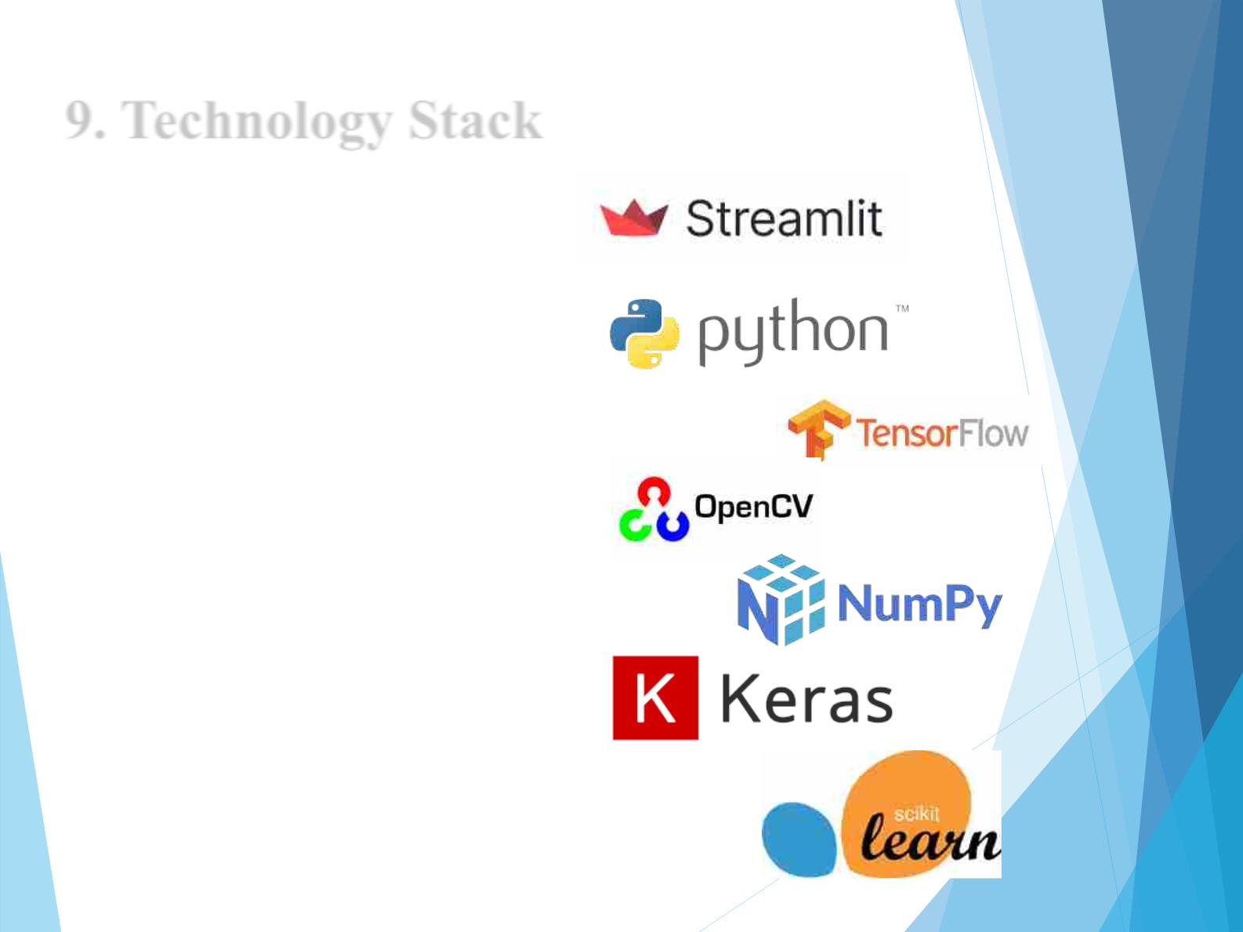
9. Technology Stack
Frontend: Streamlit
Backend: 1. Python
2. Tensorflow
3. Keras
4. OpenCV
5. NumPy
6. VGG16
7. Scikit

Slide 12
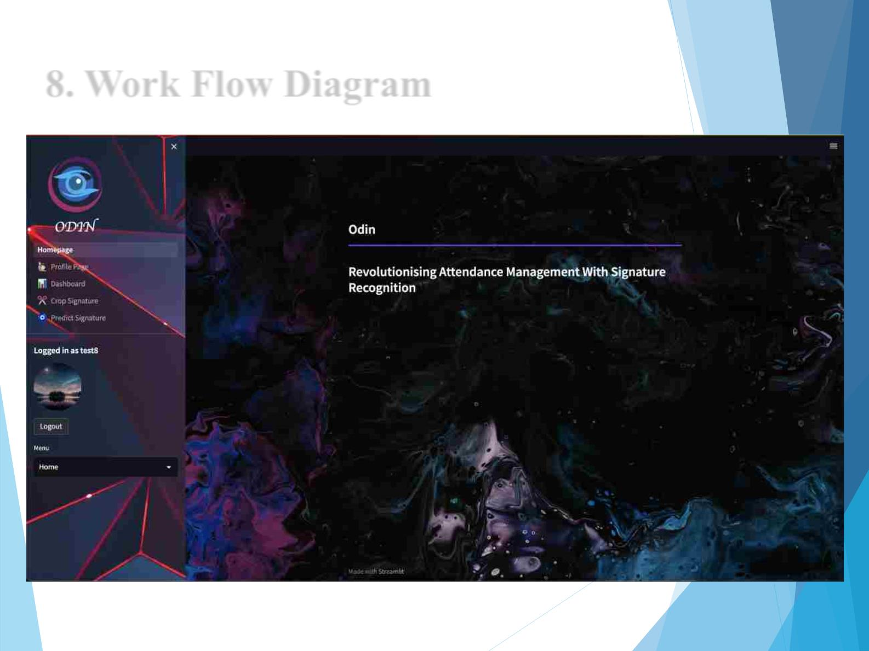
8. Work Flow Diagram

Slide 13
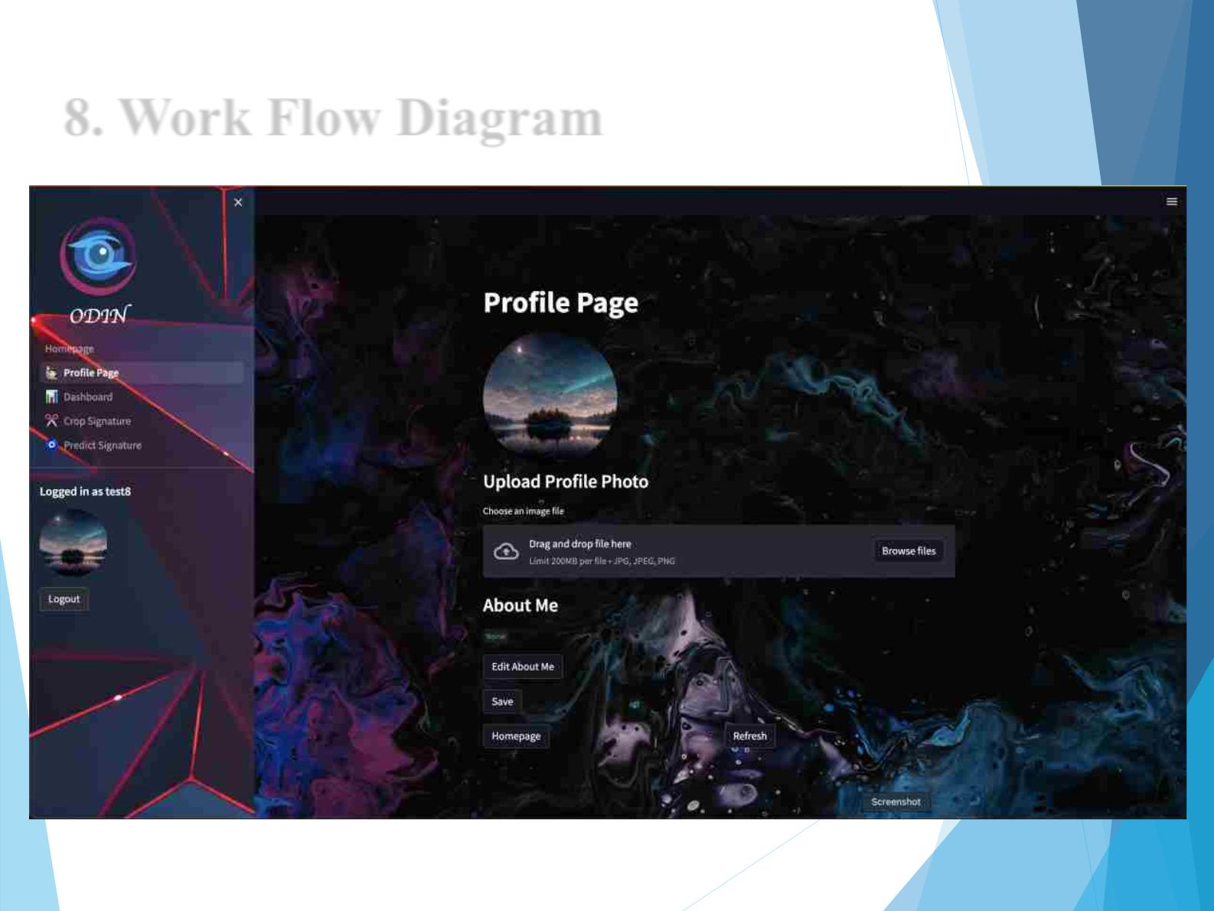
8. Work Flow Diagram

Slide 14
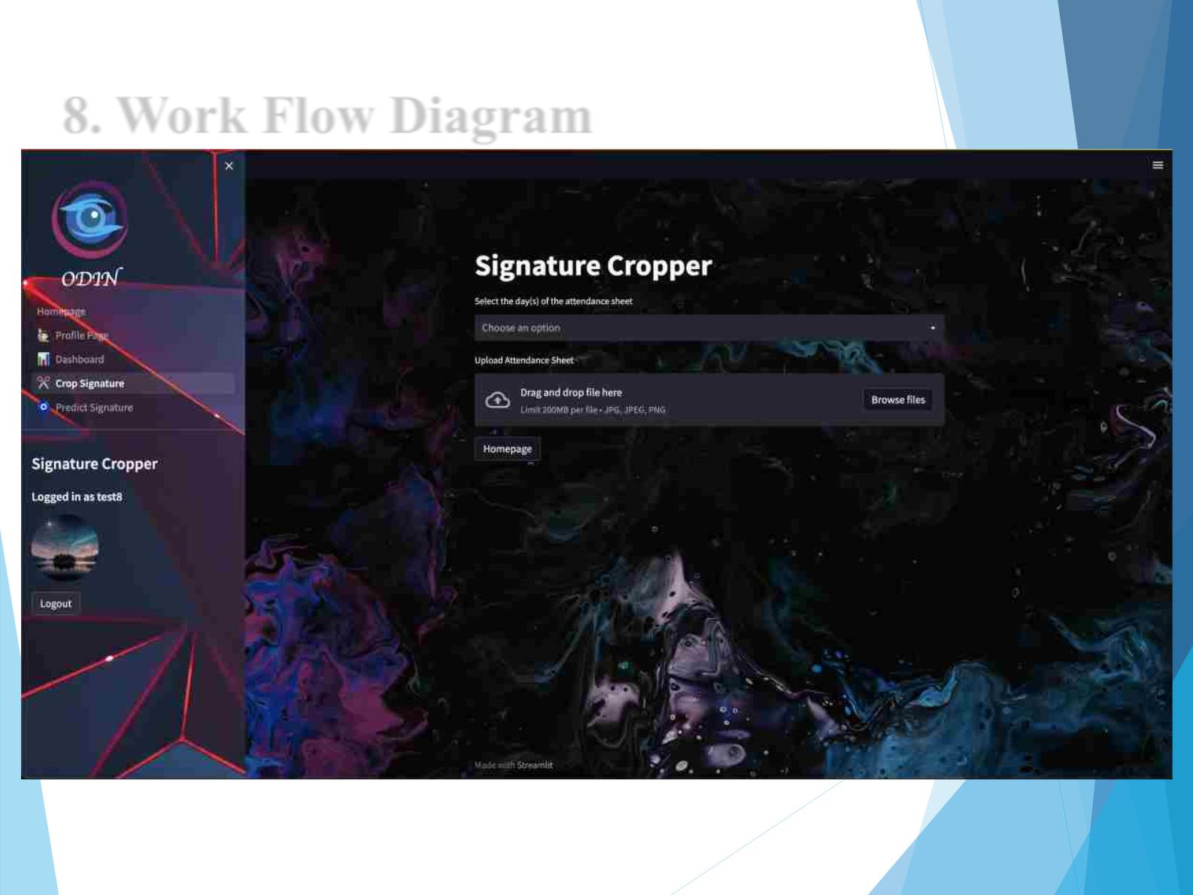
8. Work Flow Diagram

Slide 15
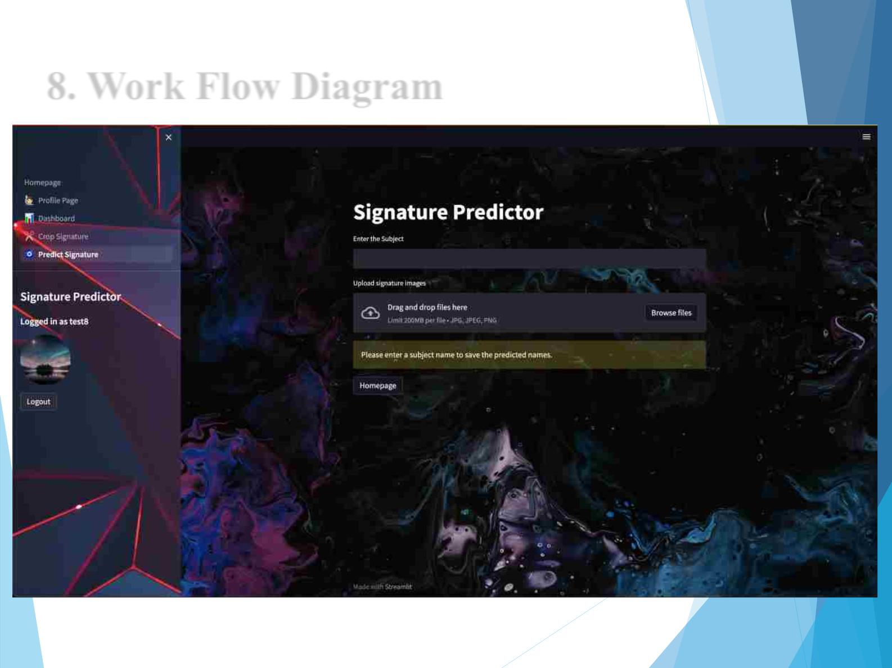
8. Work Flow Diagram

Slide 16
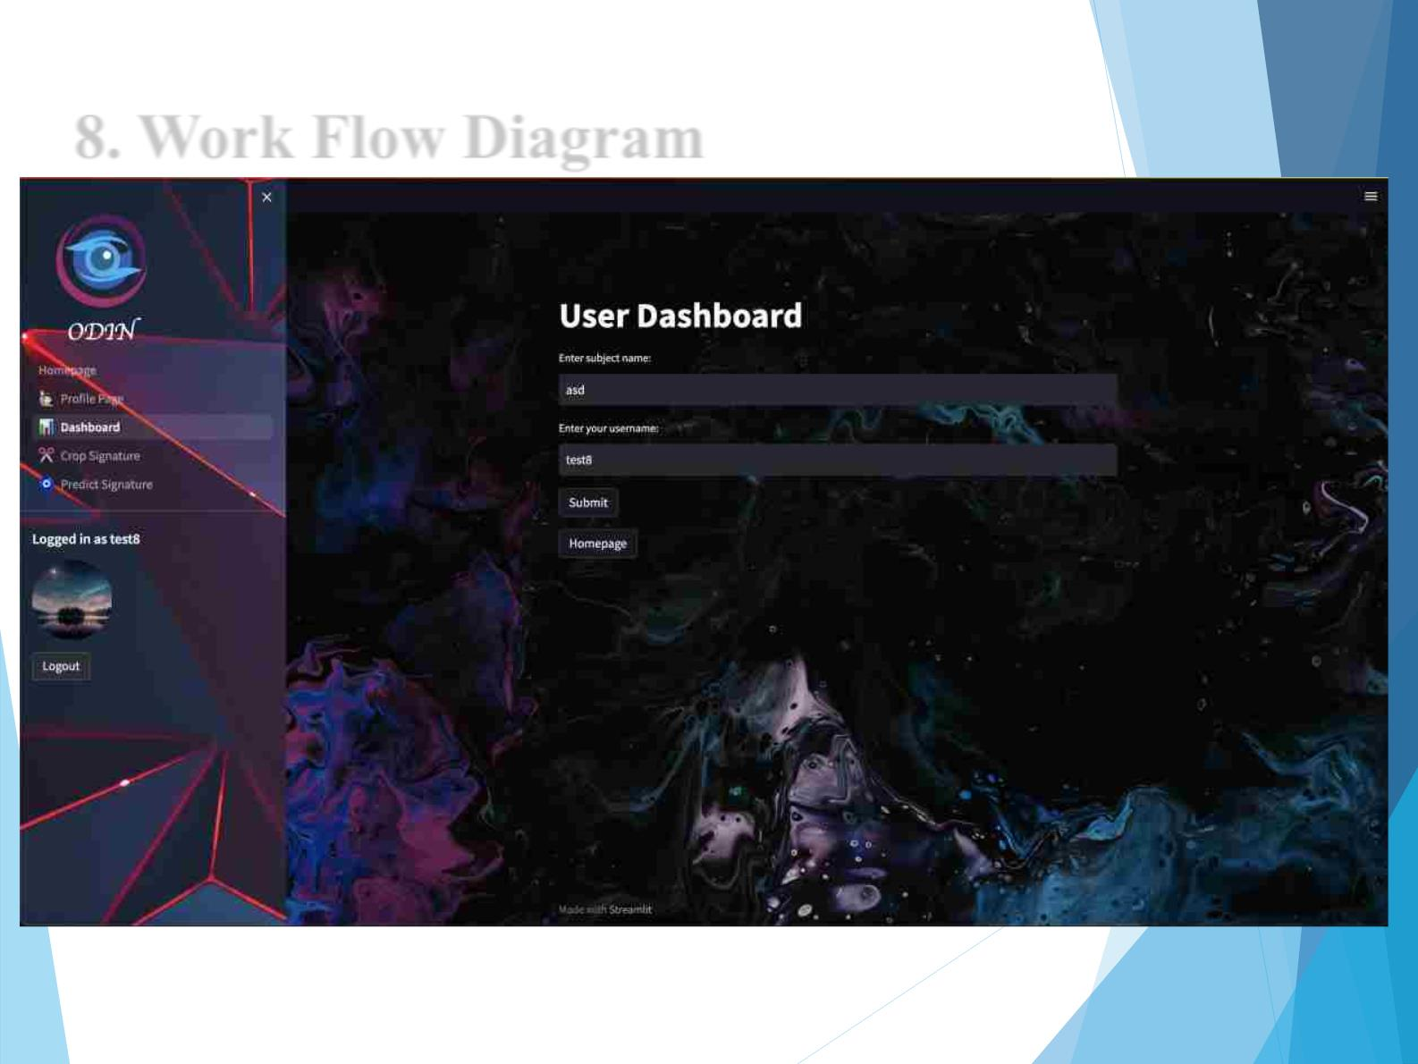
8. Work Flow Diagram

Slide 17
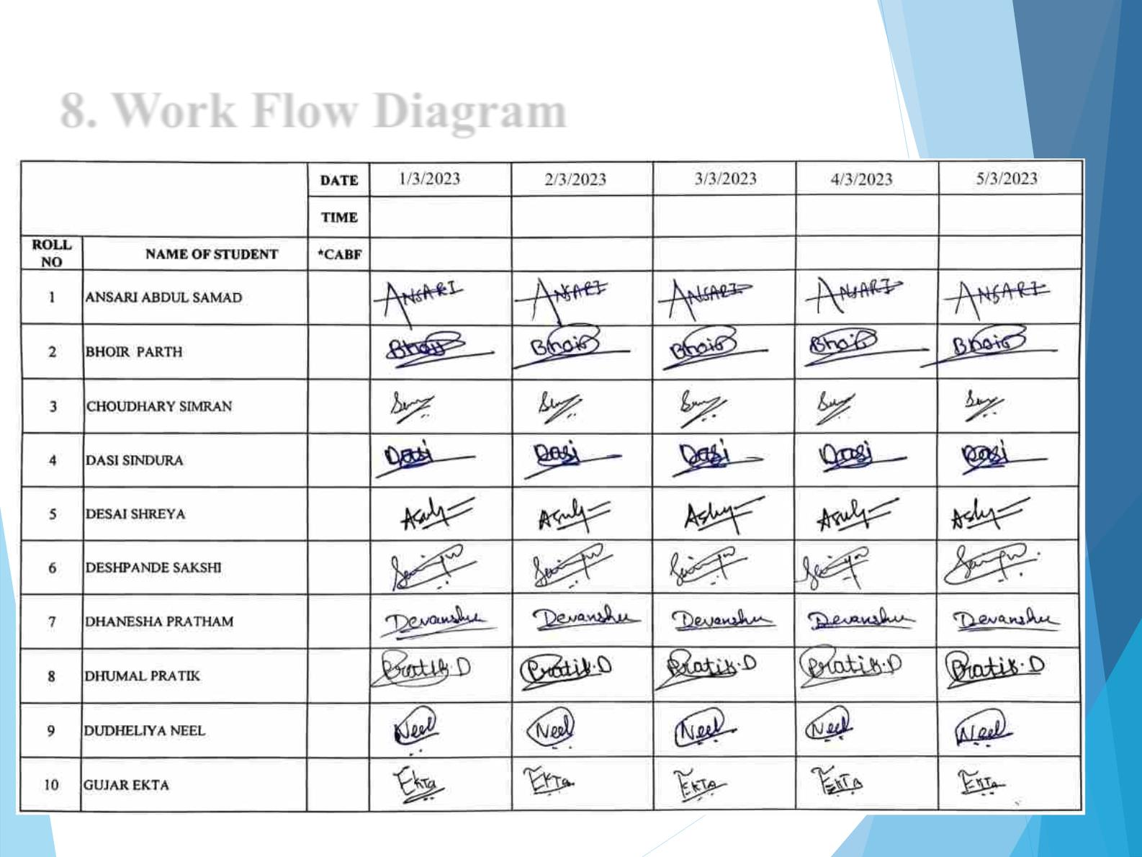
8. Work Flow Diagram

Slide 18
References
[1]. OFFLINE SIGNATURE VERIFICATION USING TRANSFER
LEARNING AND DATA AUGMENTATION ON IMBALANCED
DATASET
[2]. SigSA: On-line Handwritten Signature Database

Slide 19
Thank You...!!

