Slide 1
BT5450 PROJECT MICE PROTEIN EXPRESSION
ATHUL KRISHNA KS
CE18B111

Slide 2

INTRODUCTION
The dataset is about the expression levels of different proteins that will produce significant signals during the nuclear fraction of cortex. Down syndrome is a chromosomal disorder where organisms have an extra chromosome 21,sometimes known as trisomy 21. Being a syndrome, DS consists of multiple symptoms affecting a large number of systems in the body. It’s effect on learning results in it being an intellectual disability . 77 protein expression levels are analysed from both control and trisomic (Ts65Dn) genotype mice, both with and without treatment from the drug memantine. K-Nearest Neighbour and random forest classification approach can identify the most important proteins which may help to identify more effective drug to help learning process in people with down Syndrome.

Slide 3
DESCRIPTIVE STATISTICS AND VISUALIZATION
This dataset in each protein contain missing values. To deal with these, the mice will receive the
mean value of the mice in their class, rather than eliminating the entire mouse from the data.
The second thing that needs to be dealt with is the high variance of measurement values. For
example, some proteins have exploration value range from 0 to 1 while other proteins ranged from 0 to 8. With this condition, proteins with higher value will have more influence in this classification
outcome and make the model unable to learn correctly. Therefore, after making sure no null values
in the measurements, all value of measurements are standardized with zero means and unit
variance.

Slide 4
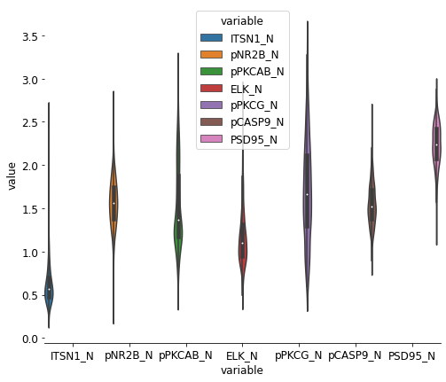
Violin Plots
Violin plots are useful to see full distribution of the data with their probability density.To make this violin plot series, the mean value of each protein is first calculated and the data frame is sorted based on their mean magnitudes. This helped to organise the data for easier visual inspection.
These violin plots showed how varied the magnitudes of each protein was, and shows why data standardization is needed. Also, the plots show most of the data have large ranges of outliers.
The 2 proteins with the most significant range of outliers will be chosen and examined:DYRK1A_N and AcetylH3K9_N.

Slide 5
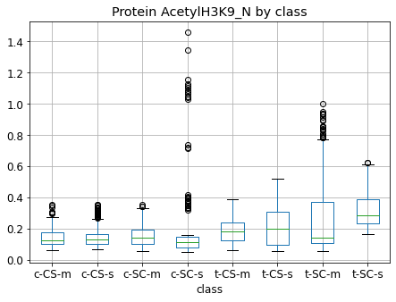
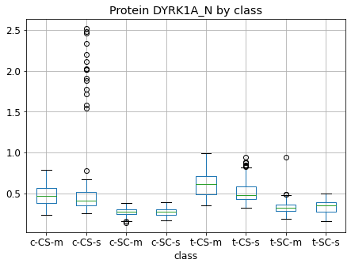
Box Plots
The box plots gives us the class with highest outliers.
These pairwise explorations show most of the big range of data magnitudes caused by outliers that usually dominated by one of the class.

Slide 6
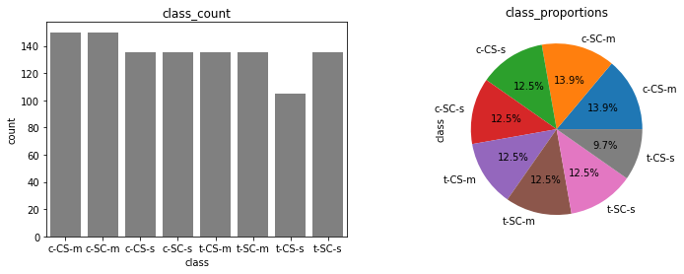
The big range of data magnitudes in protein DYRK1A_N is caused by outliers from c-CS-s class.
Now we will go deeper into each class that contains those outliers by examining the mouse numbers in those class
We can see that most of the dominating outliers in each class comes from specific mouse numbers. The obvious outliers from c-CS-s class in protein DYRK1A_N is comes from mouse number 3484.
Most of the obvious outliers is not coming from single mouse version, but from multiple mouse versions.
Most of the magnitude data in proteins is vary because the outliers. These outliers usually comes from one specific mouse class and one specific mouse number in those class.
Fig:Proportion of the classes

Slide 7
PREDICTIVE MODELING
Random forest and K nearest neighbour were used to model and predict the mice class and predict which proteins were critical for each class. These are both examples of supervised machine learning methods with the goal of creating model that predicts the value of a target variable based on several input variables.Random forest model is similar to decision tree algorithm. A single variable is being examined for each decision nodes, and move to another node based on the outcome of a comparison. This is repeated until a leaf node is reached. At a leaf node the decision is being made: whether the training data routed to the leaf node as a classification decision, or return the mean-value of outcomes as a regression estimate. Similar with decision tree, random forest also use tree representation to solve the problem. The difference is instead of using one tree, random forest averaging multiple deep decision trees and trained on different parts of the same training set, with the goal of reducing the variance and overfitting.

Slide 8
Random Forest Classification
Random forest is a supervised learning algorithm which is used for both classification as well as regression. But however, it is mainly used for classification problems. As we know that a forest is made up of trees and more trees means more robust forest. Similarly, random forest algorithm creates decision trees on data samples and then gets the prediction from each of them and finally selects the best solution by means of voting. It is an ensemble method which is better than a single decision tree because it reduces the over-fitting by averaging the result.
Accuracy of the model is 0.9907407407407407

Slide 9
K-Nearest Neighbours
K nearest neighbors is a simple algorithm that stores all available cases and classifies new cases based on a similarity measure .KNN has been used in statistical estimation and pattern recognition. Choosing the optimal value for K is best done by first inspecting the data. In general, a large K value is more precise as it reduces the overall noise but there is no guarantee. Cross-validation is another way to determine a good K value by using an independent dataset to validate the K value.
Accuracy of the model is 0.9421296296296297

Slide 10
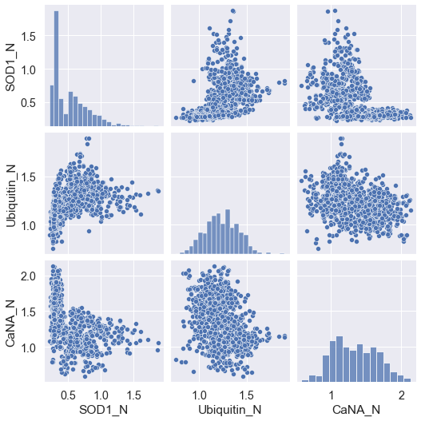
CORRELATION GRAPH
Correlation between top 3 proteins given by the model:
SOD1_N
Ubiquitin_N
CaNA_N
CaNA_N and Ubiquitin_N are highly correlated.

Slide 11
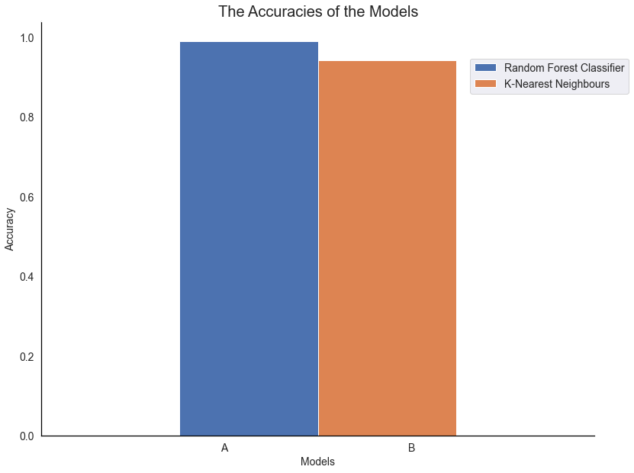
Comparision of Models
Random forest Classifier has higher accuracy than k nearest neighbours
The Random Forest had an almost perfect Recall, F1-Score and Precision scores of 0.99 for each, compared with the 0.84 for K-Nearest Neighbours.

Slide 12
RESULTS
Overall, we can see that the classification models we’ve used are useful in trying to infer which proteins are significant contributors to the learning of mice in Cognitive Stress.
As expected, the Random Forest performed much better than k nearest neighbour, which is a much less sophisticated model. The Random Forest had an almost perfect Recall, F1-Score and Precision scores of 0.99 for each, compared with the 0.84 for the k nearest . This was done by using exactly the same training and test data set by setting the seed of the random number generator for data selection. This does not affect the randomness within the Random Forest model.
The top 30 features in the Random Forest model were used in the comparison. The Relative Importance fields is the relative contribution of this feature to the model. All features importance’s sum to 1. If a features has a relative importance of 0.00, then it made no contribution. If it is equal to 1.00, then the model used this feature exclusively.
SOD1_N, pPKCG_N, and ITSN1_N were each in the top three of a model
The Relative Importance of features in Random Forests drop off a lot more quickly than in K Nearest Neighbours

Slide 13
CONCLUSION
The behavior and treatment classes have an equal ranking of features which is quite different to the Genotype expression levels. This is consistent with the genotype determining base levels of expression, with behaviour and treatment perturbing these base levels.
The top 4 proteins for Treatment and Behaviour were SOD1_N, pPKCG_N, pCAMKII_N and ITSN1_N. The protein expression levels of these proteins are significantly affected by treatment and behaviour.
In this project, random forest model behaves better than K nearest Neighbours to predict which proteins are important for learning process of mice. Random forest model shown the similar most crucial proteins in the metabolic pathways related to learning. Also, the feature importance comparison table showed us that protein influencing mice behavior and mice treatment were similar.

