Slide 1
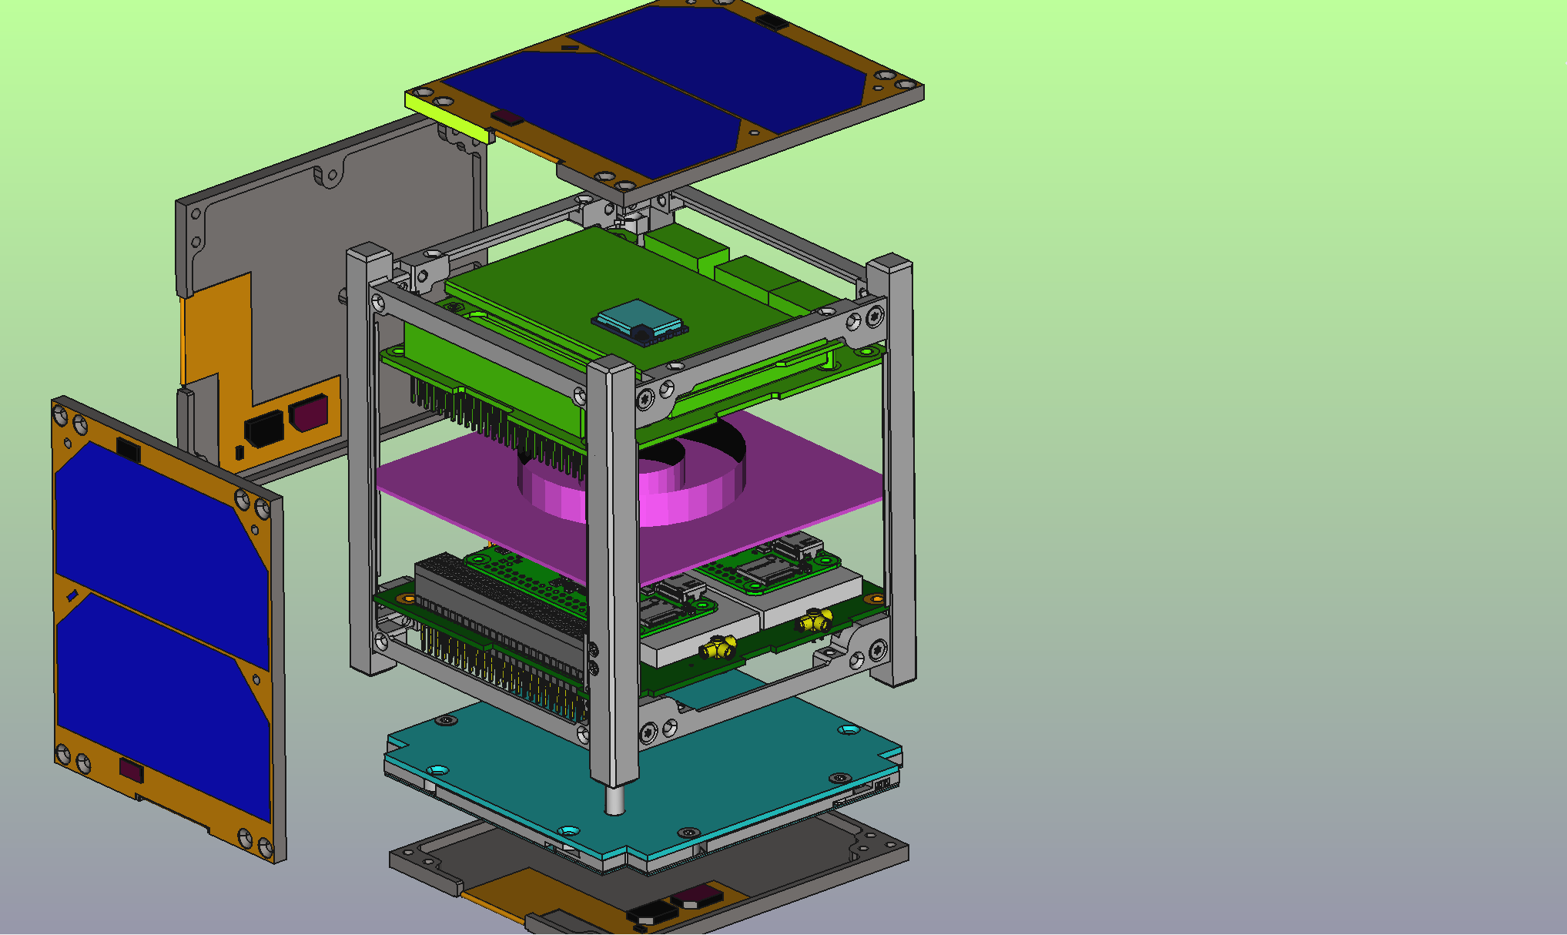
Solar panel
EPS + Battery
Structure
GPS receiver
MagSail deployer
Onboard computer
Transceiver
UHF Antenna (stowed)

Slide 2
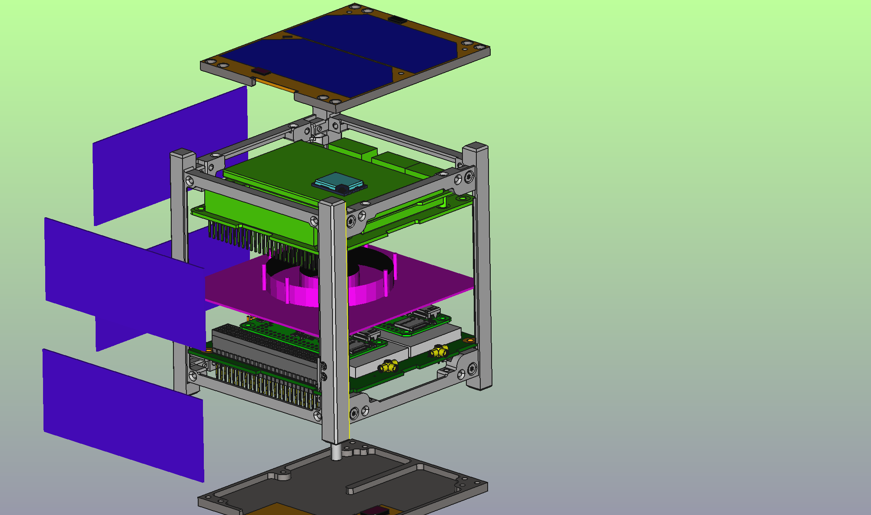
Solar panel
EPS + Battery
Structure
GPS receiver
MagSail deployer (top plate not shown)
Onboard computer(s)
Transmitter
Slot for deployer

Slide 3
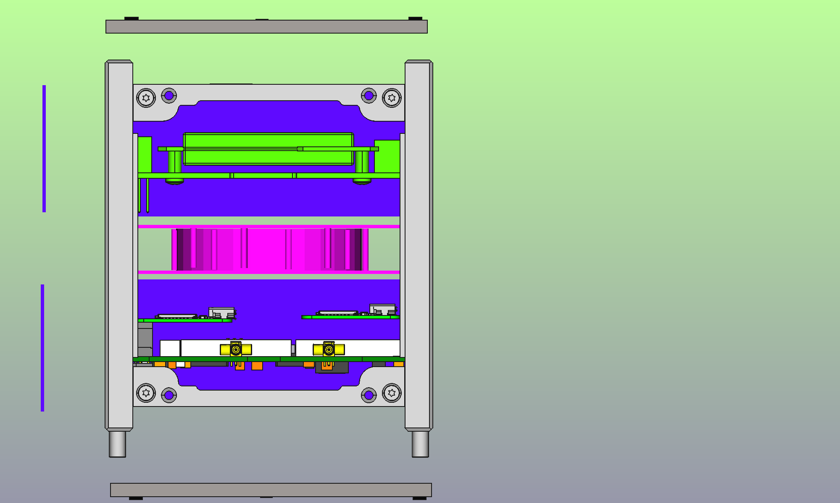
Top plate + solar panel
EPS + Battery
Structure
GPS receiver
MagSail deployer
Onboard computer(s)
Transmitter

Slide 4
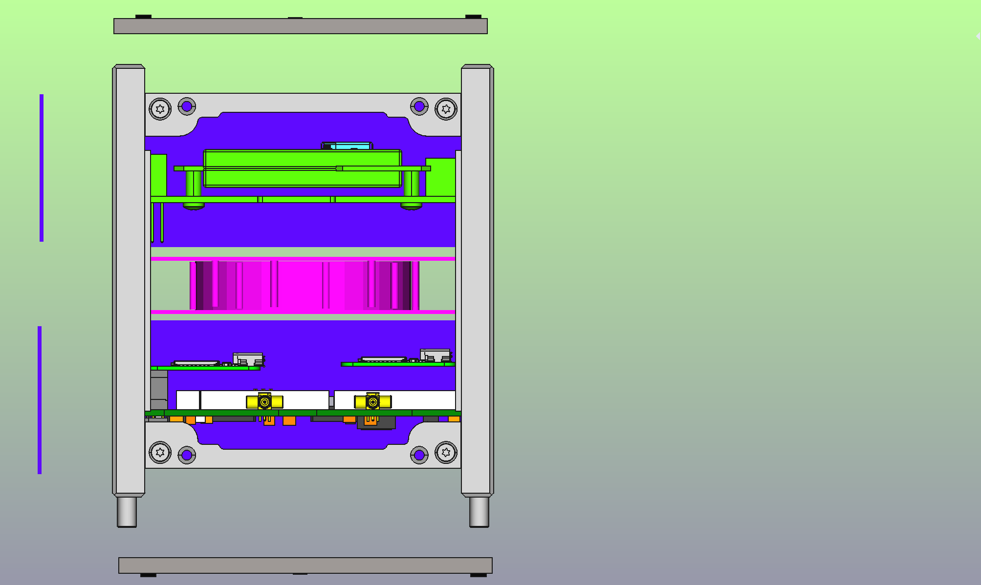
Top plate + solar panel
GPS receiver
Structure
EPS + battery
MagSail deployer (0.4U)
Onboard computer(s)
Transmitter
Bottom plate + solar panel

