Slide 1
Dependable opportunistic communication in a multi-tier sensor network architecture
Atul Prakash, Beng Heng, and Billy Lau
Computer Science and Engineering
University of Michigan
Vineet Kamat
Civil Engineering
University of Michigan
  Contact: aprakash@eecs.umich.edu

Slide 2
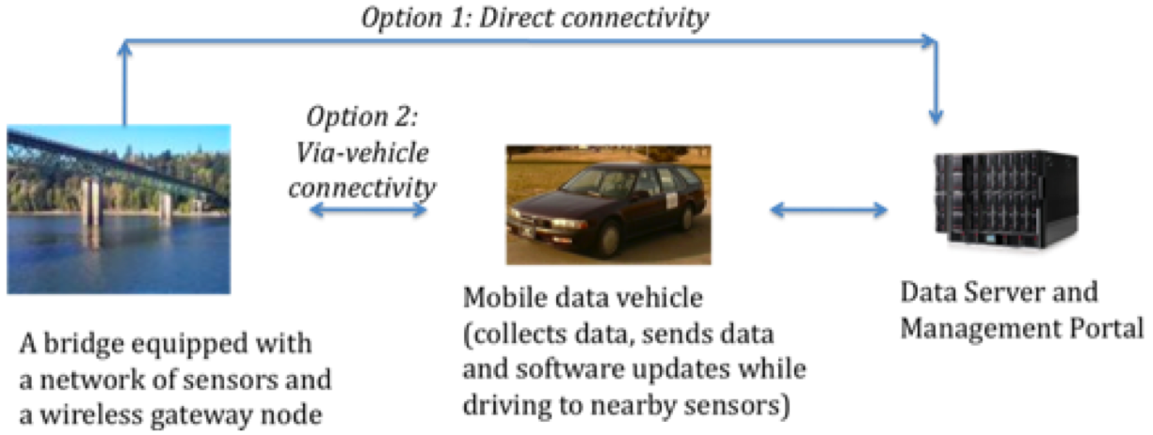
Motivation
New project: sensor networks for monitoring physical infrastructure systems.
Data collection problem:
Limited or no network connectivity
Power/cost constraints
Provide robust communication against sensor failures and security attacks
Similar problems of data collection in other domains from sensors in remote areas
Data communication architecture?

Slide 3
Approach - Multi-tier architecture

Slide 4
Drive-by data collection
High sensor densities: raw data: 100 MB to 10 GB of data/day
Tiers:
  Sensor ad hoc network <-> aggregator network
  Aggregator network <-> vehicle
  vehicle <-> back-end infrastructure

Slide 5
Requirements
Opportunistic communication and data collection
Cooperative data transfer
End-to-end dependability

Slide 6
Challenges
Buffered data at aggregagors
When to delete?
Potentially large volumes of data
Compression and prioritization
Vehicle moving at highway speeds

Slide 7
Data buffering
May not be safe to delete data upon transfer to the vehicle
aggregators <-> back-end infrastructure: acknowledgement desirable
  potentially long latencies (weeks)
security: authentication desirable

Slide 8
Data transfer to Moving Vehicle
Vehicle moving at highway speeds over large span
How does it collect data from the aggregators?
We envision the need for cooperative data transfer algorithms --- multiple aggregators must cooperate to transfer data to a moving vehicle

Slide 9
Summary
Goal: design a robust and easy-to-deploy architecture for remote sensor networks
We envision a:
  multi-tier architecture, consisting of sensor network, network of aggregators, mobile data collection nodes, and back-end infrastructure
Welcome opportunities for collaboration and finding synergies

