Slide 1
Identification of Digits using Neural Networks
By
Athul Shibu
2017118100

Slide 2
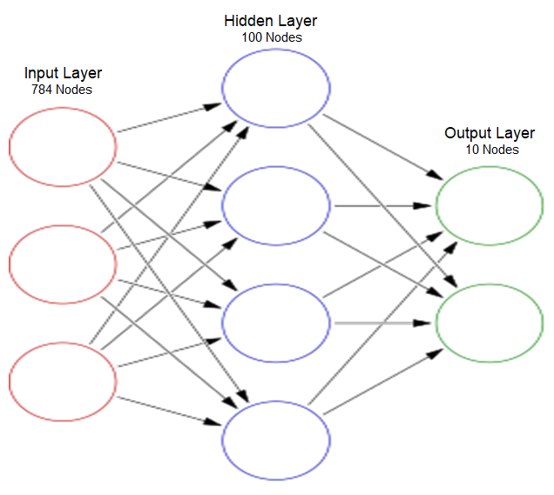
An Idea of what the Project looks like!!!!

Slide 3
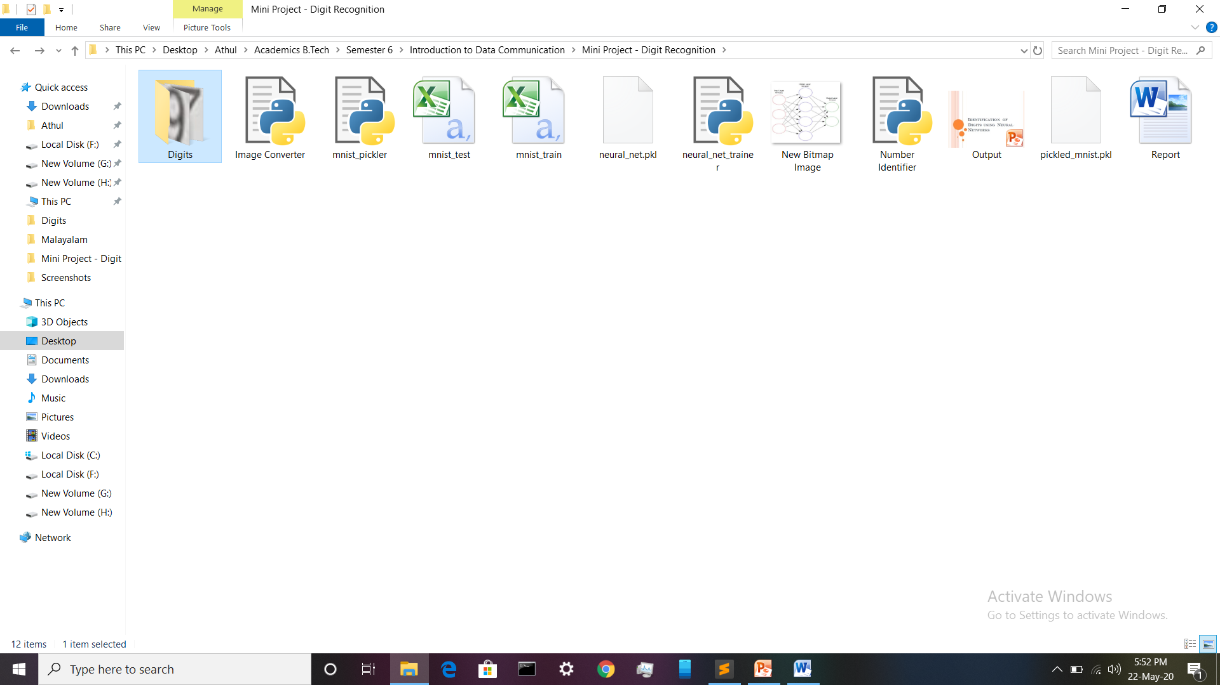
All Files of the Project!!!

Slide 4
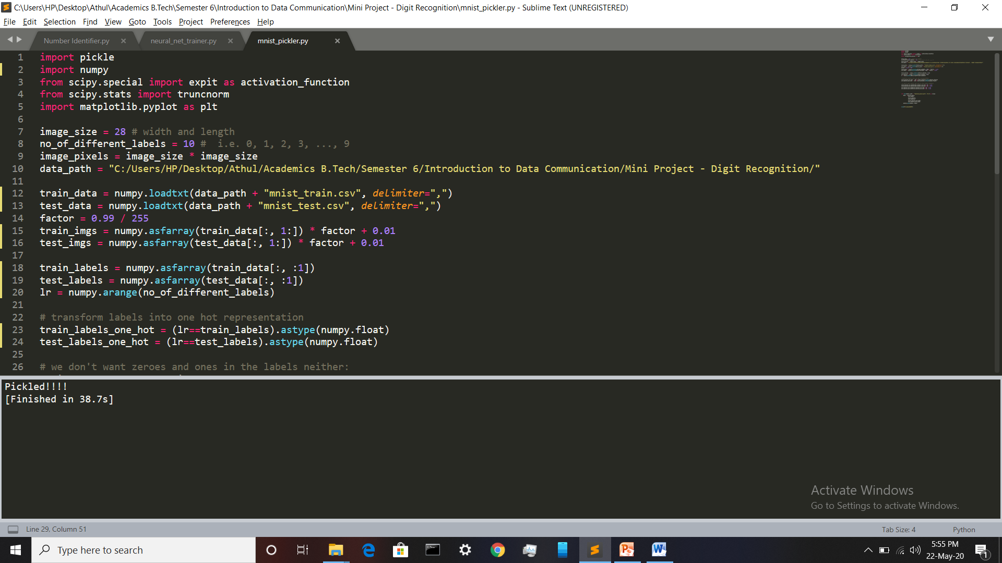
STEP 1: Access MNIST Database and Pickle it!!!!

Slide 5
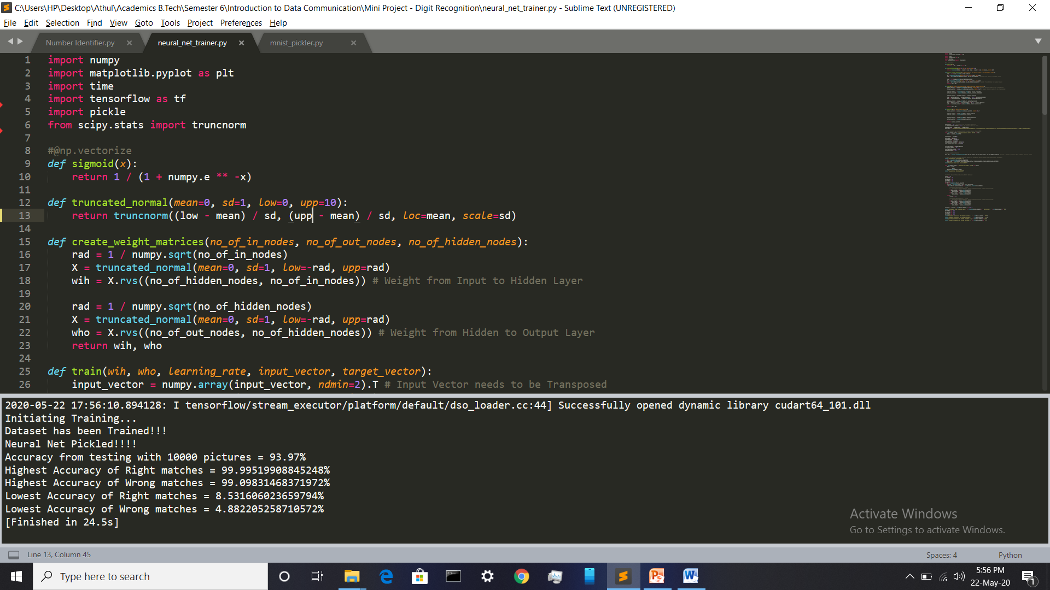
STEP 2: Train and Test the Neural Network

Slide 6
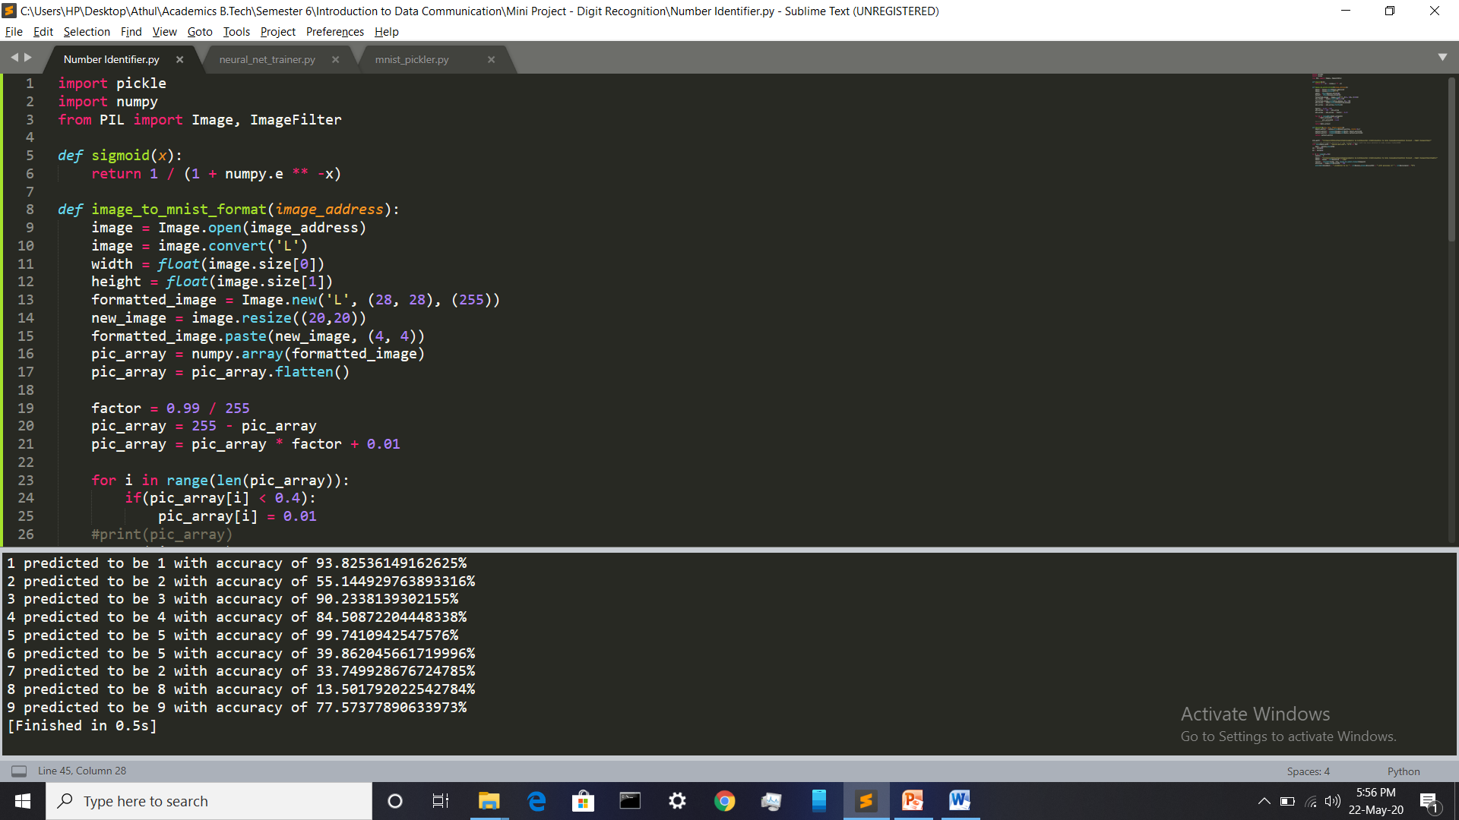
STEP 3: Test Neural net with Real Pictures

Slide 7
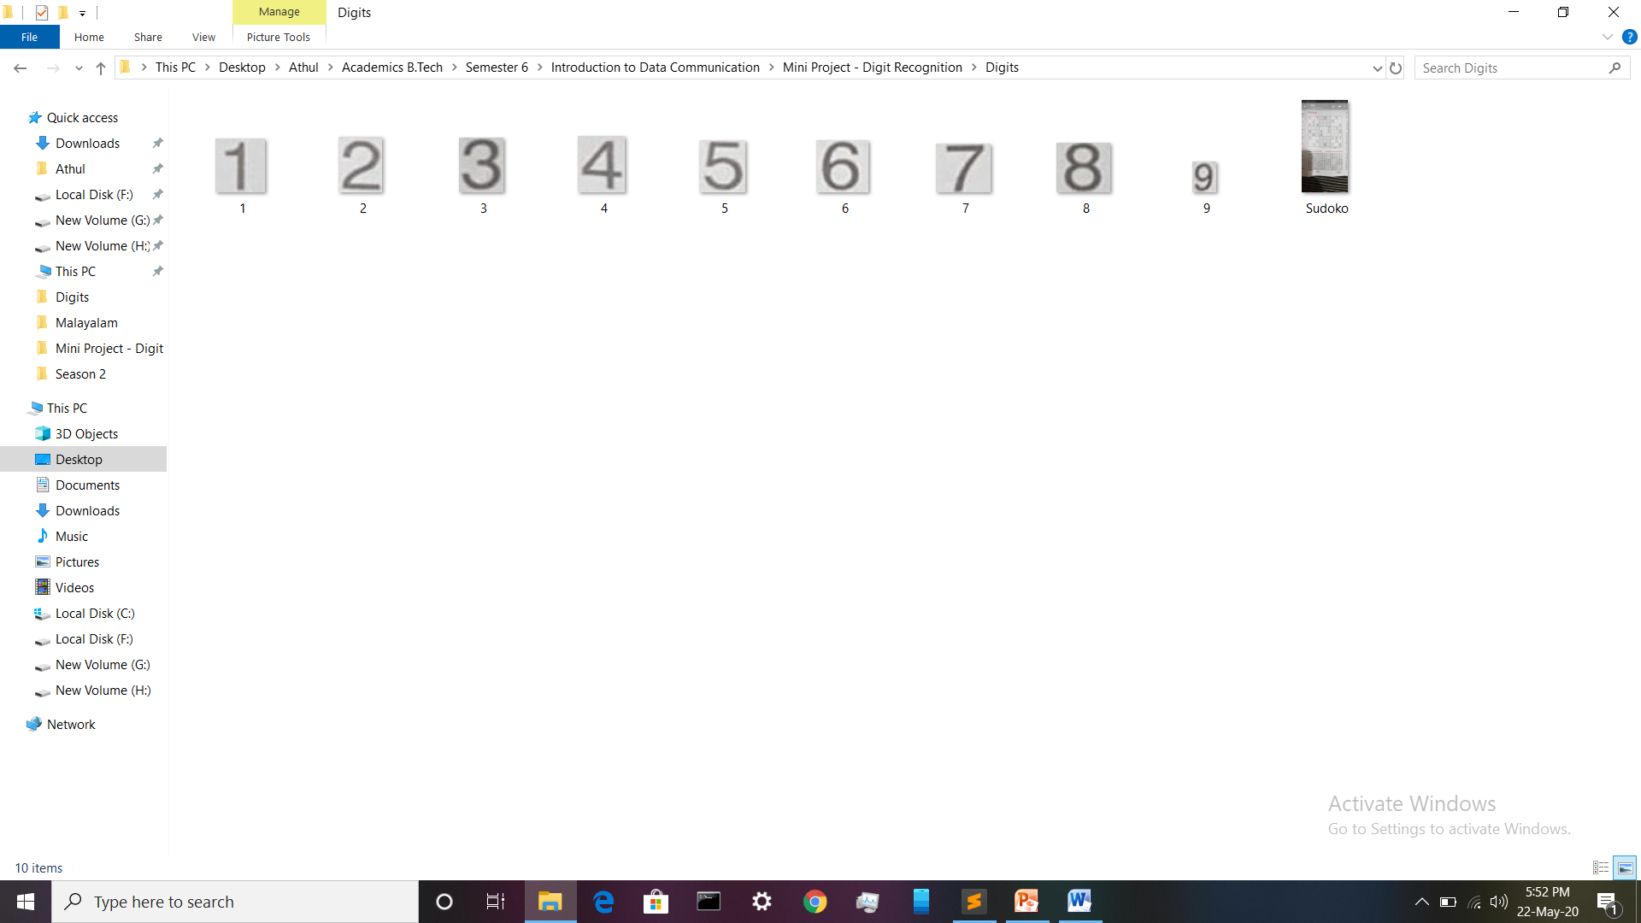
Pictures used for Final test of Neural Network

Slide 8


