Slide 1

JAIN UNIVERSITY
Language Detection Using NLP & ML
Mini Project –
Advanced Machine Learning (23CSE514)
B.Tech CSE – AI
Athul S Nair
23BTRCA019

Slide 2
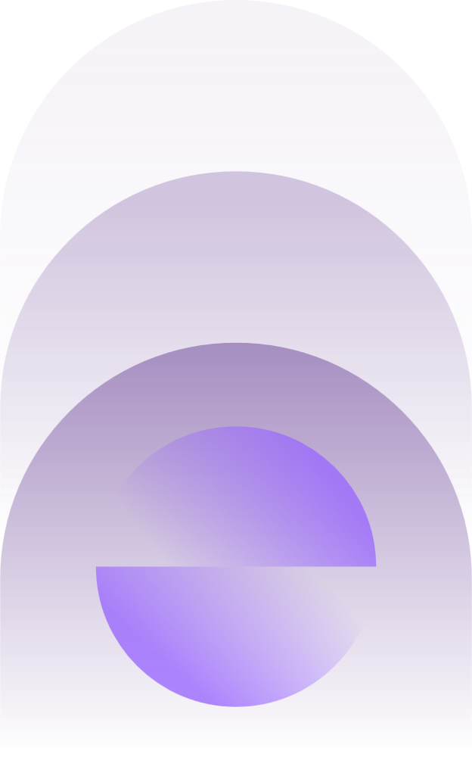
Introduction
Language detection = identifying the language of any text
Used in translation systems, NLP pipelines, chatbots, search engines
This project detects 17 different languages using Machine Learning Model
Uses TF-IDF + Logistic Regression for high accuracy

Slide 3
Prior Study (Literature Review)
Traditional rule-based approaches: dictionaries, stopwords (not accurate)
N-gram models by Cavnar & Trenkle (1994) → high accuracy
ML models used: Naïve Bayes, Logistic Regression, SVM
Deep learning exists but heavy for small datasets
TF-IDF + LR remains most practical and effective for language identification

Slide 4

Problem Statement
Need automatic language identification from user input text
Multilingual datasets contain multiple scripts (Latin, Arabic, Devanagari, Dravidian)
Dataset imbalance leads to bias in predictions
Goal: Build a robust, accurate, script-independent language detection model

Slide 5
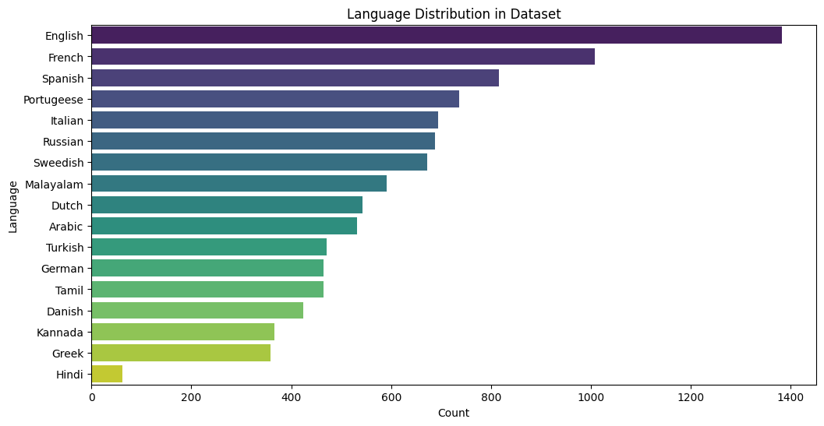
Dataset
Dataset: Language Detection.csv
Contains 17 languages
Around 10,267 samples originally
Highly imbalanced:
  English > 1000 samples
  Hindi ~ 63 samples
Balancing required to avoid bias

Slide 6
Methodology
Data Cleaning:
  Remove nulls
  Remove duplicates
  Convert text to lowercase
Feature extraction: Character-level TF-IDF (2–4 n-grams)
Balancing: Random Oversampling
Train-test split: 80% training, 20% testing
Model: Logistic Regression (multiclass)

Slide 7
How does the model detect a language?
Step 1 → Input comes from user
Example:
“hello"
Step 2 → Convert text into character n-grams
The sentence becomes many pieces like:
For the word "hello":
2-gram (bigram): he, el, ll, lo
3-gram (trigram): hel, ell, llo
4-gram: hell, ello
So, an n-gram helps the model learn the patterns of characters that are unique to each language.

Slide 8
How does the model detect a language?
Step 3 → TF-IDF gives weights to each n-gram
TF-IDF assigns:
High weight → if a character pattern is important/unique
Low weight → if it is common in many languages
This converts text → numeric vector.
Step 4 → Logistic Regression uses learned patterns
During training, the model saw thousands of samples per language and learned:
Spanish texts = have patterns like "¿", "ó", "está", "que"
Hindi = “क”, “न”, “ि” etc.
Malayalam = “ത്ത്”, “ക്ക”, “ാൻ”
Arabic = “ال”, “مر”, “كا”
English = “the”, “ing”, “er”
It learns character fingerprints.

Slide 9
How does the model detect a language?
Step 5 → Model predicts the language
Example output:
Spanish: 0.98
Portuguese: 0.01
Italian: 0.01
So, the predicted language = English.

Slide 10

Code Implementation (Training)
TF-IDF vectorizer for character n-grams
RandomOverSampler() for balancing
LogisticRegression(max_iter=2000) for stable training
Save model using joblib
Prediction function defined for inference

Slide 11
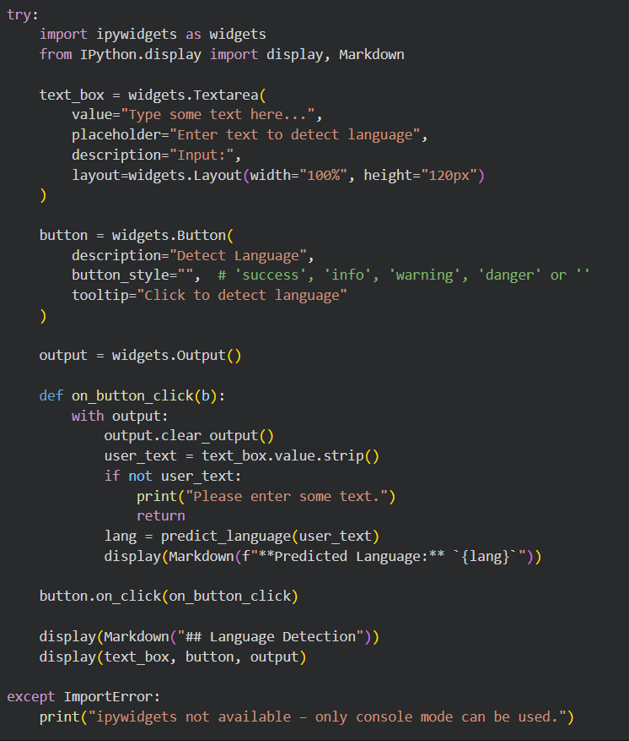
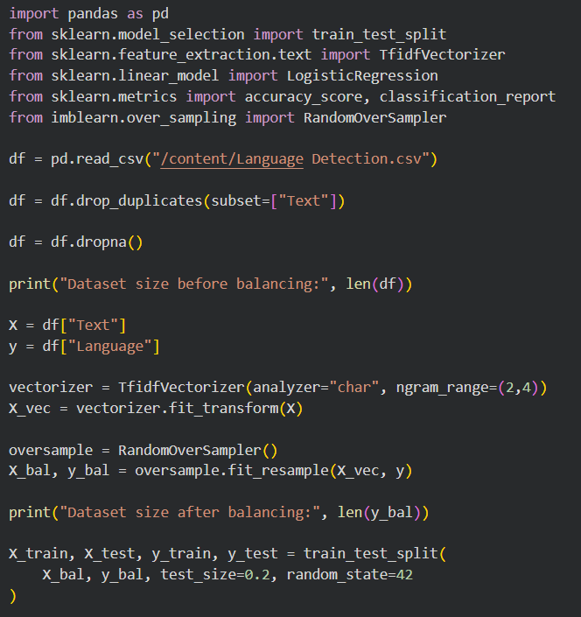
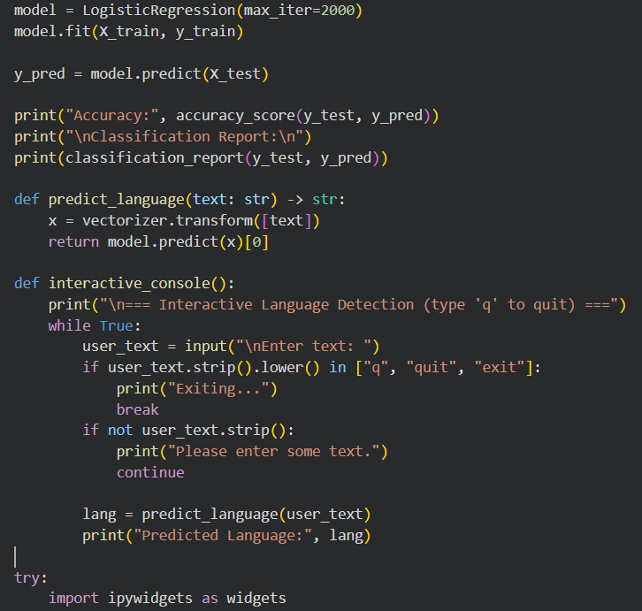
Code Implementation (Training)

Slide 12
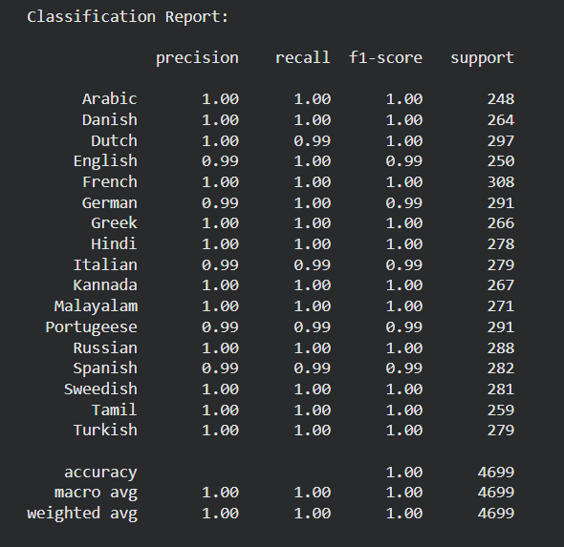

Model Evaluation

Slide 13
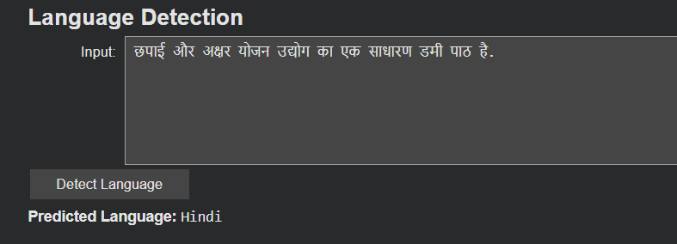
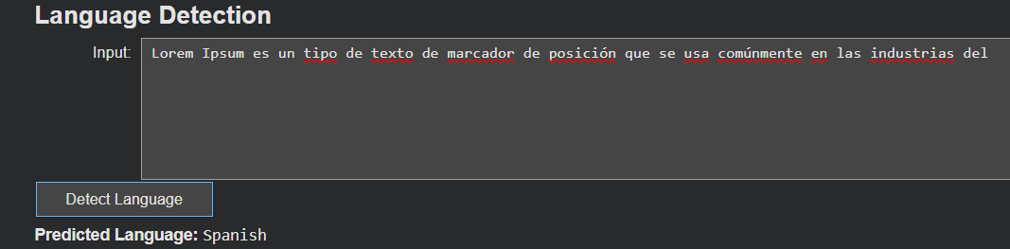
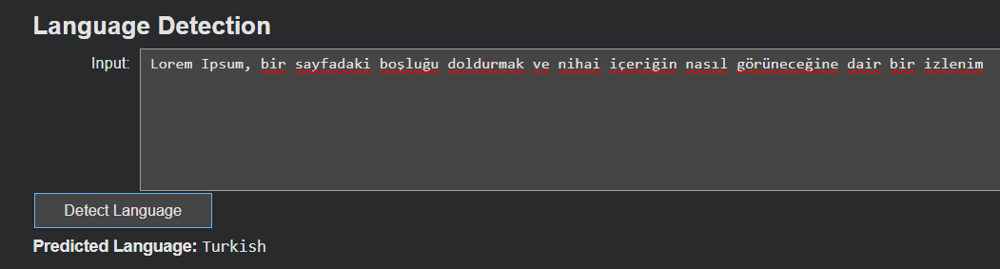
Code Implementation: Output

Slide 14
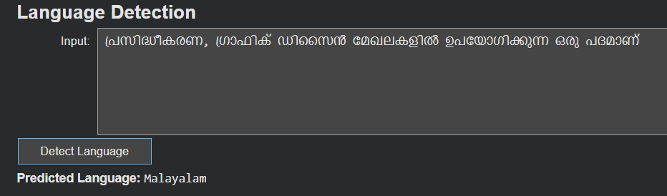
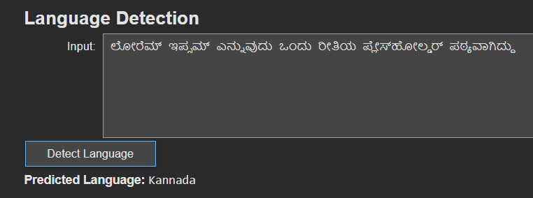
Code Implementation: Output

Slide 15
Code Implementation (Flask App)
Load saved lang_model.pkl and vectorizer.pkl
Flask routes:
  / → detect language
  /performance → show model accuracy & F1-scores
UI: text input box → predicted language
Confidence score displayed using predict_proba()
Modern UI with HTML/CSS

Slide 16
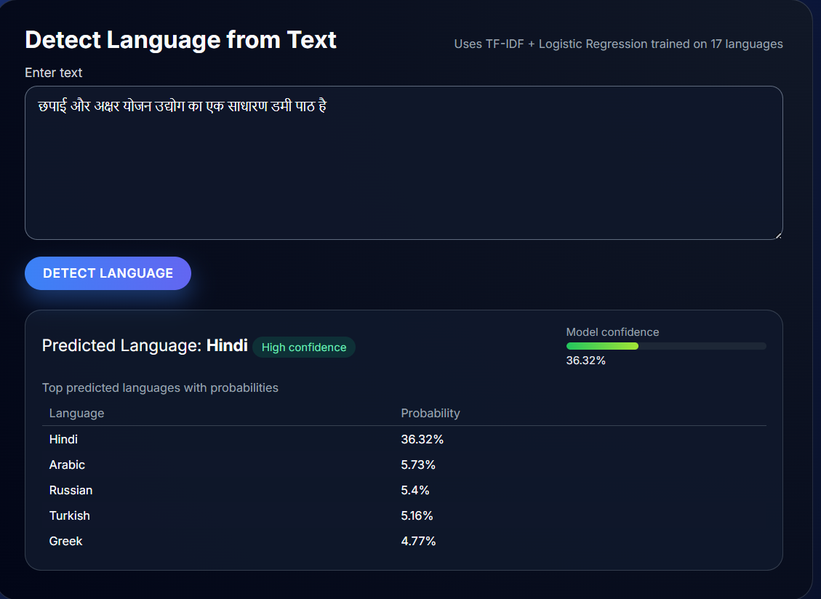
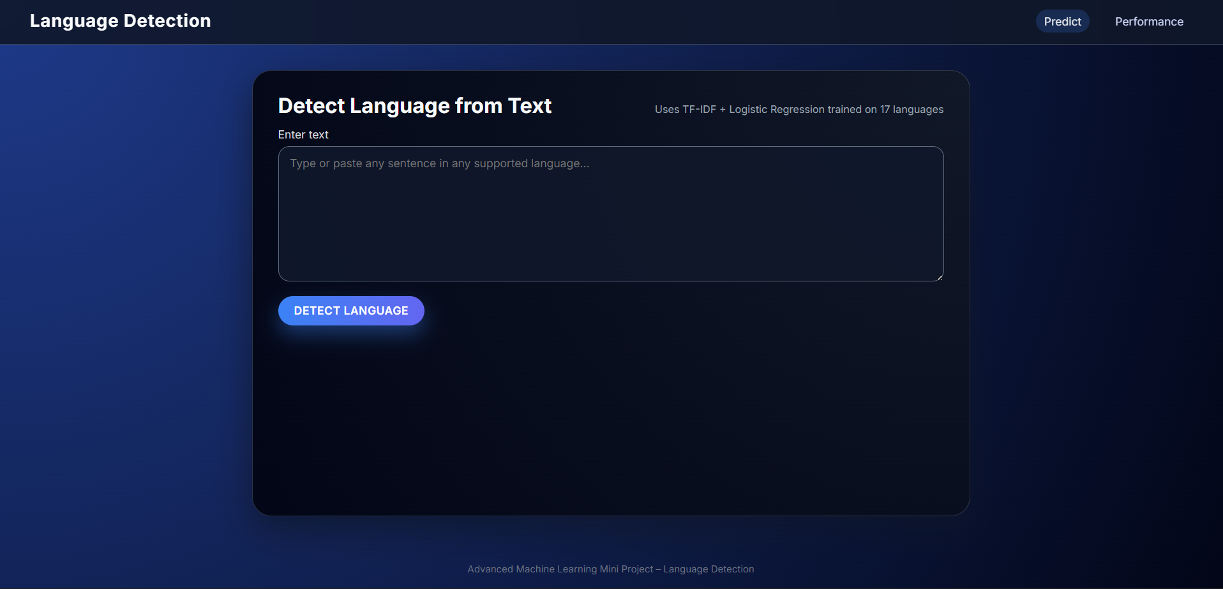
Code Implementation (Flask App)

Slide 17
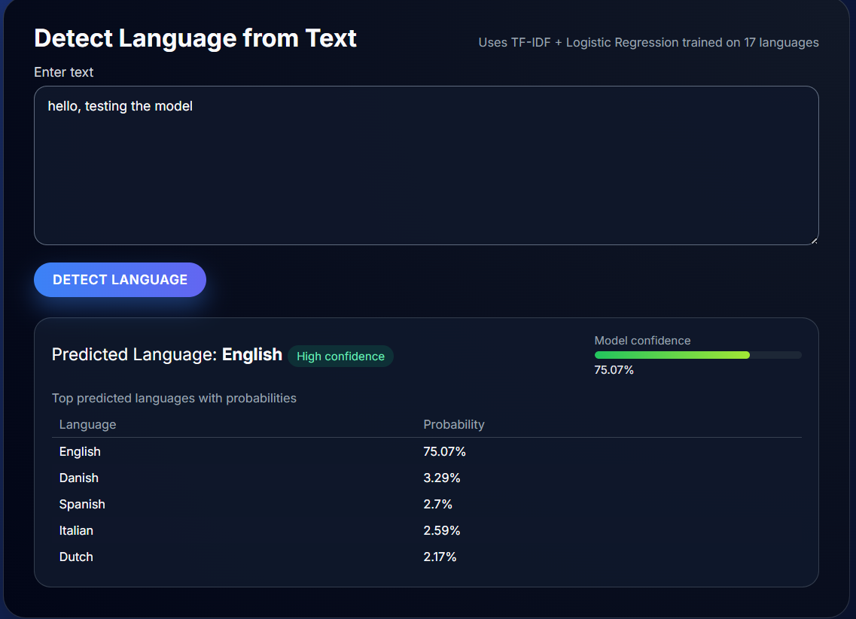
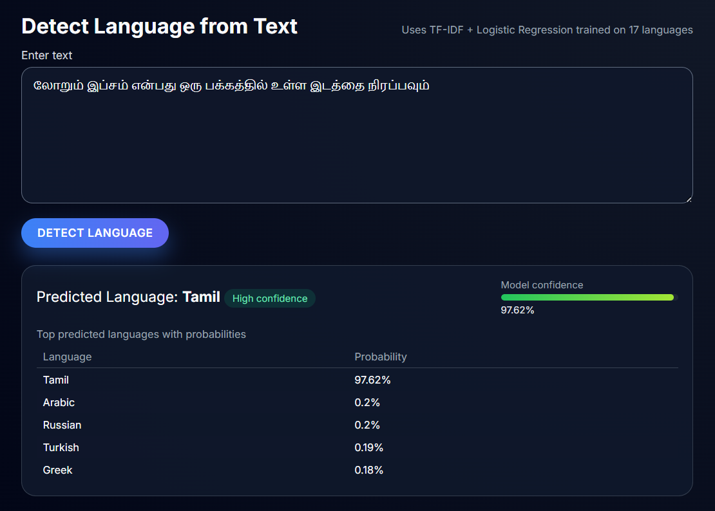
Code Implementation (Flask App)

Slide 18
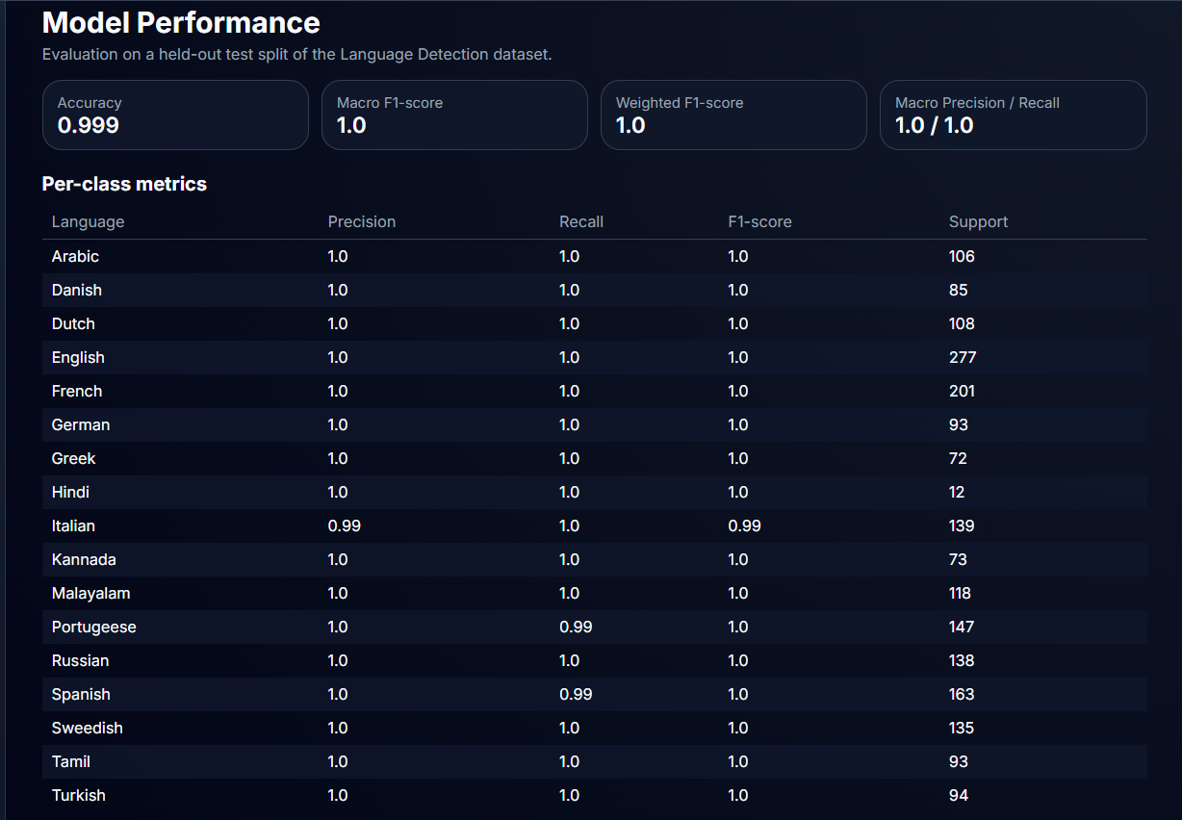
Code Implementation (Flask App)

Slide 19
Results
Accuracy: 99.9%
Macro F1-score: 1.0
Weighted F1-score: 1.0
Perfect per-language results
Balanced dataset fixed model bias
Flask app predicts accurately in real-time

Slide 20
Summary
Complete NLP + ML pipeline implemented
Very high performance achieved
Character-level n-grams ideal for language detection
Balanced dataset ensured fairness
Deployed using Flask for real-world usage

Slide 21

References
Cavnar & Trenkle (1994) – N-gram text categorization
Manning et al. – Introduction to Information Retrieval
scikit-learn documentation
imbalanced-learn documentation
Flask documentation

Slide 22

Thank You

