Slide 1





WORLD HEALTH
ATHUL SUDHEESH

Slide 2
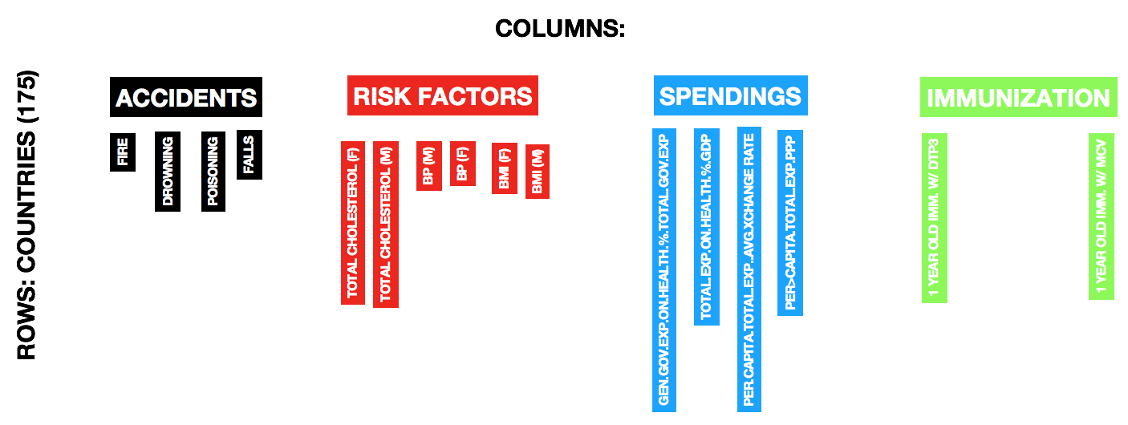
INTRODUCTION
175 Observations on 16 quantitative variables

Slide 3
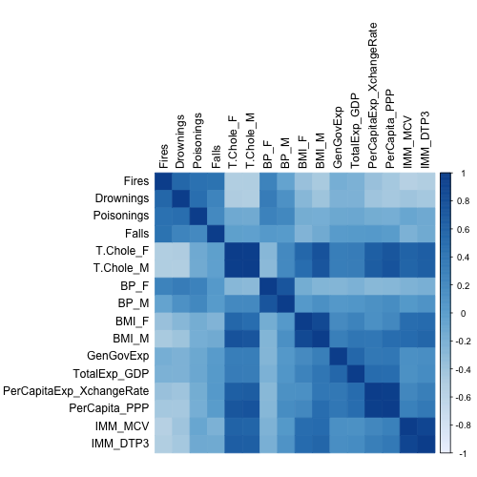
HEATMAP

Slide 4
MOTIVATION
Is there some geographic trend in health measures ?
If there is a trend, are the group effects significant ?
Is there any relationship between Risk Factors and Spending ?
Is there any relationship between Risk Factors and Immunization ?
How does the different blocks in the dataset relate to each other ?

Slide 5
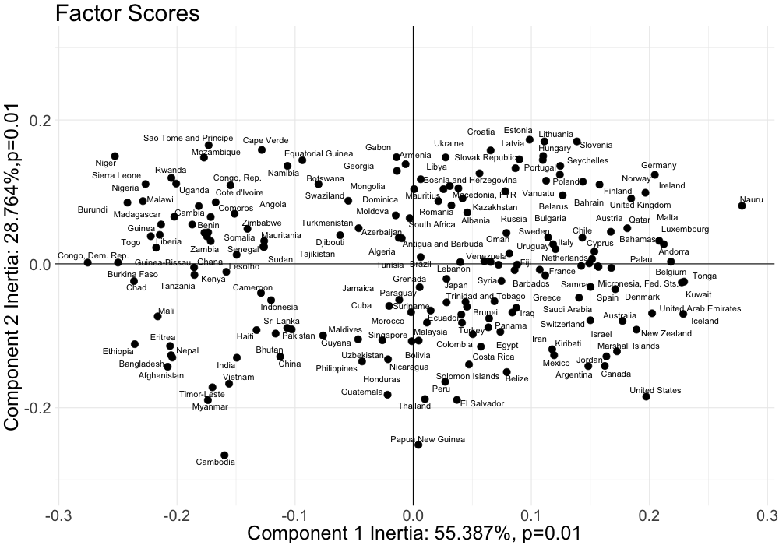
PCA - RISK FACTORS

Slide 6
PCA - RISK FACTORS
Is there some geographic trend ?

Slide 7
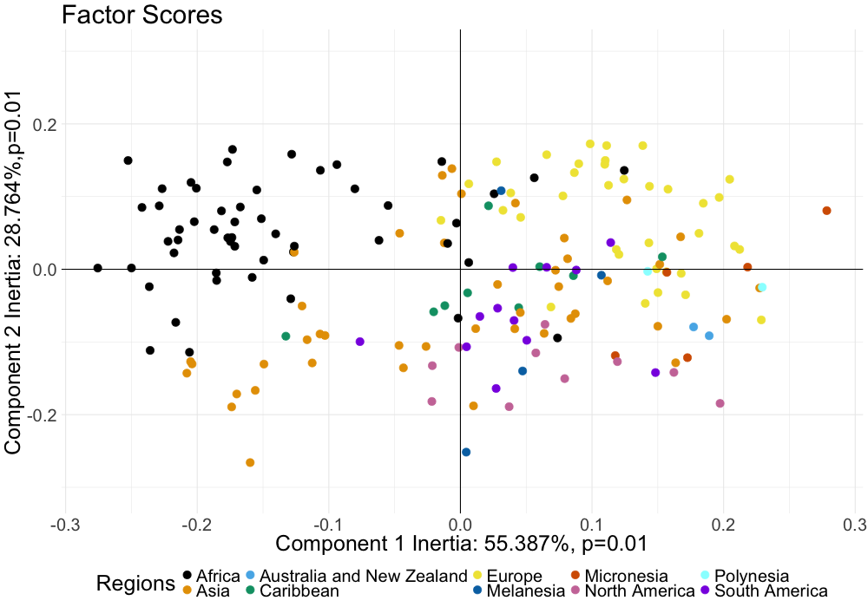
PCA - RISK FACTORS
AFRICA
EUROPE
MICRONESIA
CARIBBEAN
POLYNESIA
AUSTRALIA & NEW ZEALAND
S. AMERICA
ASIA
N. AMERICA
MELANESIA

Slide 8
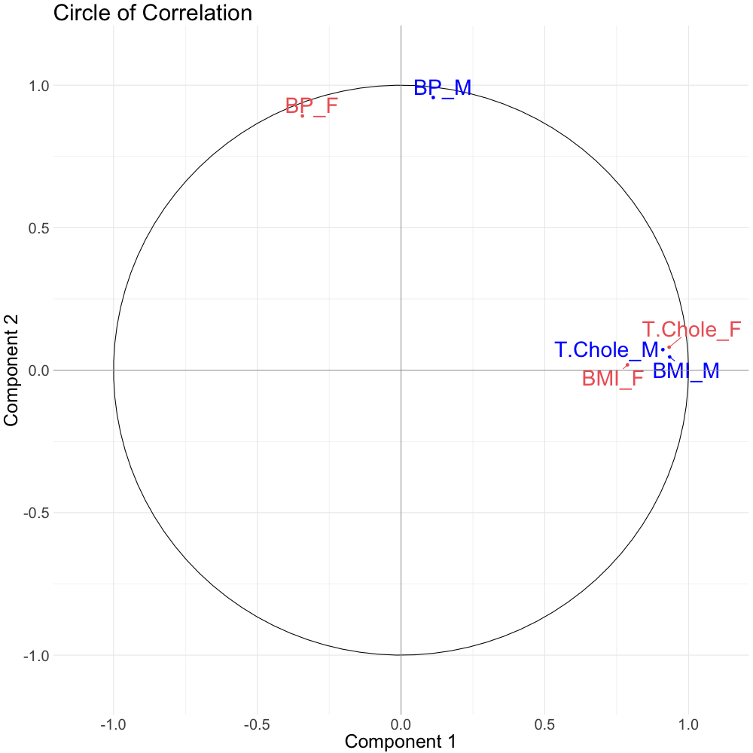
PCA - RISK FACTORS

Slide 9
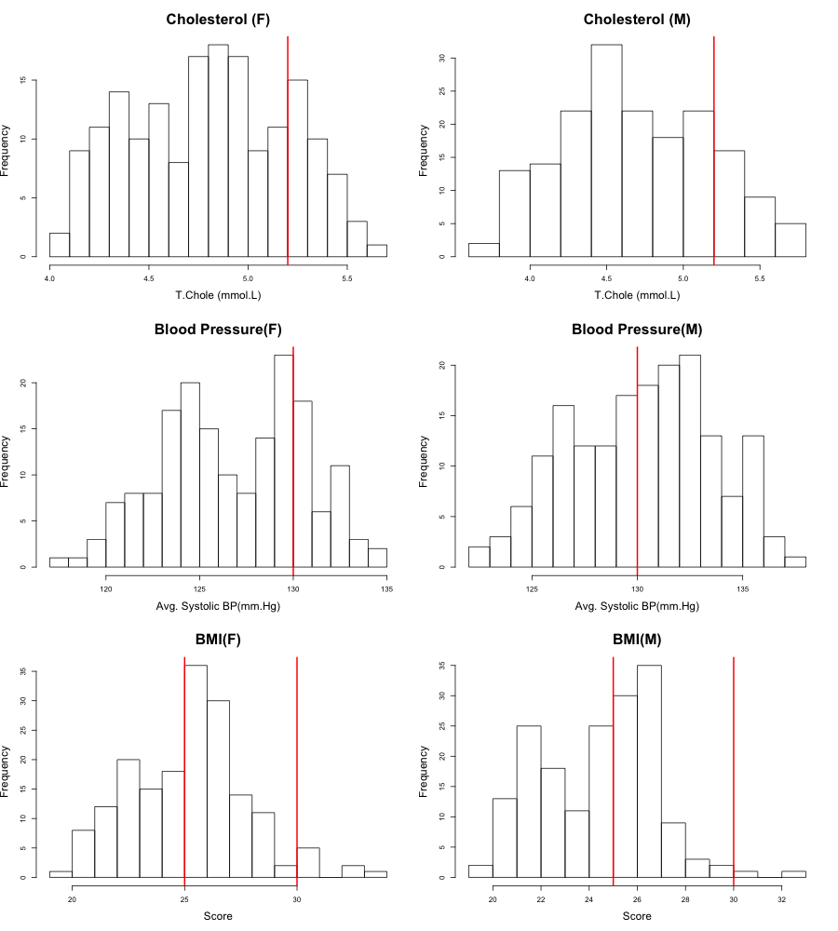
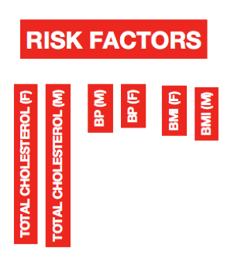
Eh…WAIT !
IDEAL
BORDERLINE
HIGH
IDEAL
PRE
UNDER
HIGH
IDEAL
OVER
OBESE

Slide 10
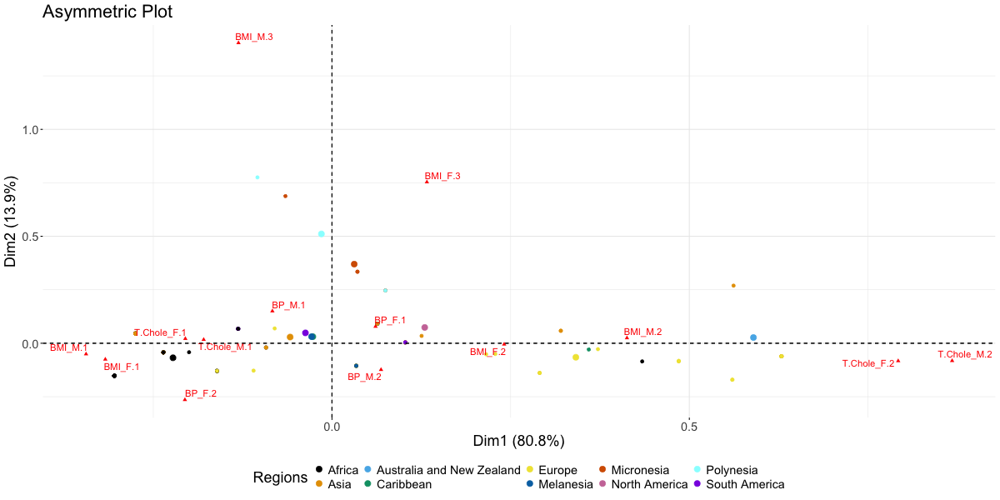
MCA - RISK FACTORS
POLYNESIA
MICRONESIA
S. AMERICA
N. AMERICA
AUSTRALIA & NEW ZEALAND
ASIA
CARIBBEAN
MELANESIA
AFRICA
EUROPE

Slide 11
MCA - RISK FACTORS
POLYNESIA
MICRONESIA
S. AMERICA
N. AMERICA
AUSTRALIA & NEW ZEALAND
ASIA
CARIBBEAN
MELANESIA
AFRICA
EUROPE

Slide 12
MCA - RISK FACTORS
POLYNESIA
MICRONESIA
S. AMERICA
N. AMERICA
AUSTRALIA & NEW ZEALAND
ASIA
CARIBBEAN
MELANESIA
AFRICA
EUROPE

Slide 13
MCA - RISK FACTORS
POLYNESIA
MICRONESIA
S. AMERICA
N. AMERICA
AUSTRALIA & NEW ZEALAND
ASIA
CARIBBEAN
MELANESIA
AFRICA
EUROPE

Slide 14
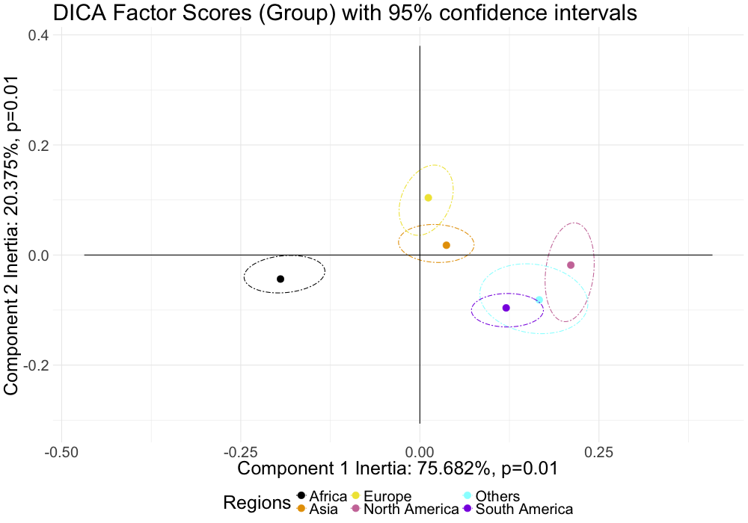
DICA - RISK FACTORS
EUROPE
ASIA
N. AMERICA
AFRICA
OTHERS
S. AMERICA

Slide 15
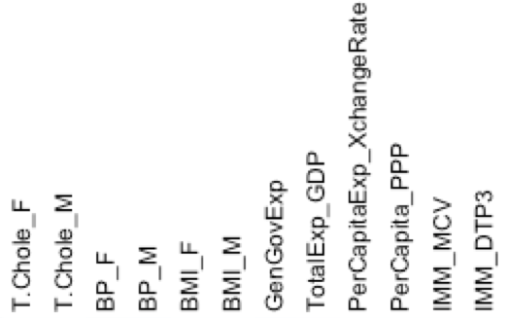
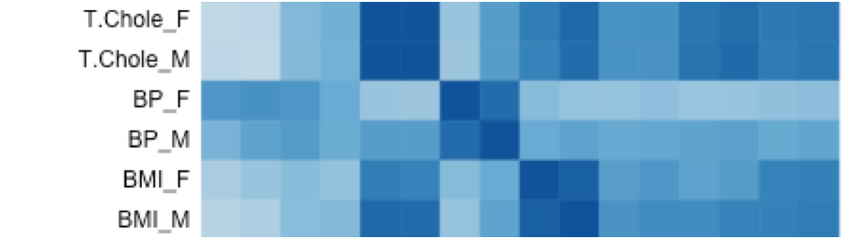
RISK FACTORS vs SPENDINGS

Slide 16
RISK FACTORS vs SPENDINGS
PLSC !!!

Slide 17
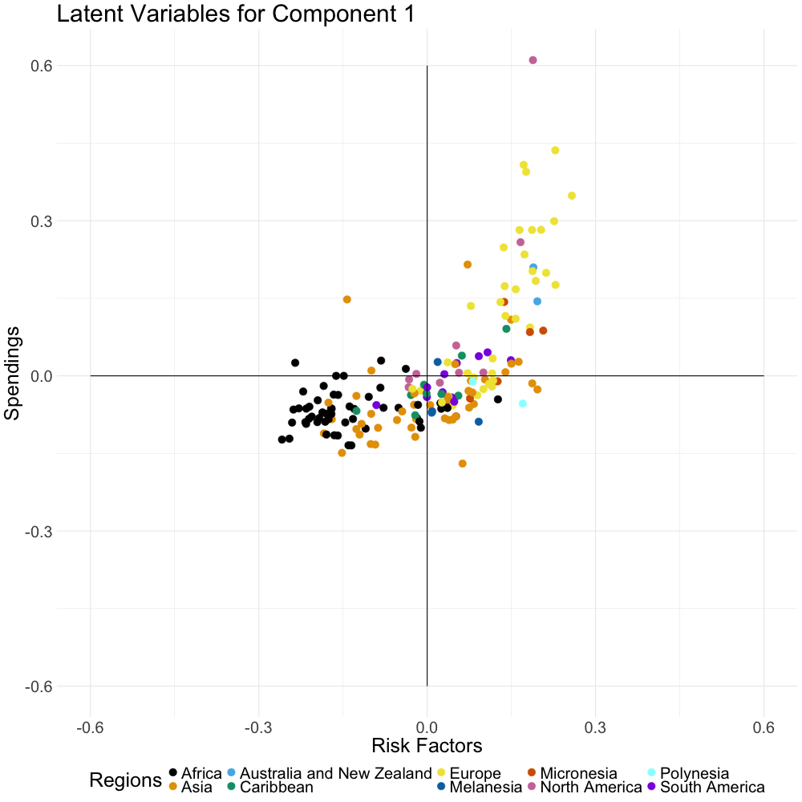
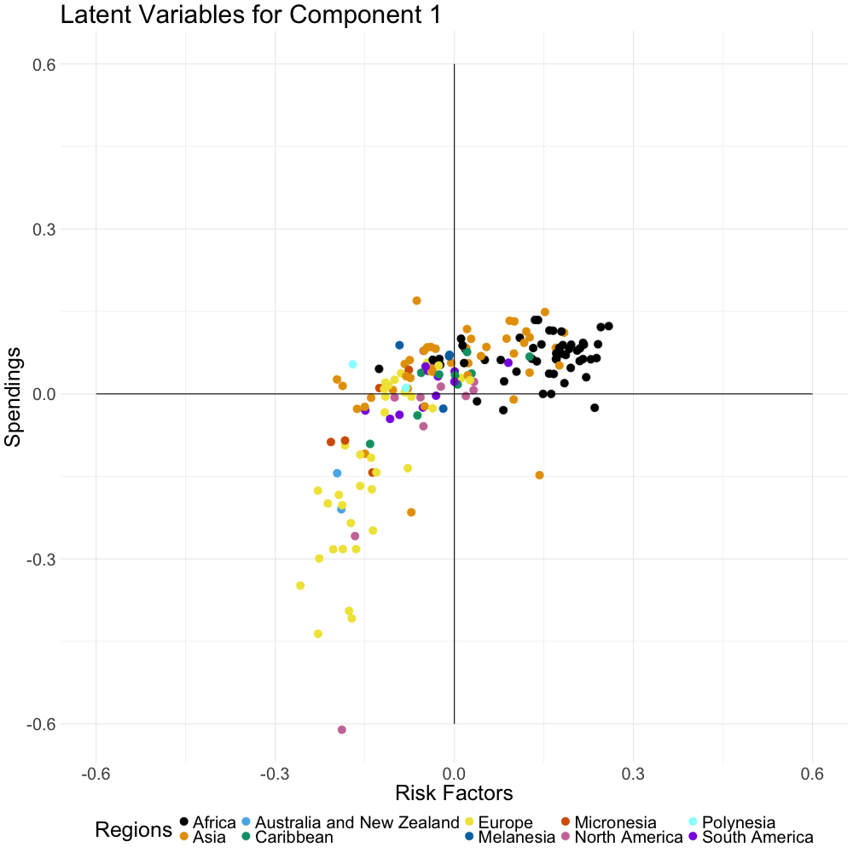
PLSC - RISK FACTORS vs SPENDINGS

Slide 18
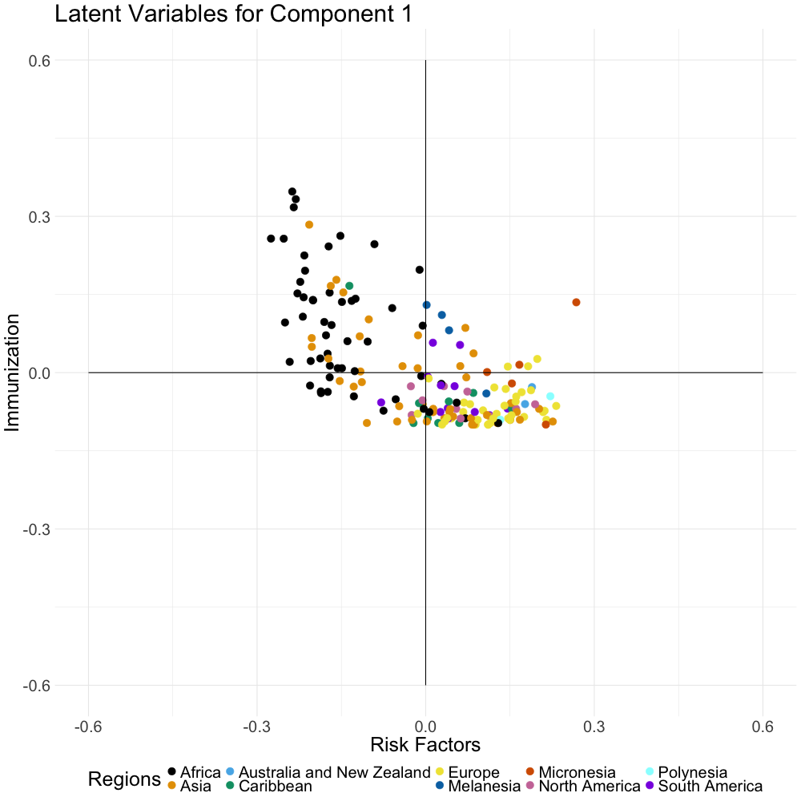
PLSC - RISK FACTORS vs IMMUNIZATION

Slide 19
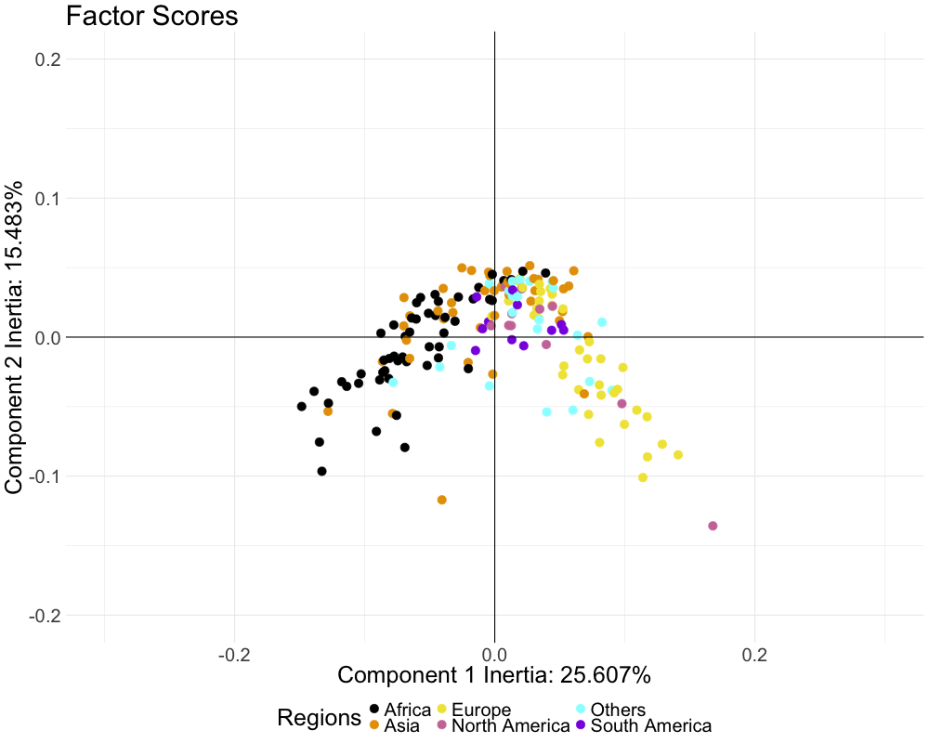
MFA – Risk factors, SPENDINGs and IMMUNIZATION

Slide 20
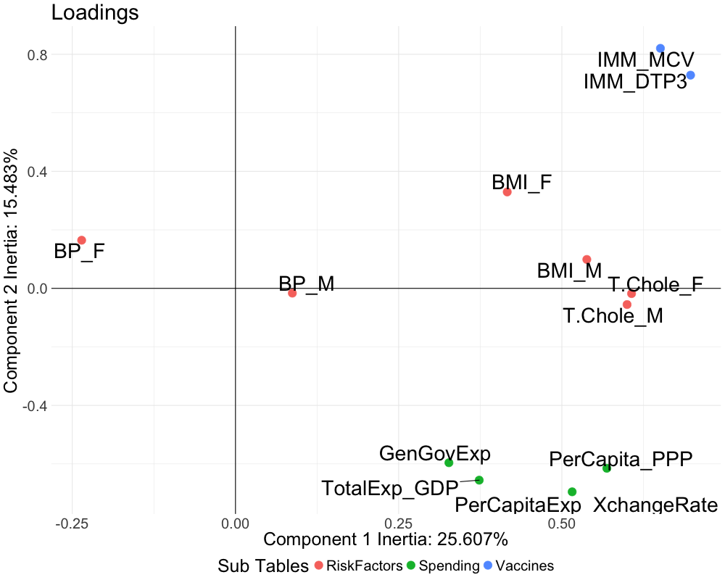
MFA – Risk factors, SPENDINGs and IMMUNIZATION

Slide 21
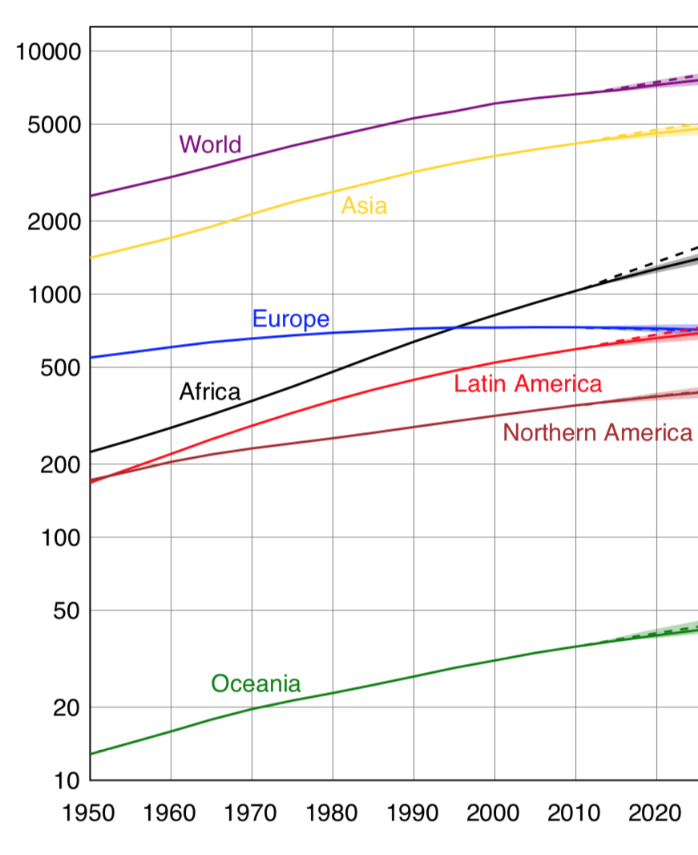
MFA – Risk factors, SPENDINGs and IMMUNIZATION
PEOPLE (in Millions)

Slide 22
CONCLUSIONs
PCA
There is a geographic trend in health measures – Africa vs Europe. Effect due to Total Cholesterol and BMI
MCA
Africans, Asians and South Americans are healthier (based on Total Cholesterol & BMI ) than Europeans and North Americans
Obesity rate is higher among Polynesians and Micronesians
DICA
The group effects among regions of interest were significant except between Asia and Europe

Slide 23
CONCLUSIONs
PLSC
Linear relationship between Risk Factors and Spending for Asia & South America
No relationship between Risk Factors and Immunization
MFA
Risk Factors independent of Population rate
Higher Spending due to unhealthier population and increased health care cost
Trends in Risk Factors mainly due to lifestyle differences

