Slide 1
video content retrieval system

Slide 2
INTRODUCTION
In the digital era, the internet is flooded with an immense volume of video content. This abundance presents both an opportunity and a challenge: how can users efficiently locate specific segments within these long videos based solely on text descriptions?

Slide 3
Existing system
Traditional video content retrieval methods rely heavily on metadata and manual tagging, which fall short in capturing the nuances and specifics of video content, making it difficult to find precise information within lengthy videos.
As video content grows exponentially, maintaining accurate and comprehensive metadata becomes impractical, leading to outdated or incomplete tags.
Moreover, these methods lack the contextual and semantic understanding of the actual video content, resulting in poor search results.

Slide 4
Solution suggested
To address the limitations of traditional video content retrieval methods, our project proposes the development of an advanced Video Content Retrieval System. This system will leverage cutting-edge technologies in video analysis, image/video captioning, and information retrieval to provide a more accurate and efficient way to locate specific segments within lengthy videos.
Utilizing pre trained Natural Language Processing (NLP) models like BERT (Bidirectional Encoder Representations from Transformers).
BERT can help in understanding and indexing the semantic content of videos more effectively.
Clustering of captions will also be incorporated to improve search performance in the case of long videos.

Slide 5
Features:
Upload a Video.
Users input descriptive text prompts.
The application, promptly and accurately identifies and retrieves the video segments.

Slide 6
VIDEO PROCESSING MODULE
The system shall extract keyframes that represent significant moments in the video.
The system shall generate captions for these keyframes using pre-trained image captioning model.
involves comparing content differences between frames using color and intensity information in the HSV color space.
Also uses canny algorithm for edge detection.

Slide 7
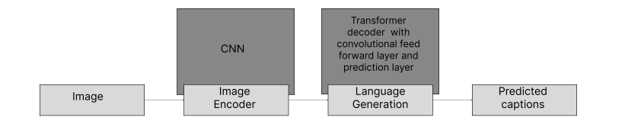
Captioning Module
Subsequently, employing Image Captioning techniques, captions will be generated for each keyframe, aiming to describe the visual content present.
This step ensures that a textual representation is available for each identified keyframe, facilitating the comparison between the user’s textual query and the content descriptors.
Done using an encoder transformer approach.(CNN)
Transformer decoder with convolution feed forward layer and prediction layer.(Language generation)

Slide 8
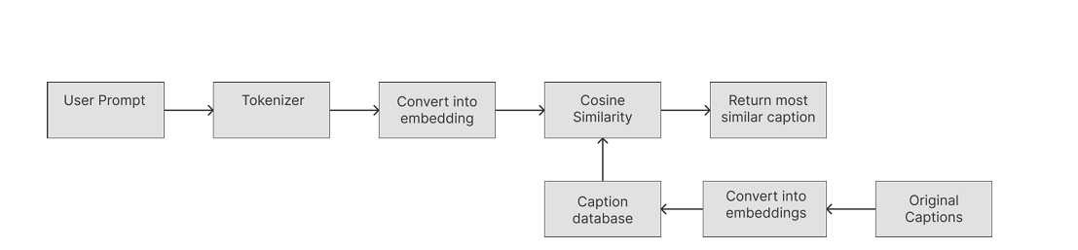
Search Module
The system shall enable users to search video content based on natural language queries.
The system shall perform semantic matching between the user's query and video captions.
The system will apply clustering techniques to improve search efficiency and accuracy.

Slide 9
User Interface Module
The system shall provide a user-friendly, web-based interface for uploading videos and inputting search queries.
Results will be displayed with relevant video segments, timestamps, and captions.
Users will have the option to play the retrieved video segments directly from the interface.

Slide 10
External Interface Requirements
1. User Interface
A web-based Graphical User Interface (GUI) developed.
Components for video upload, text-based search queries, and results visualization.
Interface to enable users to view the retrieved video segments.
2. Hardware Interface
The system shall support GPU acceleration to facilitate faster processing of video data and efficient model inference.

Slide 11
Design Constraints
The user interface must be cross-platform compatible, preferably web-based.
The system architecture must be modular to allow for easy updates and the addition of new features.

Slide 12
Attributes
Security: Implement user authentication and authorization mechanisms to restrict access to sensitive video data.
Maintainability: Ensure the system is developed with clear documentation and modular code to facilitate future maintenance and updates.
Scalability: Design the system to handle increasing volumes of video data by employing efficient indexing and search algorithms

Slide 13
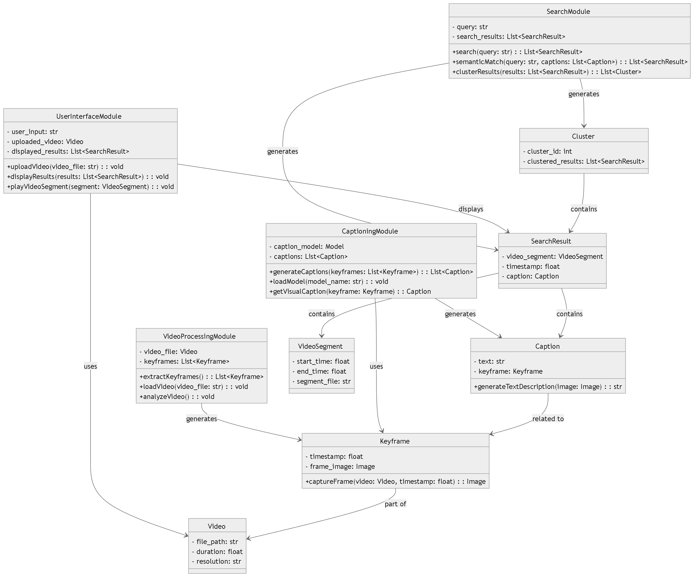
CLASS DIAGRAM

Slide 14
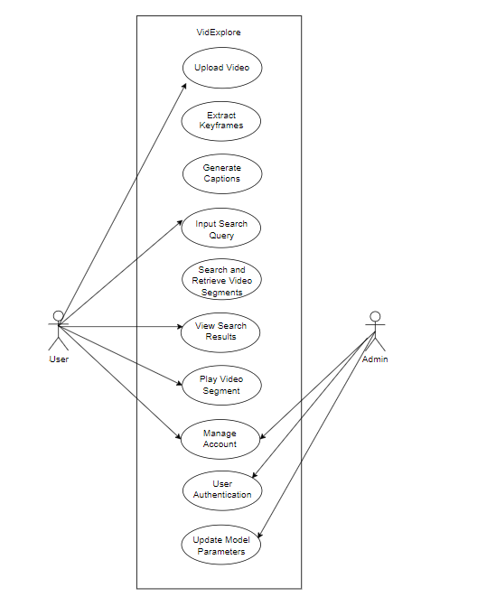
USE CASE DIAGRAM
System

Slide 15
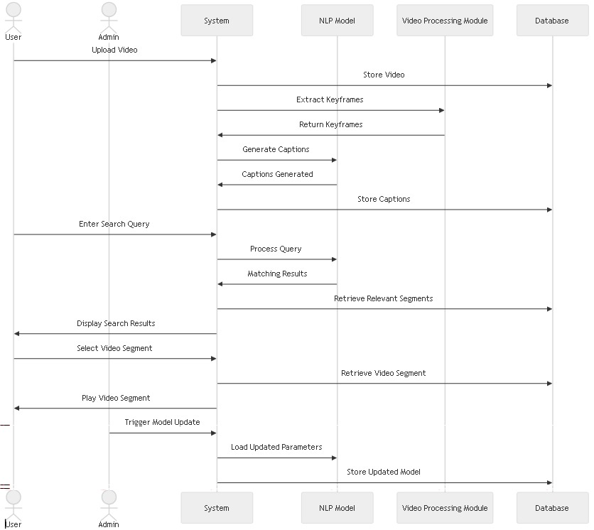
SEQUENCE DIAGRAM

Slide 16
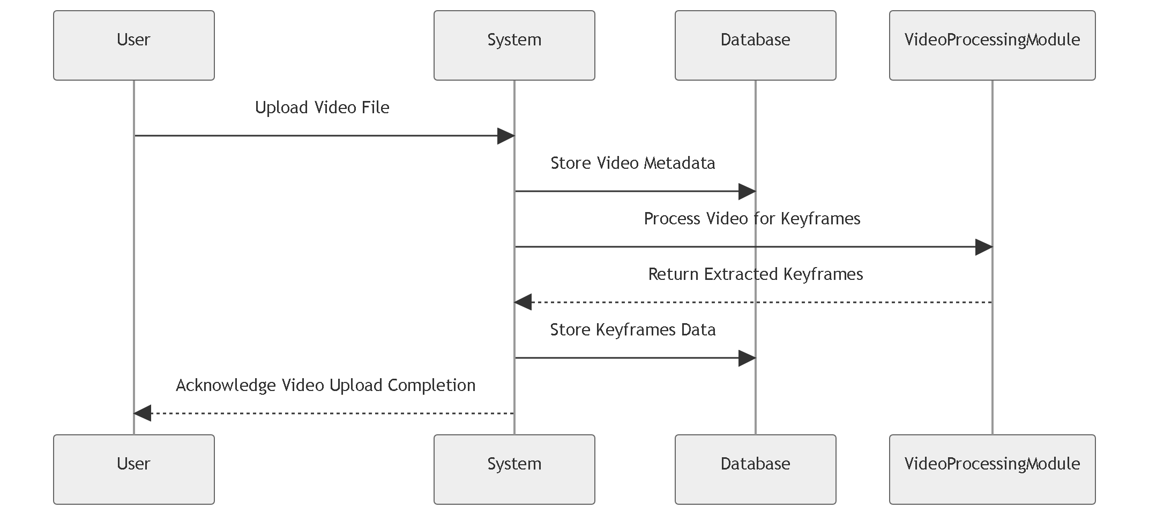
VIDEO UPLOAD PROCESS

Slide 17
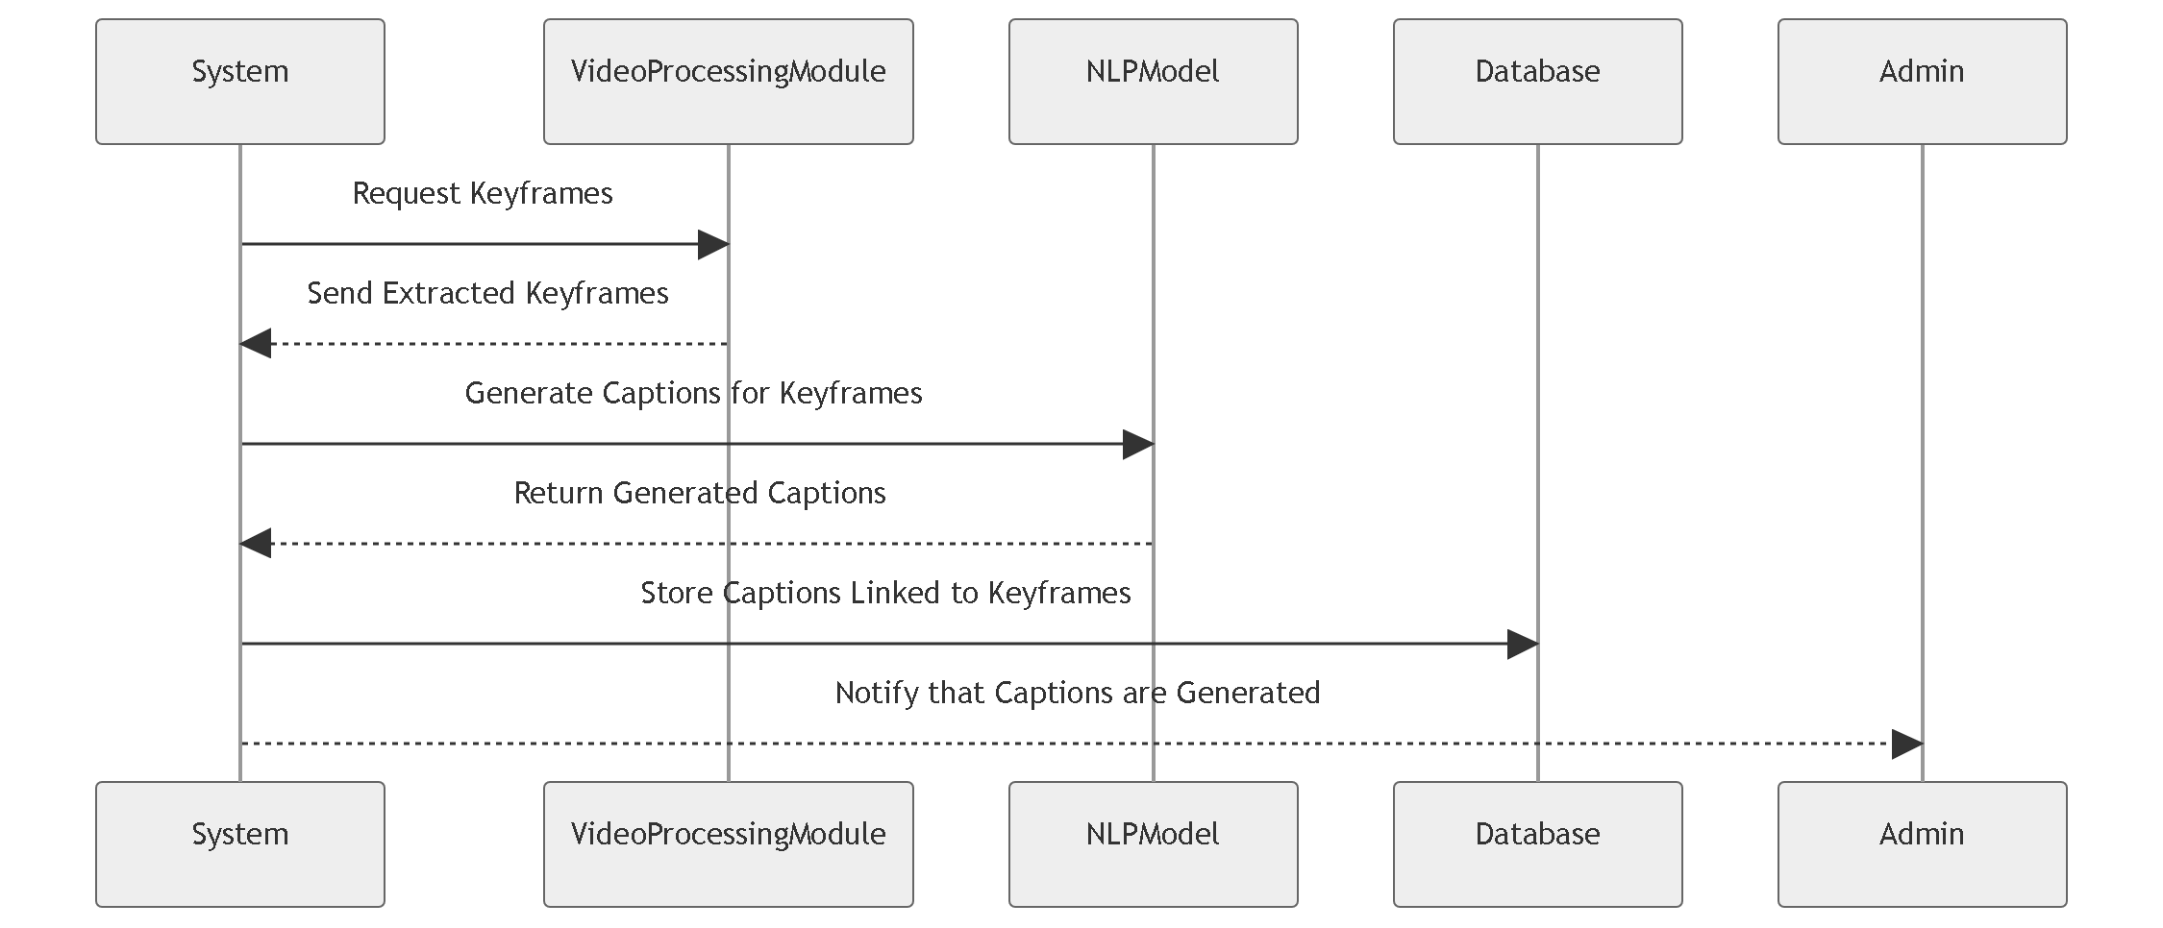
CAPTION GENERATION

Slide 18
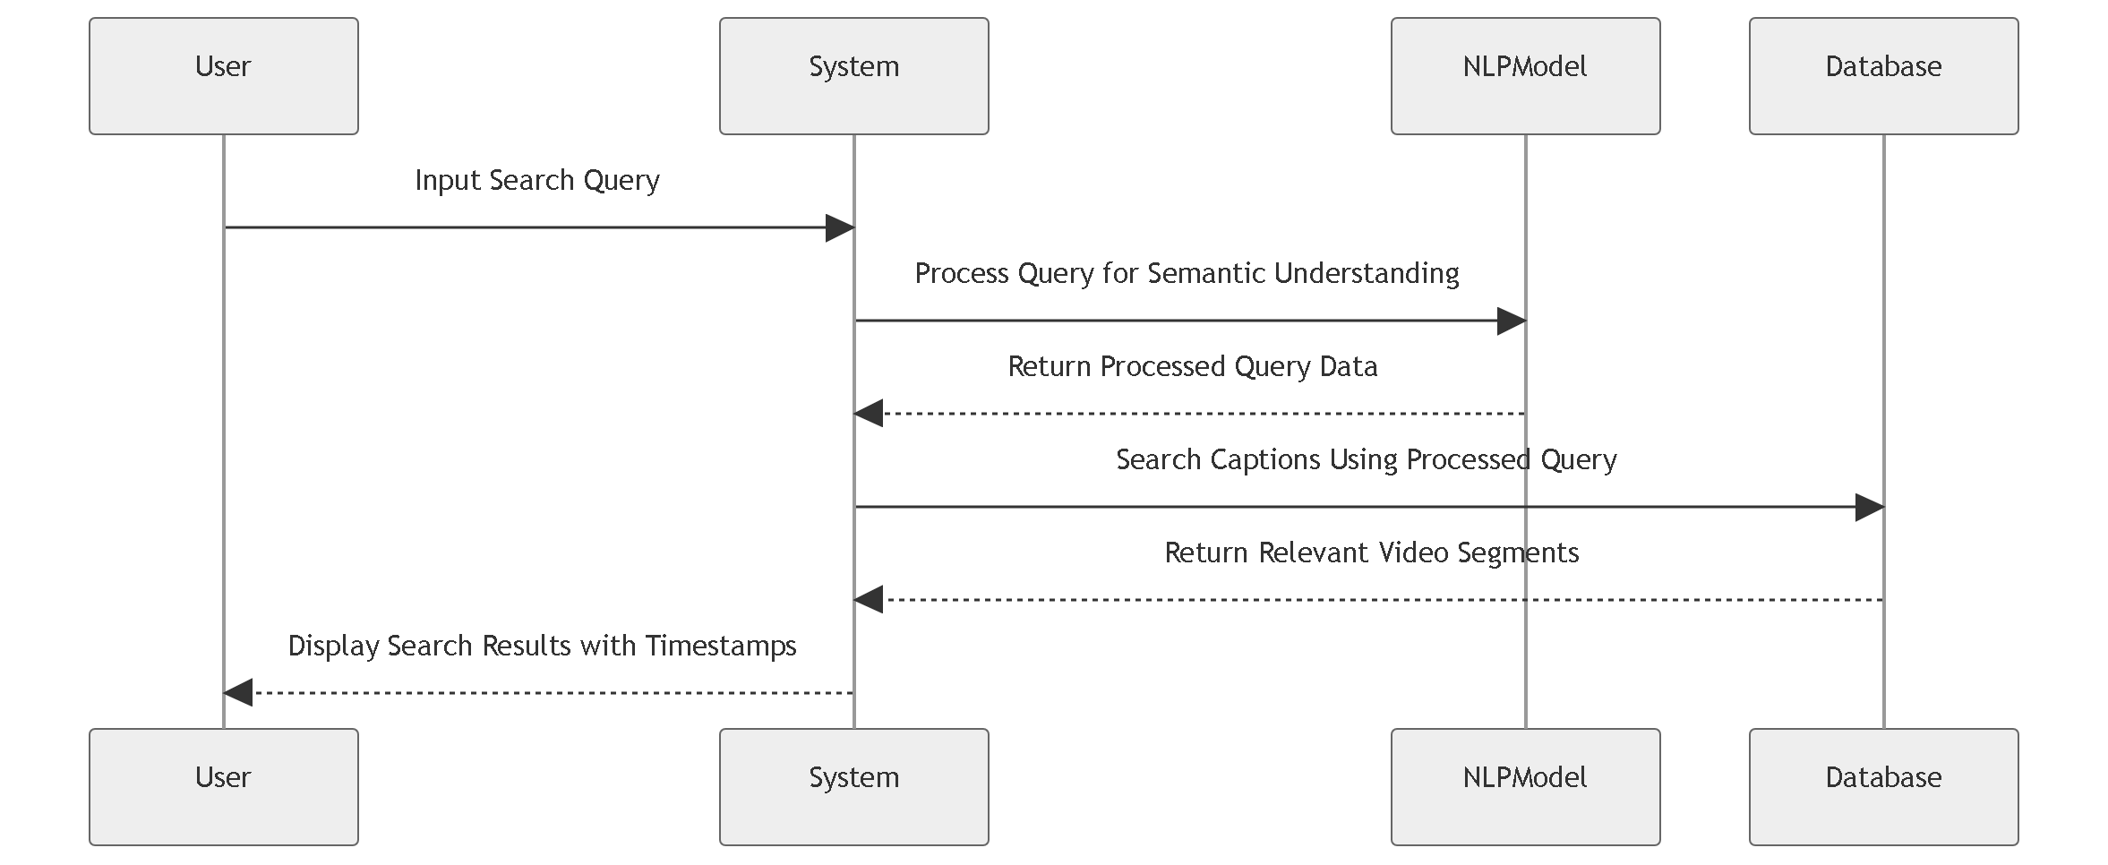
SEARCH QUERY PROCESSING

Slide 19
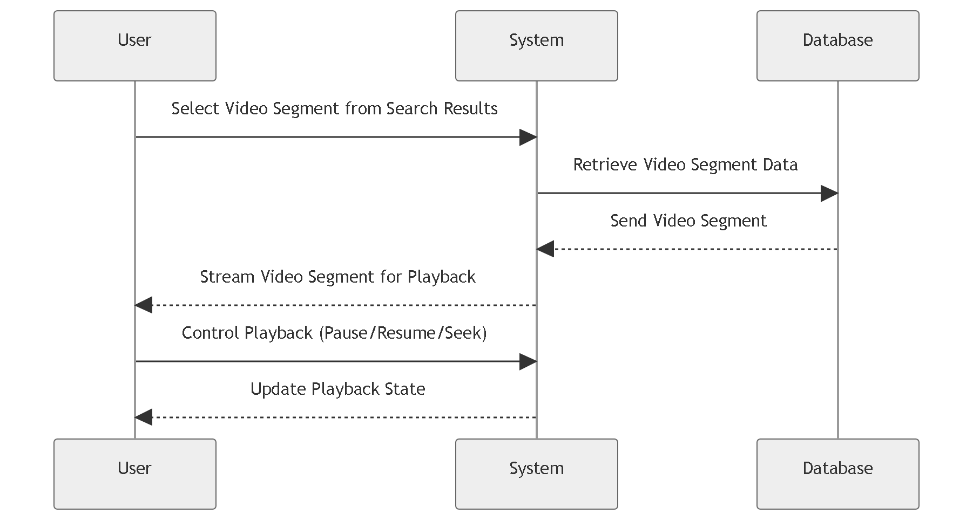
VIDEO PLAYBACK

Slide 20
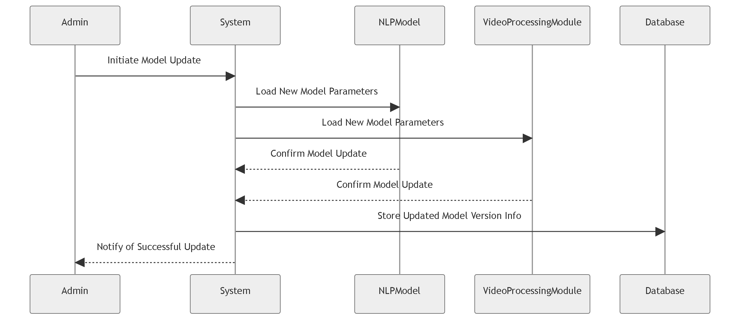
MODEL UPDATE (ADMIN FUNCTIONALITY)

Slide 21
User authentication

Slide 22
Software Requirements:
1. Python: Python is the primary programming language for this project, providing a versatile environment for various tasks.
2. Libraries:
• Transformers: Utilized for BERT-based embeddings and tokenization.
• Torch: Required for deep learning tasks.
3. Deep Learning Framework: The chosen framework for deep learning tasks, such as image captioning.
4. Text Editor or IDE: A code editor like Visual Studio Code for code development.
Hardware Requirements:
A dedicated GPU (NVIDIA CUDA-enabled) can significantly accelerate deep learning tasks, especially if working with large-scale video datasets.

Slide 23
conclusion
VidExplore Search streamlines video retrieval with advanced NLP and deep learning, enabling fast, intuitive access to key video moments. It enhances productivity and insight for educators, researchers, and creators, with future expansions planned for broader support and deeper analytics.

Slide 24
Thank you

