Slide 1
ACCENTURE × SUBAA · NOVACORP PEOPLE ANALYTICS CHALLENGE
What's driving the $42M
and where to act first
O for 4 · 15 August 2026

Slide 2
THE QUESTION YOU ASKED US
You asked what's driving $42M. We found you're counting $14M of it.
Finance sized the annual people cost at ~$42M across three buckets: regrettable attrition ($22–25M), disengagement ($12–15M), hiring inefficiency ($4–6M).
We did not set out to re-litigate that number. We set out to find which parts are tractable.
What we found first was a measurement problem, and it changes the shape of everything underneath it.
WHERE WE'RE GOING
1
What your data is hiding
2
Where the loss actually sits
3
What it's worth if you act
All of it uses your own numbers and Finance's own formulas.
2

Slide 3
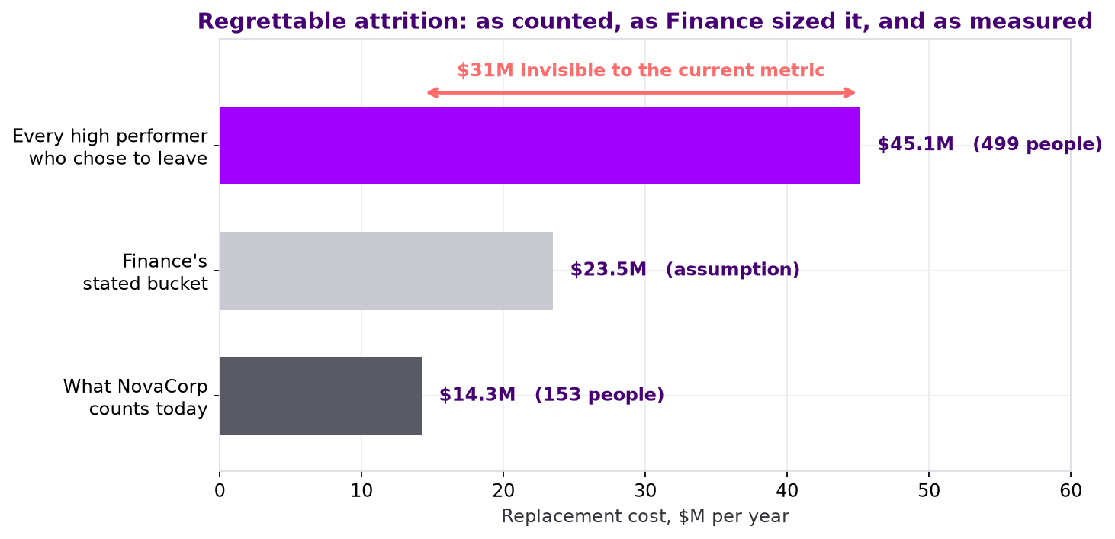
THE HEADLINE
You count $14.3M of regrettable attrition. The real figure is $45.1M.
HR's regrettable_flag fires on 153 departures over two years, which is $14.3M/yr.
Apply a value-based definition, every High Performer or Outstanding employee who chose to leave, and it is 499 departures → $45.1M/yr.
371 high-performing people walked out and were never recorded as a loss.
The same replacement-cost formula Finance gave us, applied to a population their flag excludes.
3

Slide 4
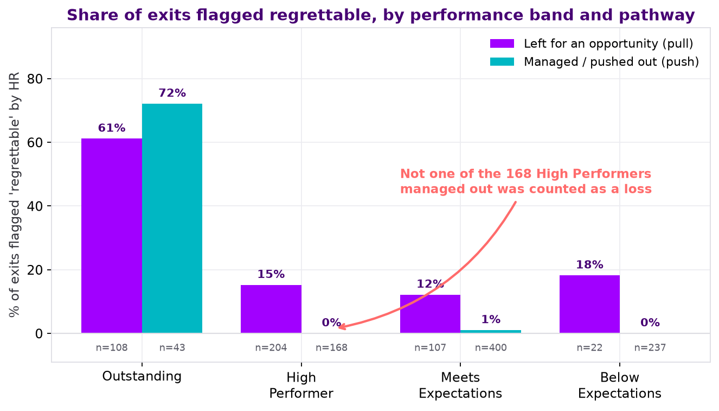
WHY THE FLAG MISSES THEM
The flag is a synonym for “Outstanding”, not a measure of value lost.
Flag rate by rating: Outstanding 61–72%. High Performer 15% (pull), 0% (push). Meets Expectations 12% / 1%.
Of the 168 High Performers who were managed out, zero were flagged regrettable. Not a low rate. Zero.
The flag is applied after the exit, by the same function that approved it. It records whether a departure was convenient, not whether it was costly.
Not bad faith. A retrospective, self-assessed metric that structurally exonerates the decision-maker is a justification, not a measurement.
4

Slide 5
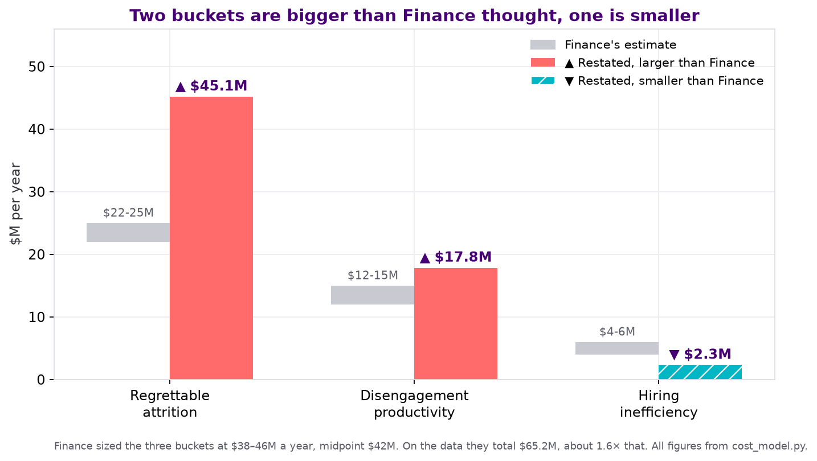
THE $42M, RESTATED
It isn't $42M. On your own formulas it's $65M, and the shape is different too.
Bucket | Finance | On the data
Regrettable attrition | $22–25M | $45.1M
Disengagement | $12–15M | $17.8M
Hiring inefficiency | $4–6M | $2.3M
Total | $38–46M | $65.2M
Only one of these moves in your favour, and it's the smallest one. The two that moved against you were both sized with a definition that excluded the expensive cases.
5

Slide 6
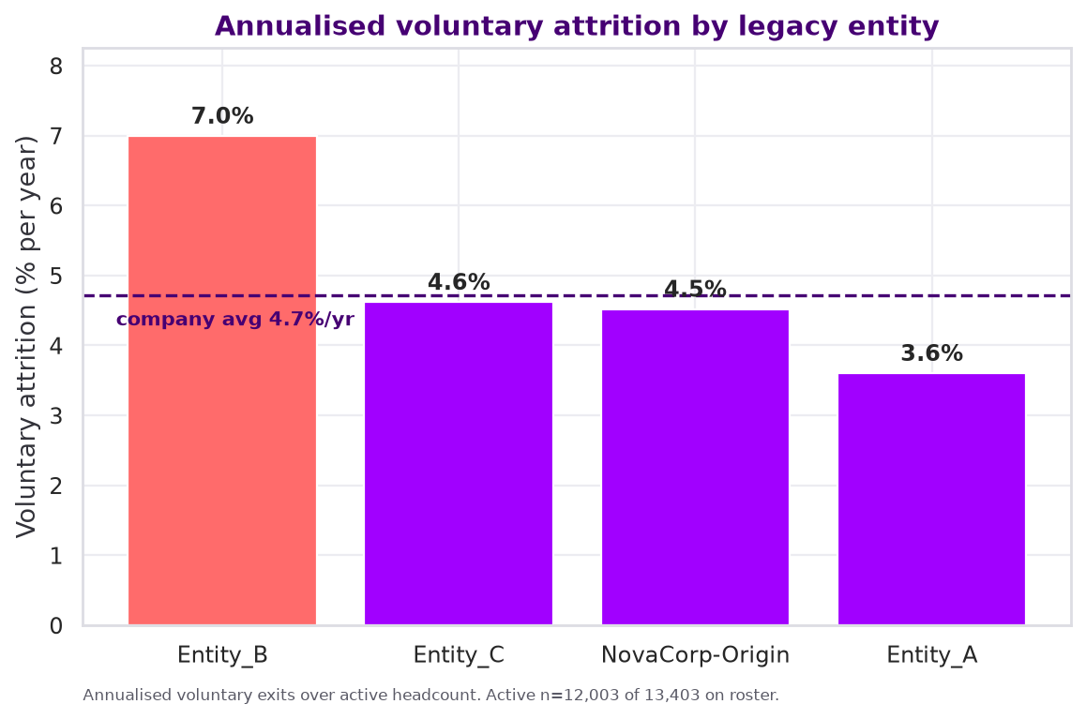
WHERE THE LOSS CONCENTRATES
Entity_B loses people at twice Entity_A's rate, and it's the one still on its own HR system.
NovaCorp-Origin 4.5% · Entity_A 3.6% · Entity_B 7.0% · Entity_C 4.6%, per year.
That gap is on 1,601 and 1,804 active staff. It is the clearest and most reliable finding in the whole analysis.
Entity_B was acquired in FY2023 and still runs on BambooHR, two years on. Entity_A was absorbed onto the core system and is now the healthiest cohort in the company.
It isn't department mix. Controlling for department, role level, pay and potential, Entity_B still leaves at 1.95× Entity_A (appendix A15).
Entity_B isn't where the most dollars sit. NovaCorp-Origin holds $29.2M of the $45.1M on headcount alone. Entity_B is where the leverage is: $8.4M in 1,601 people you already know how to fix.
6

Slide 7
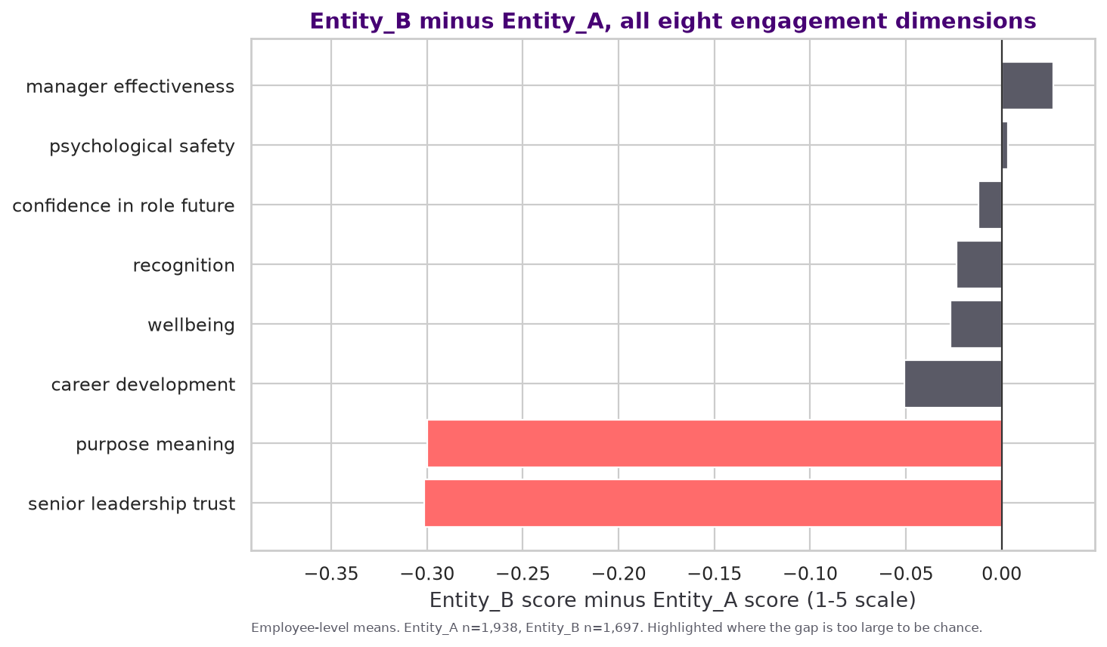
IT ISN'T PAY, AND IT ISN'T THEIR MANAGERS
Six of eight engagement dimensions are fine. Two collapsed.
Manager effectiveness: 3.344 vs 3.371. No meaningful difference.
Psychological safety: 3.351 vs 3.354. No meaningful difference.
Senior leadership trust is down 0.301 and purpose & meaning down 0.300 — far larger than any other gap, and the only two that are not explainable by chance.
And it isn't money. Entity_B sits at 0.961 compa-ratio against NovaCorp-Origin's 0.937. They are paid better and leave anyway.
Why it never showed on your dashboard: the composite index averages all eight dimensions, so two collapsed scores are diluted by six healthy ones. A gap of 0.085 that looks like nothing.
7

Slide 8
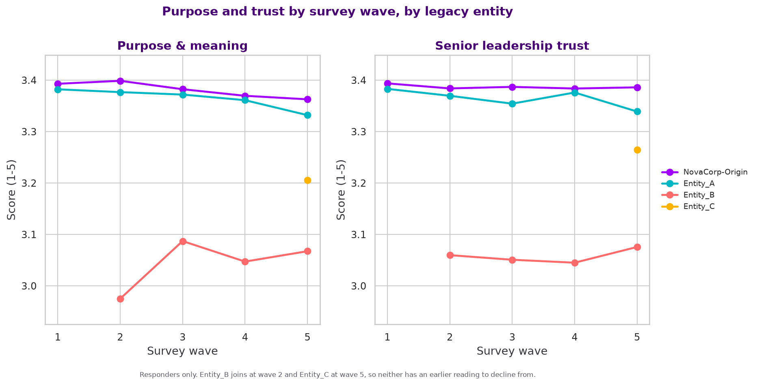
THEY ARRIVED THIS WAY, AND THEN WENT QUIET
There was no decline to detect. Entity_B's first-ever survey was already broken.
Entity_B's first measurement: purpose 2.975, trust 3.060, against NovaCorp-Origin's steady 3.38. A year later: 3.067. Flat.
Survey response rate: Entity_B 62.6% vs Entity_A 83.8%, 21 points lower.
307 employees were never issued a survey at all. 152 of the mid-window leavers among them sit on the Entity_B and Entity_C legacy systems.
They weren't silent. They were never asked.
8

Slide 9
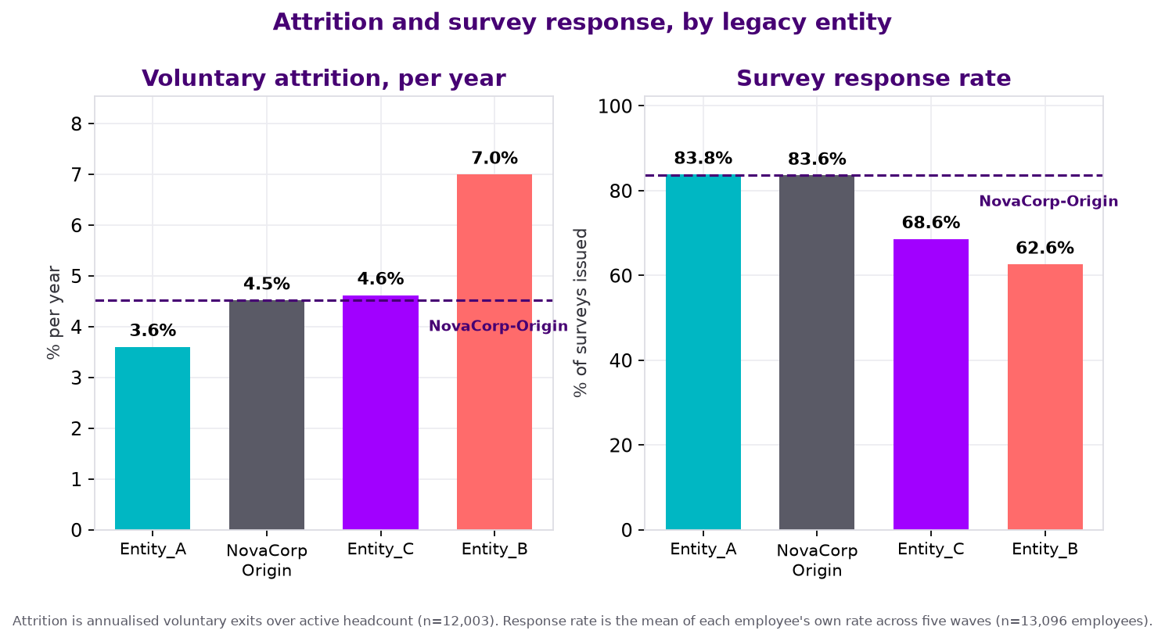
YOU'VE ALREADY SOLVED THIS ONCE
Entity_A is at 3.6%, below NovaCorp's own 4.5%. Integration works.
Entity_A (FY2022, fully integrated) is now the safest cohort in the company, better than NovaCorp-Origin itself.
Its survey response rate has recovered to 83.8%, indistinguishable from NovaCorp-Origin.
Entity_C (late FY2024) is at 4.6%, tracking with Entity_A rather than Entity_B. It is not a second Entity_B yet.
Track Entity_B against Entity_A's recovery, not against its own past or a generic benchmark. Entity_A is the only comparison that reflects this workforce.
9

Slide 10
WHAT TO DO
Three actions, in order. The first one is free.
1
Redefine what counts as a regrettable loss
~$0 · policy · this quarter
Include High Performer alongside Outstanding. Separate the flag from the function that approved the exit. Review quarterly. Restates your baseline immediately and fixes next year's $42M at source.
2
Finish the Entity_B integration, as a trust problem not a systems problem
inside the guided $40–50M FY26 integration budget
Migrate off BambooHR. Stabilise the Senior Manager layer first — Entity_B loses L3s at 9.8%/yr against Entity_A's 2.9%, a 3.4× gap — or there is nobody credible left to communicate the integration. Then leadership visibility and honest communication. Not manager training.
3
Measure acquired cohorts from day one, at cohort level
~$0
Baseline every acquired group against company norms at their first survey. Track response rate as a health metric in its own right. Fix the 307 who were never surveyed.
Notice what's not on this list: a pay round, a manager training programme, and cutting agency recruitment. The data rules out all three.
10

Slide 11
WHAT IT'S WORTH
$71M addressable. The cheapest lever is the largest.
Lever | Addressable | @20% | @40% | Cost to act
Redefine regrettable_flag + quarterly review | $45.1M | $9.0M | $18.1M | ~$0 (policy)
Disengagement (813 staff below 2.5) | $17.8M | $3.6M | $7.1M | programme-dependent
Early-tenure / acquisition onboarding | $7.9M | $1.6M | $3.2M | ~$500–800/head
of which Entity_B specifically | $6.2M | $1.2M | $2.5M
The 20% and 40% are assumptions, not findings. That's the band typically claimed for targeted retention programmes. We show both so the decision doesn't depend on the optimistic one. The first lever is a definition change, so its return isn't capped by budget at all.
11

Slide 12
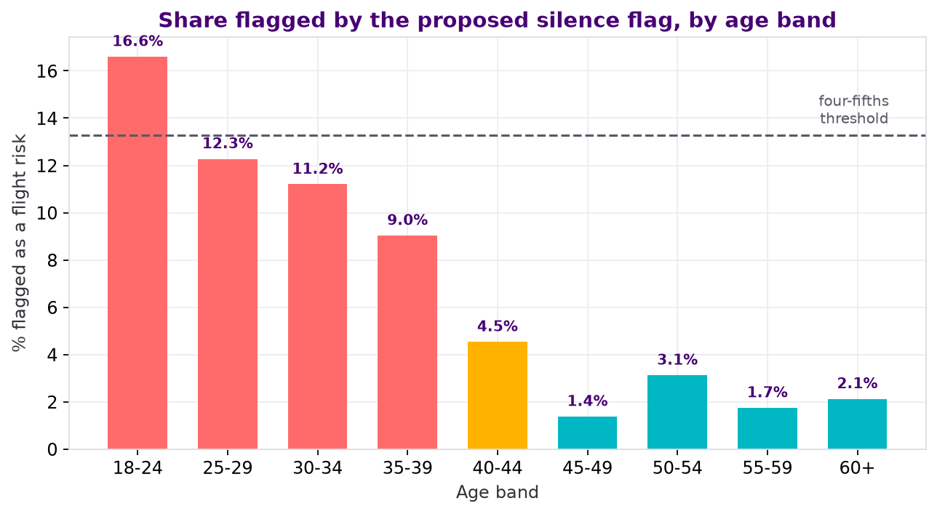
HOW NOT TO ACT ON THIS
A “who stopped answering” flag looks free. It flags 16.6% of 18–24s and 1.4% of 45–49s.
The obvious move from our own analysis is a flight-risk score built on survey silence. We recommend against deploying it at individual level.
It flags one age group twelve times more often than another, and shows the same pattern by role level (L1 9.2% vs L5 1.4%) and by acquisition cohort (Entity_C 31.7% vs NovaCorp-Origin 2.4%). That is the standard legal test for adverse impact, and it fails on all three.
It is also wrong most of the time: 901 false positives against 263 true ones, precision 23%. The dominant outcome is a career conversation about someone who was never leaving.
Low response is concentrated in the acquisition cohorts, so the flag is substantially measuring integration failure, not individual intent.
In a performance or redundancy conversation, this is a discrimination exposure that costs more than the attrition does.
12

Slide 13
HOW TO USE IT RESPONSIBLY
Team-level diagnostic, disclosed to staff, never an individual score.
1
Never as an individual score handed to a manager.
23% precision. Three in four flagged people were never leaving.
WHAT WE DELIBERATELY DID NOT DO
No demographic features in any model.
Gender, age and cultural background appear only as fairness-audit dimensions, never as predictors.
No individual employees or managers named.
Manager results aggregated, suppressed below 8 reports.
No causal language.
Association only. We never claim one thing caused another.
2
Team level only, minimum 8 responses.
Reported as a diagnostic, not a prediction.
3
Tell employees the participation metric exists.
If the survey was sold as confidential, quietly re-using non-response as a personal risk score breaks that promise. Once staff work it out, response rates collapse and you lose the instrument entirely.
13

Slide 14
WHAT WE CAN'T TELL YOU
Seven limits on what this analysis can support.
Two-year window, annualised. All rates are voluntary exits ÷ 2 years ÷ active headcount = 4.7%/yr. Your FY2025 Annual Report's “10.4% voluntary attrition” is total attrition including 267 involuntary exits across the full two years. It reproduces exactly as 1,400/13,403. We restate; we don't accuse.
We cannot see pre-acquisition Entity_B. They may have arrived unhappy from their previous employer. We genuinely cannot rule this out.
Engagement is only observed for responders, and leavers responded less, so every disengagement figure is a lower bound.
Association, not causation. Senior Manager churn and collapsed trust move together. We cannot say which drives which.
regrettable_flag, performance_band_at_exit and stated_exit_reason are retrospective HR judgements. We use them as the object of analysis, not as ground truth.
The 2025-H2 review cycle is missing, so performance data is up to 12 months stale for some leavers.
Small samples above Level 4. Nothing above L4 is reliable: 279 people at L4, 103 above it.
On a strict voluntary reading you have already met the FY2026 sub-9.5% target. That's worth resolving before the next board pack.
14

Slide 15
CLOSE
Start with the free one.
THIS QUARTER
THIS HALF
ONGOING
Redefine regrettable.
Finish Entity_B.
Baseline every acquired cohort from day one.
Cost ~$0. It restates your baseline and stops you funding a budget line built on a blind spot.
Senior Manager layer first, then leadership visibility. $8.4M concentrated, inside a budget you have already guided.
Entity_C is healthy today. It does not have to become the next Entity_B.
You already have the money set aside.
The Annual Report commits to a People Reinvention Programme three times. This is what we'd spend it on, and this is what we'd measure.
15

Slide 16
Appendix
A1 to A14. Method, assumptions, every test, and where each number comes from.

Slide 17
APPENDIX A1
Constants
Every constant below is published by Finance in the case brief §6. Nothing outside this table is used as a benchmark.
Constant | Value | Used for
Replacement cost multiplier | 1.50 × annual base salary | attrition buckets
Backfill rate | 85% of vacated roles | attrition buckets
Superannuation on-cost | 12.0% of base | all salary figures grossed up
Disengagement productivity loss | 15% of base salary/yr | disengagement bucket
Agency fee rate | 18% of first-year base | hiring bucket
Direct hire benchmark | $5,500 fully loaded | hiring bucket
The only numbers we introduce beyond this table are the 20% and 40% intervention-effectiveness rates on slide 11. Those are labelled as assumptions on the slide itself and shown at both ends, so no conclusion depends on the optimistic one.
A1

Slide 18
APPENDIX A2
Population decisions
The brief asks explicitly that these be documented. Each choice is stated with the reason it was made.
Decision | Choice | Why
Observation window | 1 Jan 2024 – 31 Dec 2025 = 2.0 years | Stated in brief §4. Every rate divided by 2 to annualise.
Attrition denominator | Active headcount (12,003) | A rate quoted against a roster that still contains leavers understates it.
Which exits count as cost | Voluntary only (1,133 of 1,400) | An involuntary exit is a decision the company made, not a loss it suffered.
“High value” | Band at exit ∈ {Outstanding, High Performer} | The only value proxy available at the point of exit.
Disengaged | Index < 2.5 over the 2 most recent responded waves | “Persistently”, per the brief. Single-wave dips are noise.
Non-responders | Retained, not dropped | Brief §4 warns these rows are intentional. They carry the silence signal.
Early-tenure population | Hired on/after 1 Jan 2024 only | Removes the left-truncation bias documented in A6 §1.1.
A2

Slide 19
APPENDIX A3
Cost formulas
Three formulas produce every dollar figure in the deck. All are the brief's own, applied to the populations defined in A2.
Replacement cost
1.50 × 0.85 × Σ(salary_at_exit × 1.12) ÷ 2.0
Applied to voluntary exits rated Outstanding or High Performer. Gives $45.1M/yr.
Disengagement
Σ(salary_active × 1.12) × 0.15
Applied to the 813 active staff whose index is below 2.5. Gives $17.8M/yr.
Agency premium
Σ max(salary × 0.18 − 5,500, 0) ÷ 2.0
Applied to the 274 agency hires made inside the window. Gives $2.3M/yr.
The early-tenure lever ($7.9M) uses the replacement-cost formula applied to the excess exits over a 6.4% NovaCorp-Origin new-joiner baseline, not to all early exits. Method in A7.
A3

Slide 20
APPENDIX A4
Fairness method and results
Four-fifths (80%) rule, the standard EEOC adverse-impact screen: a group's rate divided by the highest group's rate. Below 0.80 warrants investigation.
Flag tested | Dimension | Worst ratio | Detail | Verdict
Proposed silence flag | Age band | 0.08 | 18–24: 16.6% vs 45–49: 1.4% (n = 1,253 / 1,017) | Fails badly
Proposed silence flag | Role level | 0.15 | L1 9.2% vs L5 1.4% (n = 6,931 / 74) | Fails
Proposed silence flag | Acquisition cohort | 0.08 | Entity_C 31.7% vs NovaCorp-Origin 2.4% | Fails
HR regrettable_flag | Gender, within Outstanding leavers | 0.60 | M 74.6% / F 59.4% / NB 44.4% (n = 67 / 64 / 9) | Under-powered
The silence flag result is unambiguous. It fails on three dimensions at once, on groups of 900 to 1,900 people. This is why we recommend against individual-level deployment on slide 12.
The regrettable_flag result is suggestive but under-powered. With 9 non-binary staff in the comparison we report it as a governance risk requiring audit, not as established discrimination. Saying more than the sample supports would be the same error we are criticising.
A4

Slide 21
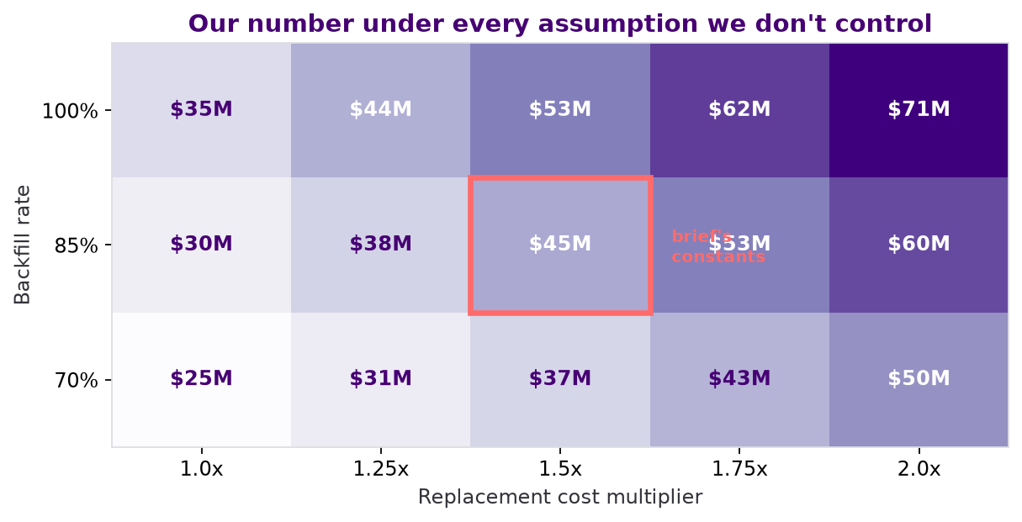
APPENDIX A5
Sensitivity
How the $45.1M headline moves across the two assumptions we do not control.
Full range across the grid: $24.8M to $70.8M.
We quote $34–56M as the defensible band, roughly ±25% around the brief's own constants.
Every cell in the grid exceeds the $14.3M currently counted. The finding does not depend on the assumption. That is the point of showing the grid rather than a single number.
A5

Slide 22
APPENDIX A6
Data quality register — issues found
The brief calls data preparation “a substantive analytical step, not a preprocessing formality”. This records every issue, and what we did about it.
# | Issue | What we did
1.1 | hire_date is a system-entry date for acquired staff. Entity_C's whole roster reads as under 9 months tenure. Material. | Restricted all early-tenure analysis to in-window hires, so everyone is observed from tenure 0. Changed the lever from $29.6M to $7.9M. See A7.
1.2 | The 2025-H2 performance cycle is absent, so band at exit can be up to 12 months stale. | Used performance band as a value proxy at exit, not a current-state measure, and flagged staleness wherever it carries a dollar.
1.3 | 307 employees have no engagement records. 171 were employed while surveys ran and were still never asked; 152 sit on Entity_B and Entity_C systems. | Excluded from the silence-flag population, because “never issued” is not “issued and declined”. Reported separately as a data-fragmentation finding.
1.4 | 10,264 rows have response_flag = False with null dimensions. Intentional, per the brief. | Retained every row. Response rate used as a variable in its own right. Scores averaged per employee before any group comparison.
1.5 | “Push” does not mean disengagement-driven. 267 of 955 push exits are involuntary. Definitional. | Removed any claim that 68% push implies 68% preventable. All cost figures use voluntary exits only.
1.6 | Small samples above Level 4: L5 78, L6 16, L7 8, L8 1. | Report nothing above L4 as a finding. Where a senior gap appears, state the n and decline to conclude.
1.7 | The Annual Report's “voluntary attrition” is total attrition over two years on the full roster. | Restated as annualised voluntary on active (4.7%/yr) and footnoted the denominator on every slide carrying a rate.
A6

Slide 23
APPENDIX A6
Data quality register — checks that came back clean
Nine integrity checks across the four files, and what each returned.
Check | Result
Duplicate employee_id in employees.csv | 0
attrition_log rows with no matching employee | 0
Employees marked departed with no attrition record | 0 — exact 1:1 on all 1,400
exit_date disagreement between the two files | 0 of 1,400
salary vs salary_at_exit disagreement | 0 of 1,400
Date formatting variation | None — all YYYY-MM-DD across all files
Negative or impossible tenure values | 0
Survey rows dated after an employee's exit date | 0 — the link is not an artifact
Nulls outside the two expected fields | None
WHAT THIS MEANS
The data is materially cleaner than the brief's framing implies.
The substantive issues are semantic, not structural. Fields that are well-formed but do not mean what their names suggest: hire_date, pathway, and the Annual Report's “voluntary attrition”.
That is the harder failure mode to catch, and it is where our data-preparation effort went.
A6

Slide 24
APPENDIX A7
Early-tenure correction: $29.6M → $7.9M
The largest single correction we made to our own work. Reproduces with cost_model.py §3 and §5, cross-checked independently by cost_fix2.py.
WHAT WAS WRONG
THE FIX
The original defined an early exit as anyone departed with tenure ≤ 12 months, measured against all hires of that source.
But 94.7% of NovaCorp-Origin staff were hired before the window opened, so we never see their first year. Entity_C cannot contain anyone above 9 months' tenure, so 100% of its exits are early exits by construction.
The comparison measured who we can observe, not who leaves early.
Cohort | n | early exits | rate
NovaCorp-Origin | 455 | 29 | 6.4%
Entity_C | 1,014 | 85 | 8.4%
Entity_B | 1,884 | 192 | 10.2%
Restricted to people hired inside the window, so everyone is observed from tenure 0. Cross-checked with a left-truncated Kaplan-Meier.
Cohort | rate vs 6.4% baseline | excess exits | cost
Entity_B | 10.2% | 72 | $6.2M/yr
Entity_C | 8.4% | 20 | $1.8M/yr
Total |  | 92 | $7.9M/yr
Only the excess over baseline is addressable. The old figure counted the ~6.4% early attrition every employer carries. Two claims were retracted with it: see A12.
A7

Slide 25
APPENDIX A8
Statistical test register — findings we rely on
Every comparison in this deck, the test behind it, and the result. Run with scipy.stats, threshold p < 0.05. Survey comparisons average each employee across waves first, so nobody is counted five times. Attrition rates are annualised voluntary on active headcount.
# | Claim | Test | Result | p | n
1 | Attrition differs by legacy entity | Chi-square, 4 groups | 4.5 / 3.6 / 7.0 / 4.6 %/yr | 6.7×10⁻⁹ | 12,003
2 | Entity_B vs Entity_A specifically | Chi-square, pairwise | 7.0% vs 3.6%/yr | 8.0×10⁻⁹ | 1,601 / 1,804
3 | Senior leadership trust collapsed | Welch's t | 3.352 → 3.051 (−0.301) | 1.5×10⁻²⁵ | 1,938 / 1,697
4 | Purpose & meaning collapsed | Welch's t | 3.358 → 3.058 (−0.300) | 2.6×10⁻²⁵ | 1,938 / 1,697
5 | …and holds among active staff only | Welch's t | same direction | 4.6×10⁻²⁵ | active only
6 | Manager effectiveness is NOT different | Welch's t | 3.344 vs 3.371 | 0.35 — null | 1,938 / 1,697
7 | Psychological safety is NOT different | Welch's t | 3.351 vs 3.354 | 0.91 — null | 1,938 / 1,697
8 | Entity_B response rate is lower | One-way ANOVA | 83.6 / 83.8 / 62.6 / 68.6 % | 7.0×10⁻³⁰⁴ | 13,096
9 | Entity_B is paid above NovaCorp-Origin | One-way ANOVA | 0.937 / 0.959 / 0.961 / 0.962 | 2.2×10⁻⁷¹ | 13,403
10 | Entity_B loses Senior Managers (L3) | Chi-square | 2.9% vs 9.8%/yr | 0.0047 | 140 / 123
11 | HIPO staff leave at 1.6× | Chi-square | 7.3% vs 4.5%/yr | 1.2×10⁻⁷ | 12,003
12 | Attrition NOT concentrated under bad managers | Chi-square goodness-of-fit | worst 10% hold 18.4% of exits | 0.9957 — null | 1,196 mgrs
13 | Regrettable flag ≠ value-based definition | Chi-square | 97 of 312 overlap | <10⁻⁶ | 1,400
14 | Entity_B new joiners leave early more | Two-proportion z | 10.2% vs 6.4% | 0.012 (z=2.50) | 1,884 / 455
15 | Composite engagement barely differs | One-way ANOVA | 3.377 / 3.366 / 3.280 / 3.346 | 2.5×10⁻⁹ — trivial | 13,096
Row 15 is deliberately included. A significant p-value on a 0.085-point gap is the clearest illustration of why significance is not importance.
A8

Slide 26
APPENDIX A8
Statistical test register — the nulls that matter
Findings that came back null. Each one rules out an expensive intervention, which makes them as load-bearing as the positives.
Claim tested | Test | Result | p | Why the null matters
Manager effectiveness differs in Entity_B | Welch's t | 3.344 vs 3.371 | 0.35 | Rules out a manager training programme, the most expensive obvious response
Psychological safety differs in Entity_B | Welch's t | 3.351 vs 3.354 | 0.91 | Rules out a team-climate intervention
Entity_B is underpaid | One-way ANOVA | 0.961 vs 0.937 — paid above | 2.2×10⁻⁷¹ | Rules out a retention pay round. They are paid better and leave anyway
Attrition concentrates under bad managers | Chi-square GoF | worst 10% hold 18.4% | 0.9957 | Rules out performance-managing a manager tail
Purpose separates leavers within Entity_B | Welch's t | 2.929 vs 3.070 | 0.084 | Rules out individual targeting on purpose scores
Entity_A vs Entity_C attrition | Chi-square | 3.6% vs 4.6%/yr | 0.101 | Entity_C is not a second Entity_B — yet
Three of the six nulls each rule out a seven-figure programme. Slide 10's “notice what's not on this list” rests entirely on this page.
A8

Slide 27
APPENDIX A9
Glossary
No statistics background assumed. Every term used in this deck, in plain English.
p-value
If there were no real difference between two groups, how surprising would a gap this big be from luck alone? Below 0.05 by convention. It is not the size of an effect.
Statistically significant
Shorthand for “unlikely to be a coincidence”. It does not mean big or important.
Chi-square test
Used when comparing rates or categories between groups.
Welch's t-test
Used when comparing the average of a number between two groups.
Left truncation
When people only become visible partway through their tenure. Ignoring it makes newer cohorts look like they leave faster. See A6 §1.1.
Pseudo-replication
Counting the same person once per survey wave, which makes results look more certain than they are. Avoided here.
Four-fifths rule
The standard EEOC adverse-impact screen. Below 0.80 warrants investigation.
Precision / recall
Of everyone a flag identifies, precision is the share who actually leave. Recall is the share of leavers it catches.
Compa-ratio
Salary divided by the midpoint of the pay range for that role and level. 1.00 = paid exactly at midpoint.
HIPO
“High potential.” A talent-review tag marking a likely future leader. Separate from a performance rating.
Push vs pull
Push = the organisation drove or managed the exit. Pull = an outside opportunity drew them away. Push includes genuinely involuntary exits and does not mean disengagement-driven.
Regrettable attrition
HR's label for a departure the company didn't want. Here it is a retrospective judgement recorded after the exit, not a measurement. That is the subject of slides 3 and 4.
Composite index
One number made by averaging several scores. It can hide a serious problem in one component by averaging it against healthy ones, which is what happened to Entity_B.
Backfill rate
The share of vacated roles actually refilled, 85% per the brief. Unfilled roles incur no replacement cost.
FAR
Financial Accountability Regime. Australian legislation effective March 2024 imposing personal accountability on senior financial executives. Named in NovaCorp's Annual Report as a driver of Risk & Compliance attrition.
A9

Slide 28
APPENDIX A10
Annual Report reconciliation
We cross-checked against NovaCorp's published FY2025 Annual Report to confirm we describe the same workforce. Headcounts matched exactly. The attrition metric did not match its label.
Department | AR “voluntary attrition” | Our total attrition | Our voluntary only | Annualised voluntary on active
Retail Banking | 9.3% | 9.3% | 7.7% | 4.2%
Technology | 10.4% | 10.4% | 8.5% | 4.7%
Risk & Compliance | 11.8% | 11.8% | 9.6% | 5.5%
Insurance | 10.3% | 10.3% | 8.0% | 4.5%
Wealth Management | 10.5% | 10.5% | 7.9% | 4.4%
Corporate Operations | 11.6% | 11.6% | 9.7% | 5.5%
Executive Leadership | 8.3% | 8.3% | 7.4% | 4.0%
Group | 10.4% | 10.4% | 8.5% | 4.7%
Active employees, departures and all seven department headcounts matched the Annual Report exactly, which is what makes the attrition column meaningful. We restate the metric and flag the definition gap. We do not use it as an accusation.
A10

Slide 29
APPENDIX A11
Reproducibility
Every figure in this deck regenerates from the four supplied CSVs. No seeds, no sampling, no external benchmarks.
Script | Produces
ethics_finance/cost_model.py | Every dollar figure in the deck, the Annual Report reconciliation, the sensitivity grid and the entity attrition table
ethics_finance/ethics_audit.py | Flag consistency, all four-fifths tests, flag precision and recall
ethics_finance/make_figures.py | The six E-charts, including E6 on slide 5
explore_part1.py | Part 1's 21 charts, including slide 6's entity chart
explore_pt2/explore_part2.py | Part 2's 15 charts and 18 findings, including slides 7 and 8
recommendation/cost_fix2.py | Independent cross-check of the corrected early-tenure lever
recommendation/reconcile_deck_numbers.py | The denominator audit and population table behind A2 and A14
recommendation/make_deck_figures.py | Slide 9's entity recovery chart
recommendation/build_deck.py | This deck
Dependencies are pinned in requirements.txt. From a clean clone: create the venv, install, then run each script from its own directory. Two independent implementations agree on the early-tenure lever; four agree on the entity rates.
A11

Slide 30
APPENDIX A12
What we cut, and why
Decided deliberately, not by running out of room. All remain in the repo and are defensible if raised.
Finding | Why it is not in the deck
Recognition gap — under-recognised high performers leave at 9.6% vs 8.1% | A 1.2× lift is weak next to Entity_B's 1.9×. Doesn't survive a “how big is that really?” question.
Pay equity by level and gender | Gaps are ≤1.0pt where samples are large, and only appear at L5–L7 where n < 80. Leading with pay also contradicts slide 7, where Entity_B is paid above NovaCorp-Origin and leaves anyway.
“Frozen middle” — attrition flat across L1–L4 | A null result. Useful for ruling out a middle-management framing, but no recommendation attaches to it.
Manager Pareto and psychological safety by team | The manager finding is now a negative. It appears on slide 10 as something we rule out, so it does not need its own slide.
“68% of exits are push, therefore preventable” | Cut on correctness, not space. Push includes 267 involuntary exits; the brief defines it as involuntary-or-managed, not disengagement-driven. See A6 §1.5.
“Employees go silent before they quit” | Cut on correctness. There is no pre-exit decay. Leavers respond at 70.6% in wave 1 and 70.3% in wave 5, and the gap to stayers narrows. Reframed on slide 8 as a stable signal available from arrival.
“91% of early exits are acquisition-sourced” and “agency is one of our best sources” | Both retracted. Artifacts of the left-truncation problem in A6 §1.1. On a like-for-like population agency is the second-worst source, not the second-best. See A7.
A12

Slide 31
APPENDIX A13
Risk & Compliance, and the department view
NovaCorp's Annual Report singles out Risk & Compliance. We looked, and it is real — but it is not where we would act first.
Department | High-value exits | Cost/yr | Roster | High-value loss rate
Corporate Operations | 82 | $7.7M | 1,509 | 5.4%
Risk & Compliance | 83 | $8.0M | 2,022 | 4.1%
Wealth Management | 59 | $5.5M | 1,549 | 3.8%
Insurance | 67 | $6.1M | 1,781 | 3.8%
Retail Banking | 107 | $9.3M | 3,280 | 3.3%
Technology | 96 | $8.0M | 3,032 | 3.2%
Executive Leadership | 5 | $0.5M | 230 | 2.2%
The Annual Report is right to be concerned. R&C loses high-value people at a materially higher rate than the large divisions. Technology carries 50% more headcount and loses the same dollars.
Corporate Operations is worse still, at 5.4%, and appears nowhere in the Annual Report's commentary. We raise it as a finding requiring follow-up, not a recommendation, because we have not established a mechanism.
Why we didn't lead with R&C. FAR imposes personal liability on senior regulatory staff from March 2024. That is a pull problem in a tight external market, and the classic response is compensation benchmarking, which the Annual Report already commits to. We would be recommending what NovaCorp has already decided to do.
Entity_A is the proven precedent. It ran the same integration and now sits at 3.6%/yr, below NovaCorp-Origin's own rate. There is no equivalent proof that a compensation response fixes FAR-driven regulatory attrition.
Both cuts are in the data and both are correct. We chose the one with an identified cause, a proven fix and a guided budget already attached.
A13

Slide 32
APPENDIX A14
Where every number comes from
Each figure quoted on a slide, traced to the script that produces it. Run the script, get the number. Two independent implementations agree on the early-tenure lever; four agree on the entity attrition rates.
Slide | Figure | Value | Source
3 | Regrettable as counted / value-based | $14.3M → $45.1M | cost_model.py §1
3 | High performers never counted | 371 | cost_model.py §1
5 | Three buckets restated | $45.1M · $17.8M · $2.3M | cost_model.py §1–3
5 | Restated total against Finance's $42M | $65.2M | cost_model.py
6 | Attrition by legacy entity | 4.5 / 3.6 / 7.0 / 4.6 %/yr | cost_model.py §6
6 | Entity_B concentration | $8.4M in 1,601 active | cost_model.py §5
7 | Trust and purpose gaps | −0.301 and −0.300 | explore_part2.py §7g
7 | Compa-ratio | 0.961 vs 0.937 | explore_part2.py §7f
8 | Entity_B first survey | purpose 2.975, trust 3.060 | explore_part2.py §7i
9 | Entity_A recovery | 3.6%/yr, 83.8% response | make_deck_figures.py
10 | Senior Manager gap | 9.8%/yr vs 2.9% | explore_part2.py §7h
11 | Lever table, all rows | $45.1M / $17.8M / $7.9M / $6.2M | cost_model.py §5
12 | Four-fifths ratios | 0.08 age · 0.15 level · 0.08 cohort | ethics_audit.py §3
12 | Flag precision | 263 true / 901 false, 22.6% | ethics_audit.py §4
14 | Annualised voluntary rate | 4.7%/yr | cost_model.py §0
14 | Annual Report reconciliation | 1,400 / 13,403 = 10.4% | cost_model.py §0
Method notes for the figures restated during the build are in A6 §1.5, §1.7 and A7.
A14

Slide 33
APPENDIX A15
Does the Entity_B finding survive controls?
The obvious challenge to slide 6 is that Entity_B might simply sit in departments or levels that lose people anyway. We tested it. It does not.
Model | Entity_B vs Entity_A | 95% CI | p
Controlling for department, role level, pay and high-potential status | 1.95× | 1.55 – 2.44 | 8.4×10⁻⁹
…and additionally for tenure | 1.92× | 1.53 – 2.41 | 1.6×10⁻⁸
The effect holds either way. Slide 6 quotes a 1.9× rate ratio. The adjusted odds ratio is 1.95, so the headline is not an artifact of what Entity_B does or where it sits.
Department explains very little. Only one of six department terms reaches p < 0.05, and every odds ratio sits between 0.77 and 1.00. Risk & Compliance is exactly 1.00 once entity is in the model.
High-potential status replicates independently. OR 1.59 (p = 3.6×10⁻⁶) here, against the 1.64× lift in A8 test 11 computed a different way.
WHY TENURE IS REPORTED SEPARATELY
tenure_months is the system-entry artifact from A6 §1.1, so for the acquired cohorts it is close to a restatement of entity itself:
Entity_C 0–9 months · Entity_B 0–20 · Entity_A 7–33 · NovaCorp-Origin 0–462
Controlling for it is close to controlling for the thing being measured, so we report both models rather than picking the flattering one. Baseline is Entity_A because that is the comparison the deck makes. NovaCorp-Origin is the worst choice of baseline here, since it is the cohort the artifact distorts most.
This does not establish cause. It rules out the most likely confounders, which is a different and weaker claim, and the one we make.
A15

Slide 34
APPENDIX A16
What to measure, and when you can actually read it
Targets are Entity_A's current position. Milestones are paced to the survey cadence NovaCorp actually runs.
Metric | Entity_B today | Target (Entity_A today) | First readable | Why this one
Survey response rate | 62.6% | 83.8% | Next wave | Moves first and costs nothing to measure. The leading indicator.
Senior leadership trust | 3.051 | 3.352 | Next wave | One of the two dimensions that actually collapsed.
Purpose & meaning | 3.058 | 3.358 | Next wave | The other one.
Employees never surveyed | 152 on B and C systems | 0 | Next wave | You cannot manage a cohort you are not asking. Fixable before the wave issues.
Senior Manager (L3) attrition | 9.8%/yr | 2.9%/yr | 2 quarters | The layer that has to carry the integration message.
Voluntary attrition | 7.0%/yr | 3.6%/yr | 3–4 quarters | The outcome. Moves last, so do not judge the programme on it early.
BEFORE THE NEXT WAVE
Redefine the regrettable flag, separate it from the function that approves exits, restate the baseline, and add the 152 unsurveyed staff to the issue list. All policy, all ~$0.
AT THE NEXT WAVE
The first real read. Response rate and the two collapsed dimensions, against Entity_A's trajectory rather than Entity_B's own past. Attrition will not have moved.
THE WAVE AFTER
Confirm direction rather than declare success. Two consecutive wave-on-wave improvements in response rate is the earliest defensible signal.
Anchored to waves, not days: NovaCorp's ran 122, 92, 123 and 181 days apart, mean 4.2 months and widening. A 90-day plan would promise a reading the cadence cannot deliver — and a leading indicator read twice a year is not a leading indicator.
A16

Slide 35
APPENDIX A17
Model card — cohort diagnostic
Intended use, prohibited use, and known limits for the accompanying dashboard.
INTENDED USE
• Cohort-level diagnostic for HR and integration leads.
• Identifying which parts of the organisation resemble Entity_B before its attrition rose, so integration effort can be directed.
• Tracking cohorts against the A16 measures over time.
PROHIBITED USE
• Any decision about an individual. The file contains no employee, manager or team identifier, so this is enforced by construction rather than by policy.
• Performance management, redundancy selection, or promotion input.
• Publishing cohort scores to managers without the fairness context in A4.
KNOWN LIMITS
• Diagnostic, not predictive. It has no validated forward accuracy and none is claimed.
• Engagement is observed only for responders, so every score is a lower bound on a partially observed population.
• Component weights (40/40/20) are a judgement, not a finding. They are shown separately in the tool so the score can be audited.
• Eight cohorts covering 44 people are suppressed below the response floor.
Why there is no individual-level version
We built and tested one. On the four-fifths rule it returns impact ratios of 0.08 on age, 0.15 on role level and 0.08 on acquisition cohort, and its precision is 22.6% — 901 false positives against 263 true ones. Low response is concentrated in the acquisition cohorts, so at individual level the flag would substantially be measuring integration failure rather than intent, so we did not ship it.
If a participation metric is ever used, staff should be told it exists. A survey sold as confidential and quietly re-used as a risk score costs you the instrument.
A17

Slide 36
APPENDIX A18
Questions we expect — the number
Prepared answers, with the page that backs each one. Anyone on the team can present from this.
“Your number is double Finance's. Which is right?”
Both, for different questions. Finance priced the departures HR flagged. We priced the departures that cost you money. The gap is the finding, not a disagreement about arithmetic — we used their formula and their constants.
Slides 3–5
“Your buckets total $65M, not $42M. Haven't you just inflated the problem?”
Two of the three moved against you and one moved in your favour, and we show all three. The hiring bucket you were most worried about is the smallest thing here at $2.3M against Finance's $4–6M. If we were inflating, that is the number we would have left alone.
Slide 5
“How confident are you in $45.1M?”
It is a point estimate on your own constants. The defensible range is $34–56M, varying the replacement multiplier 1.0–2.0× and backfill 70–100%. Every cell in that grid is above the $14.3M you currently count, so the finding does not depend on the assumption.
A5
“You changed your own figure from $29.6M to $7.9M. Why trust the rest?”
Because we found it, said so, and showed the method. The original counted the baseline early attrition every employer carries as if it were addressable. Correcting it cost us $21.7M of headline and is the reason to believe the numbers we kept.
A7
“How do we know any of these numbers are right?”
Every figure on a slide traces to the script that produces it, listed page by page. Two independent implementations agree on the early-tenure lever to the dollar; four agree on the entity attrition rates to the decimal. Run them yourself.
A14, A11
A18

Slide 37
APPENDIX A18
Questions we expect — the recommendation
Continued.
“Are you telling me my HR team is dishonest?”
No. The flag was almost certainly built to spot top-talent loss, and it does that for Outstanding. The failure is that it was then used as a cost metric, which it was never designed to be. That is a governance gap, not a personnel matter.
Slide 4
“Isn't Entity_B just sitting in your worst departments?”
No. Controlling for department, role level, pay and high-potential status, Entity_B still leaves at 1.95× Entity_A (95% CI 1.55–2.44). Only one of six department terms is significant, and Risk & Compliance comes out at exactly 1.00 once entity is in the model.
A15
“Entity_B is only 1,601 people. Why should I care?”
You shouldn't care about it for the dollars — NovaCorp-Origin holds $29.2M of the $45.1M on headcount alone. You should care because it is the one place where the cause is identified, the fix is proven inside your own company, and the budget is already guided.
Slides 6, 9
“Can't I just run the silence flag? It's free.”
At team level, yes. As an individual score it fails the four-fifths rule on age by a factor of twelve and is wrong roughly three times in four. If it ever surfaced in a performance or redundancy conversation, the exposure would cost more than the attrition does.
Slides 12–13, A4
“What would change your mind?”
Pre-acquisition Entity_B engagement data. If they arrived unhappy from their previous employer, the integration story weakens considerably and we cannot currently rule that out. A shorter survey cadence would also test it: if response rate does not move within two waves of the flag change, our leading indicator is wrong.
Slide 14, A16
A18

