Slide 1
AI/ML/RL based techniques for Judicial Analytics and Efficient Court Management
BTP-1 Presentation by
Atishay Jain
20CS30008
Under the Supervision of
Prof. Partha Pratim Chakraborti

Slide 2
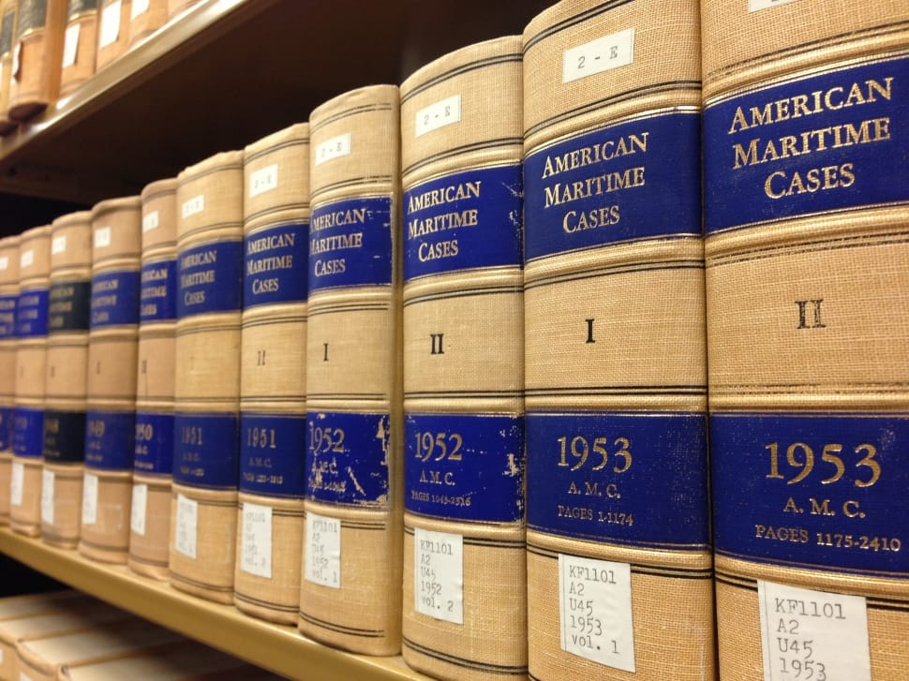
Background
LegalNLP, an emerging field, leveraging the advancements in language technology and NLP enhances legal processes.
AI-based Language Models, like Judgement Prediction, have recently been proposed for the legal sector.
But challenges persist in dealing with issues of hallucination
Models may pick up social biases from the training data.

Slide 3

Literature Review
In-group bias in Indian Judiciary: Analysis of a 5-million-case dataset from 7000 Indian district and subordinate courts (2010-2018) reveals almost negligible bias in criminal proceedings.
How ready are pre-trained abstractive models and llms for legal case judgement summarization?: abstractive summarization models generally achieve slightly higher scores than extractive models, but are not yet ready for fully automatic deployment for case judgement summarization.

Slide 4

Problem Statement
4.3 crore pending cases, primarily in district courts, the highest global record for case backlog.
Develop a model that predicts the outcome of bail requests
Analyse the results and find the scope for improvement.
Use different methods and more parameters

Slide 5

What did we do?
Utilized the concept of topic modeling for selecting a few keywords from a given document.
Augmented these with additional relevant terms to create a concise representation of the case document.
So, each case document is represented as a set of few keywords.
Trained classifiers using these as input parameters.
Combined the output of these classifiers to generate the best output.
Analysis of the result and iterative improvements.

Slide 6

Dataset
Hindi Legal Documents Corpus (HLDC)
912,568 raw documents in Hindi from district courts of Uttar Pradesh after OCR and NER
Segmented into facts-and-arguments and judge's opinion section
Contains the district, case number and bail decision

Slide 7
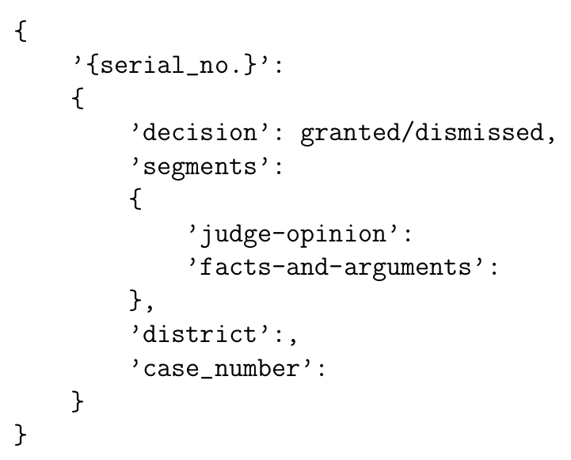
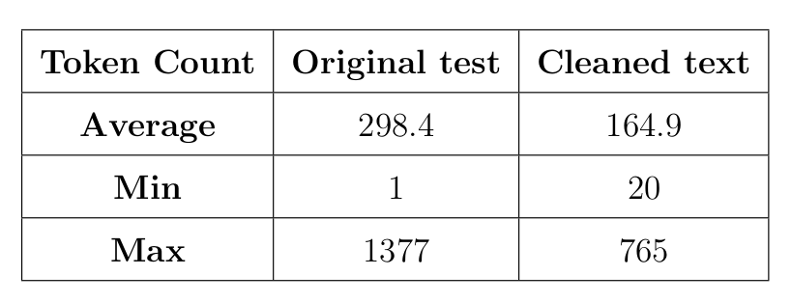
Dataset Stats

Slide 8
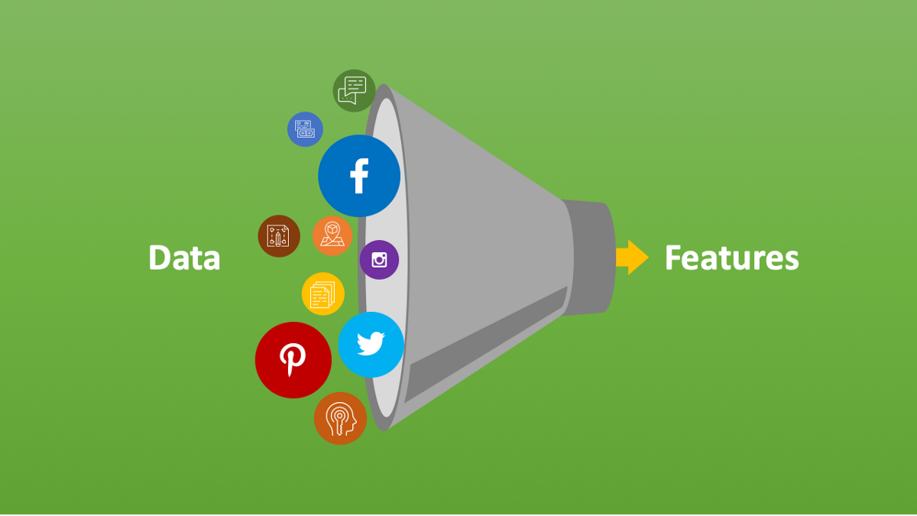
Feature Engineering using LDA
A simple feature representation strategy that can enable interpretability in the later stages as well
Latent Dirichlet Allocation (LDA) is a topic modelling technique to extract latent topics in a document from a given text corpus using the idea that “a document is best described using a group of topics and topics are best described using a group of words”
Unsupervised learning and soft clustering approach

Slide 9

Our Base Model
Pre-processing of the text
Training the LDA model with 85 categories
Assigning a dominant and a second dominant class to every document
Extracting 3 and 2 words respectively from the documents relating to these topics
Total 7 keywords(2 topics and 5 words) are representing a document
Training Decision Tree, Support Vector and Naive Bayes Classifiers using these as parameters and the bail decision as outcome.

Slide 10
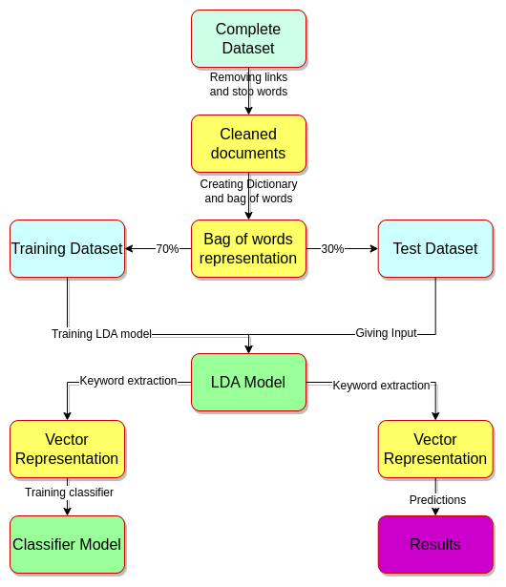
Model

Slide 11
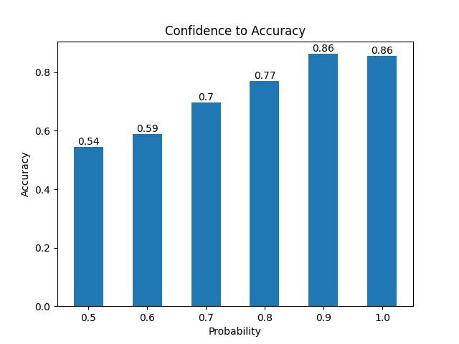
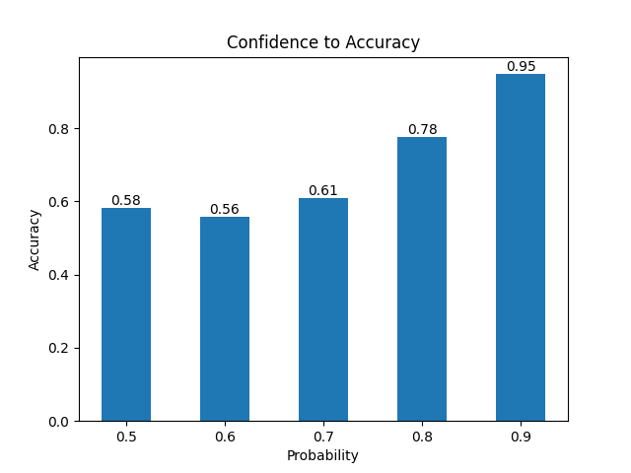
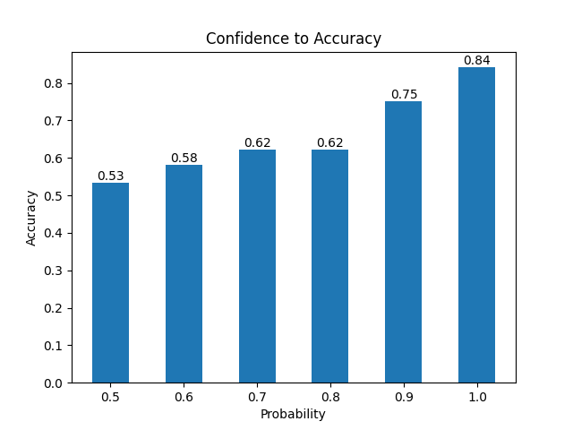
Results and Analysis
Decision Tree
Accuracy: 0.742
Support Vector
Accuracy: 0.753
Naive Bayes
Accuracy: 0.734

Slide 12
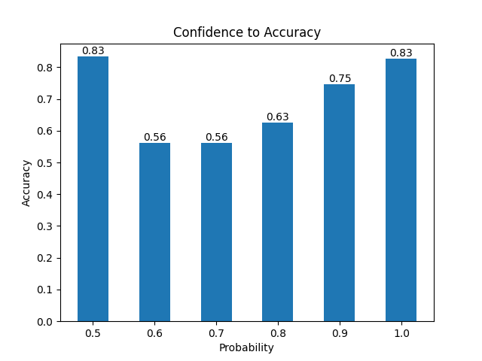
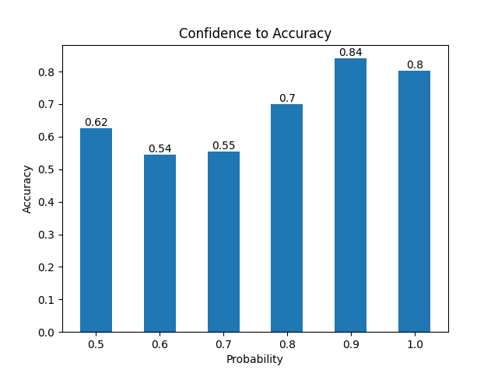
Combined Results
Max. Probability output
Accuracy: 0.746
Max. Accuracy output
Accuracy: 0.749
Dominant Output
Accuracy: 0.752

Slide 13

Inference and Issues
Different Classifiers giving similar outputs
No. of unique vectors getting formed is only 12% of the total documents
No. of words used in these vectors is even less (only 0.07!)
90% of these vectors encompass documents that give both bail granted and dismissed decisions
Synonyms and different forms of the same words are being considered different
Keyword extraction process is not holistic

Slide 14

Refined Model
Lemmatization at the pre-processing stage
Considering only unique words within each document
Including Judge’s opinion section in the training data
Extracting 12 keywords from each document
3 topics and 4, 3 and 2 words respectively relating to them
Training only one Decision Tree Classifier (as it doesn't matter)
Using a subset of data with 19,123 documents

Slide 15

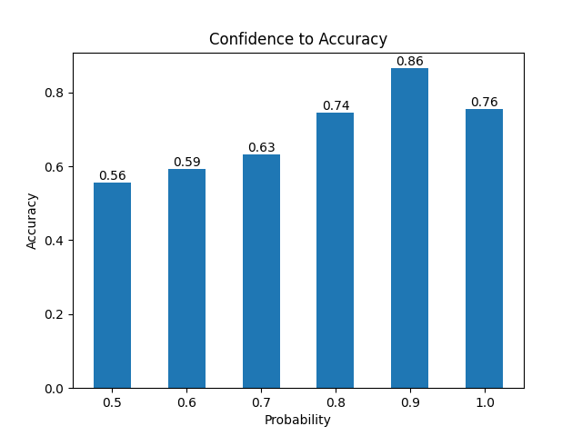
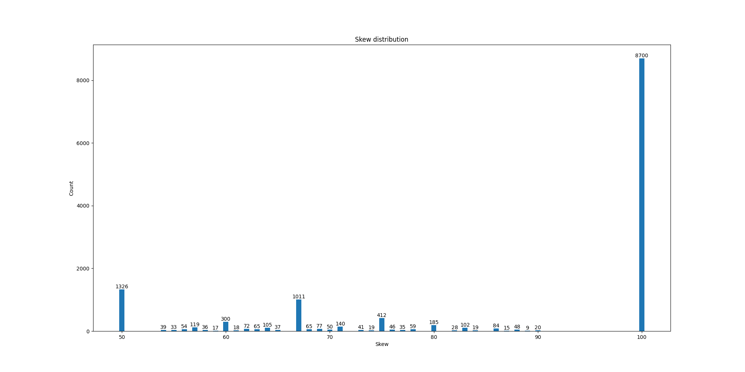
Results and Analysis
Decision Tree
Accuracy: 0.716

Slide 16

Comparison
While we have made efforts to address the concerns raised in the previous section, it is apparent that these challenges persist, albeit with reduced intensity
 | Training Data | Test Data | Dictionary | Words in Vector(%) | Unique Vector(%) | Accuracy
Base Model | 75,600 | 32,400 | 524,682 | 406 (0.07%) | 12,998 (12%) | 0.753
Refined Model | 13,386 | 5,737 | 179,966 | 526 (0.3%) | 12,963 (68%) | 0.716

Slide 17

Future Works
Using word-to-vector representation
Alternative keyword extraction method
Employing even more keywords
Translation to english
Extend to even more complicated cases

Slide 18

Thank You

