Slide 1

Restricted End-to-End Automated Speech Recognition
Under the supervision of
Prof. Pabitra Mitra
by
Suvvari Venkata Sai
(20CS10067)

Slide 2
Introduction
Speech recognition is a technology that enables machines to convert spoken language into written text or machine-readable data.
The primary goal of speech recognition is to accurately transcribe and interpret spoken language, making it possible for computers to understand and interact with humans using voice as an input modality.
This has a wide range of applications, from voice assistants like Siri and Alexa, YouTube captioning to transcription services, accessibility tools for people with disabilities etc.

Slide 3
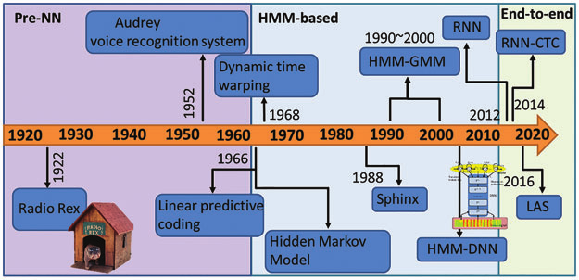

Slide 4
Why speech recognition is difficult?
Variability in speech
Ambient Noise
Speaker Variability
Out-of-Vocabulary words
Pronunciation Guidance
Data and Training
Low-Resource Languages

Slide 5
Problem Statement
To improve the accuracy of End-to-End automated speech recognition for Indian languages on domain-specific vocabulary for specialized tasks by choosing a speech embedding which gives more accurate transcriptions.
Telugu Language is chosen for my project to work on Restricted End-to-End automated speech recognition.
One of the main applications include interacting with the ATMs in rural and remote areas where the literacy of technology is comparatively low.

Slide 6
Automated Speech Recognition (ASR) Systems
ASR systems have become integral in various applications, including transcription services, voice assistants, and accessibility tools.
Fundamental Equation of Statistical Speech Recognition: If X is the sequence of acoustic vectors (observations) and W denotes a word sequence, the most likely word sequence W* is given by: W* = arg max_W P (W |X).

Slide 7
Evaluation Metrics
Word Error Rate (WER)
Letter Error Rate (LER)
Token Error Rate (TER)
Phone Error Rate (PER)

Slide 8
Work Flow of ASR
Feature Extraction
Preprocessing
Windowing
Feature Extraction
Context Window
Feature Normalization
Acoustic Modeling

Slide 9
Introduction of Neural Networks into ASR
The introduction of neural networks involves the integration of feedforward or RNNs into the acoustic model.
The Tandem Scheme combines the strengths of neural networks and HMMs to model acoustic features.
The outputs of neural networks are given as input features to standard CD-GMM-HMM system.
Adaptation techniques allow HMMs to adapt to different acoustic conditions or speakers.
Methods such as MLLR and MAP adaptation help improve recognition performance in varying conditions.

Slide 10
End-to-End ASR
End-to-end Automatic Speech Recognition (ASR) is a speech recognition approach that aims to simplify and streamline the traditional ASR process by directly mapping acoustic features from spoken language to text in a single step.
Key characteristics of E2E ASR include Neural Network Architecture, Direct Mapping, Data-Driven Learning and Simplified Pipeline.
RNNs mainly follows CTC and Encoder-Decoder approaches for mapping input to output sequences.

Slide 11
Connectionist Temporal Classification(CTC)
CTC is a critical component of many E2E ASR systems, particularly those that use RNNs or related architectures.
CTC is a loss function and decoding algorithm that helps align the acoustic features with the predicted text or phoneme sequences without the need for explicit alignment information.
The CTC loss encourages the model to learn the correct alignment between speech and text, even when the lengths do not match perfectly.
Although CTC can handle variable-length sequences effectively it finds difficulty in handling ambiguous cases or fine-grained alignment issues.
Combining language models with CTC can improve recognition accuracy and fluency.

Slide 12
Attention-based Encoder-Decoder
The attention-based encoder-decoder architecture plays a pivotal role in many state-of-the-art E2E ASR systems.
This has 4 main components: Encoder, Attention, Decoder and Softmax.
The attention mechanism uses current decoder RNN hidden state and sequence of encoder hidden states to compute alignment matrix which are used as weights to compute context vector.
The decoder uses the context vector and current decoder hidden state to estimate subword distribution.
A significant problem with naïve encoder is length of input sequence. This can be tackled using pyramid architecture.

Slide 13
Pyramid Model
The pyramid model combines the consecutive layers of encoder.
3 layers of pyramid architecture reduces the time resolution by a factor of 8.
Thus, attention mechanism has an easier job, weighting over 8x fewer encoder hidden states.

Slide 14
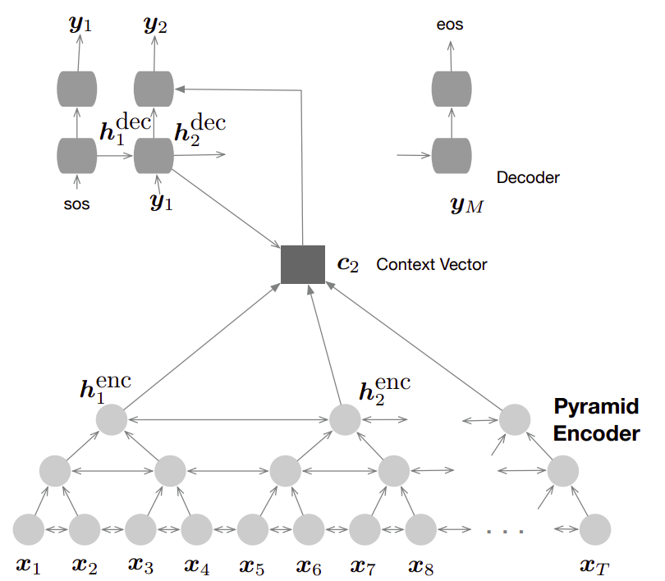

Slide 15
Speech Embeddings
Speech embeddings serve as vector representations of audio data and provide a compact way to capture the acoustic, phonetic, or linguistic characteristics of speech.
They serve as an intermediary step between raw audio data and machine learning models, making it easier for machines to work with and understand spoken language.
Examples of speech embeddings include MFCCs, PLP Cepstral Coefficients, Filter Bank Energies, Vector Quatization Codes etc.

Slide 16
Neural Speech Embeddings
Neural speech embeddings represent a subset of speech embeddings that are generated using neural network-based models.
These embeddings leverage the power of deep learning to capture intricate patterns in audio data.
They are good at adaptability, context-awareness, and effectiveness in various speech and audio processing tasks.
Examples include Acoustic Embeddings, Phonetic Embeddings, Speaker Embeddings, Transfer Learning Embeddings.
Popular Models that use neural speech embeddings are Wav2Vec 2.0, Conformer and Deepspeech.

Slide 17
Dataset, Training and Testing
The dataset was obtained from IIT Madras research lab AI4Bharat which focuses on open-source dataset and models etc. The dataset is called Shrutilipi.
It contains All India Radio news bulletins for 12 Indian languages collected between 21 Feb 2018 and 17 May 2021 in which Telugu is included.
The audio input is split into frames of 25ms audio. The reference text is denoted as a sequence of N characters.
The whole data is normalized and used for training and testing.
The Wav2Vec and Conformer models are finetuned on this data.
https://ai4bharat.iitm.ac.in/shrutilipi/

Slide 18
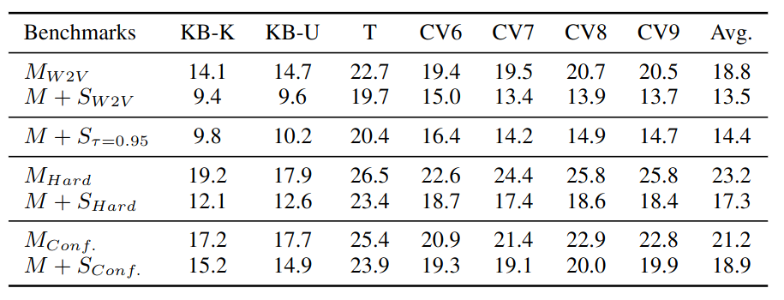
Evaluation Results (WER)
M = MUCS, S = Shrutilipi, W2V = Wav2Vec, Hard = hard benchmark, Conf = Conformer, KB = Kathbath, K = Known, U = Unknown, T = Tarini, CV = CommonVoice
https://arxiv.org/abs/2208.12666

Slide 19
Future Work
Try more models and speech embeddings on Telugu corpus and choose the model that gives better accuracy among all.
Finetune that model again on domain specific dataset and evaluate.
Possibly propose a new speech embedding that works better for restricted end to end asr.
From the results of Wav2Vec and Conformer models, we got to find that Wav2Vec has better accuracy on dataset. So, we can start with finetuning these models for our domain-specific vocabulary.

Slide 20

Thank you

