Slide 1
Data Mining and Machine Learning: Introduction

Slide 2
Data Mining and Machine Learning: Introduction
Lecture Notes Compiled from
Introduction to Data Mining, 2nd Edition
by
Tan, Steinbach, Karpatne, Kumar

Slide 3
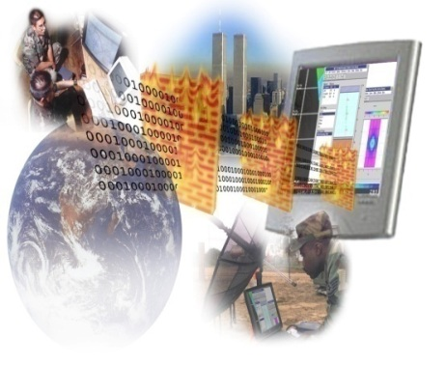

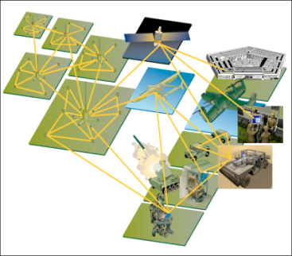
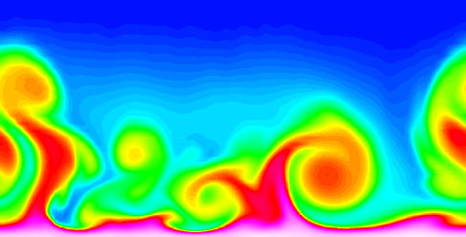
Large-scale Data is Everywhere!
There has been enormous data growth in both commercial and scientific databases due to advances in data generation and collection technologies
New mantra
Gather whatever data you can whenever and wherever possible.
Expectations
Gathered data will have value either for the purpose collected or for a purpose not envisioned.
E-Commerce
Cyber Security
Traffic Patterns
Social Networking: Twitter
Sensor Networks
Computational Simulations
Notes:
3

Slide 4
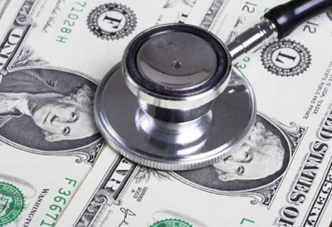
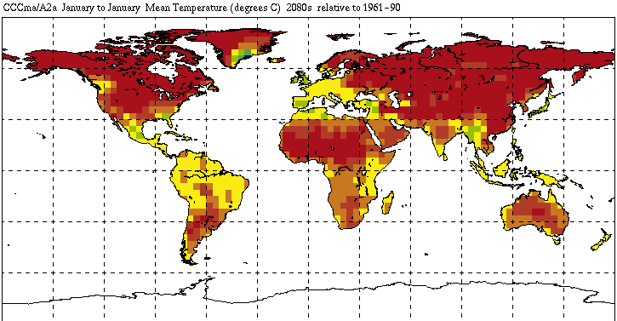
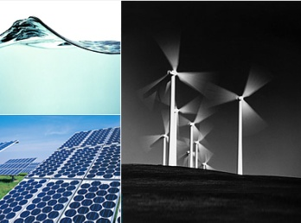
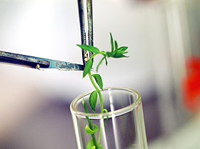
Great Opportunities to Solve Society’s Major Problems
Improving health care and reducing costs
Predicting the impact of climate change
Finding alternative/ green energy sources
Reducing hunger and poverty by
increasing agriculture production

Slide 5
What is Data Mining/Data Science
Many Definitions
Non-trivial extraction of implicit, previously unknown and potentially useful information from data
Exploration & analysis, by automatic or semi-automatic means, of large quantities of data in order to discover meaningful patterns

Slide 6
Data Mining Tasks
Prediction Methods
Use some variables to predict unknown or future values of other variables.
Description Methods
Find human-interpretable patterns that describe the data.
From [Fayyad, et.al.] Advances in Knowledge Discovery and Data Mining, 1996

Slide 7
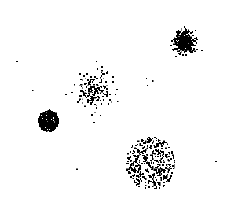

Data Mining Tasks …
Data
Clustering
Predictive Modeling
Association Rules
Anomaly Detection
Milk

Slide 8
Predictive Modeling: Classification
Find a model for class attribute as a function of the values of other attributes
Model for predicting credit worthiness
Class

Slide 9
Classification Example
categorical
categorical
quantitative
class
Test
Set
Learn
Classifier
Training
Set
Model

Slide 10
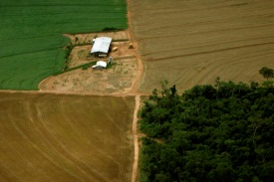
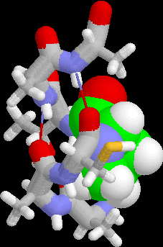
Examples of Classification Task
Classifying credit card transactions as legitimate or fraudulent
Classifying land covers (water bodies, urban areas, forests, etc.) using satellite data
Categorizing news stories as finance, weather, entertainment, sports, etc
Identifying intruders in the cyberspace
Predicting tumor cells as benign or malignant
Classifying secondary structures of protein as alpha-helix, beta-sheet, or random coil

Slide 11
Classification: Application 1
Fraud Detection
Goal: Predict fraudulent cases in credit card transactions.
Approach:
Use credit card transactions and the information on its account-holder as attributes.
When does a customer buy, what does he buy, how often he pays on time, etc
Label past transactions as fraud or fair transactions. This forms the class attribute.
Learn a model for the class of the transactions.
Use this model to detect fraud by observing credit card transactions on an account.

Slide 12
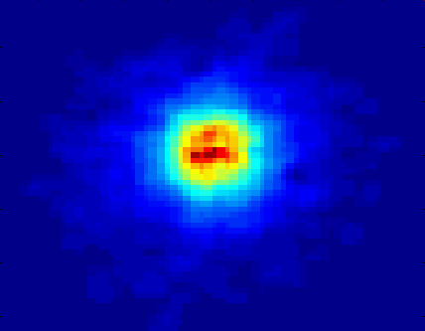
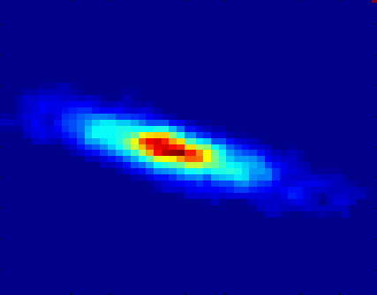
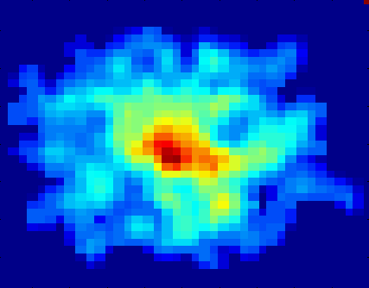
Classifying Galaxies
Courtesy: http://aps.umn.edu
Early
Class:
Stages of Formation
Attributes:
Image features,
Characteristics of light waves received, etc.
Intermediate
Late
Data Size:
72 million stars, 20 million galaxies
Object Catalog: 9 GB
Image Database: 150 GB

Slide 13
Regression
Predict a value of a given continuous valued variable based on the values of other variables, assuming a linear or nonlinear model of dependency.
Extensively studied in statistics, neural network fields.
Examples:
Predicting sales amounts of new product based on advetising expenditure.
Predicting wind velocities as a function of temperature, humidity, air pressure, etc.
Time series prediction of stock market indices.

Slide 14
Clustering
Finding groups of objects such that the objects in a group will be similar (or related) to one another and different from (or unrelated to) the objects in other groups
Inter-cluster distances are maximized
Intra-cluster distances are minimized

Slide 15
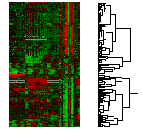
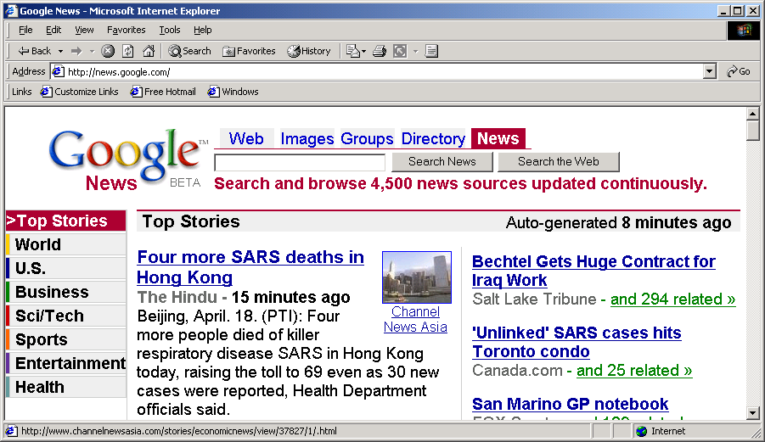
Applications of Cluster Analysis
Understanding
Custom profiling for targeted marketing
Group related documents for browsing
Group genes and proteins that have similar functionality
Group stocks with similar price fluctuations
Summarization
Reduce the size of large data sets
Courtesy: Michael Eisen
Use of K-means to partition Sea Surface Temperature (SST) and Net Primary Production (NPP) into clusters that reflect the Northern and Southern Hemispheres.

Slide 16
Clustering: Application 1
Market Segmentation:
Goal: subdivide a market into distinct subsets of customers where any subset may conceivably be selected as a market target to be reached with a distinct marketing mix.
Approach:
Collect different attributes of customers based on their geographical and lifestyle related information.
Find clusters of similar customers.
Measure the clustering quality by observing buying patterns of customers in same cluster vs. those from different clusters.

Slide 17
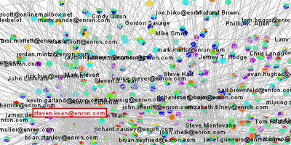
Clustering: Application 2
Document Clustering:
Goal: To find groups of documents that are similar to each other based on the important terms appearing in them.
Approach: To identify frequently occurring terms in each document. Form a similarity measure based on the frequencies of different terms. Use it to cluster.
Enron email dataset

