Slide 1


Slide 2
Introduction to the database:
The project is for implementing PostgreSQL based Hospital management database for maintaining patients information, doctors information, appointments history, medical test reports, medicines, prescription history, medicine prescriptions.
This project uses PostgreSQL queries to see information of patients like age weight, height, medical history and prescribed medicines taking information from 7 table list in the database which will talk about further we go into the presentation.

Slide 3
Setting up database:
This project is containerized using docker for easy setup with the step by step process mentioned below (make sure there is docker and PostgreSQL tools are installed and running before this steps):- This steps also uploaded in README
Visit and Fork https://github.com/karthik-bit1/CS377-A_hospital_medicaldb.git
git clone https://github.com/karthik-bit1/CS377-A_hospital_medicaldb.git
cd CS377-A_hospital_medicaldb
docker compose up -d
docker exec -it hospital_postgres psql -U postgres -d hospital_meddb

Slide 4
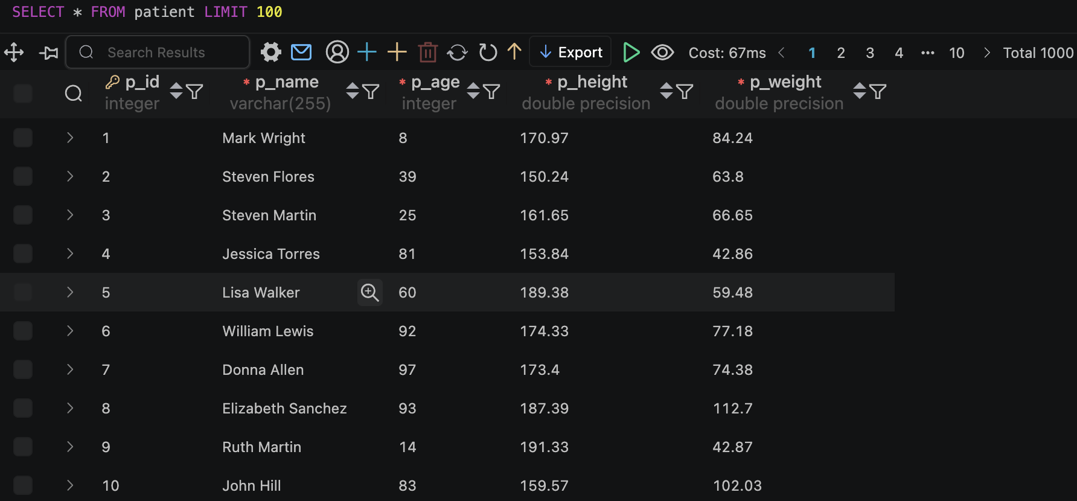
Tables in the Database:
patient: stores patient information

Slide 5
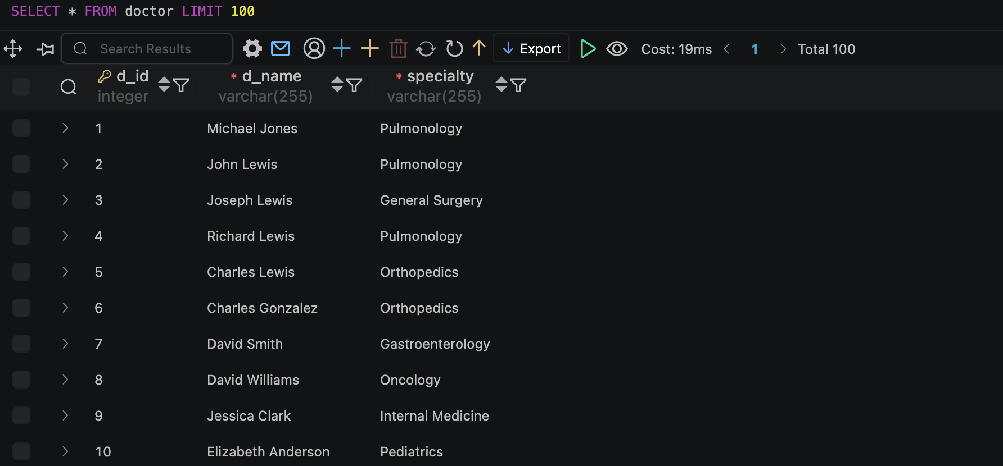
doctor: stores doctor details

Slide 6
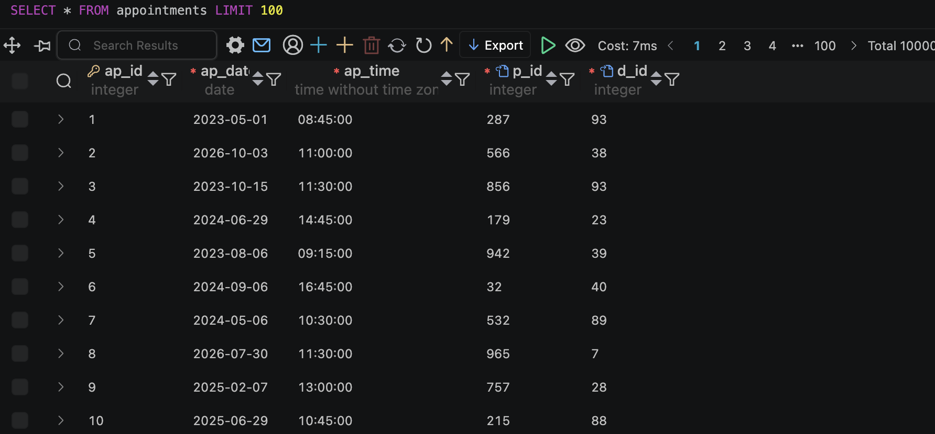
appointments: tracks patients appointments with their doctor

Slide 7
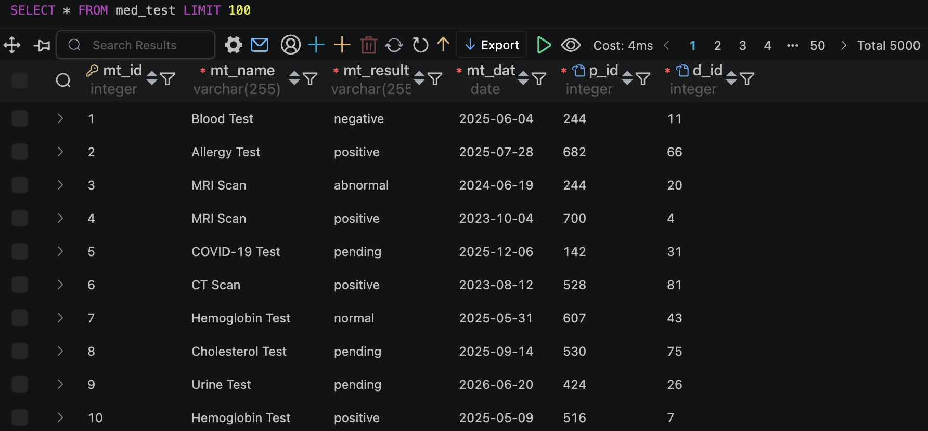
med_test: stores medical test results

Slide 8
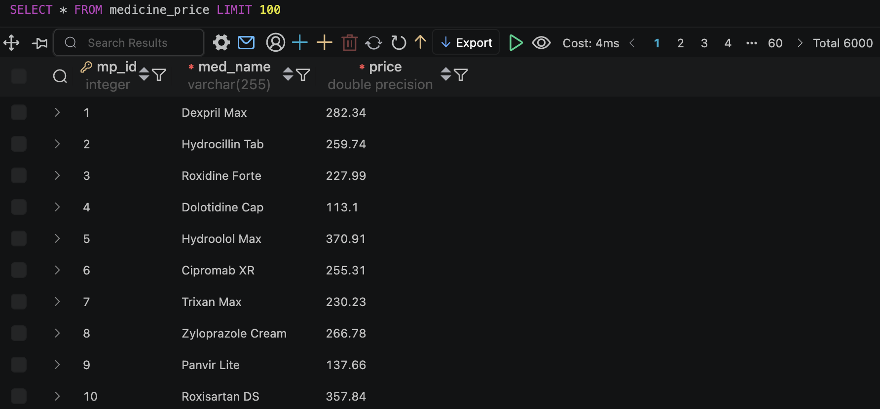
medicine_price: stores medicine pricing

Slide 9
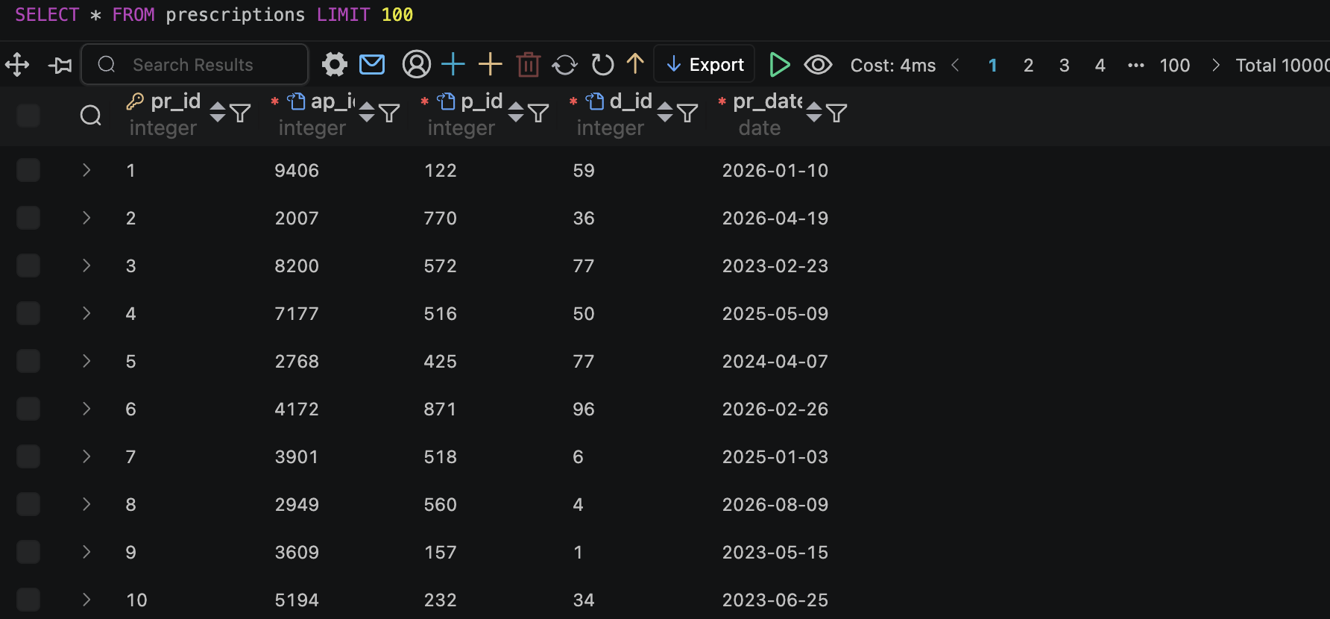
prescriptions: records prescriptions issued

Slide 10
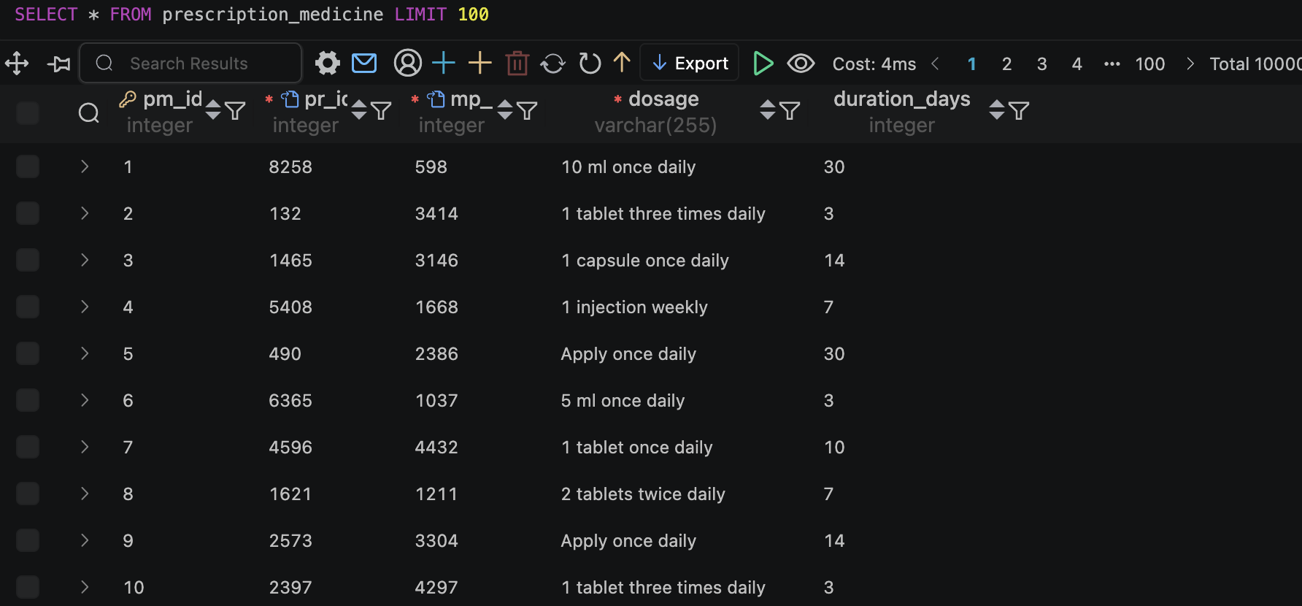
prescription_medicine: links prescriptions with medicines

Slide 11
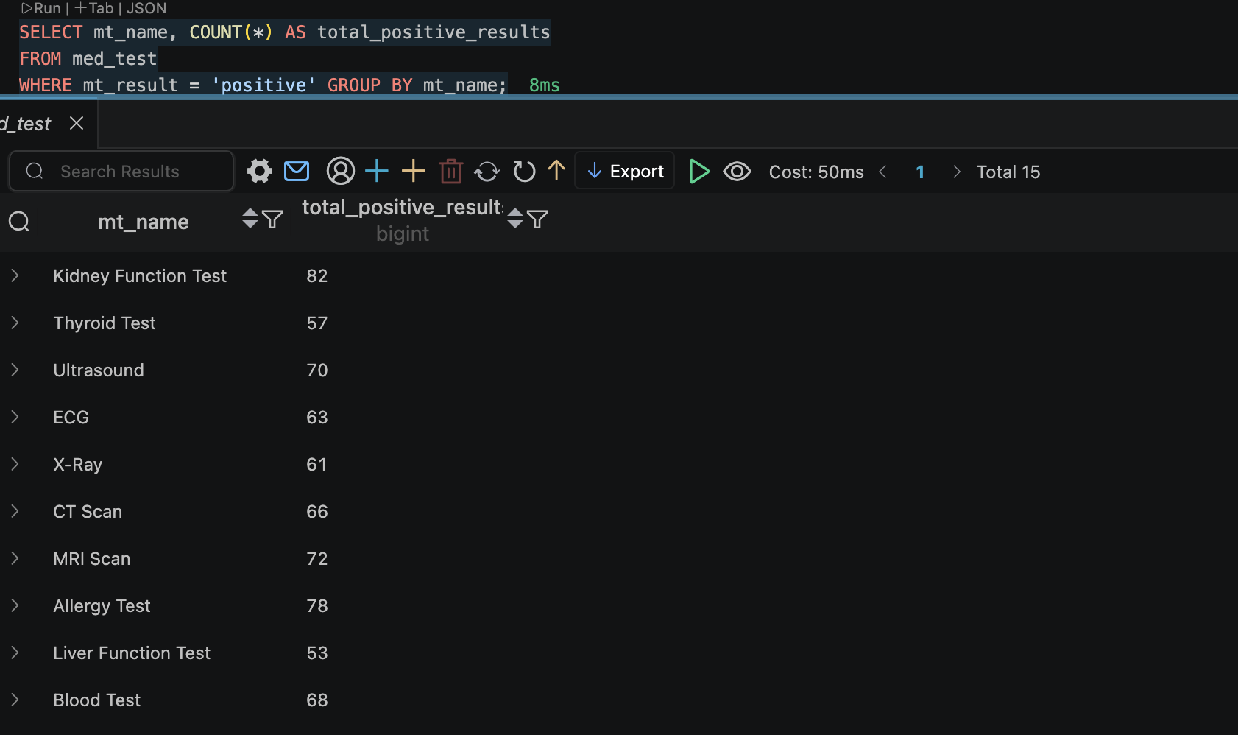
Sample Queries: Counting total number of positive result of grouped by each med_test name

Slide 12
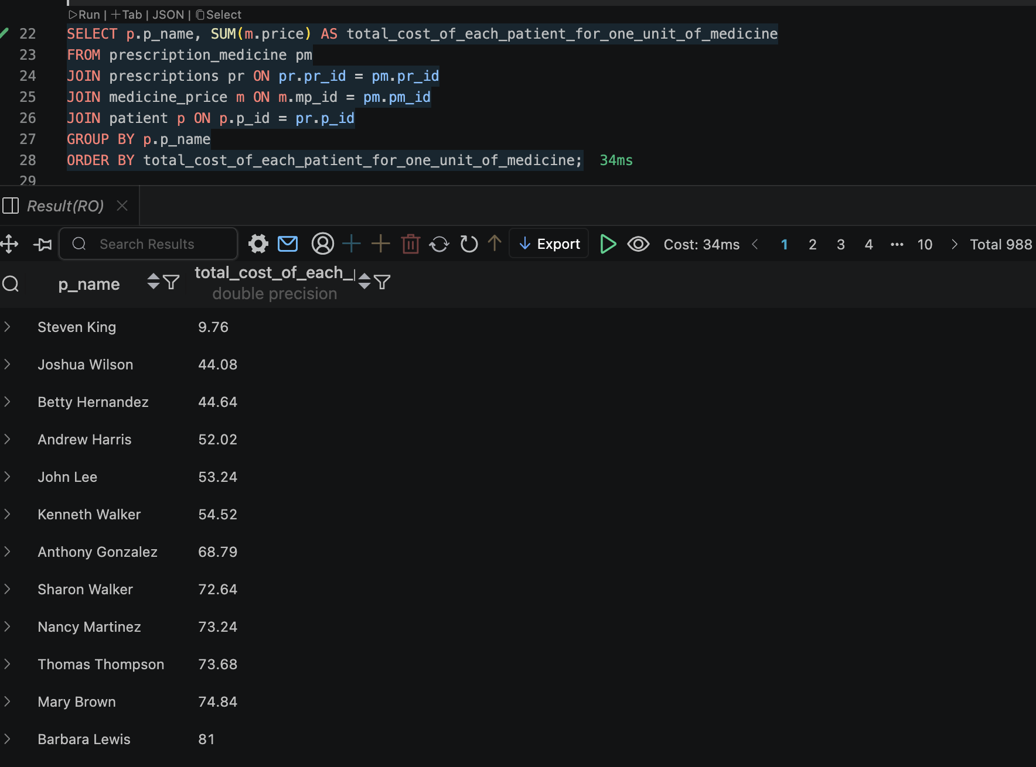
Sample Queries: total costs of medicines for each patient for eachunit of medicne

Slide 13
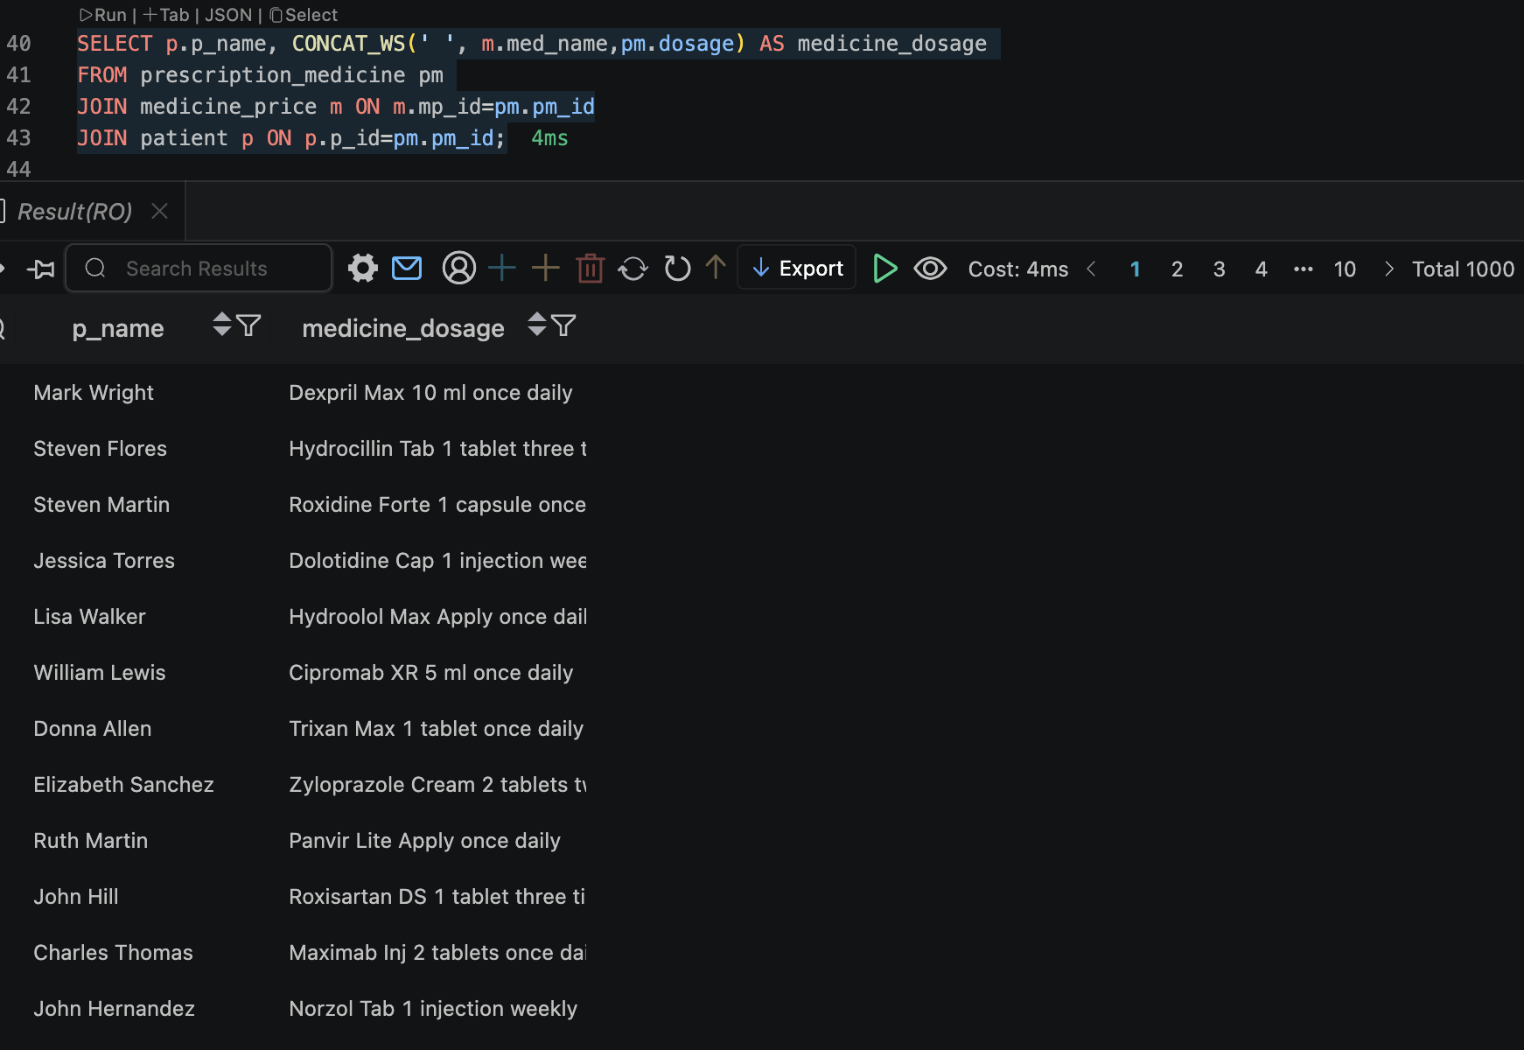
Sample Queries: concatenating medicine name with dosage

Slide 14
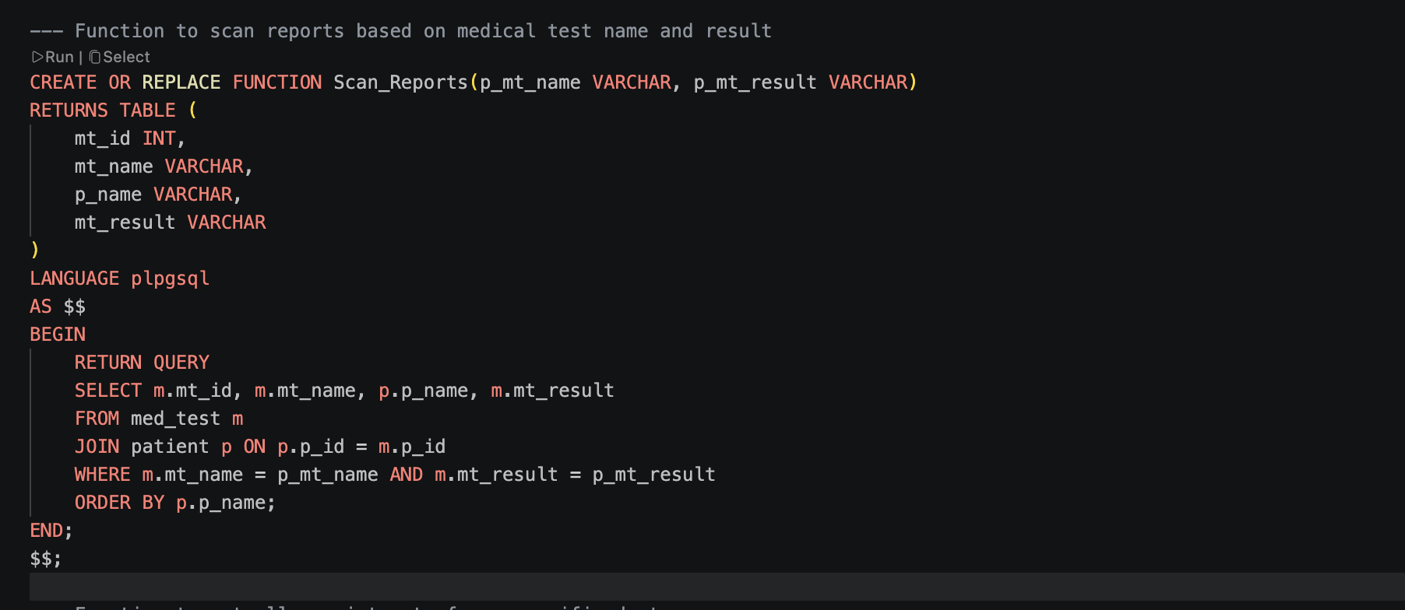
New Feature Function Queries: 1. Scan_reports results

Slide 15
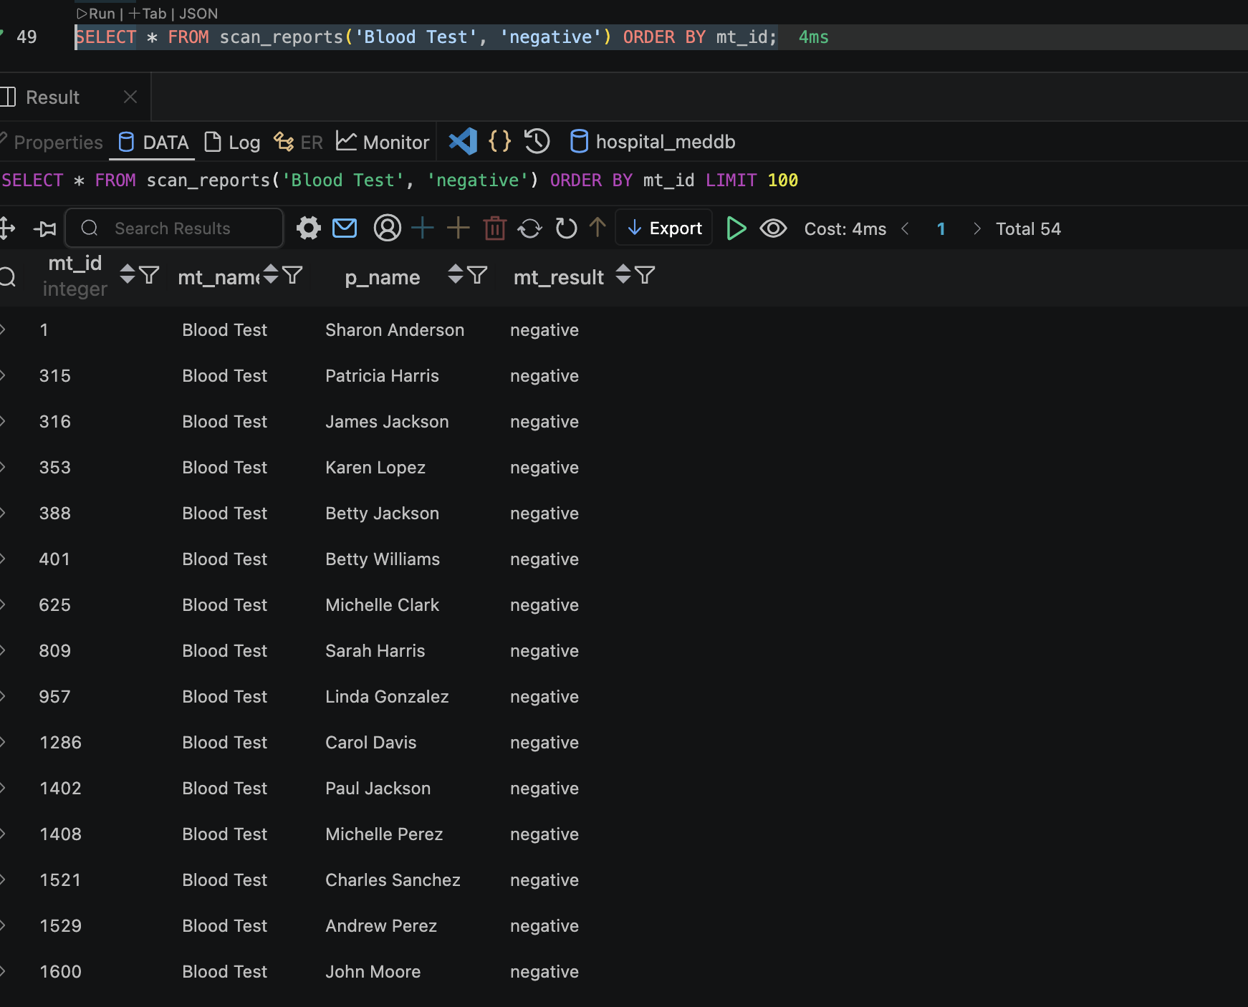

Slide 16
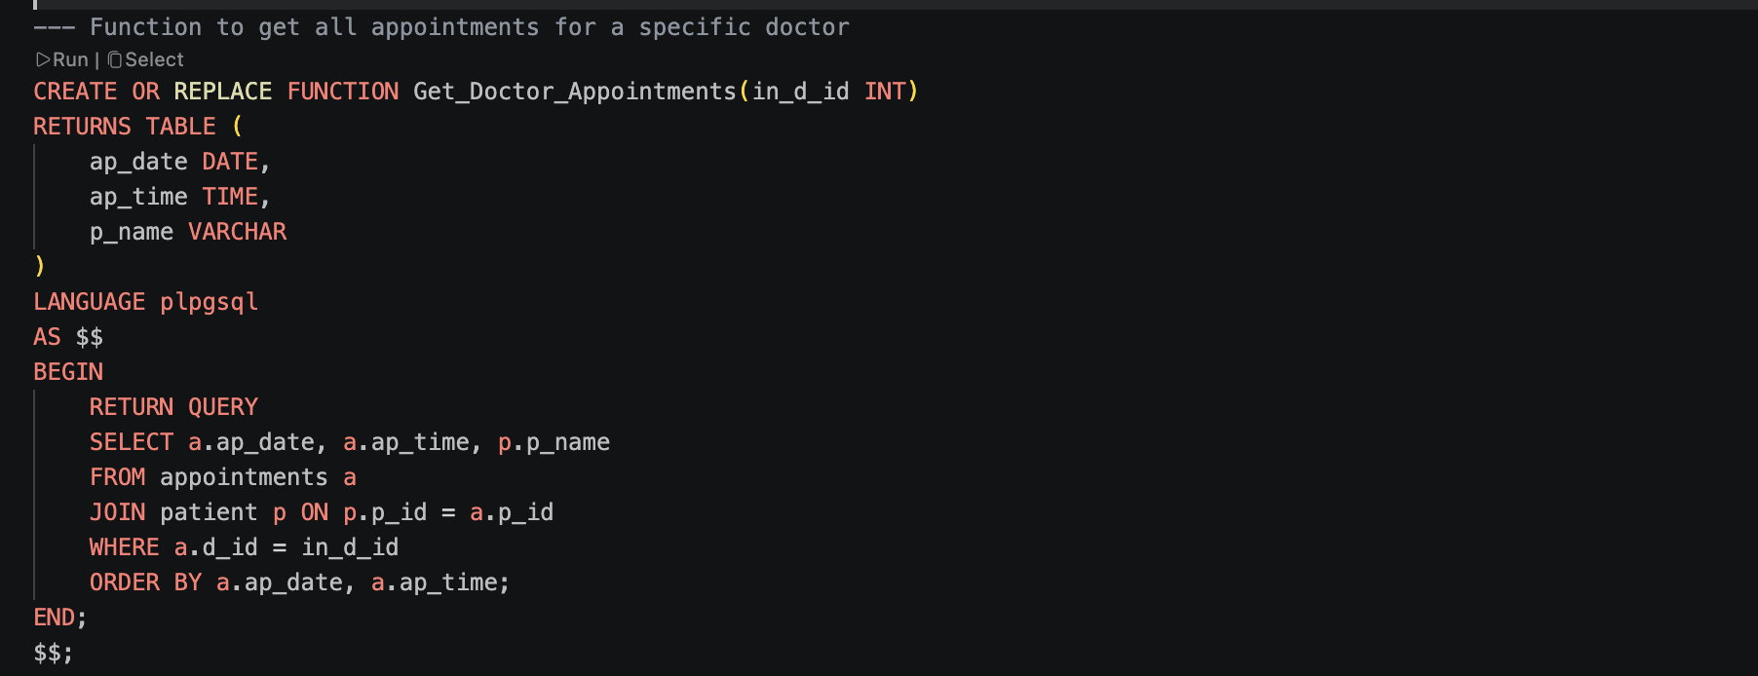
New Feature Function Queries: 2. Get_Doctor_Appointments

Slide 17
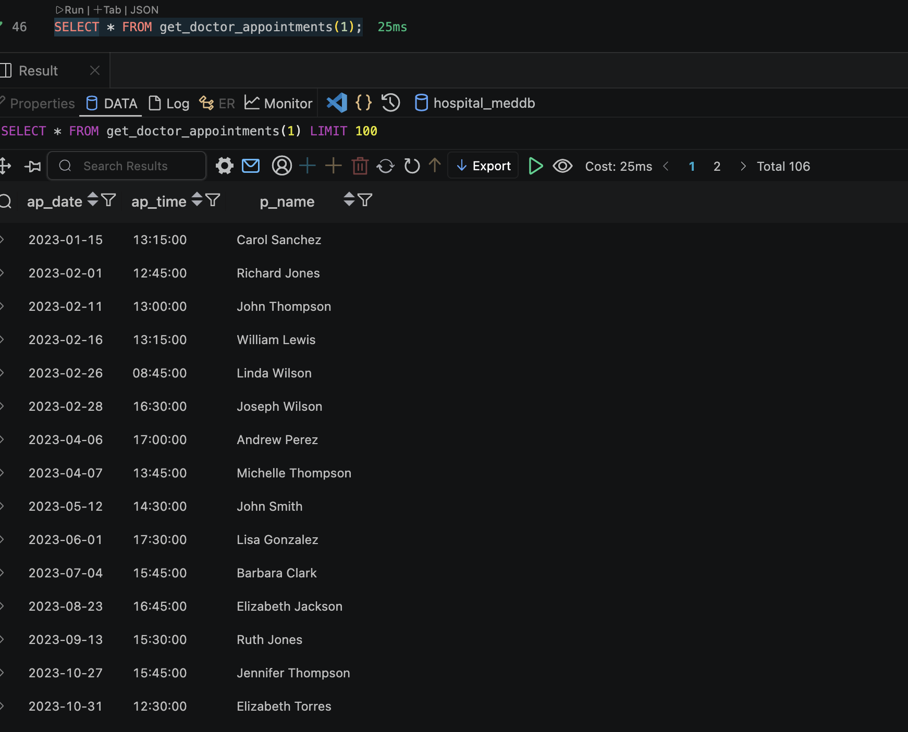

Slide 18
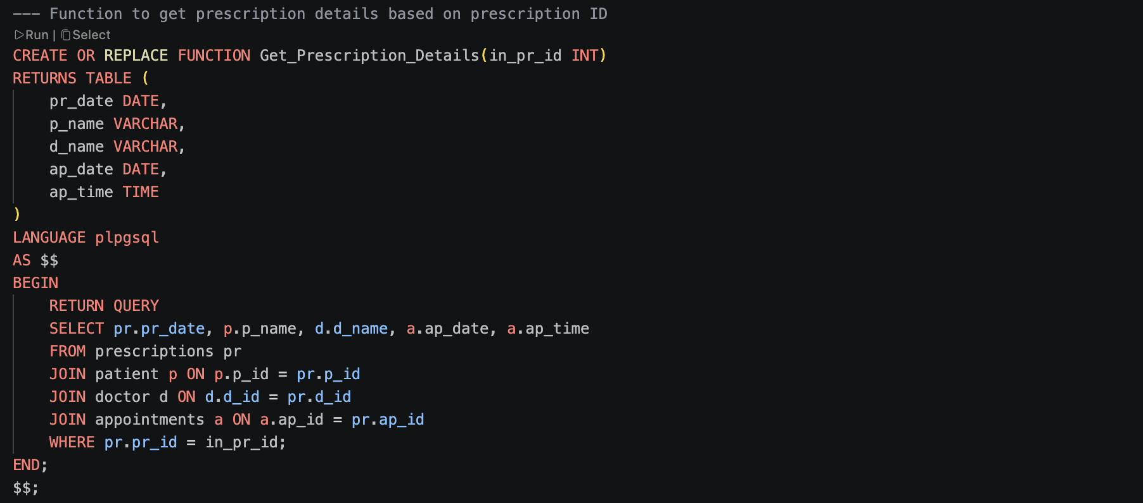
New Feature Function Queries: 3. Get_prescription_details

Slide 19
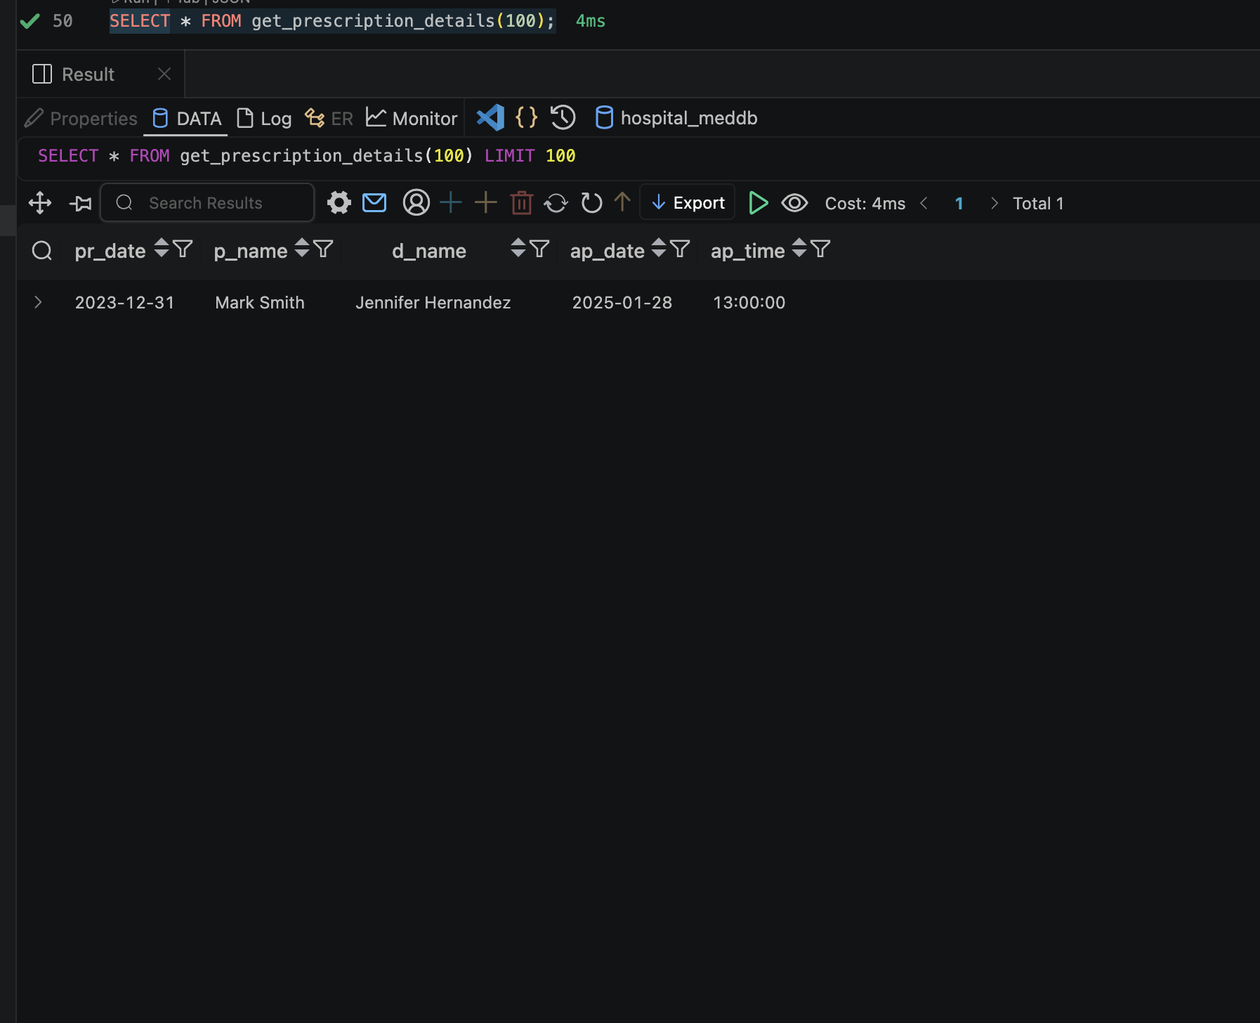

Slide 20
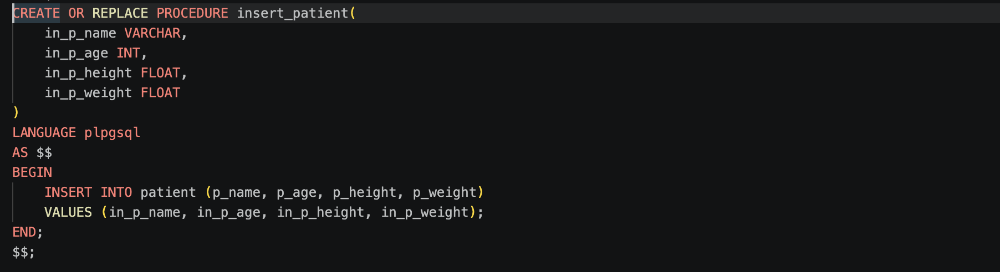
New Feature Procedure Queries: 1. Insert_patients data

Slide 21
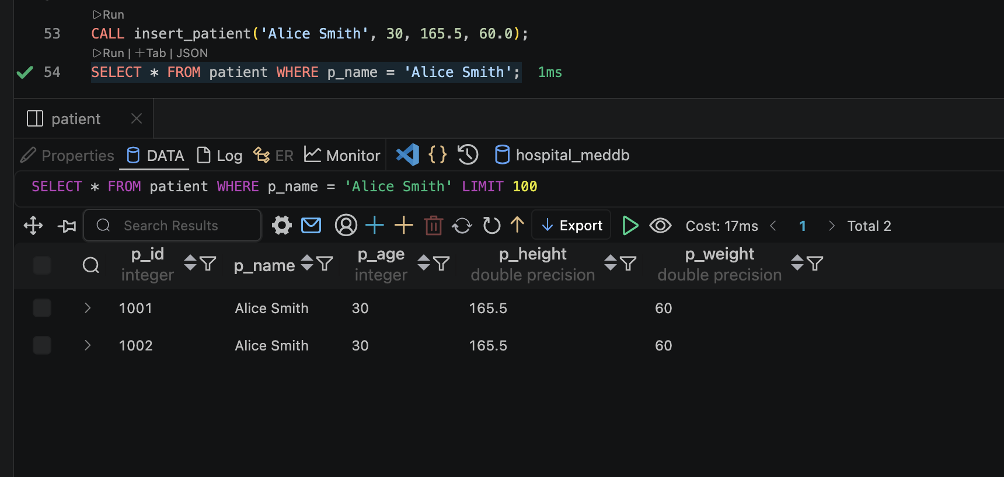

Slide 22
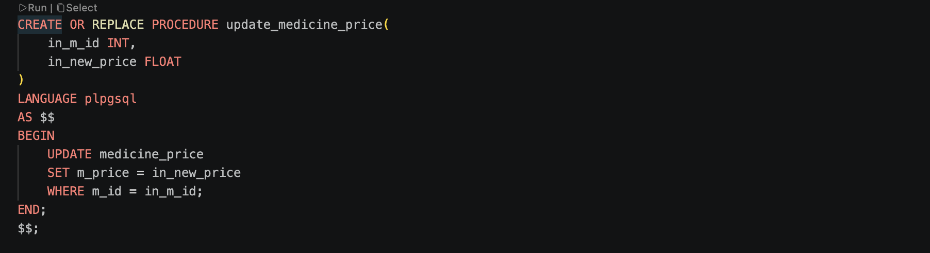
New Feature Procedure Queries: 2. Updating medicine prices

Slide 23
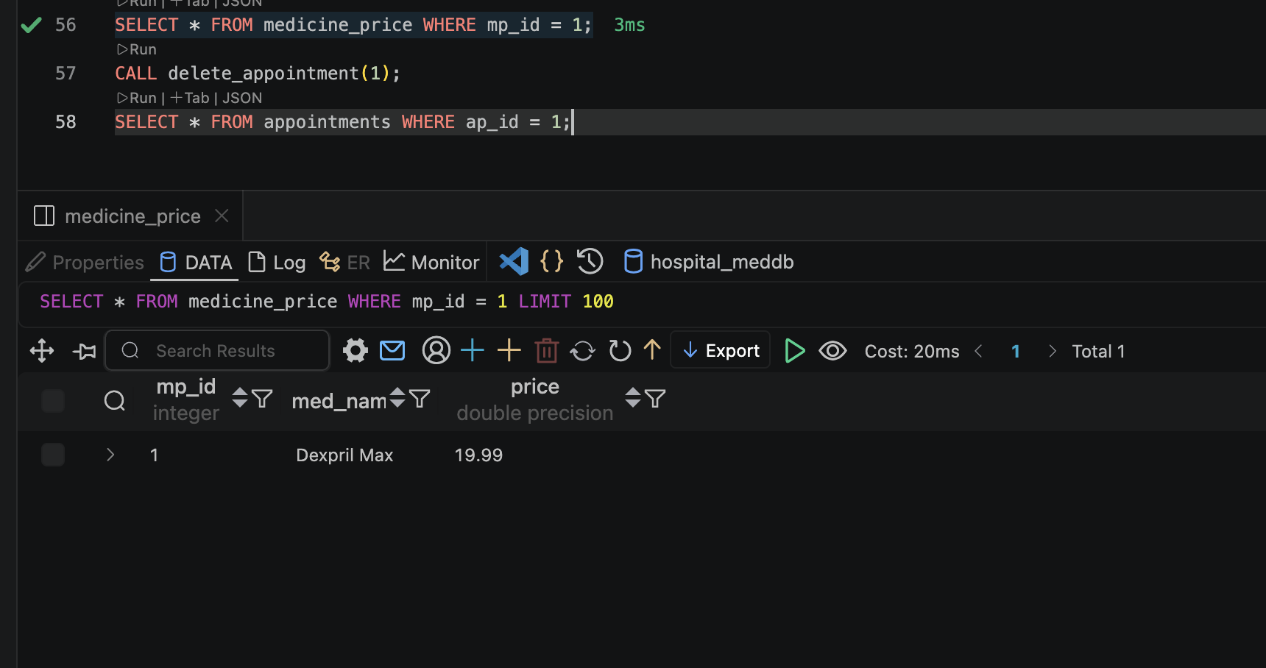

Slide 24
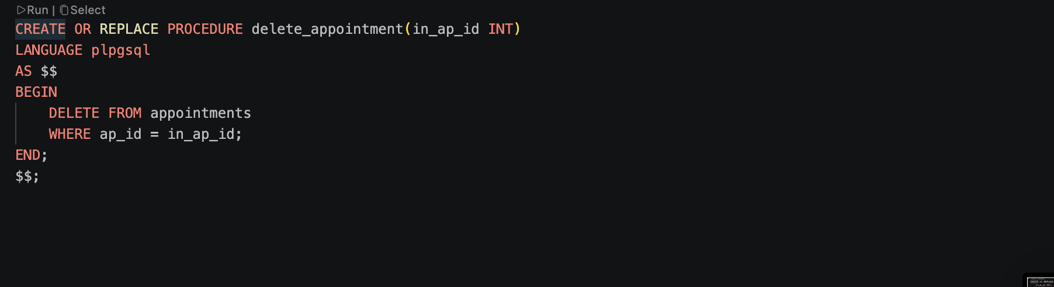
New Feature Procedure Queries: 3. delete appointments

Slide 25
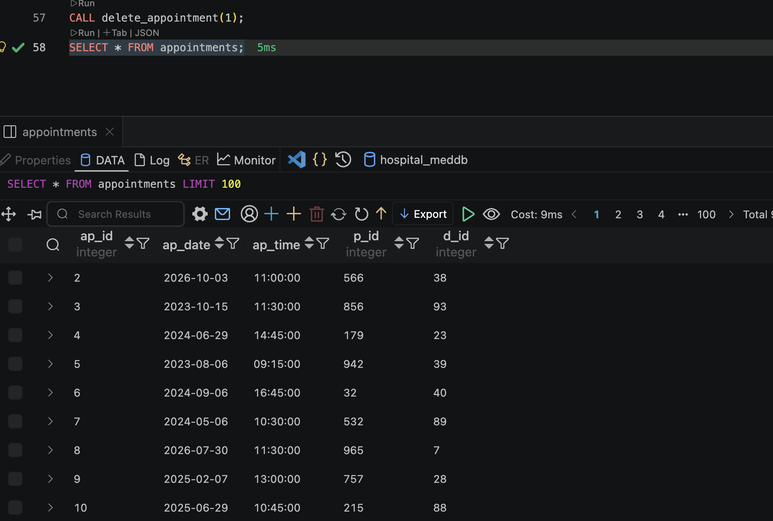

Slide 26
Conclusion:
This SQL prompt are mainly used to manage the data in the hospital database.
Looking for patients' data, medical reports and doctors' history of managing appointments, and more.
Future Works:
Adding more sql functions and procedure, creating an app.py to make access to this sql prompts easier and an interactive website.

Slide 27
Any Questions?

