Slide 1
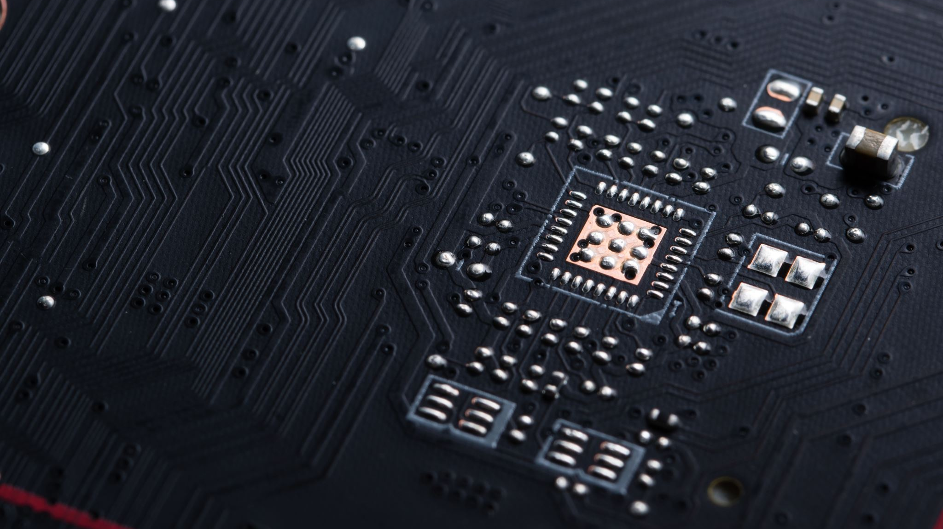
Gira Board
Efficiently Track and Manage Projects

Slide 2
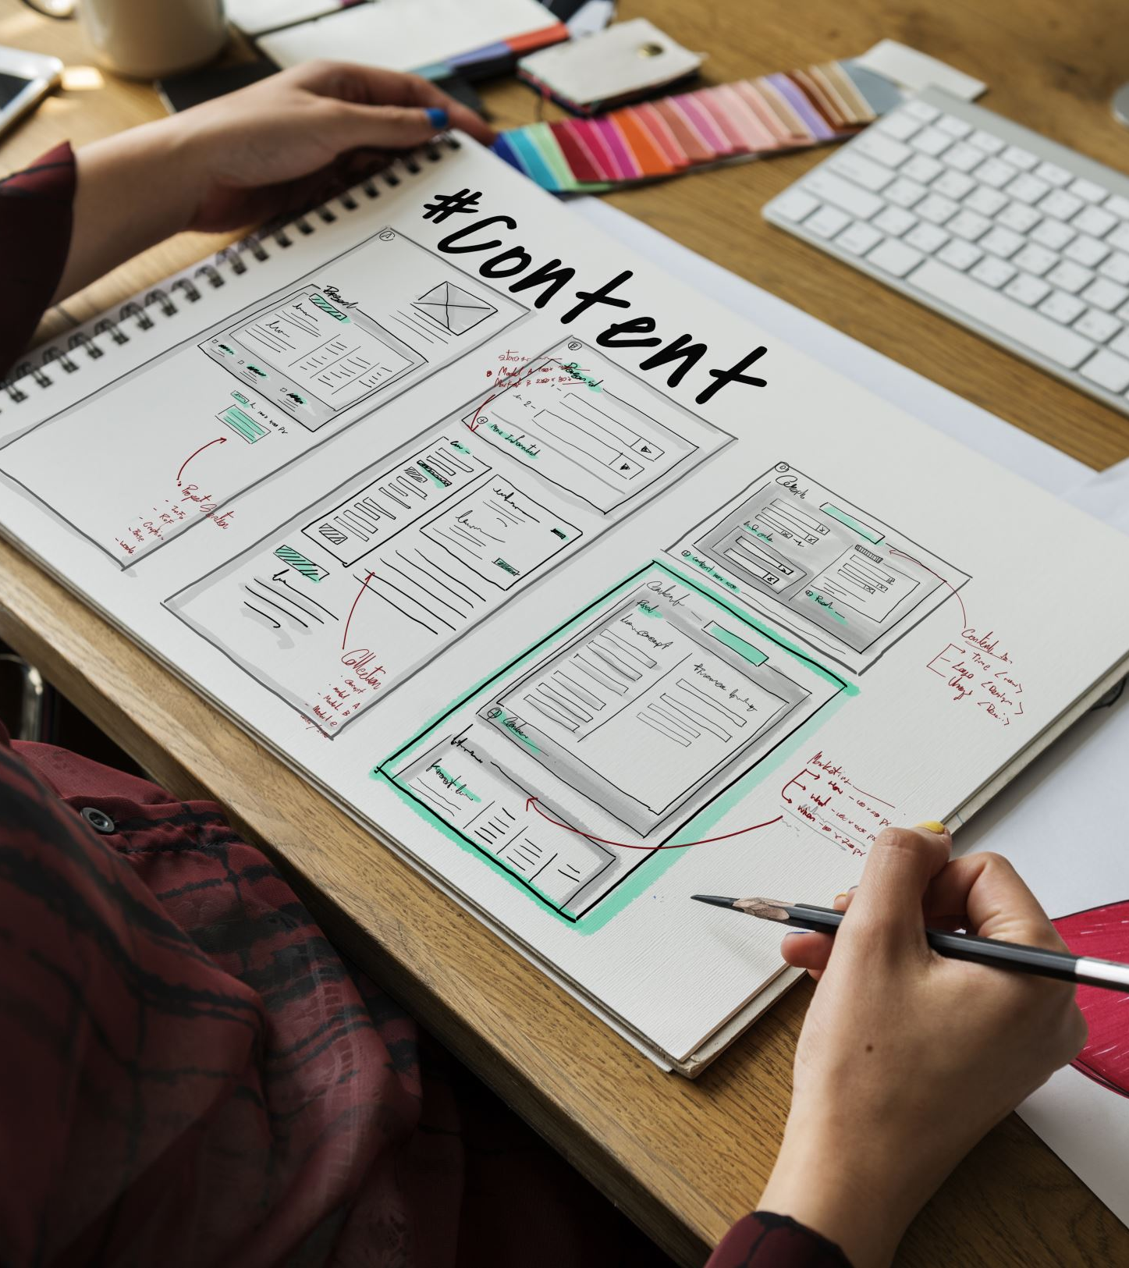
What is Gira Board?
Gira Board is a project management tool designed to streamline task tracking, enhance team collaboration, and improve productivity.

Slide 3
Features of Gira Board
- Task Tracking
- Team Collaboration
- Custom Workflows
- Time Management

Slide 4
Why Use Gira Board?
- Improved efficiency
- Clear accountability
- Real-time progress tracking

Slide 5
Using Gira Board
Create
- Create a project
Add
- Add tasks and assign team members
Monitor
- Monitor progress with dashboards

Slide 6
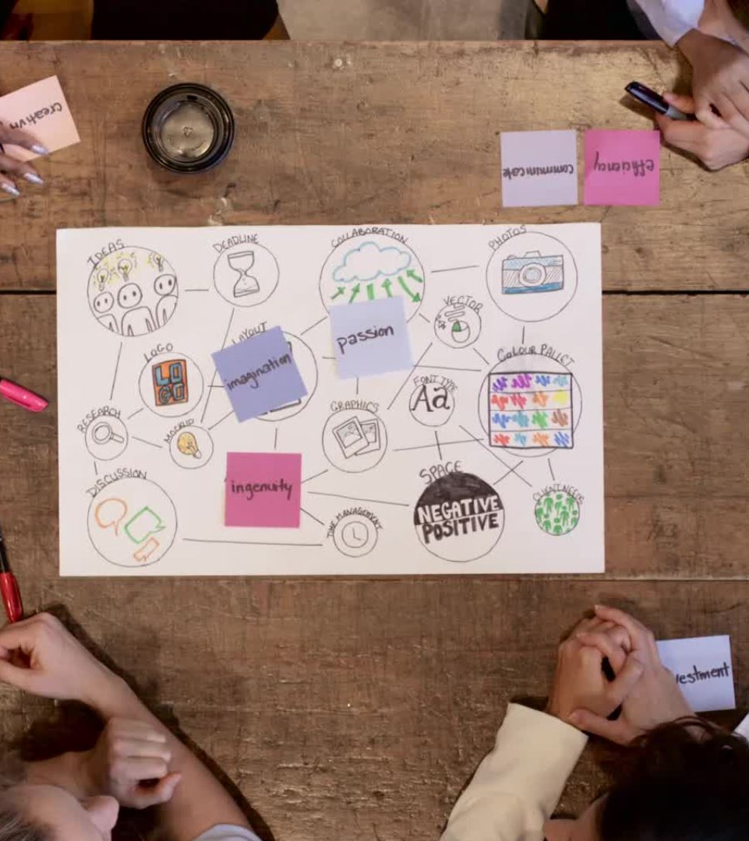
Get Started with Gira Board Today!
Join thousands of teams worldwide who trust Gira Board to manage their projects effectively.

