Slide 1
Clustering of complex datasets
Milestone Presentation
Ahmed Tidjani, Fabio Buso, Paul Velthuis & Zahin Azher
Service-centric Networking | Tu Berlin | May 11th, 2016

Slide 2
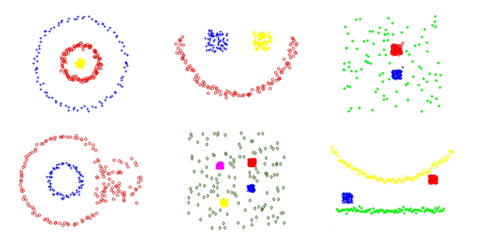
Complex Datasets
^{[2]}
Clustering of Complex Datasets
Ahmed Tidjani, Fabio Buso, Paul Velthuis & Zahin Azher

Slide 3
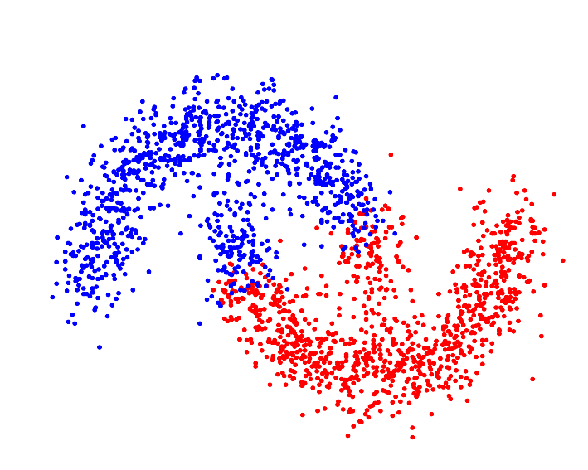
Clustering
Grouping a set of objects in a way that similar objects are in the same cluster.
Types:
Well Separated
Centroid Based
Density Based
[...]
kMeans Clustering
Clustering of Complex Datasets
Ahmed Tidjani, Fabio Buso, Paul Velthuis & Zahin Azher

Slide 4
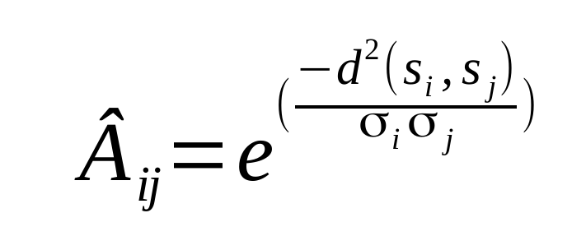
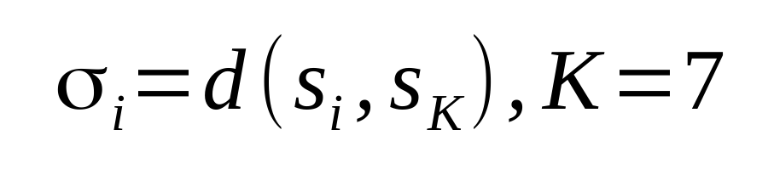
Self-tuning Spectral Clustering^{[2]}
Requires:
Max number of Clusters
Operates a dimensionality reduction using the eigenvectors of the affinity matrix.
Exploits the eigenvectors structure to determine the optimal number of clusters.
Clustering of Complex Datasets
Ahmed Tidjani, Fabio Buso, Paul Velthuis & Zahin Azher

Slide 5
Self-tuning Spectral Clustering^{[2]} - contd
Implementations already available in: C++ and Matlab
Objective:
Investigate the construction of the affinity matrix
Comparison with OPTICS
Performance Analysis
Clustering of Complex Datasets
Ahmed Tidjani, Fabio Buso, Paul Velthuis & Zahin Azher

Slide 6
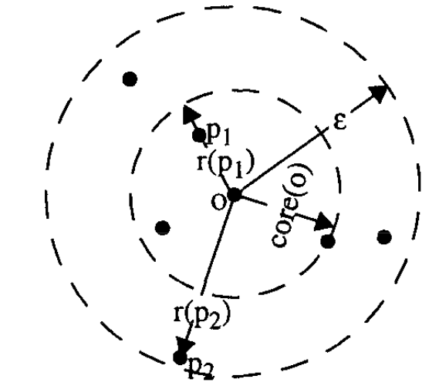
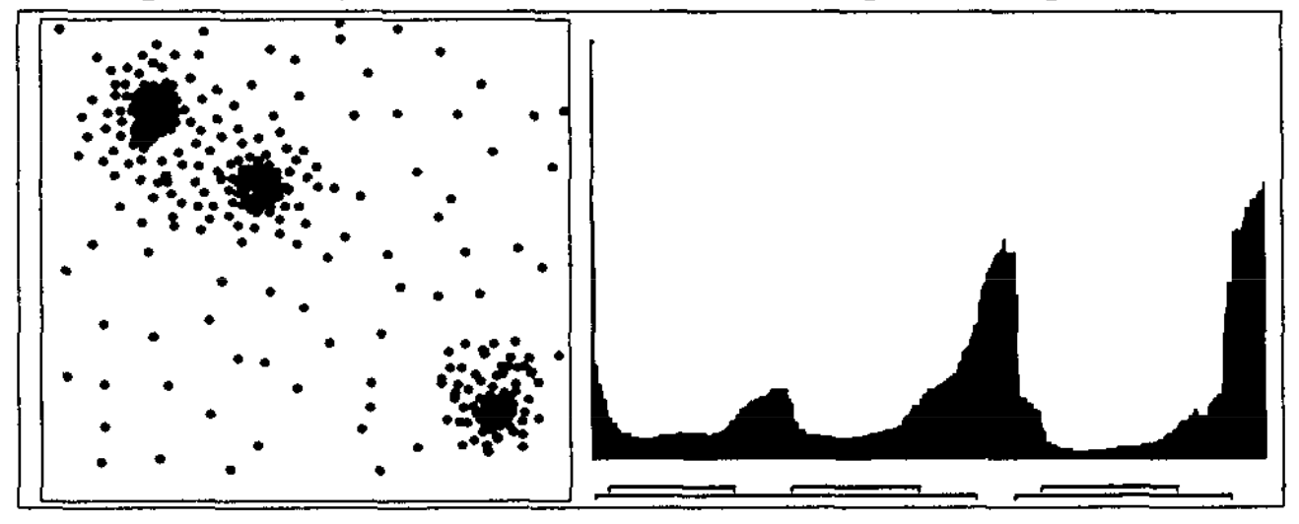
OPTICS ^{[1]}
Density Based
Requires:
Min # Points in a Cluster (MinPts),
Max Neighborhood radius (ε),
Degree of Steepness (ξ).
Produces Reachability Plot
Automatic cluster extraction from the plot
Clustering of Complex Datasets
Ahmed Tidjani, Fabio Buso, Paul Velthuis & Zahin Azher

Slide 7
OPTICS^{[1]} - contd
Implementations already available in: Java, Python, R and Matlab.
Objective:
Comparison of the different Implementations, with the focus on the automatic extraction
Performance Analysis
Problem:
Not all implementations extract automatically the clusters
Clustering of Complex Datasets
Ahmed Tidjani, Fabio Buso, Paul Velthuis & Zahin Azher

Slide 8
Organization

Slide 9
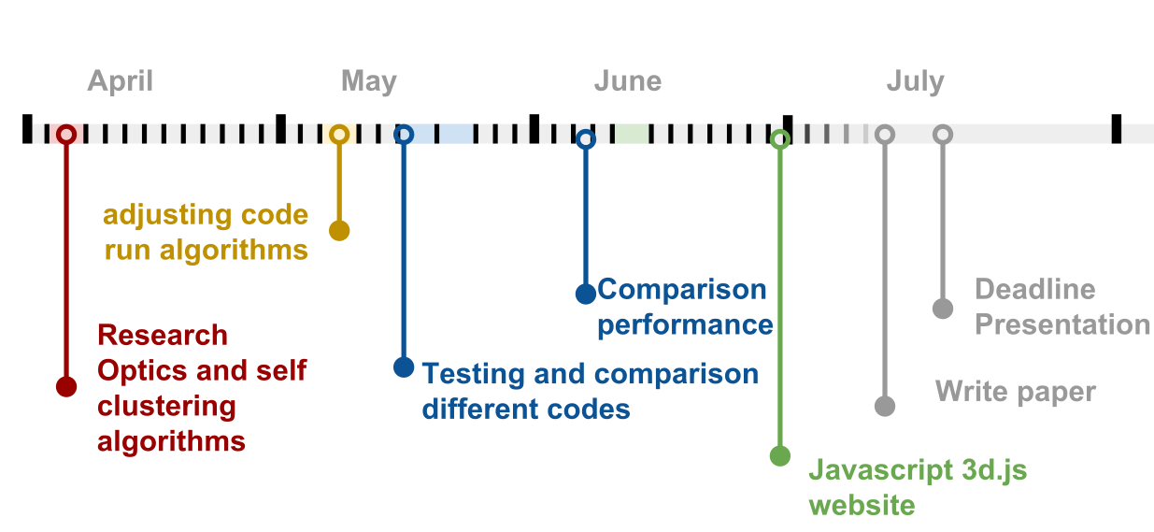
Timeline
Clustering of Complex Datasets
Ahmed Tidjani, Fabio Buso, Paul Velthuis & Zahin Azher

Slide 10
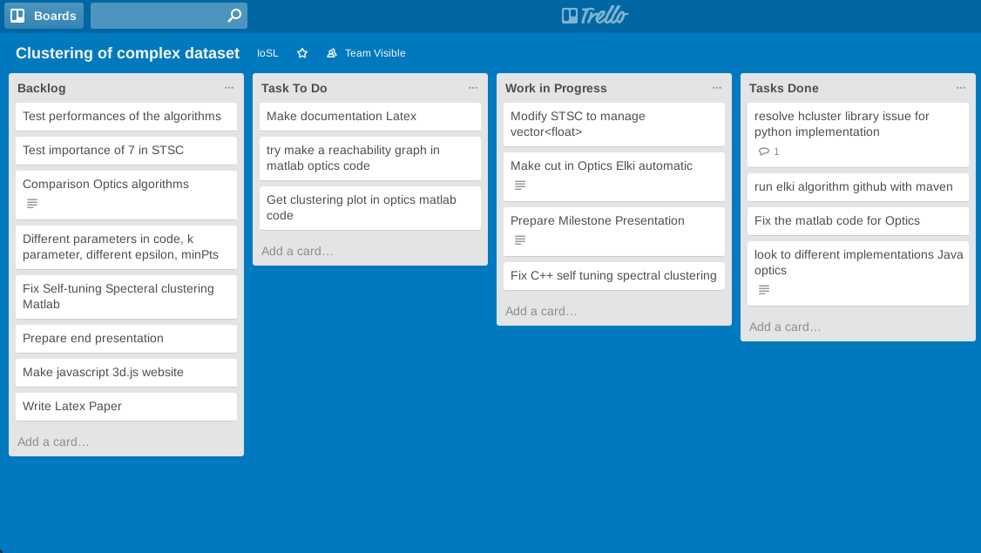
Tools
Trello
Clustering of Complex Datasets
Ahmed Tidjani, Fabio Buso, Paul Velthuis & Zahin Azher

Slide 11
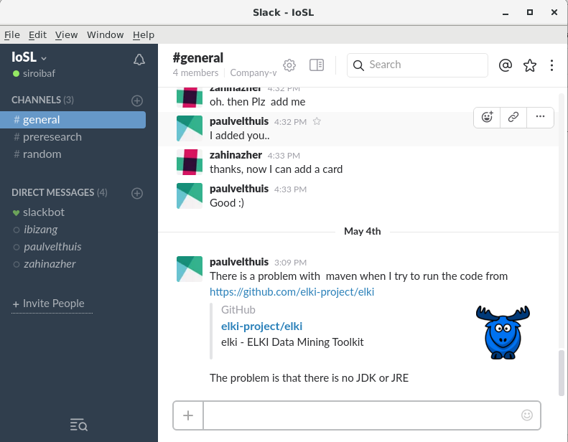
Tools
Trello
Slack
Clustering of Complex Datasets
Ahmed Tidjani, Fabio Buso, Paul Velthuis & Zahin Azher

Slide 12
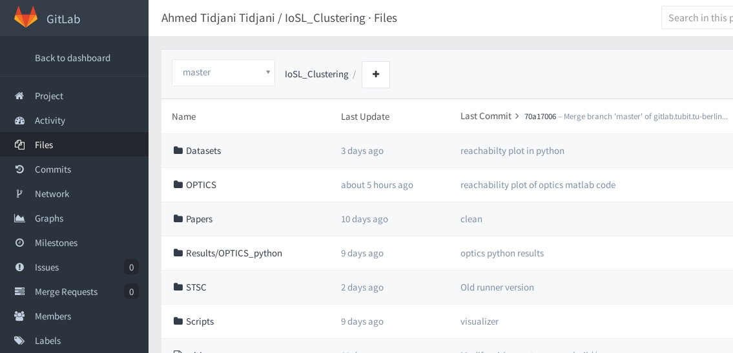
Tools
Trello
Slack
GitLab
Clustering of Complex Datasets
Ahmed Tidjani, Fabio Buso, Paul Velthuis & Zahin Azher

Slide 13
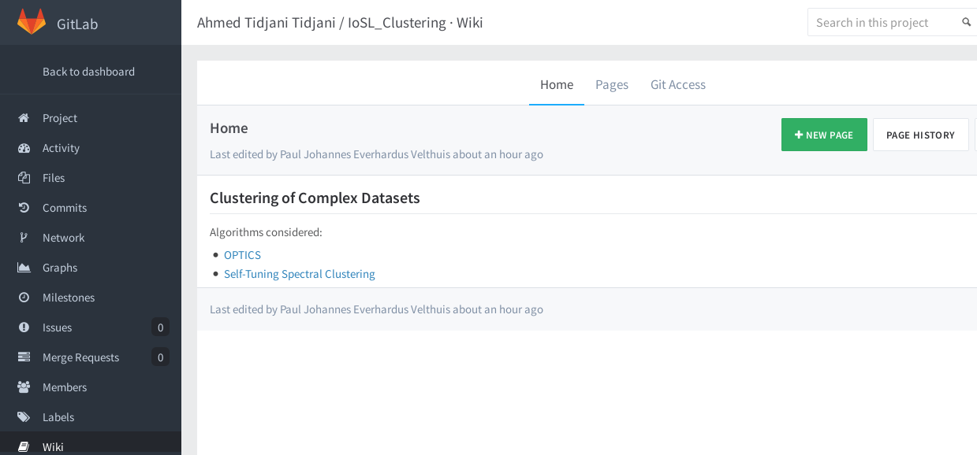
Tools
Trello
Slack
GitLab
GitLab - Wiki
Clustering of Complex Datasets
Ahmed Tidjani, Fabio Buso, Paul Velthuis & Zahin Azher

Slide 14
Thank You for your Attention
Questions?

Slide 15
References
[1] Ankerst, M., Breunig, M. M., Kriegel, H. P., & Sander, J. (1999, June). OPTICS: ordering points to identify the clustering structure. In ACM Sigmod Record (Vol. 28, No. 2, pp. 49-60). ACM.
[2] Zelnik-Manor, L., & Perona, P. (2004). Self-tuning spectral clustering. InAdvances in neural information processing systems (pp. 1601-1608).
Clustering of Complex Datasets
Ahmed Tidjani, Fabio Buso, Paul Velthuis & Zahin Azher

