Slide 1
Clustering of complex datasets
Milestone Presentation
Ahmed Tidjani, Fabio Buso, Paul Velthuis & Zahin Azher
Service-centric Networking | Tu Berlin | May 11th, 2016

Slide 2
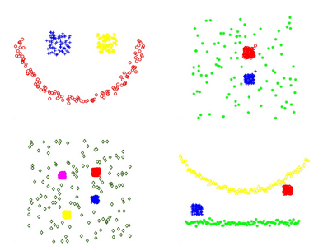
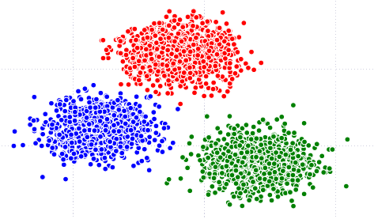
Complex Datasets
Normal Dataset
Complex Datasets
Clustering of Complex Datasets
Ahmed Tidjani, Fabio Buso, Paul Velthuis & Zahin Azher

Slide 3
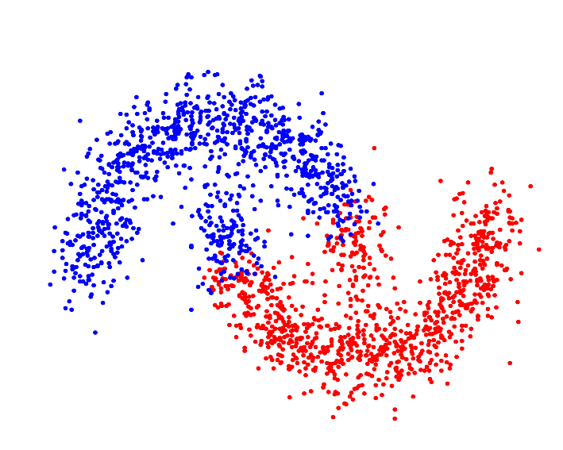
Clustering
Grouping a set of objects in a way that similar objects are in the same cluster.
Types:
Connectivity Based (Hierarchical)
Centroid Based (kMeans)
Density Based (OPTICS)
Self-Tuning Spectral Clustering
Kmeans Clustering
Clustering of Complex Datasets
Ahmed Tidjani, Fabio Buso, Paul Velthuis & Zahin Azher

Slide 4
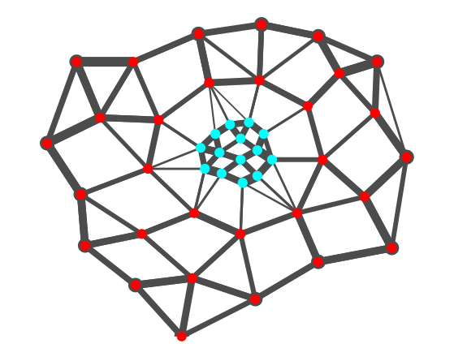
Self-tuning Spectral Clustering^{[2]}
Requires:
Max number of Clusters
Builds the affinity matrix based on the relations between objects in the dataset.
Operate a dimensionality reduction based the eigenvectors of the matrix.
Exploits the eigenvectors structure to determine the optimal number of clusters.
Clustering of Complex Datasets
Ahmed Tidjani, Fabio Buso, Paul Velthuis & Zahin Azher

Slide 5
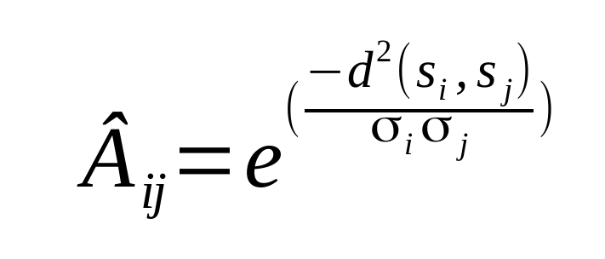
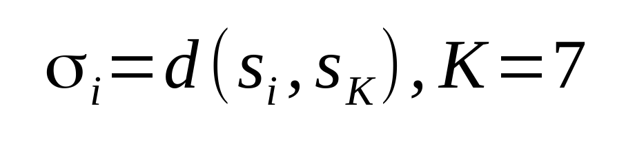
Self-tuning Spectral Clustering^{[2]} - contd
Building of the Affinity Matrix:
Clustering of Complex Datasets
Ahmed Tidjani, Fabio Buso, Paul Velthuis & Zahin Azher

Slide 6
Self-tuning Spectral Clustering^{[2]} - contd
Implementations already available in: C++ and Matlab
Objective:
Investigate the construction of the affinity matrix
Comparison with OPTICS
Performance Analysis
Clustering of Complex Datasets
Ahmed Tidjani, Fabio Buso, Paul Velthuis & Zahin Azher

Slide 7
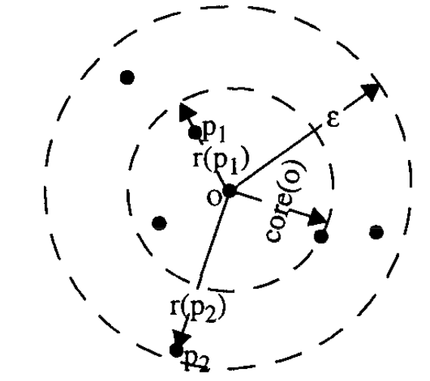
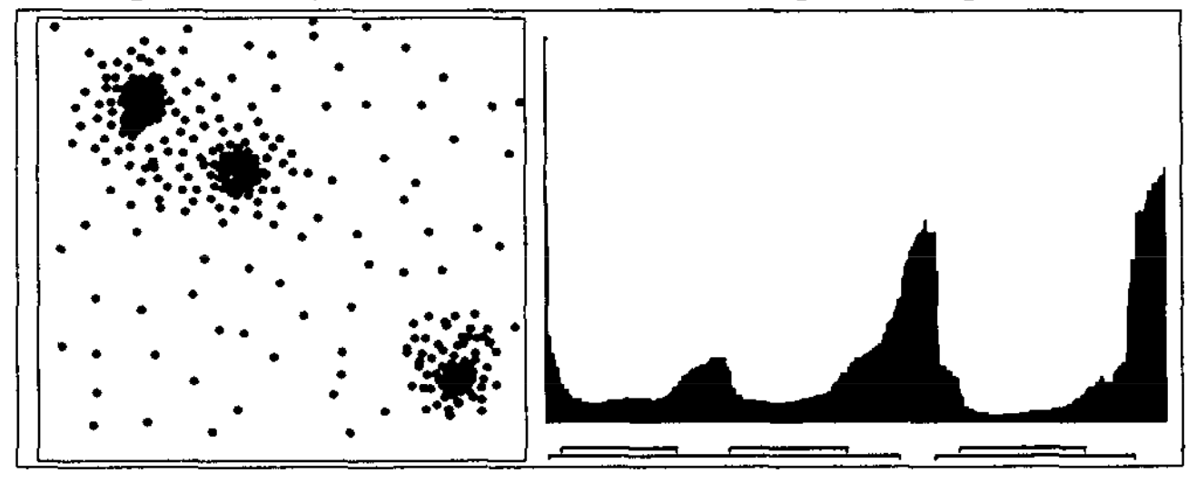
OPTICS ^{[1]}
Density Based
Requires:
Min # Points in a Cluster (MinPts),
Max Neighborhood radius (ε),
Degree of Steepness (ξ).
Produces Reachability Plot
Automatic cluster extraction from the plot
Clustering of Complex Datasets
Ahmed Tidjani, Fabio Buso, Paul Velthuis & Zahin Azher

Slide 8
OPTICS^{[1]} - contd
Implementations already available in: Java, Python, R and Matlab.
Objective:
Comparison of the different Implementations
Focus on the automatic cluster extraction
Performance Analysis
Problem:
Not all implementations extract automatically the clusters
Clustering of Complex Datasets
Ahmed Tidjani, Fabio Buso, Paul Velthuis & Zahin Azher

Slide 9
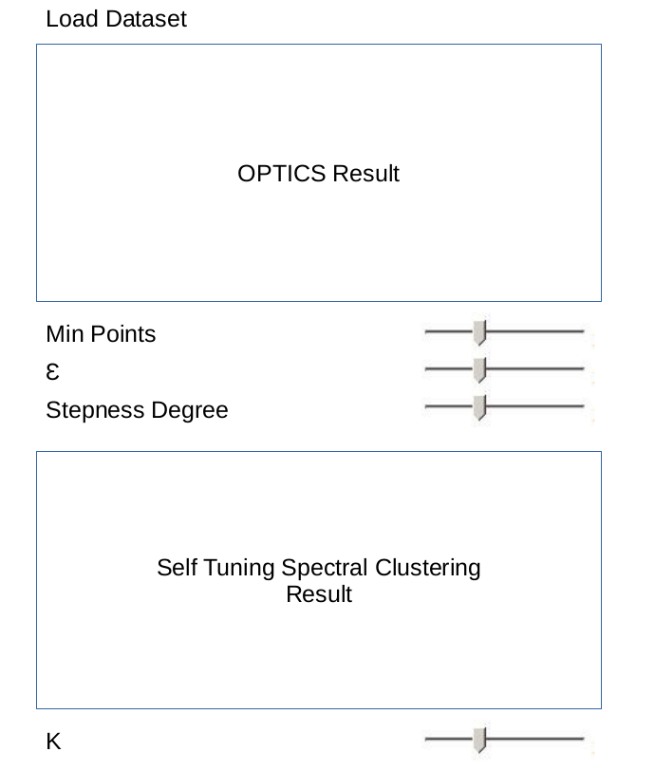
Visualization Tool
Website to run the experiments and visualize the results.
Possibility to set the parameters and see the result in real time.
Plot with the Javascript library D3.js
Backend in Python to execute the different algorithms.
Clustering of Complex Datasets
Ahmed Tidjani, Fabio Buso, Paul Velthuis & Zahin Azher

Slide 10
Organization

Slide 11
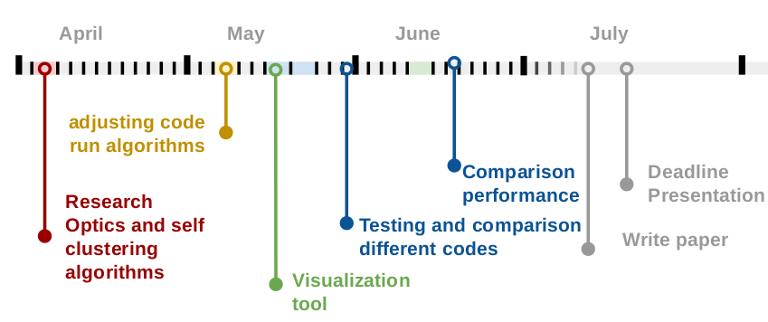
Timeline
Clustering of Complex Datasets
Ahmed Tidjani, Fabio Buso, Paul Velthuis & Zahin Azher

Slide 12
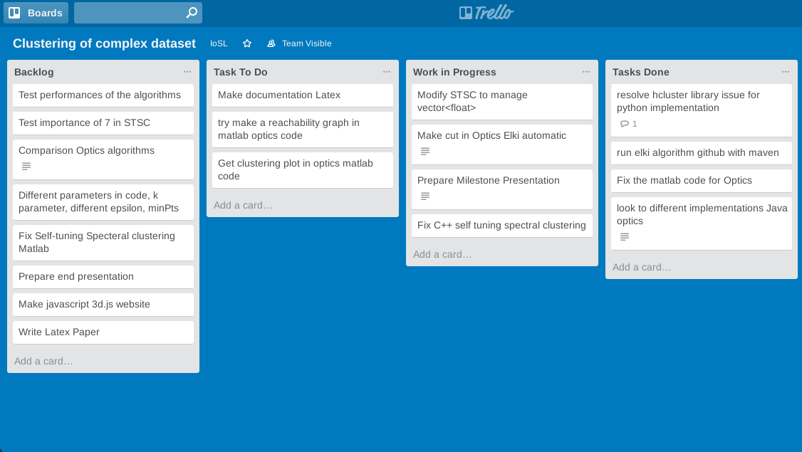
Tools
Trello
Clustering of Complex Datasets
Ahmed Tidjani, Fabio Buso, Paul Velthuis & Zahin Azher

Slide 13
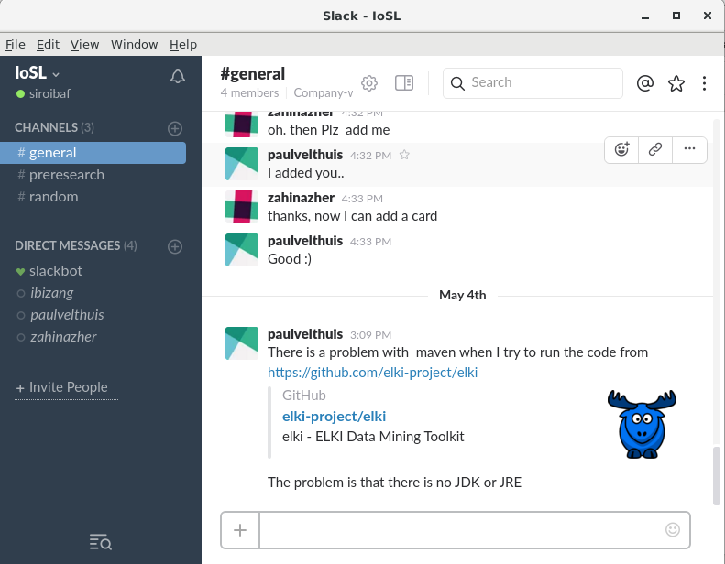
Tools
Trello
Slack
Clustering of Complex Datasets
Ahmed Tidjani, Fabio Buso, Paul Velthuis & Zahin Azher

Slide 14
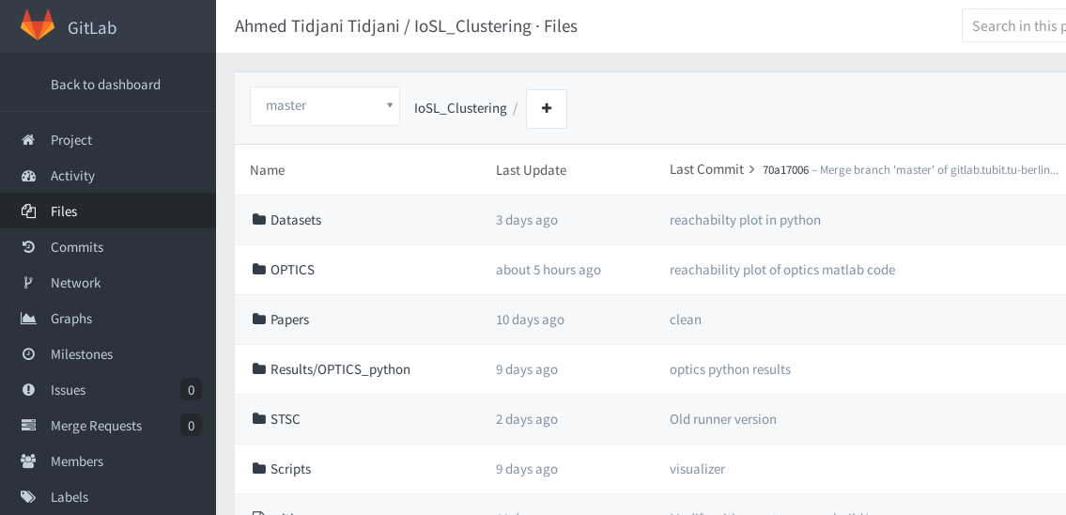
Tools
Trello
Slack
GitLab (Wiki)
Clustering of Complex Datasets
Ahmed Tidjani, Fabio Buso, Paul Velthuis & Zahin Azher

Slide 15
Thank You for your Attention
Questions?

Slide 16
References
[1] Ankerst, M., Breunig, M. M., Kriegel, H. P., & Sander, J. (1999, June). OPTICS: ordering points to identify the clustering structure. In ACM Sigmod Record (Vol. 28, No. 2, pp. 49-60). ACM.
[2] Zelnik-Manor, L., & Perona, P. (2004). Self-tuning spectral clustering. InAdvances in neural information processing systems (pp. 1601-1608).
Clustering of Complex Datasets
Ahmed Tidjani, Fabio Buso, Paul Velthuis & Zahin Azher

