Slide 1
Detecting the Higgs Boson Signal Amidst Background Noise Using RNN
GROUP 4:
VENKATA GANGADHAR NAVEEN PALAKA
ANURADHA TIDKE
RAKSHITH REDDY ELETI

Slide 2
Motivation
The main motivation for developing this code is to apply the theoretical knowledge of Recurrent Neural Networks we gained during this class, to a real world problem.

Slide 3
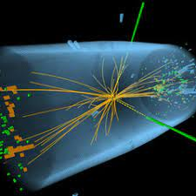
What is the Higgs boson?
The Higgs boson is a basic particle linked with the Higgs field, which supplies mass to other fundamental particles like electrons and quarks.
In 2012, a subatomic particle with the expected properties was discovered by the ATLAS and CMS experiments at the Large Hadron Collider (LHC) at CERN near Geneva, Switzerland.
The new particle was subsequently confirmed to match the expected properties of a Higgs boson.

Slide 4
Experiment Description
The Higgs boson machine learning challenge (HiggsML or Challenge in short) has been set up to promote collaboration between high energy physicists and data scientists.
Our task was to analyze a set of simulated particle collision data containing features characterizing events detected by ATLAS (a particle physics experiment at the Large Hadron Collider at CERN).
The objective of the analysis was to classify events as either a signal, indicating the tau tau Decay of a Higgs boson, or background noise.

Slide 5
Dataset explanation
Training data
250000 events
ID column
30 feature columns
a weight column
a label column
Test data
550000 events
ID column
30 feature columns

Slide 6
Feature description
The variables prefixed with PRI (for PRImitives) are “raw” quantities about the bunch collision as measured by the detector, essentially the momenta of particles.
Variables prefixed with DER (for DERived) are quantities computed from the primitive features
Label
Background noise
Higgs boson signal

Slide 7

Architecture of a traditional RNN
Recurrent neural networks, also known as RNNs, are a class of neural networks that allow previous outputs to be used as inputs while having hidden states.
Simple RNN model

Slide 8
Shortcomings of RNN
Gradients are values used to update a neural networks weights.
The vanishing gradient problem is when the gradient shrinks as it back propagates through time.
If a gradient value becomes extremely small, it doesn’t contribute much to learning.
So because the earlier layers don’t learn, RNN’s can forget what it has seen in longer sequences, thus having a short-term memory.
Gradients shrink as it back-propagates down

Slide 9
Our approach
We decided to choose LSTM algorithm for our code.
As the number of features is large (30), and the derived features are dependent on the primitive features, we decided to run our code in 3 ways:
using only primitive features
using only derived features
using both primitive and derived features

Slide 10
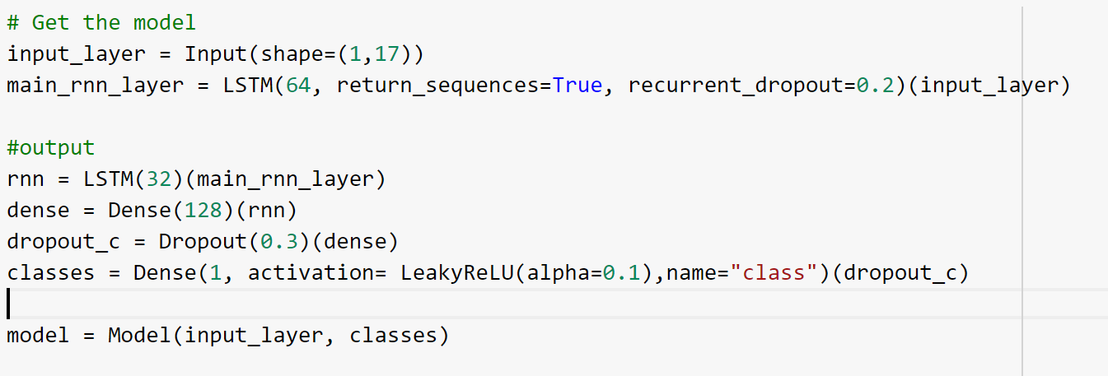
Pipeline
Data cleaning:
Dropping unnecessary feature columns
Finding uncommon variables and dropping them
Handling missing values
Normalize the data
Build model architecture: The following screenshot is for the model with primitive features (17 variables)

Slide 11
Pipeline contd.
Defining optimizer and loss functions:
There are multiple loss functions based on their target variable type:
We decided to go with ADAM optimizer as it is the best.
Setting callbacks:
ModelCheckpoint callback:
Callback to save the Keras model or model weights at some frequency.
For our model, we set the variable to monitor as validation accuracy and saved the weights of best model so far.
ReduceLROnPlateau callback:
Reduce learning rate when a metric has stopped improving.
For our model, we set the variable to monitor as validation accuracy. If the accuracy doesn’t improve in 3 epochs, the learning rate will be reduced by a factor of 0.5
MSE | Gaussian target var
MS logarithmic loss | target variable values are widely spread
Binary cross entropy loss | target values are in the set {0, 1}
Hinge loss | target values are in the set {-1, 1}

Slide 12
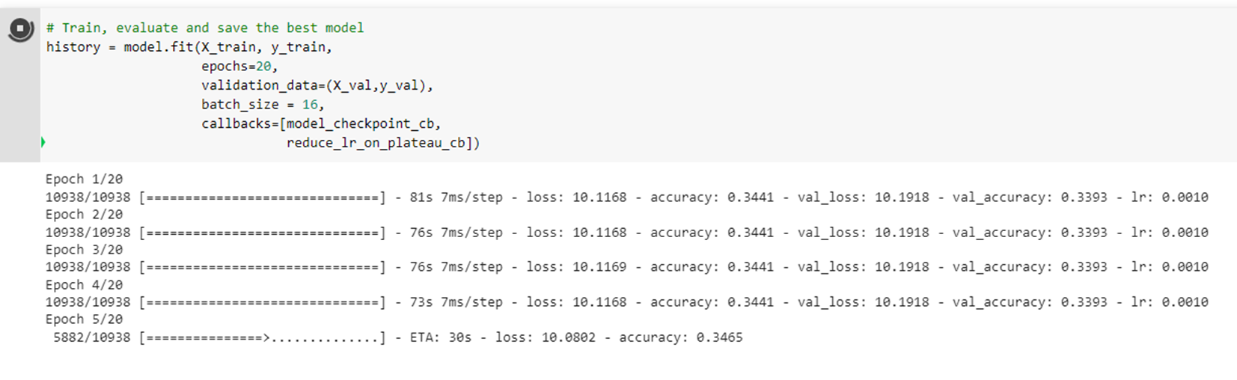
Case study
We tried running the model with batch size = 16 and noticed the loss values are too large and accuracy is minimal.
So, we increased it and did more experiments with other parameters as shown in the next slide

Slide 13
Case 1: Considering only primitive features
Version/parameter to monitor for callbacks | Start learning rate Start Learning Rate | Batch size Batch Size | Best_model_val_loss Best_model_val_loss | Best_model_val_Accuracy Best_model_val_Accuracy
1/val_loss | 1e-3 | 64 | 0.5682 | 0.6963
2/val_accuracy | 1e-3 | 64 | 0.5765 | 0.7151
3/val_accuracy | 1e-3 | 128 | 0.5763 | 0.7022
4/val_accuracy | 1e-3 | 256 | 0.5810 | 0.6896

Slide 14
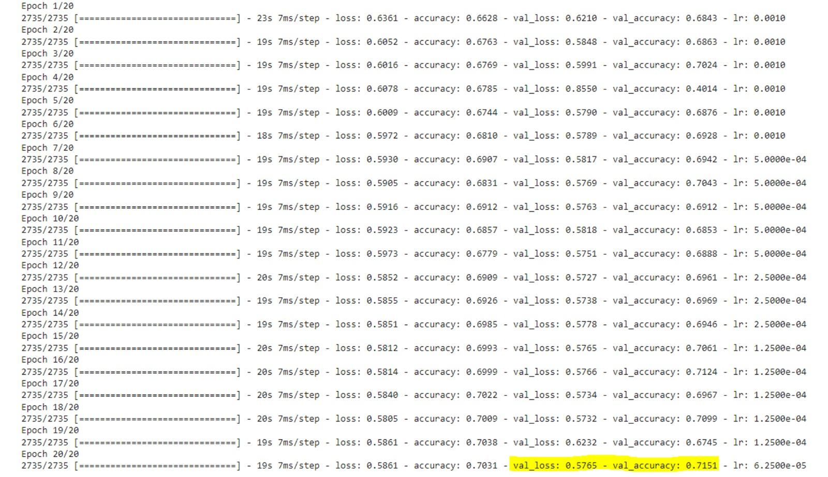

Slide 15
Case 2: Considering only derived features
Version/parameter to monitor for callbacks | Start learning rate Start Learning Rate | Batch size Batch Size | Best_model_val_loss Best_model_val_loss | Best_model_val_Accuracy Best_model_val_Accuracy
1/val_loss | 1e-3 | 64 | 0.4896 | 0.7560
2/val_accuracy | 1e-3 | 64 | 0.4981 | 0.7475
3/val_accuracy | 1e-3 | 128 | 0.5267 | 0.7445
4/val_accuracy | 1e-3 | 256 | 0.5869 | 0.7287

Slide 16
Case 3: Considering both primitive and derived features
Version/parameter to monitor for callbacks | Start learning rate Start Learning Rate | Batch size Batch Size | Best_model_val_loss Best_model_val_loss | Best_model_val_Accuracy Best_model_val_Accuracy
1/val_loss | 1e-3 | 64 | 0.5153 | 0.7365
2/val_accuracy | 1e-3 | 64 | 0.4984 | 0.7585
3/val_accuracy | 1e-3 | 128 | 0.4953 | 0.7586
4/val_accuracy | 1e-3 | 256 | 0.5558 | 0.7087

Slide 17
CONCLUSION
We got the validation accuracy of:
75.86% when we considered all 30 features (primitive and derived)
75.6% with just the 13 derived features
71.51% with just the 17 primitive features
We consider the second experiment with derived features, the best because:
Lower number of features
Less computational cost
Negligible loss of accuracy as compared to the best model

Slide 18
Thank you!

