Slide 1
Selling Price of Used Cars
Team :
Anuradha Tidke
Priya Johny
Rakshith Reddy Eleti
Venkata Gangadhar Naveen Palaka

Slide 2
Dataset
This is a comprehensive about used cars. This data can be used for lot of purposes such as price prediction to exemplify the use of linear regression.
Source: Kaggle
The data comes from the
8128 observations and 13 variables
“name” -[chr] “owner” -[chr]
“year” -[int] “mileage” -[chr]
“selling_price” -[int] “engine” -[chr]
“km_driven -[int] “torque” -[chr]
“fuel” -[chr] “seats” -[int]
“seller_type” -[chr] “transmission” -[chr]

Slide 3
SMART Questions
Variation in the selling price of cars by: ● Fuel type (diesel, CNG, LPG, petrol) ● Seller type (dealer, individual, trustmark dealer
● Model year (1983-2020)
● Number of previous owners (1-4) ● Transmission type (automatic, manual)
● Number of seats in the car ● Kilometers driven
Type of car that has been sold the most (in each category) and the prefered category in each variable mentioned above.
Calculate correlation between the selling price and all the remaining variables.
Build a model to predict the selling price based on the variables (Feature selection, Linear regression model, Principal component analysis and Principal component regression)

Slide 4
Exploratory Data Analysis

Slide 5
Dataset
Turn the variable “seller_type”, “transmission”, “owner”and “fuel” into factors (categorical).
Turn the variable “mileage”, “engine”, “max_power”, “torque”, and “owner” into numeric.
Graphs used:
○ Boxplot ○Correlation plot ○Line plot ○Scatter plot ○Histograms

Slide 6
Variation in the selling price of cars
#w.r.t. Categorical Features
● Fuel type (diesel, CNG, LPG, petrol) ● Seller type (dealer, individual, trustmark dealer) ● Transmission type (automatic, manual)

Slide 7
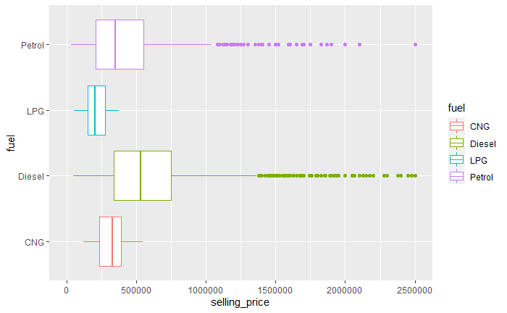
Variation in the selling price of cars
Minimal overlap between the plots of each fuel category.
Significant correlation between selling price and fuel type.
In other words, the selling price depends greatly on the fuel type.

Slide 8
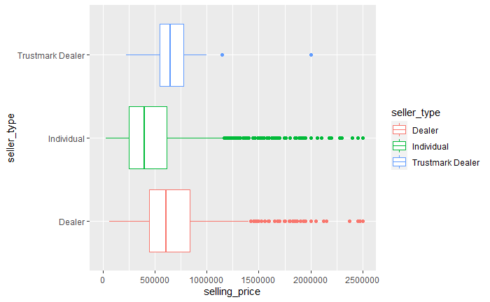
Variation in the selling price of cars
Significant overlap between the plots of seller types 'dealer' and 'trustmark dealer' which is expected as both are dealers in the end.
But the overlap between 'individual' and other two is not significant.
Significant correlation between selling price and seller type.
In other words, the selling price depends on the seller type.

Slide 9
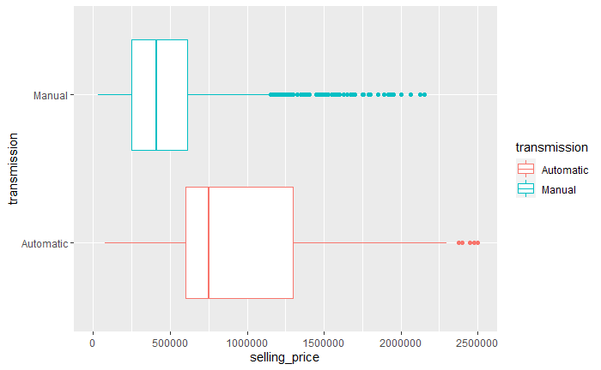
Variation in the selling price of cars
Minimal overlap between the plots of each transmission category.
Significant correlation between selling price and transmission type.
In other words, the selling price depends greatly on the transmission type.

Slide 10
Variation in the selling price of cars
#w.r.t. Numerical Features
● Number of previous owners (1-4)
● Number of seats in the car ● Kilometers driven
● Model year (1983-2020)

Slide 11
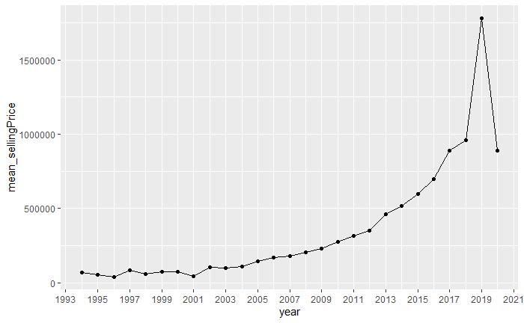
Variation in the selling price of cars
We can see that the selling price greatly depends on the year of the model.
It is higher for a more recent car than an older one. This observation is expected.

Slide 12
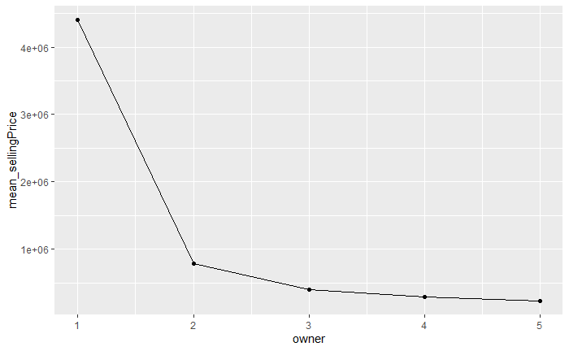
Variation in the selling price of cars
We can see that the selling price greatly depends on the number of previous owners.
The lesser the number of previous owner, more is the price which is expected.

Slide 13
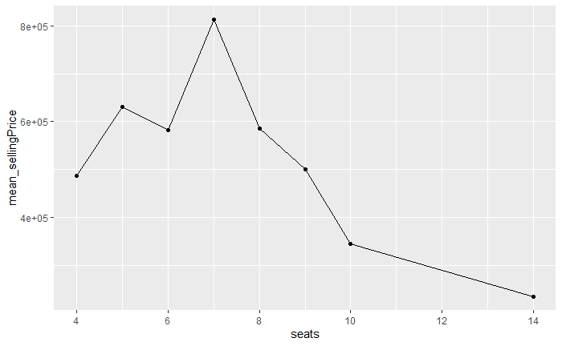
Variation in the selling price of cars
We can see that the selling price depends on the number of seats, increasing till 7 for an SUV and decreasing after that.

Slide 14
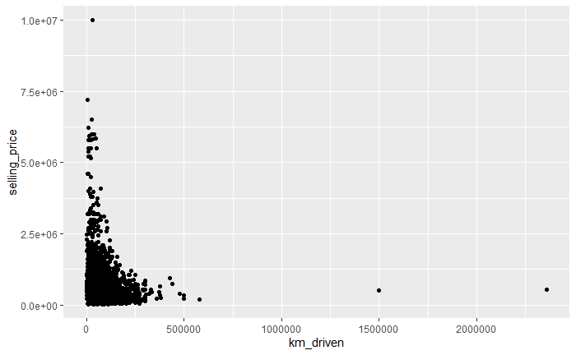
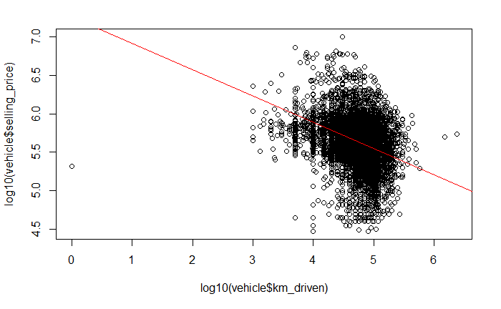
Variation in the selling price of cars
The graph is exponential, as km_driven increases, the selling_price decreases which is expected.
So to calculate the mathematical relation between these variables, we plotted them after taking log of both because we will have a linear model.
A linear fit line was plotted as well.

Slide 15
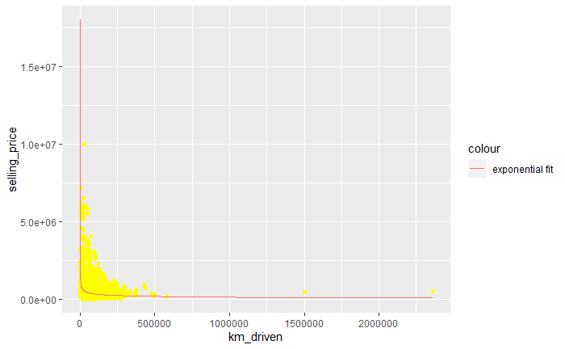
Variation in the selling price of cars
Using the coefficients we obtained from this linear model, we plotted the best fit exponential curve onto the original scatter plot.

Slide 16
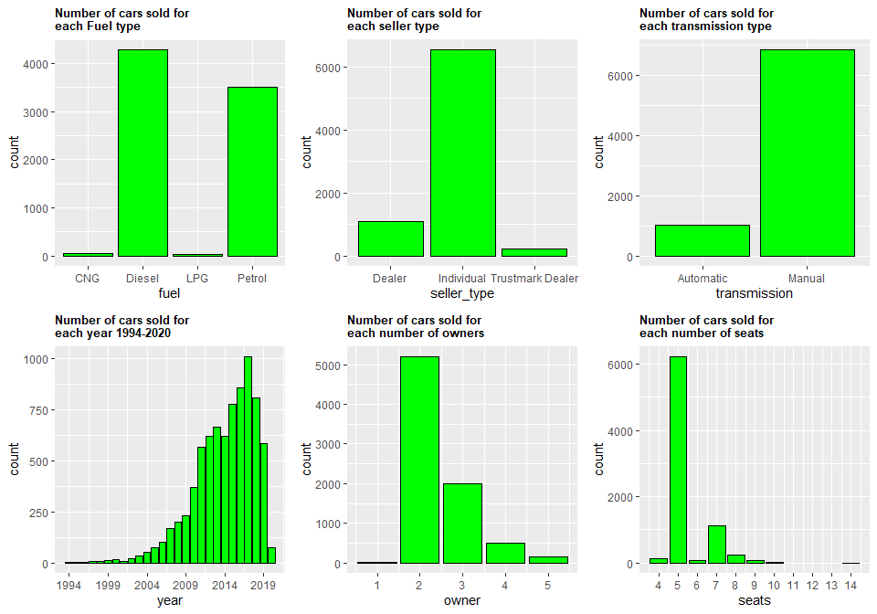
Type of car that has been sold the most
Variable | Category
Fuel | Diesel/Petrol
Seller type | Individual
Transmission | Manual
Year of the model | 2017
Number of previous owners | 2
Number of seats | 5

Slide 17



Correlation between the selling price and all the remaining variables
As seen from the boxplots, we concluded that the selling price was significantly dependent on the categories of all the categorical variables.
To confirm this observation, we ran anova test on each of them, found p-value < 2e-16 for all
SP_fuel = aov(selling_price ~ fuel, data = vehicle)
SP_transmission = aov(selling_price ~ transmission, data = vehicle)
SP_sellerType = aov(selling_price ~ seller_type, data = vehicle)

Slide 18
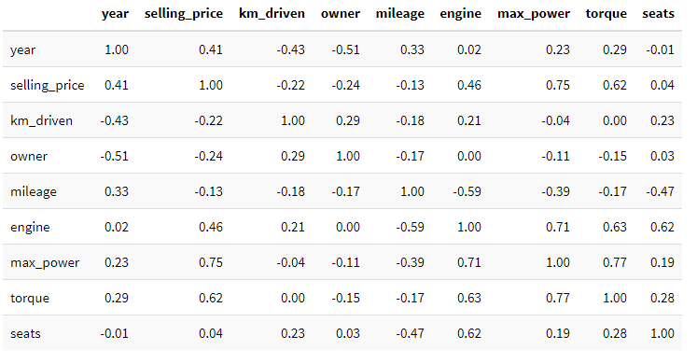
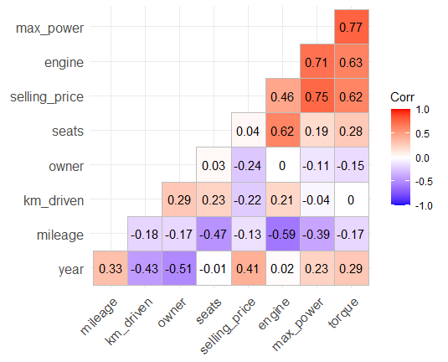
Correlation between the selling price and all the remaining variables

Slide 19
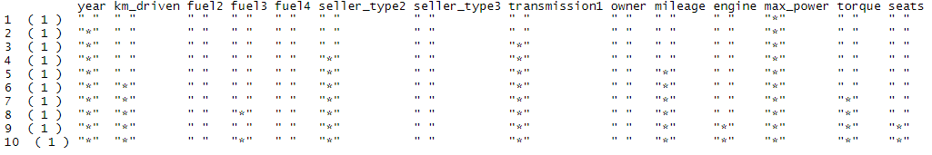
Logistic Regression
Feature Selection:
Exhaustive and forward methods were tried and compared.
A full OLS model was built (excluding the name variable):
reg.best10 <- regsubsets(selling_price~. -name , data = vehicle, nvmax = 10, nbest = 1, method = "exhaustive")

Slide 20
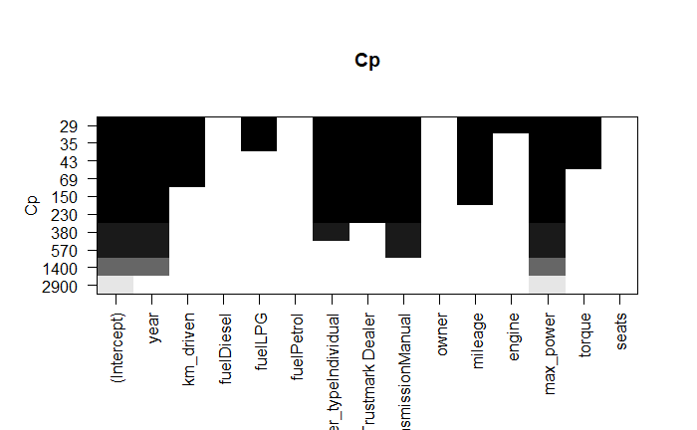
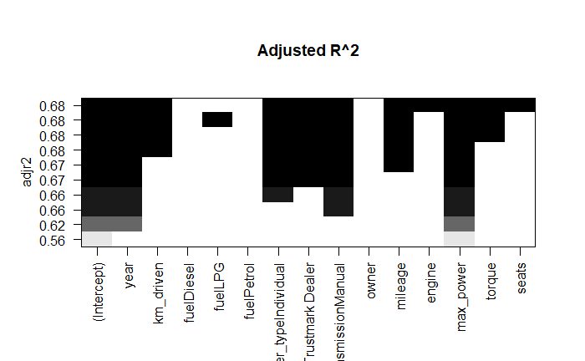

Logistic Regression
The models were plotted for Adj_R2, BIC and Cp
Maximize R2, minimize BIC and CP, and minimize the number of variables to reduce model complexity, the following model seems the best:
best_model = lm(selling_price~ year + km_driven+ seller_type+ transmission + mileage + max_power, data = vehicle)
Similar results were obtained when we tried forward method.

Slide 21
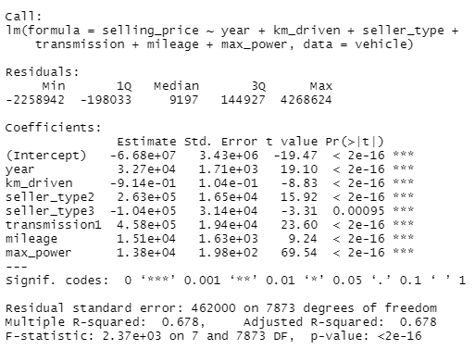
Linear regression model
best_model = lm(selling_price~ year + km_driven+ seller_type+ transmission + mileage + max_power, data = vehicle)
As can be seen from the p-values, all the selected features are highly significant.
Let’s run a prediction algorithm on this model.

Slide 22
Prediction model
best_model = lm(selling_price~ year + km_driven+ seller_type+ transmission + mileage + max_power, data = vehicle)
R_square value of the model: 0.678
Same model was constructed but considering train dataset instead of the full dataset (vehicle)
R_square value of this model: 0.679
This model was then applied to the test split dataset as follows
test$pred <- predict(model, test, type = "response")
Using the function rsq <- function(x, y) summary(lm(y~x))$r.squared, we found out its value to be 0.672.
Thus we can say that this model can explain around 67% of the variation in the y-variable (selling_price)
We tried PCA-PCR to see if we can get higher values for R_squared coefficient of determination.

Slide 23
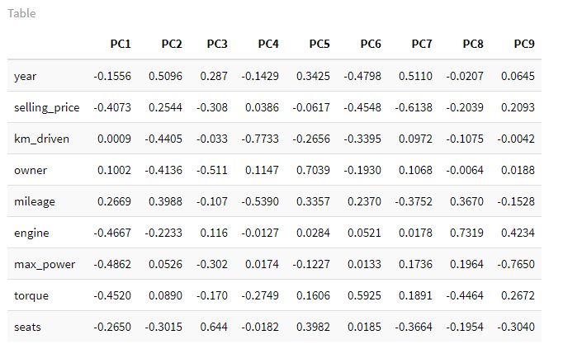

PCA
As can be seen from the “Importance of components” table, first 4 principal components can explain more than 80% of the variance.

Slide 24
PCA
The dataframe is already centered and scaled.
We use `nnpcomp <- prcomp(nndf)` to get the 9 PC-components. For `PC1`, which are the four strongest components it consists of?
For PCA, finding the components can be done directly with prcomp( ), and chose to standardize the variables there. Let us look at the results, and see that component coefficients. Notice that all these components are given in "unit vector" form, although it still has an arbitrary sign factor overall.
Strongest four components for PC1
max_power at -0.4862
engine at -0.4667
torque at -0.4520
Selling_price at -0.4073
Strongest four components for PC2
km_driven at -0.4405
owner at -0.4136
seats at -0.3015
engine at -0.2233

Slide 25
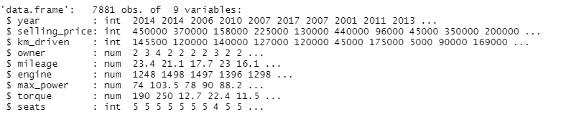
PCR
The basic idea behind PCR is to calculate the principal components and then use some of these components as predictors in a linear regression model fitted using the typical least squares procedure.
We need all numeric variables
We take subset with variables of numeric type

Slide 26
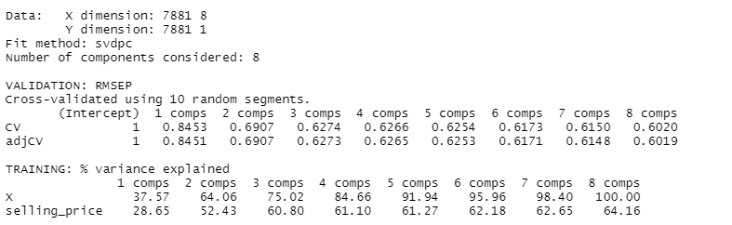
PCR
We can observe the validation error and the cumulative percentage of variance explained using ‘n’ components.
We expect Low cross validation error with a lower number of components than the number of variables in dataset. If this is not the case, then no dimensionality reduction occurs.
It looks like 5 components are enough to explain more than 90% of the variability in the data although the CV score is a little higher than with 8 components. Finally, note that 8 components explain all the variability as expected.

Slide 27
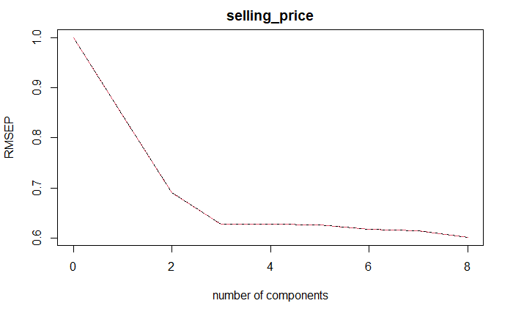
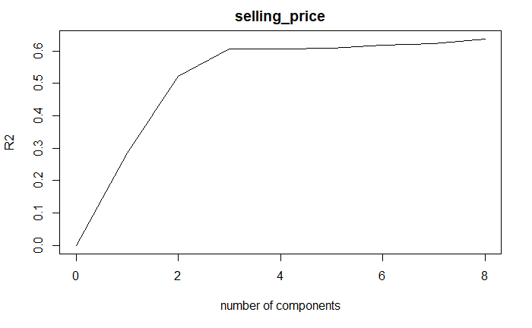
PCR
Root mean squared error was plotted for the pcr fit model, against number of principal components.
R-squared metric was plotted as well to see if the PCA improved the model.

Slide 28
Conclusion
To build a prediction model for our dataset we did the following things:
Perform exploratory data analysis (EDA) to check which variables affect our output variable which is the selling price of the car
Plot boxplots, line plots, histograms
Evaluate correlation matrix
Feature selection
Build a linear regression prediction model using the best features selected and test its R2 value
Build a PCR model by conducting PCA, to see if we can improve the R2 metric
We concluded that the variables which affect the selling price the most are:
year, km_driven, seller_type, transmission, mileage, max_power
The maximum value of R2 that can be attained using linear models is around 0.68.

Slide 29
QUESTIONS?

