Slide 1

Session 1
Linear Programming – Transportation
Big Data and Analytics
Topic 1:
Introduction to Big Data

Slide 2
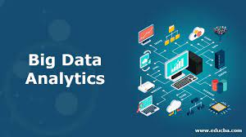
Introduction to Big Data Analytics
Linear Programming – Transportation
Overview:
Program description and course syllabus
Course Overview
Course content
Assignments
Module 1

Slide 3
Course Contents
Linear Programming – Transportation
This course includes 12 sessions which will be delivered over 12 weeks.
S1
Introduction to Big Data and Analytics
S2
Data Sourcing and Ingestion
S3
Big Data Integration and Storage
S4
Analytics Engine for Big Data- Apache Spark (Assignment 1 due)
S5
Data Exploration and Cleaning
S6
Classification
S7
Model Evaluation
S8
Predictive Modelling (Assessment 2 Due)
S9
Clustering
S10
Association Rules
S11
Graph Analytics
S12
Big Data Privacy and Security (Assessment 3 Due )

Slide 4
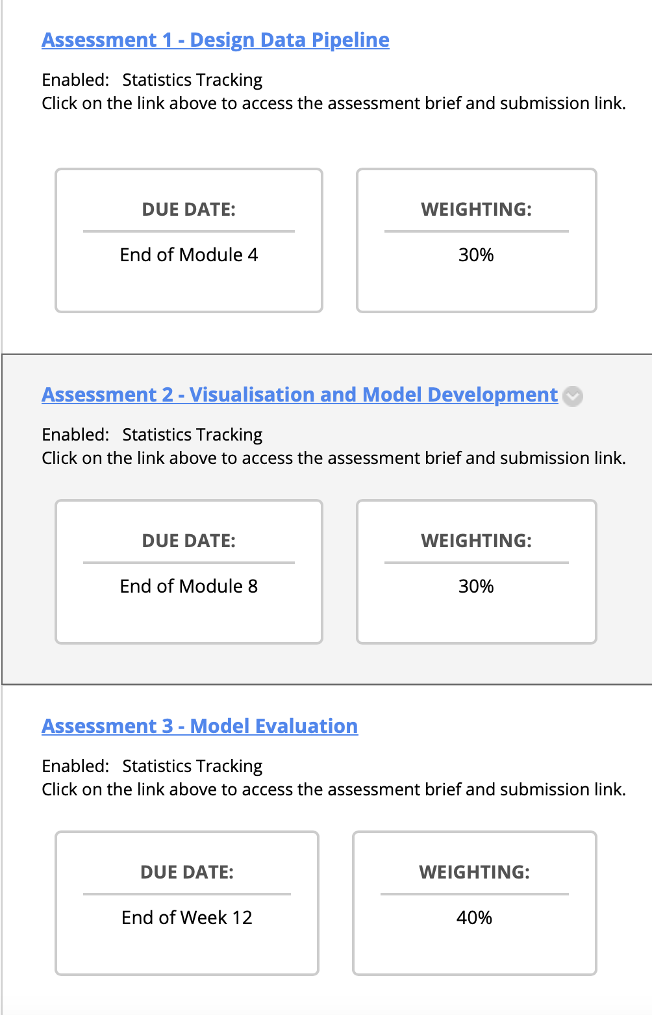

Assessments
Linear Programming – Transportation

Slide 5
Module 1
Linear Programming – Transportation
In this module, you will learn:
The rapid growth of data;
How data is being generated and driving the way we live and work;
The key uses of big data in business:
The characteristics of big data; and
The data analytics lifecycle.

Slide 6
Module 1
Linear Programming – Transportation
The rapid growth of data: In recent years, the healthcare industry has seen a significant increase in the generation of patient data. Electronic Health Records (EHRs), medical imaging, wearable health devices, and genomic data have all contributed to this growth. For instance, a single genome sequence can generate over 100 gigabytes of data. This explosion of healthcare data has led to advancements in personalized medicine and the development of more effective treatments. How data is being generated and driving the way we live and work: The Internet of Things (IoT) has transformed the way we live and work. Smart home devices, such as thermostats, cameras, and voice assistants, continuously collect data about our preferences and habits. This data is then used to automate tasks, enhance energy efficiency, and improve security. For instance, a smart thermostat can learn your temperature preferences and adjust settings to save energy while keeping you comfortable.
The key uses of big data in business: Retailers like Amazon utilize big data analytics to personalize recommendations for customers. They analyse a customer's past purchases, browsing history, and even demographic information to suggest products that are highly likely to be of interest to the individual. This not only enhances the customer experience but also drives increased sales and customer loyalty.

Slide 7
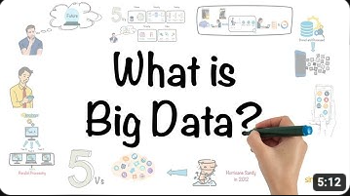
What is Big Data?
Linear Programming – Transportation
https://www.youtube.com/watch?v=bAyrObl7TYE

Slide 8
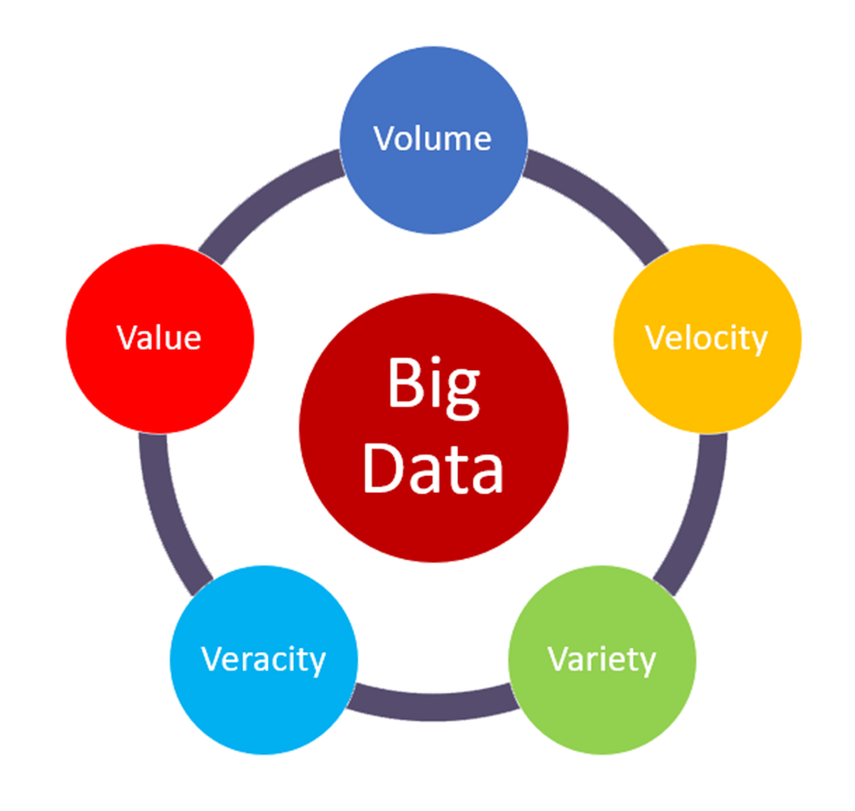
‌Big Data Characteristics
Linear Programming – Transportation
The "5 Vs" is a commonly used framework to describe the key characteristics of big data. These characteristics are important because they help differentiate big data from traditional data and highlight the unique challenges associated with managing and analyzing large and complex datasets. The five Vs of big data are:
Volume: This refers to the sheer size of the data. Big data typically involves datasets that are too large to be easily managed and processed by traditional database systems. Volume can range from terabytes to petabytes and beyond.
Velocity: Velocity relates to the speed at which data is generated, collected, and processed. In the era of real-time data and the Internet of Things (IoT), data can be generated and updated rapidly. High velocity data requires efficient and near real-time processing.
Notes:
The characteristics of big data: Social media platforms like Facebook handle vast amounts of big data every day. These data sets include text, images, videos, and user interactions. The characteristics of big data, often referred to as the "3Vs" (Volume, Velocity, and Variety), are exemplified here. Facebook deals with enormous volumes of data, experiences rapid data velocity as users post content in real-time, and manages a variety of data types, from text statuses to multimedia files.

Slide 9
‌Big Data Characteristics
Linear Programming – Transportation
Variety: Variety pertains to the diversity of data types and sources. Big data encompasses structured data (e.g., databases), unstructured data (e.g., text, images, videos), and semi-structured data (e.g., JSON, XML). Data can come from a wide range of sources, including sensors, social media, logs, and more.
Veracity: Veracity is about the quality and reliability of the data. Big data often includes noisy, incomplete, or inconsistent data. Ensuring data quality and accuracy is a significant challenge in big data analytics.
Value: Ultimately, the goal of working with big data is to extract value and insights. Value refers to the ability to derive meaningful and actionable insights from the data, which can lead to improved decision-making, business opportunities, and innovation.

Slide 10


‌Life Cycle of Big Data
Linear Programming – Transportation
The big data life cycle involves several key stages:
Data Generation: Data is created from various sources.
Data Ingestion: Data is collected and prepared for storage.
Data Storage: Data is stored in scalable systems.
Data Processing: Data is processed for analysis.
Data Analysis: Insights are derived from the data.
Data Visualization: Data is presented visually for understanding.
Decision-Making: Informed decisions are made.
Data Maintenance: Data is updated and maintained.
Scaling and Optimization: Infrastructure is optimized as data grows.
Feedback Loop: Insights drive changes and improvements.
This cycle is continuous and helps organizations harness the power of big data for informed decisions and innovation.
Regenerate
Example
Notes:
Data Generation: A smartwatch measures a user's heart rate, steps taken, and sleep patterns every day.
Data Ingestion: These readings from the smartwatch are automatically synced to the cloud every hour.
Data Storage: All the data from users around the world is stored in a distributed file system like Hadoop HDFS.
Data Processing: Every night, the data is processed to calculate average heart rate, total steps, and sleep duration for each user.
Data Analysis: Patterns are recognized in the data, such as the correlation between increased physical activity and improved sleep quality.
Data Visualization: A dashboard displays graphs and charts showing trends in user activity and health metrics over time.
Decision-Making: A health company decides to roll out a new fitness challenge feature in their app, inspired by the data showing that increased physical activity improves sleep.
Data Maintenance: Over time, as users replace their smartwatches, the old data is archived and the new data sources are integrated.
Scaling and Optimization: As the number of users grows, more storage nodes are added to the Hadoop cluster, and data processing tasks are optimized to run faster.
Feedback Loop: After the fitness challenge feature is released, user data shows increased engagement. This feedback leads to the development of more such features and periodic challenges to keep users motivated.

Slide 11

Github (Installation and Join)
Linear Programming – Transportation
What is Github?
Platform: Online hub for code collaboration.
Version Control: Tracks code changes.
Repos: Project containers with history.
Pull Requests: Code review and merge.
Community: Global developer network.
Integrations: Tool and CI/CD support.
Security: Protects code and detects vulnerabilities.
GitHub enhances code collaboration, project management, and innovation for developers and teams.
My Github
Sharing info on Github

Slide 12

Installation
Linear Programming – Transportation

Slide 13

Anaconda
Linear Programming – Transportation
A widely used open-source distribution of Python and R programming languages for scientific computing, data science, and machine learning.
Provides a comprehensive ecosystem of tools and libraries for data analysis, numerical computing, and machine learning, making it a popular choice among data scientists, researchers, and developers.
Key features and components of Anaconda include:
Conda: Anaconda comes with its package manager called Conda, which allows users to easily install, manage, and update packages, dependencies, and environments. Conda simplifies the process of setting up and maintaining the software stack required for data science and scientific computing.
Package Management: Anaconda includes a vast collection of pre-built packages and libraries, such as NumPy, SciPy, pandas, scikit-learn, Matplotlib, and many others, which are essential for various data analysis and machine learning tasks.

Slide 14
Anaconda
Linear Programming – Transportation
Environments: Anaconda enables users to create isolated environments for different projects, each with its own set of packages and dependencies. This helps ensure project-specific dependencies and avoids conflicts between packages.
Jupyter Notebooks: Anaconda includes the Jupyter Notebook, a popular interactive computing environment that allows users to create and share documents containing live code, equations, visualizations, and narrative text. It's widely used for data exploration, analysis, and documentation.
Integrated Development Environment (IDE): Anaconda can be used with various integrated development environments like JupyterLab, Spyder, and others, which provide powerful tools for coding, debugging, and running data science projects.
Supported Platforms: Anaconda is available for Windows, macOS, and Linux, making it a cross-platform solution for data scientists and researchers.
Commercial Support: Anaconda, Inc., the company behind Anaconda, offers commercial versions of Anaconda that include additional features, support, and services for enterprise users.

Slide 15
Anaconda (Installation)
Linear Programming – Transportation
Download Anaconda:
Visit the Anaconda download page at https://www.anaconda.com/products/individual and download the installer for your operating system (Windows, macOS, or Linux). Choose the version (Python 3.x is recommended) that suits your needs.
Run the Installer:
Once the installer file is downloaded, run it. Follow the installation wizard's instructions to set up Anaconda on your system.
On Windows: Double-click the downloaded .exe file and follow the prompts.
On macOS: Open the downloaded .pkg file and follow the installer's instructions.
Follow the installation wizard: …
Refer to my Github, under the Installation Folder

Slide 16


Anaconda (Initialize)
Linear Programming – Transportation
Initialize Anaconda
To start using Anaconda, you can open a new terminal or command prompt and enter the following command to initialize Anaconda:
Verify the Installation
You can verify that Anaconda was installed correctly by opening a new terminal or command prompt and running the following command:
.
This should display the installed Conda version.
Use conda installpython=3.11 to install Python

Slide 17

Jupyter Notebook
Linear Programming – Transportation
Jupyter Notebook is an open-source web app for creating interactive documents with live code, text, and visualisations. Key features:
Interactive: Run code step by step.
Multi-language: Supports Python, R, Julia, etc.
Notebooks: Combine code, text, equations, and visuals.
Kernels: Execute code in different languages.
Rich Outputs: Generate plots, tables, widgets.
Sharing: Save and share as HTML, PDF, or .ipynb.
Extensions: Enhance functionality with plugins.
Used in data science, research, and education for interactive computing and data analysis.
Installation and initialization: Refer to my Github, under the Installation Folder

Slide 18
Jupyter Notebook (Sample Code)
Linear Programming – Transportation
Jupyter Cell Types:
In Jupyter Notebook, there are three main types of cells:
Code Cells: Used for writing and executing code in various languages. Markdown Cells: Used for adding formatted text and explanations. (#, - , **)
Raw Cells: Allow you to add unprocessed content, like HTML or LaTeX.
Kernels:
In Jupyter Notebook, selecting kernels refers to choosing the programming language and environment in which you want to execute code within a specific notebook. Each notebook can be associated with a particular kernel, allowing you to work with multiple programming languages or different Python environments within the same Jupyter Notebook interface. Here's how to explain selecting kernels in Jupyter:
Multiple Language Support: Jupyter Notebook supports various programming languages, such as Python, R, Julia, and more. Each language has its own kernel.
Kernel Selection: When you create or open a Jupyter Notebook, you can choose a kernel that matches the programming language you intend to use for that notebook. This selection is made at the notebook's creation and can be changed later.
print(“Hello Word”). SHIFT+ENTER
2+2 SHIFT+ENTER

Slide 19
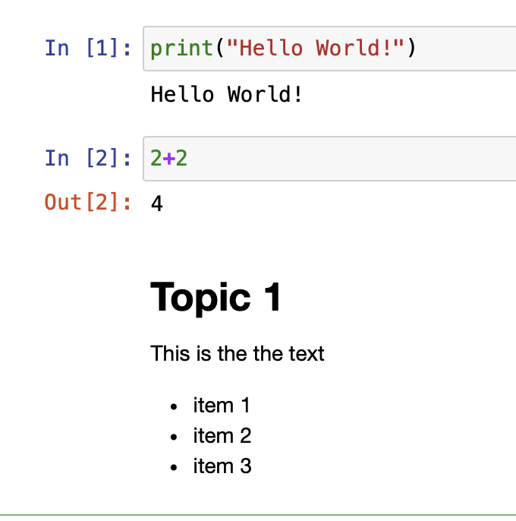
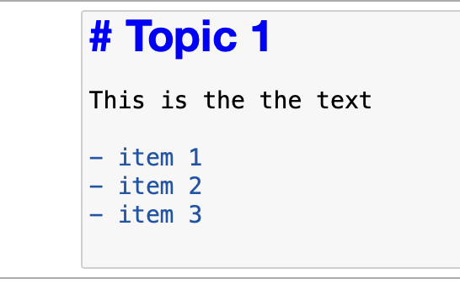
Jupyter Notebook
Linear Programming – Transportation
SHIFT + ENTER

Slide 20
Questions?

