Slide 1
Product reviews Analysis
Sentiment & Adjective frequency analysis

Slide 2


As a customer
When I am out there to purchase a product
I am many a times biased by the product reviews section
I wonder what if I could get the best out of all the reviews!
Hmm… it can potentially help
me make a quicker judgement

Slide 3

As a product owner
There are lots of bad reviews on this product
I seem to kind of like it but why are people giving negative comments?
Can I get meaningful knowledge base so I know a quantified/spelled issue to fix?

Slide 4
“Sentiment is an attitude, thought, or judgment prompted by feeling”
There are tons of data sitting out there to be transformed to create a statement, an statement which can potentially help business/consumers make an impactful decision.

Slide 5
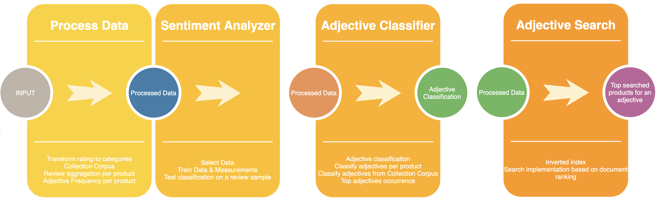
Solution Design

Slide 6
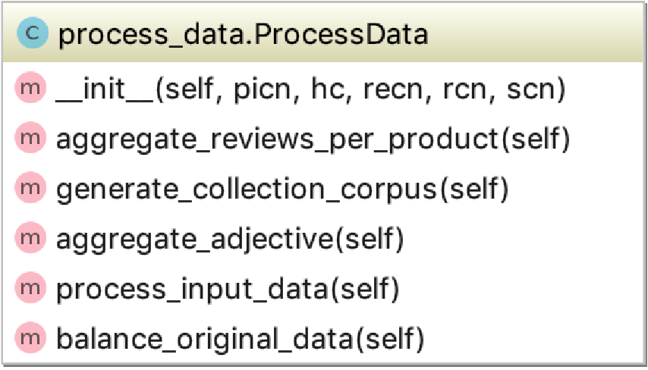
Process data
Data is cleaned here and processed to suit as inputs for further analysis
All the reviews per product are aggregated for adjectives per product analysis
Ratings are translated to labels of categories for classification

Slide 7
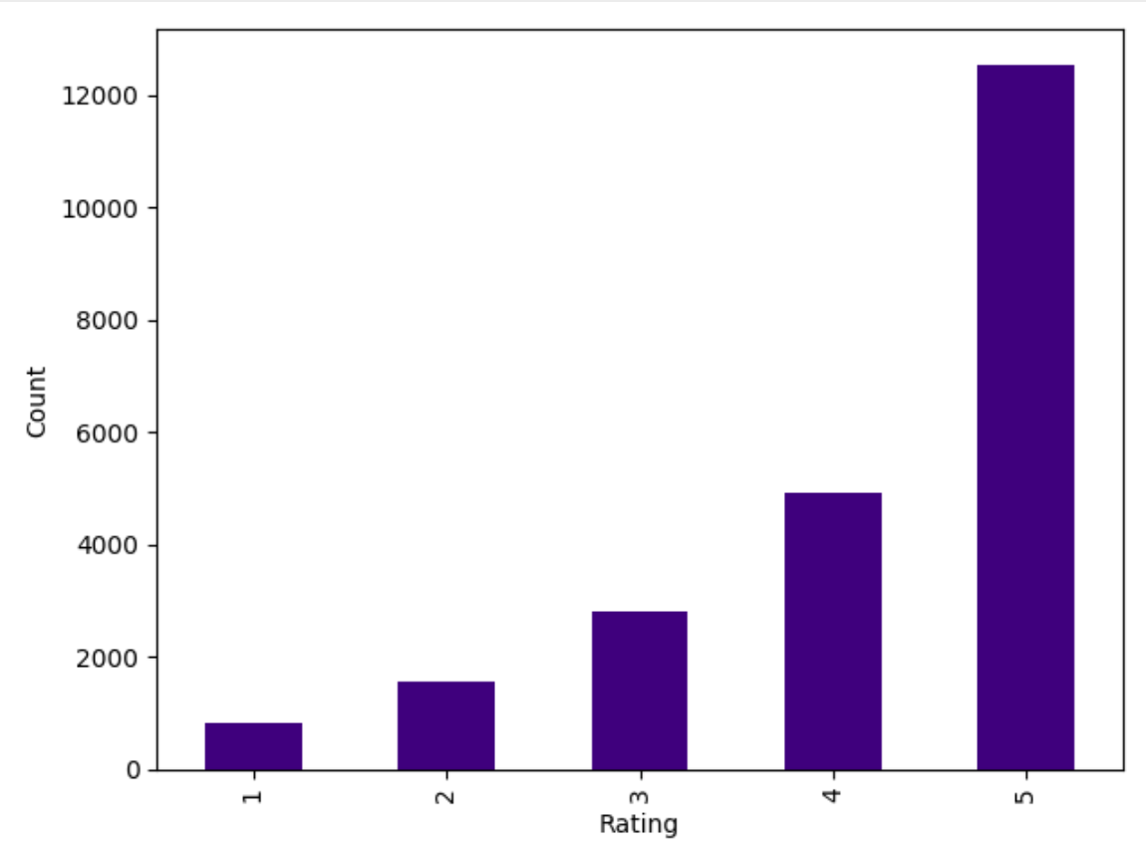
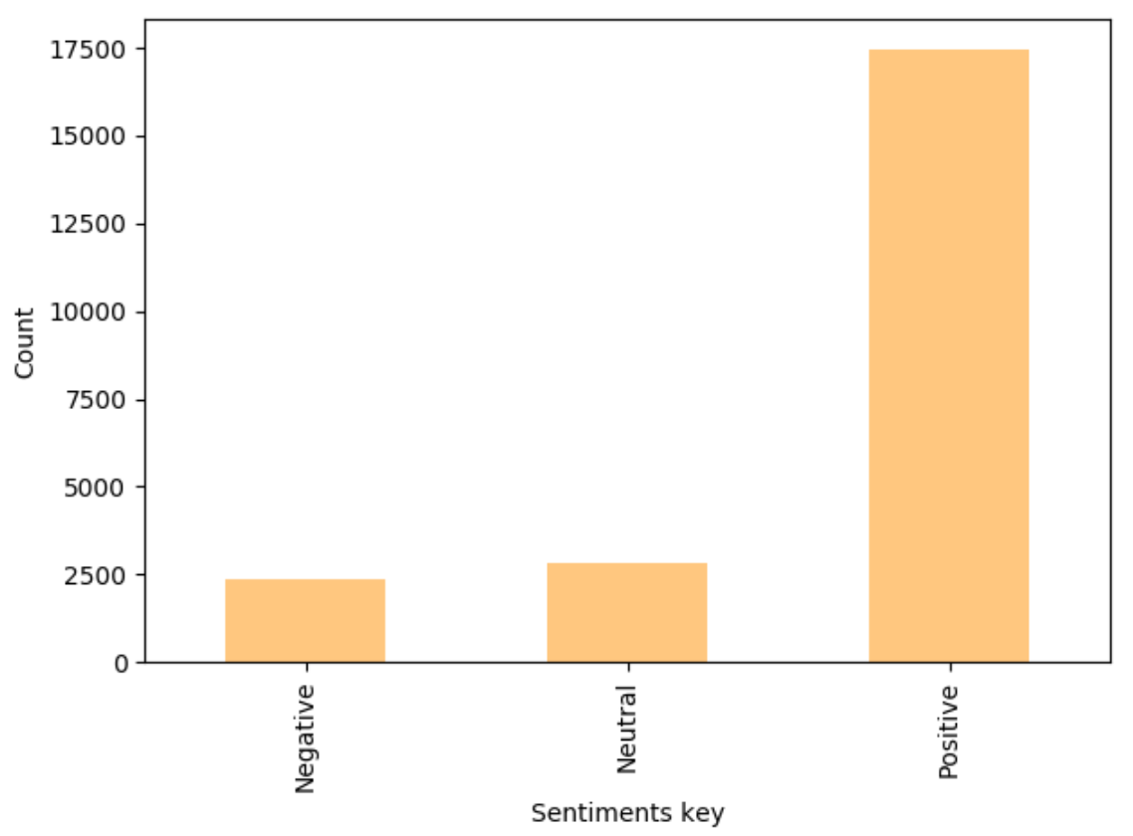
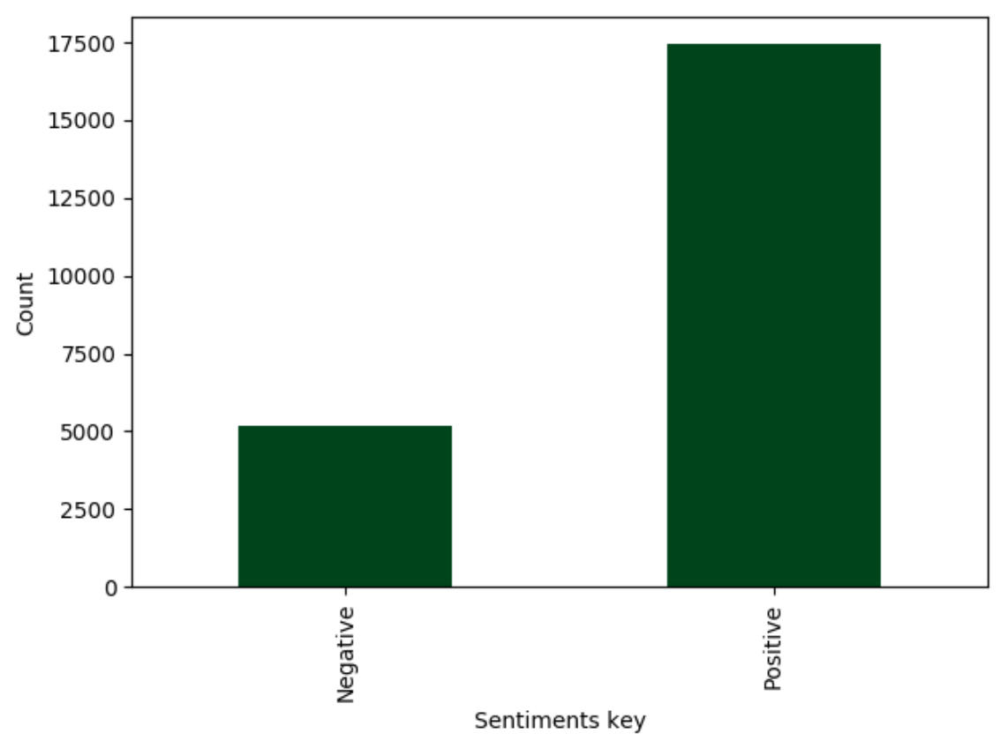
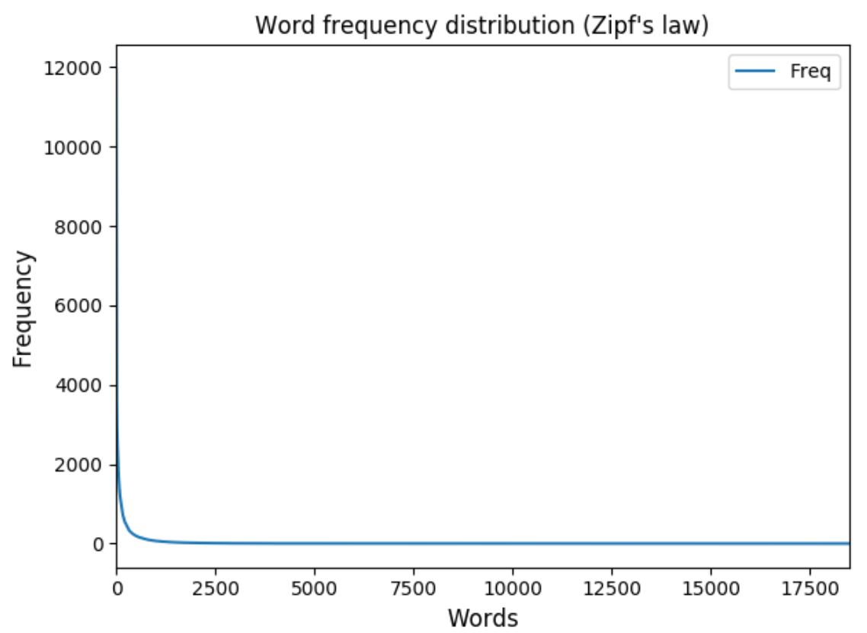
initial Graphical analysis on data

Slide 8
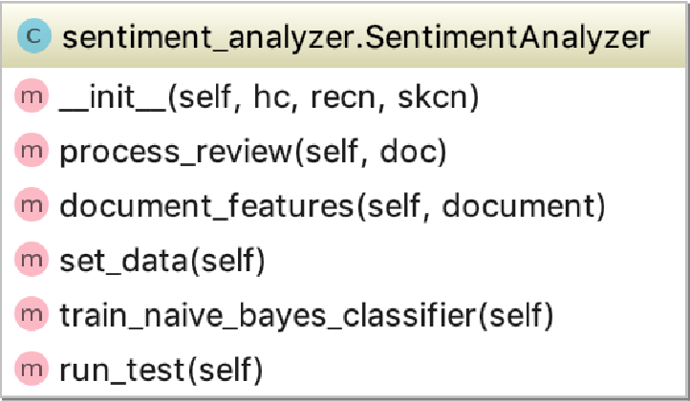
Sentiment analyzer
Create features set to be used as input to Naïve Bayes classifier
Use train data set and test data set to create classifier
Measure precision, recall, f-measure

Slide 9
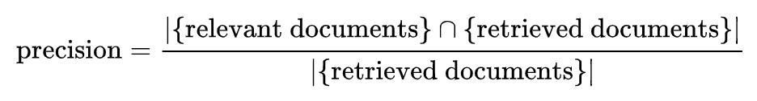
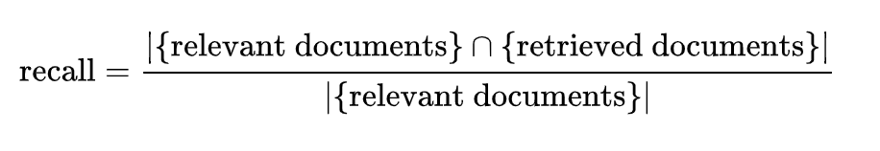
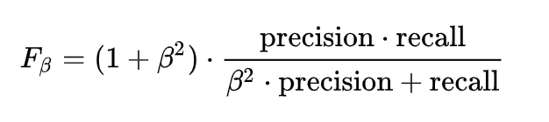
Sentiment analysis - result
Naive Bayes Classifier accuracy: 0.67
 | Precision | Recall | Fmeasure
Positive | 0.9205955334987593 | 0.961139896373057 | 0.9404309252217998
Neutral | 0.7459016393442623 | 0.7109375 | 0.728
Negative | 0.8888888888888888 | 0.6464646464646465 | 0.7485380116959064
In pattern recognition, information retrieval and classification (machine learning), precision (also called positive predictive value) is the fraction of relevant instances among the retrieved instances, while recall (also known as sensitivity) is the fraction of the total amount of relevant instances that were actually retrieved. Both precision and recall are therefore based on an understanding and measure of relevance.
A measure that combines precision and recall is the harmonic mean of precision and recall.

Slide 10

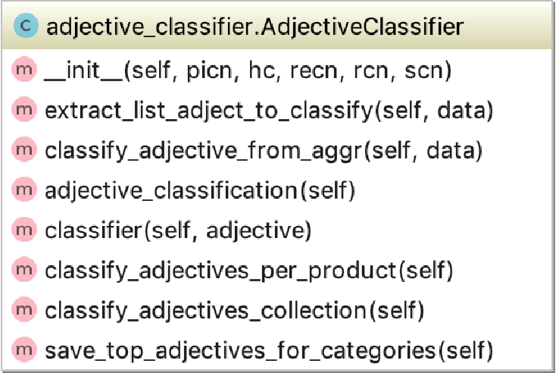
Adjective classification
Adjectives extraction based on POS tagging
Multinomial Naïve Bayes to train the data and test
Use the classifier to apply on the dataset needed to be classified
Generate top adjectives on entire collection corpus

Slide 11
Adjective classification - result
A confusion matrix is a table that is often used to describe the performance of a classification model (or "classifier") on a set of test data for which the true values are known.
true positives (TP): These are cases in which we predicted Positive, and they are Positive.
true negatives (TN): We predicted Negative, and they are Negative.
false positives (FP): We predicted Positive, but they are Negative
false negatives (FN): We predicted Negative, but they Positive
Confusion Matrix | Predicted: Negative | Predicted: Positive
Actual: Negative | 547 | 726
Actual: Positive | 242 | 4145

Slide 12
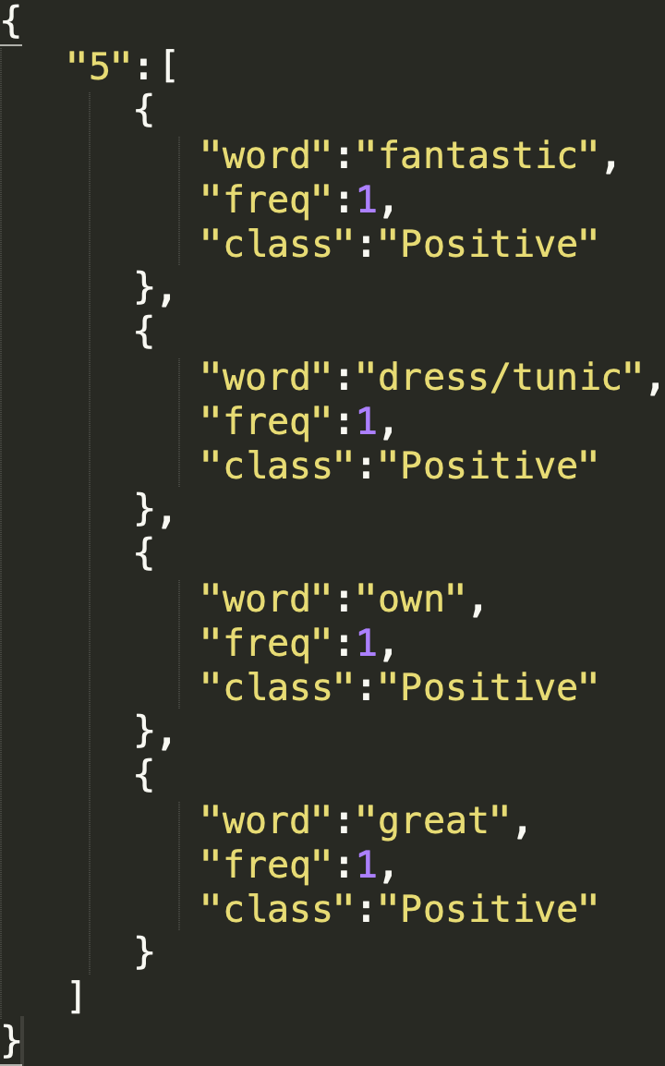
Adjective classification - result
great | 6104 | Positive
small | 4565 | Positive
top | 4062 | Positive
soft | 3275 | Positive
little | 3189 | Positive
huge | 541 | Negative
disappointed | 398 | Negative
bad | 389 | Negative
cheap | 275 | Negative
excited | 239 | Negative

Slide 13
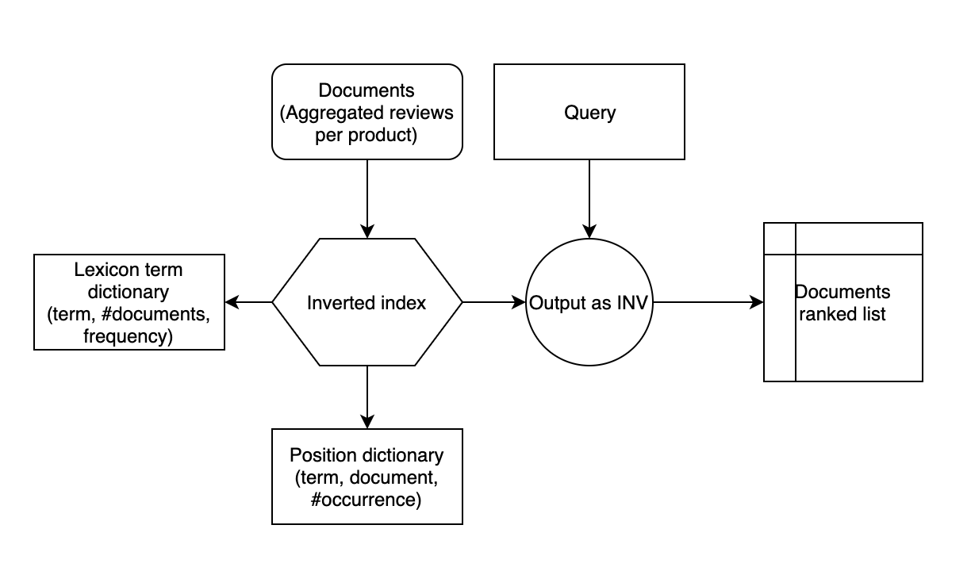
Search top products – document ranking

Slide 14
Top Products - Result
Word ‘great’
Document# | Score
612 | 1.3661322593688965
1010 | 1.3613137006759644
347 | 1.3603975772857666
839 | 1.3587143421173096
218 | 1.3542499542236328

Slide 15
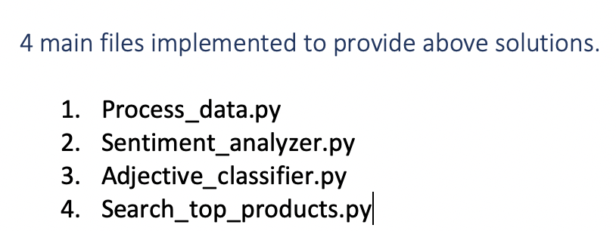
Steps to follow for execution
Execute in the order above. Please make sure the required libraries are installed for the python SDK you choose. Carefully observe the original data set and its column headers “WomensClothing-E-Commerce-Reviews”.
All the output should be generated and saved in “output” directory.
You can either run throw any IDE or CLI. Just call the main class. Its not designed to be parametrized.

Slide 16
Libraries used
Metapy
Pandas
NLTK
Matplotlib
Sklearn
https://stash.lbidts.com/projects/FATE/repos/product-review-analysis/browse

