Slide 1
R
Stock Requests, Simplified.
A fully digital platform for submitting, tracking, and managing retail stock requisitions — from field employees to head-office admins, with real-time status updates and rich export tools.
Next.js 16
Supabase
Role-Based Access
Real-Time Dashboard
Excel & CSV Export
TCS Pakistan — Retail Requisition System

Slide 2
01
SECTION
Public Experience
The marketing landing page and requisition form — accessible to all TCS field employees without any login required.

Slide 3
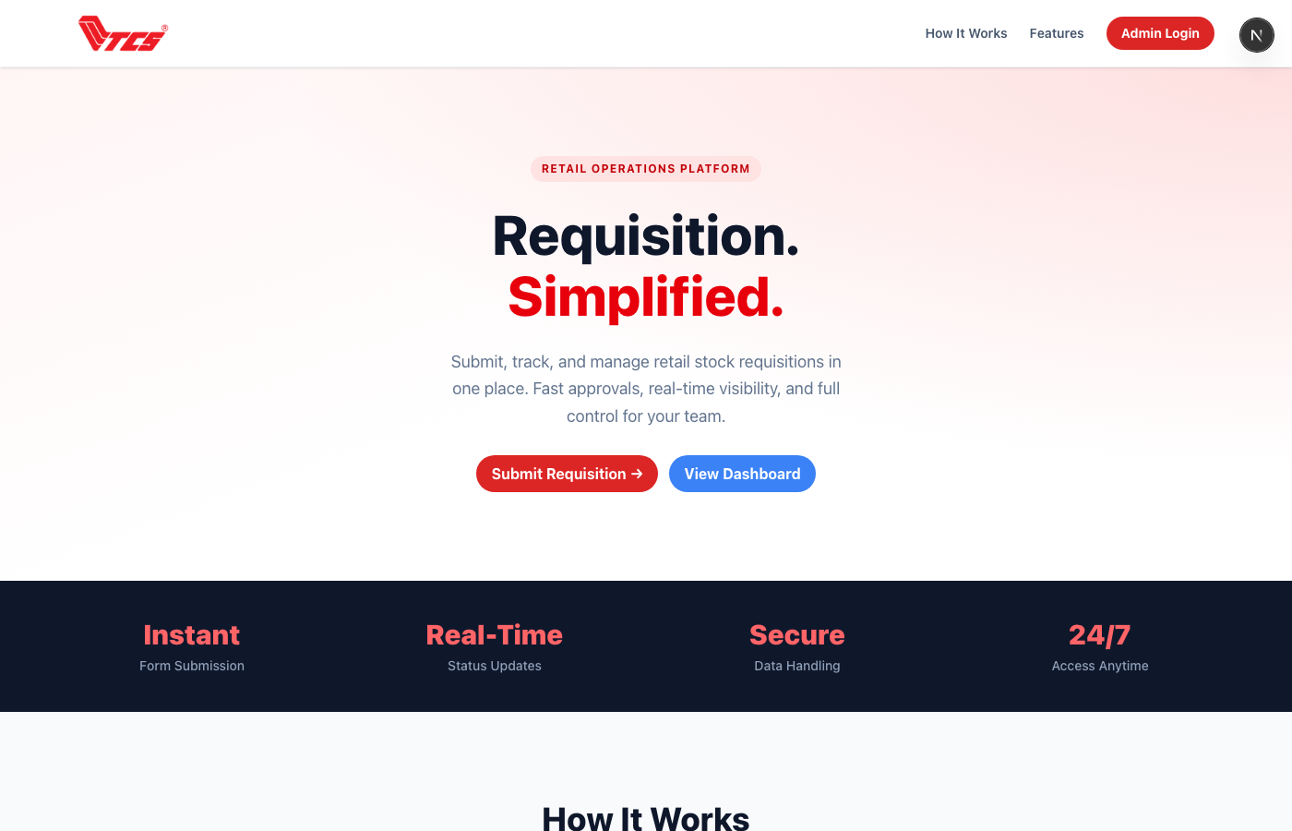
01 / PUBLIC — HOME PAGE
Landing Page & Navigation
The public home page introduces the system to all TCS staff. It highlights key benefits, links to the requisition form, and provides a route to the admin dashboard for authorised users.
Clear call-to-action to open the requisition form
Sticky navigation with Admin Login access
SEO-optimised with full Open Graph metadata
Responsive design — works on mobile and desktop
3

Slide 4
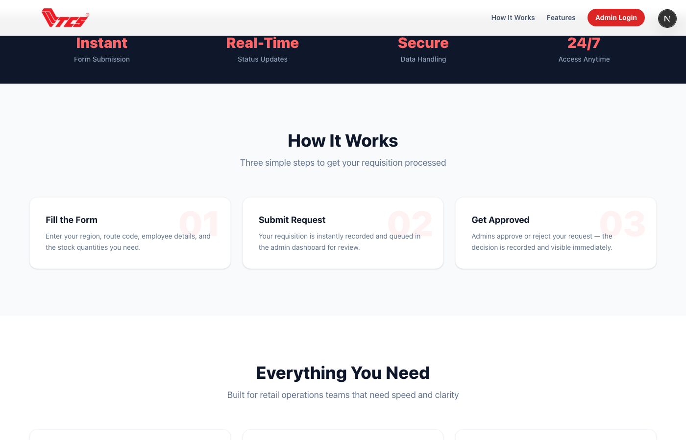
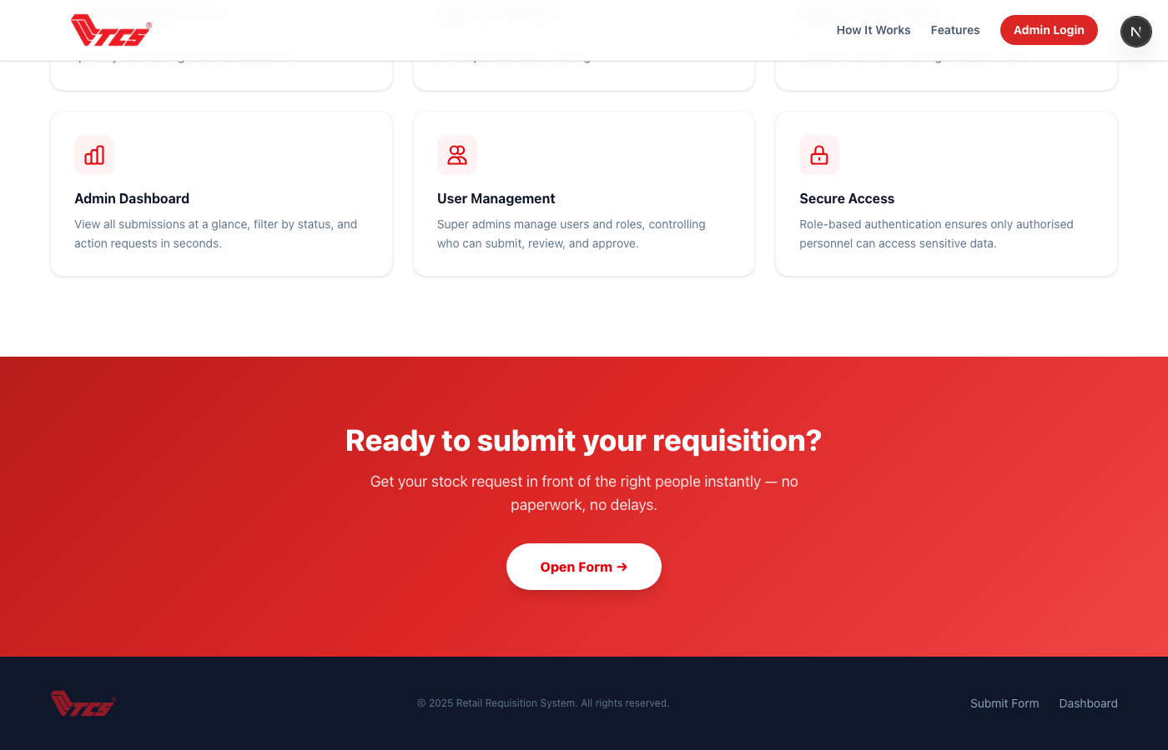
01 / PUBLIC — HOME PAGE
Features & How It Works
Scrolling reveals six core feature cards and a three-step visual guide showing employees how to submit a request and get it processed.
Six features: Form, Approval, Region Routing, Dashboard, Users, Secure Access
Three-step process guide (Fill → Submit → Approved)
Bold CTA banner at bottom leading back to the form
Footer with quick navigation links
4

Slide 5
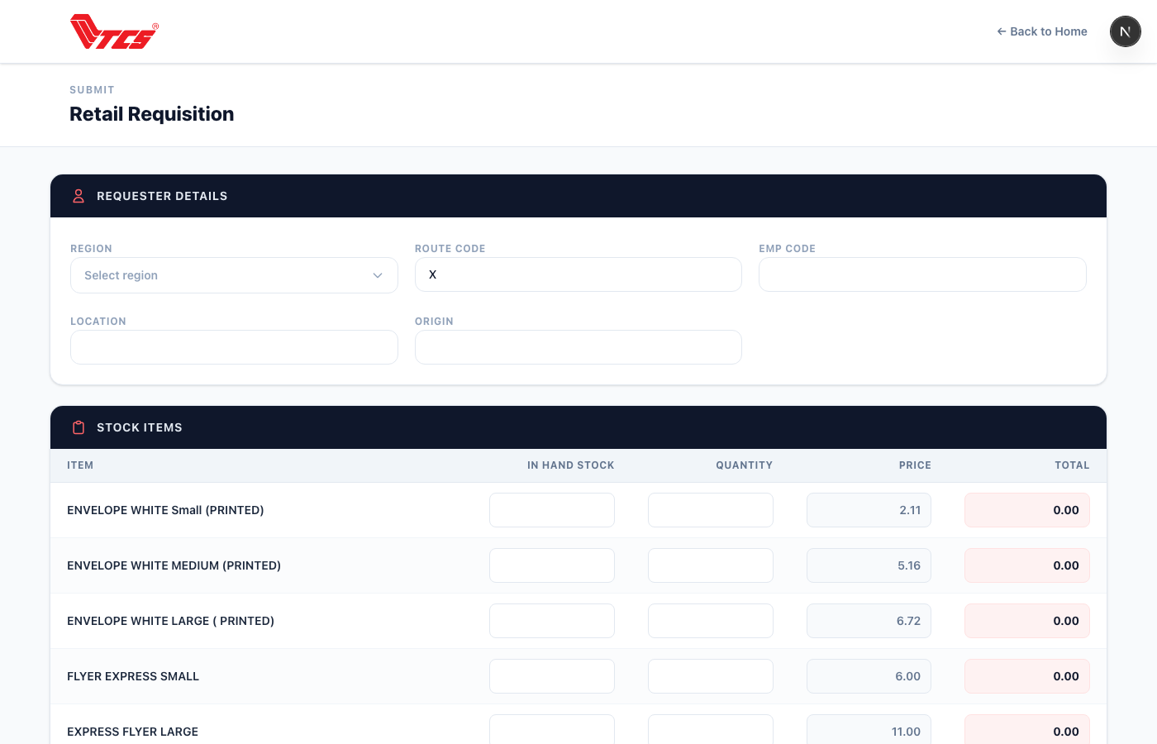
02 / PUBLIC — REQUISITION FORM
Employee Details Input
The form begins with requester information. Employees enter their Region, Route Code, Employee Code, Location, and Origin using validated input fields.
Region selected from a fully-styled custom dropdown — all Pakistan regions
Route Code enforced to start with "X"
EMP Code accepts numbers only — auto-strips letters
Location auto-converts to uppercase
Origin limited to 3 alphabetic characters
5

Slide 6
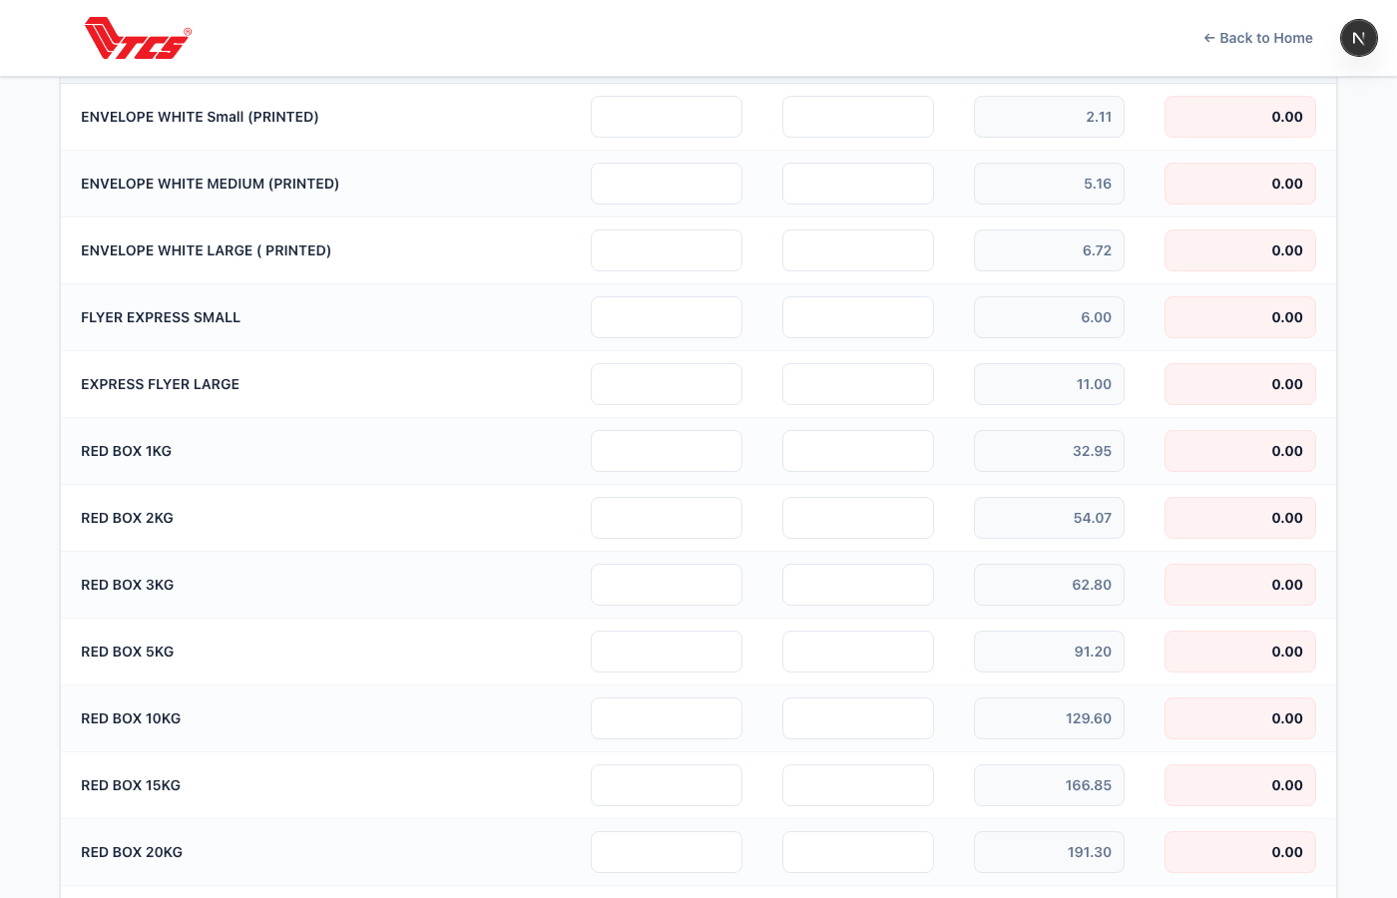
02 / PUBLIC — REQUISITION FORM
Stock Items & Grand Total
Below the header, employees enter quantities for each retail stock item. The form dynamically calculates line totals (Qty × Price) and the Grand Total in real time.
All 36 retail items loaded dynamically from the database
Each row: Item, Unit Price, Quantity, In-Hand Stock, Total
Grand Total updates live as quantities are typed
Mobile card layout for small screens; table on desktop
Single Submit button sends all data to the admin queue
6

Slide 7
Requisition Submission Flow
1
2
3
4
5
Employee Fills Form
Data Saved to DB
Admin Notified
Review & Action
Status Updated
Enters region, route code, EMP details and stock quantities on the public form
On submit, header + all item quantities and totals stored in Supabase with status = Pending
New record immediately appears in the admin dashboard under the Pending filter
Admin opens the record, adjusts quantities if needed, then Approves or Rejects
Record moves to Approved or Rejected. Approved records exported for deduction processing
All data stored in Supabase PostgreSQL with Row-Level Security and cascading deletes for referential integrity.
7

Slide 8
02
SECTION
Admin Dashboard
Secure, role-based access for TCS administrators to review, action, and export all requisition records.

Slide 9
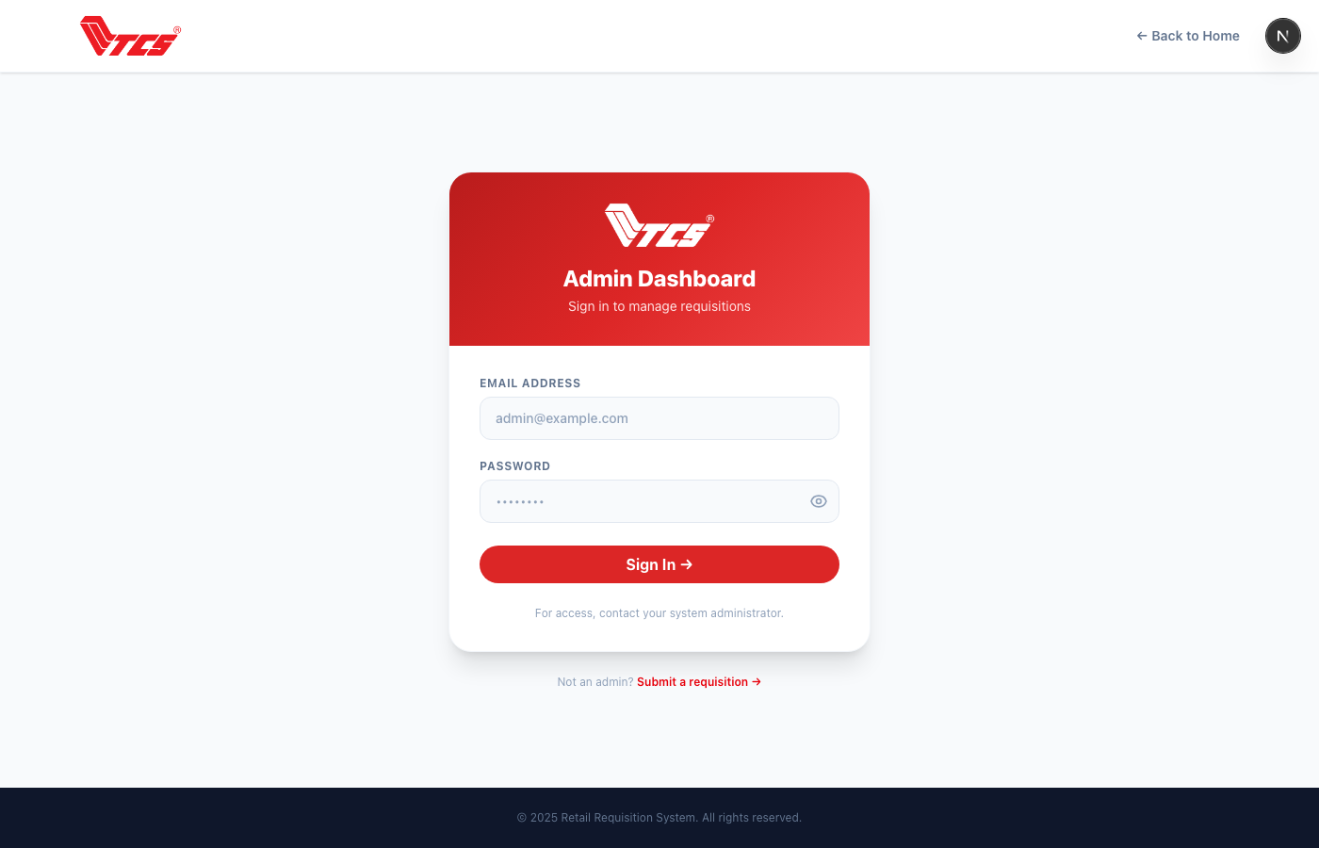
03 / ADMIN — SECURE LOGIN
Admin Login Page
Only authorised TCS staff can access the dashboard. The login page uses Supabase Auth with email and password authentication, and is excluded from search engine indexing.
Email + password authentication via Supabase Auth
Password visibility toggle (show/hide eye icon)
Clear error messaging on invalid credentials
robots: noindex — never appears in Google search
Redirects to the Requisitions dashboard on success
9

Slide 10
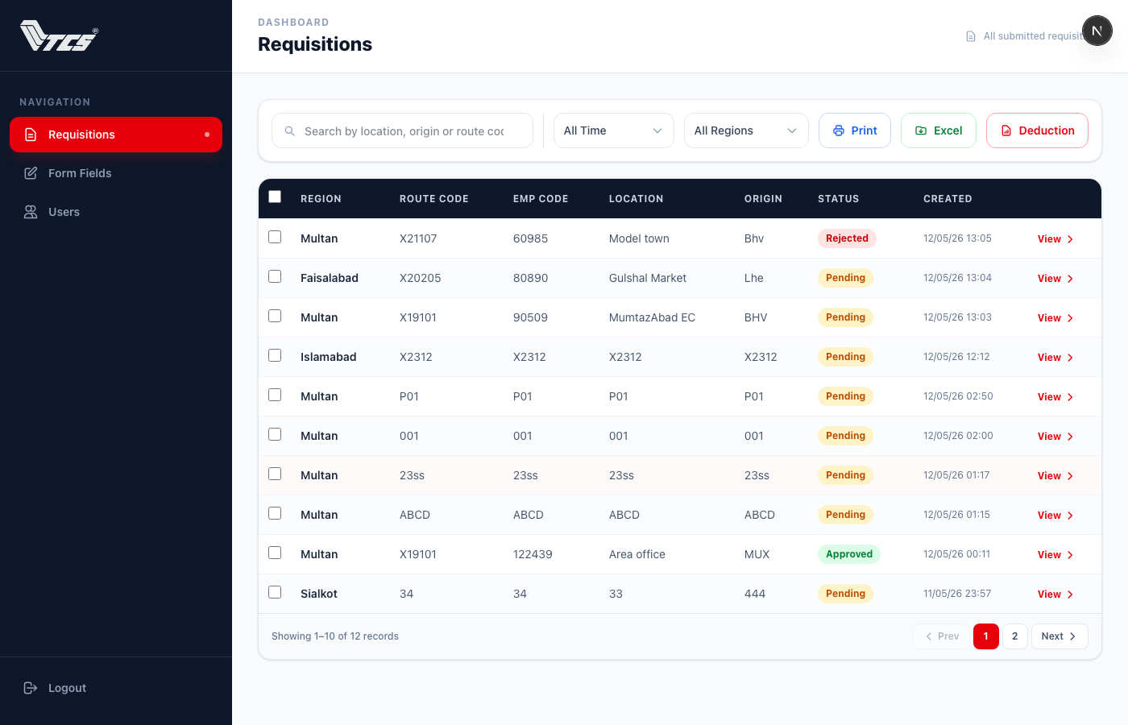
04 / ADMIN — REQUISITIONS DASHBOARD
Main Requisitions Table
The central hub for all admin activity. Every submission appears in a filterable, searchable table. Admins can filter by status, region, and date range.
Live search across Route Code, EMP Code, Location, Origin
Status filter: All / Pending / Approved / Rejected
Time filter: Today / Yesterday / Last 7 Days / Last 30 Days / Custom Range
Region multi-select filter (Super Admin only)
Pagination with configurable page sizes
Totals bar showing Grand Total sum for filtered view
10

Slide 11
04 / ADMIN — ACTIONS & EXPORTS
Approve, Export & Bulk Delete
Admins can take action on individual records or in bulk. Three export formats are available at any time. Super Admin and Head roles can permanently delete records to save database space.
Print (Blue) — formatted print view of all filtered records
Excel (Green) — multi-sheet workbook grouped by EMP category
Deduction (Red) — CSV of all approved records for payroll
Checkboxes for bulk-select with a red Delete toolbar
Confirmation modal warns when approved records selected
11

Slide 12
03
SECTION
System Management
Super Admin tools for controlling what appears on the form and who has access to the dashboard.

Slide 13
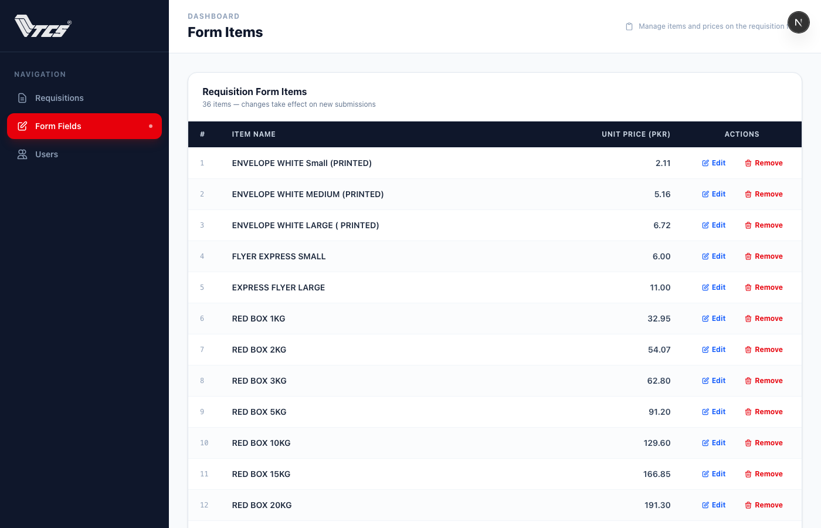
05 / ADMIN — FORM FIELDS MANAGEMENT
Manage Retail Items & Prices
Super Admins can control the exact items shown on the requisition form — their names, unit prices, and active status. Changes take effect on the next form load.
All 36 retail items listed with their current price
Inline edit — change item label or price, then Save
Add new items at the bottom of the list
Remove items (soft-delete: marks inactive, not hard-deleted)
Auto-seeded to DB on first access if table is empty
Form revalidates every 5 minutes (ISR) to pick up changes
13

Slide 14
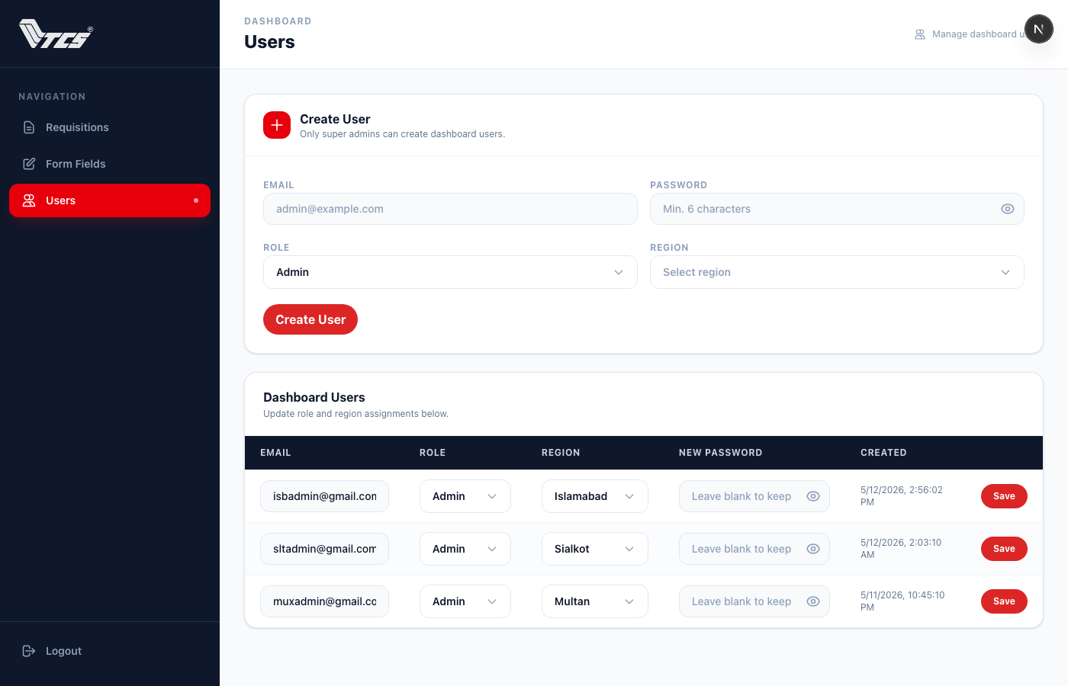
06 / ADMIN — USER MANAGEMENT
Create & Manage Dashboard Users
Super Admins have full control over who can access the dashboard. Users can be created, assigned roles and regions, and have their passwords changed at any time.
Create new users with email, password, role, and region
Edit email, role, and region of existing users inline
Change any user's password (leave blank to keep existing)
Password visibility toggle on all password fields
Roles: Admin, Head, Super Admin
Regions: all Pakistan regions via styled custom dropdown
14

Slide 15
Role-Based Access Control
Super Admin
Head
Admin
FULL ACCESS
REGIONAL MANAGER
REVIEWER
✓ View & action ALL regions
✓ View own-region records only
✓ View own-region records only
✓ Approve / Reject requisitions
✓ Approve / Reject requisitions
✓ Approve / Reject requisitions
✓ Bulk delete any records
✓ Bulk delete own-region records
✗ Delete records
✓ Print, Excel & Deduction export
✓ Print, Excel & Deduction export
✓ Print & Excel export
✓ Manage form items & prices
✗ Manage form items & prices
✗ Manage form items & prices
✓ Create & manage all users
✗ Create & manage users
✗ Create & manage users
✓ Change any user password
✗ Change user passwords
✗ Change user passwords
Access enforced server-side on every API route via Supabase session cookies — no client-side bypass possible.
15

Slide 16
Technical Architecture
⚡ Next.js 16 (App Router)
🗄️ Supabase PostgreSQL
🔐 Supabase Auth
Server components for data fetching, client components for interactivity. ISR for public form (5-min cache). Route handlers for all API endpoints.
form_submissions + form_submission_values with ON DELETE CASCADE. retail_items table for dynamic form fields. Row-Level Security on all tables.
Session-cookie authentication. Server-side session validation on every protected route and API call. Admin SDK for user creation & password management.
🎨 Tailwind CSS v4
📊 SheetJS (xlsx)
🚀 Performance & SEO
Utility-first styling with custom CSS classes for app-select dropdowns and button variants. Fully responsive — mobile card layout & desktop table.
Lazy-loaded Excel workbook generation with multiple sheets — one per EMP category (SIS, Agent, Franchise, COCO) based on EMP code prefix rules.
next/image with AVIF/WebP formats, ISR caching, security headers (HSTS, X-Frame-Options), sitemap.ts, robots.ts, Open Graph metadata & PWA manifest.
16

Slide 17
R
TCS Retail Requisition System
A fully paperless, real-time, role-controlled stock requisition
platform built for TCS Pakistan retail operations.
localhost:3000 / form / dashboard
Next.js 16
Supabase
TypeScript
Tailwind CSS
Thank You
17

