Slide 1

Workmethods
Atifa Zakeri
Digital Talents Academy
8 / 8 / 2024

Slide 2
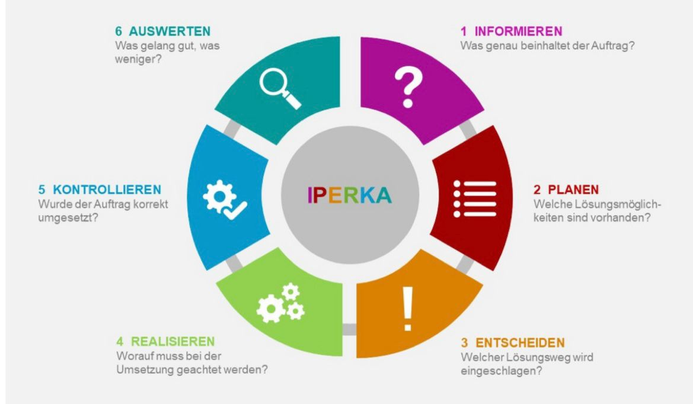
The 6 steps of IPERKA
It’s a suitable method for doing tasks.
Example :
Planning a Journey.
To take a new project in your workplace.
Self-organization

Slide 3
For me INFORMATION is the most important step
Because:
According to the Information that you have , you plan.
You decide and accept orders.
You're going to analysis the data.
You can start requirements gathering.
We can create new ideas for an order.

Slide 4
My Strengths and Weaknesses about using IPERKA Method
Strengths:
Successful
Fast
Decrease Mistakes
Secure
Weaknesses:
Need Focus in every Step
All steps are connecting to each other.

Slide 5


