Slide 1
Demo Web-shop Presented By: Atif Ali Khan
Website URL : https://demowebshop.tricentis.com/ Github : https://github.com/atifalikhan1946/capstone-webShop.git

Slide 2
Contents
1.Project Overview
2.Website Image
3. Project Objective & Goals
4. Tools & Technologies Used
5. Project Structure
6. Base Class
7. Utility Classes
8. Test Cases Overview
9. Reporting & Execution Flow
10.Allure Report
11.Extent Report
12.Conclusion

Slide 3
Project Overview Project Name Demo Web Shop Automation Project URL https://demowebshop.tricentis.com/
Problem Statement
This is a comprehensive e-commerce platform that allows users to log in, search products, add to cart, and filter the product. Users can edit orders and the checkout process Involves entering shipping details and payment through card. Failures in the System which can lead to significant user dissatisfaction and revenue lose so, implement automated testing for the Online Shopping site using Selenium, TestNG to ensure functionality by using POM or Page Factory.

Slide 4
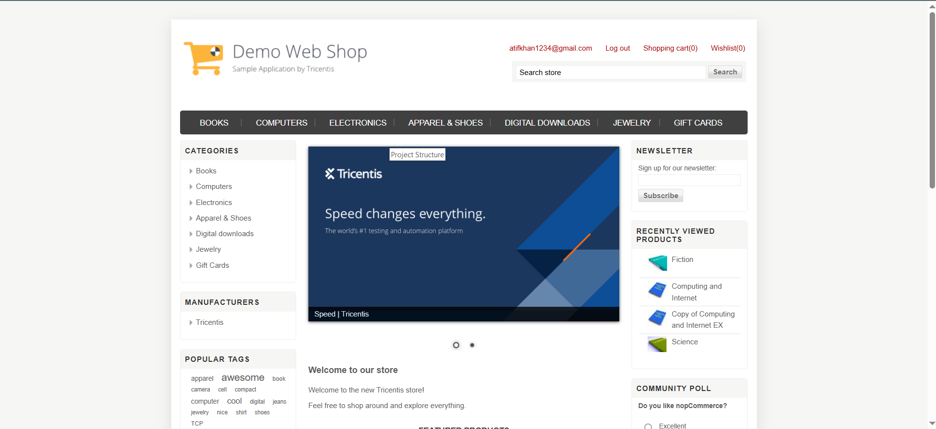
Website Image

Slide 5
Project Objective & Goals
Objective
Automate the testing of key functionalities of an e-commerce Demo Web Shop website. The automation covers UI testing to ensure correct website functions, providing a reliable user experience.
Goals
1.Write test cases (both positive and negative).
2. Automate the scenarios/test cases written using the framework mentioned.
3. Deliver a reliable user-friendly experience for customers.

Slide 6
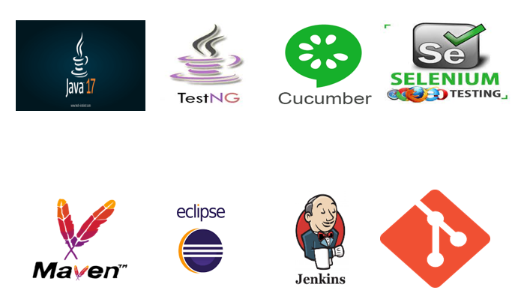
Tools & Technologies Used

Slide 7
Project Structure
src/test/java
-base: Base class for WebDriver initialization
-features: Cucumber feature files
-stepdef: Cucumber step definitions
-myrunner: Cucumber runner for executing tests
-pages: Page Object Model (POM) classes for Ul Interactions
-testcases: Test classes for different scenarios
-utility: Utility classes (Excel reader, Extent Report generator)

Slide 8
Test Cases Overview
User Registration Test
Automates the registration process using Selenium WebDriver, testing, and Page Object Model, Steps include reading properties file, launching the browser, registering a user, logging execution status, and closing the browser.
User Login Test (Valid Credentials)
Automates the login process with valid credentials. Steps include reading properties file, launching the browser, login actions, validating and logging test status, and closing the browser.
User Login Test (Invalid Credentials)
Automates login test case for invalid credentials using a data from Excel Sheet This Includes steps for opening the browser, navigating to the URL, entering credentials. and verifying the error message. Uses Extent Reports for logging test data and results.

Slide 9
Search and Add to Cart
Automates searching for a product and adding it to the cart. Includes product search, filtering, adding to cart, scrolling down using JavascriptExecutor, and capturing a screenshot.
Adding Multiple Products to Cart
The AddToCartjewelryTest.java file automates adding multiple products to the cart. Includes product selection, filtering, adding two products to the cart, validation, and reporting.
Validating Successful Purchase (Checkout)
Automates the checkout process including adding a product to the cart. applying coupons, selecting shipping details, and order confirmation. Steps Include file reading, browser launch and login, product selection, entering billing and shipping details, and confirming the order.
Update and Remove Product from Cart
Automates update and removal of products in the cart using BDD-Cucumber. Includes feature definition, step definition implementation, test execution. and reporting.
Logging out after Valid Login
Automates the logout functionality post successful login. Includes steps for loading URL, launching browser, logging in with valid credentials, performing logout, and capturing screenshots.

Slide 10
Reporting & Execution Flow
Execution Reports & Allure Reports
Extent Reports: Generates detailed and customizable test reports with pass/fall status and execution time.-Allure Reports: Ensures fresh and accurate reports for each test execution. preventing stale or duplicate results.
Execution Flow
Execution: Utilizes TestNG for test execution with browser configuration parameters. Tests are executed via an XML file
Reports: Post execution, reports are generated in the test-output folder. Extent Reports show test details and execution time; Allure Report is generated in the allure-results folder.

Slide 11
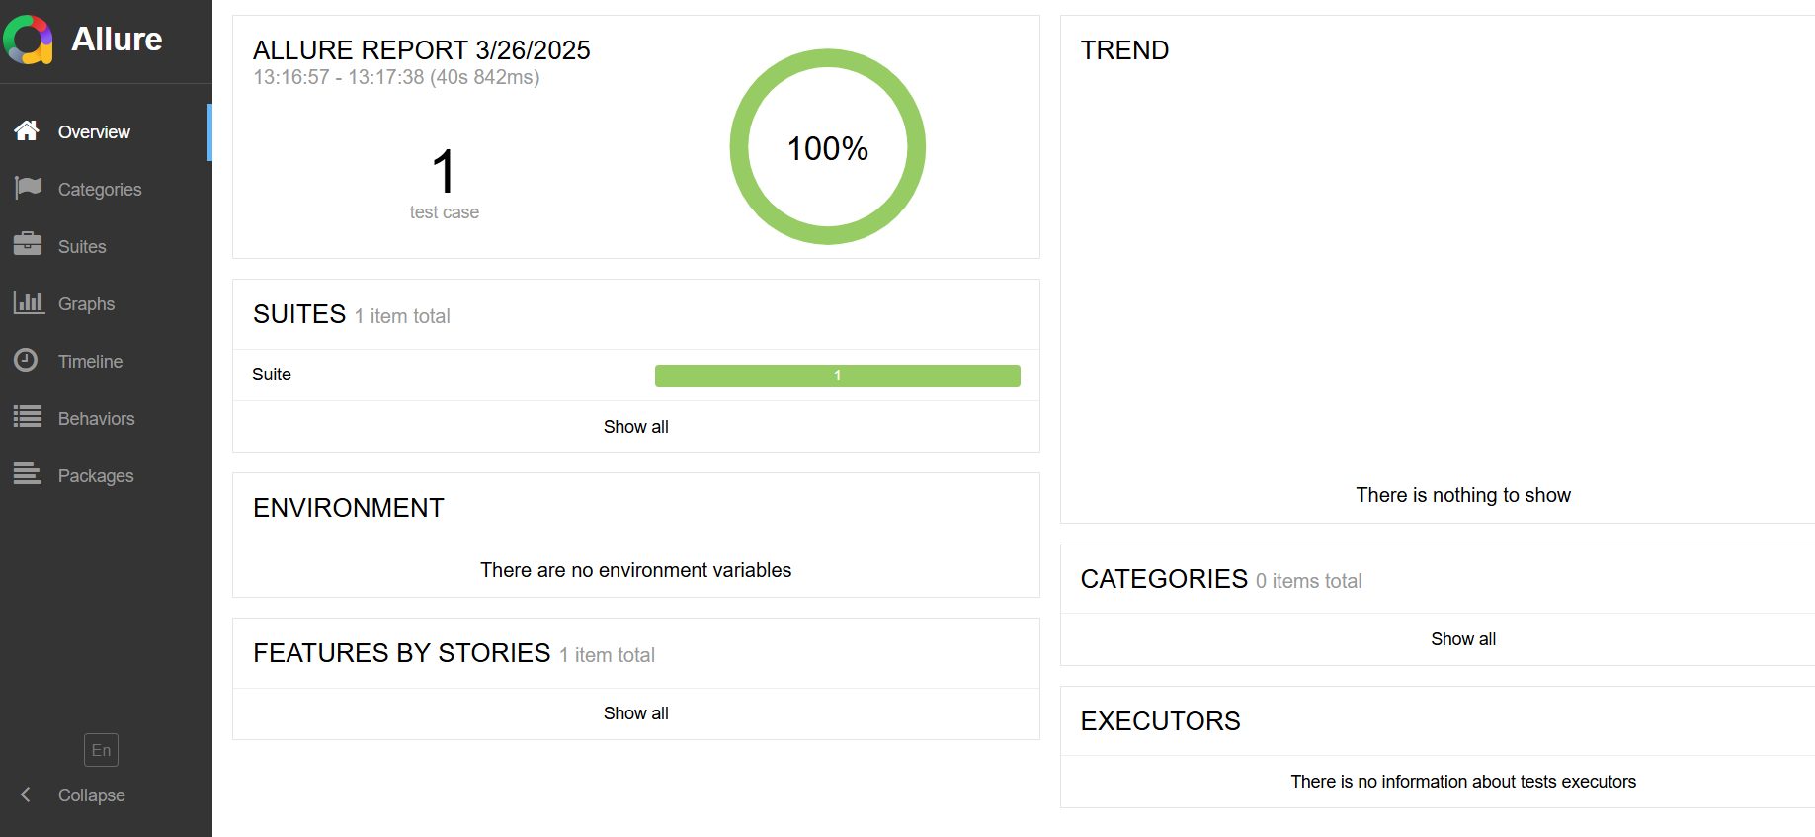
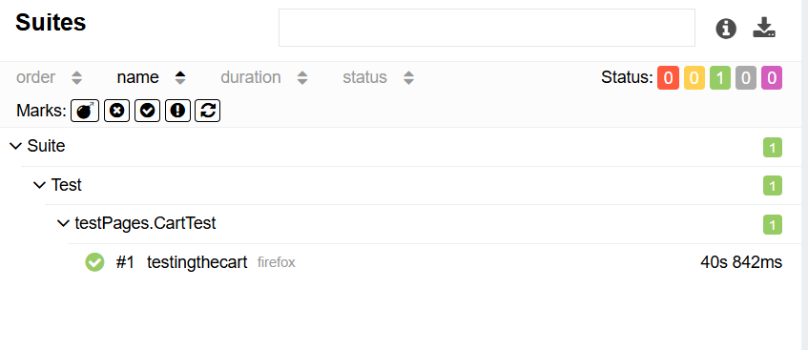
Allure Report

Slide 12
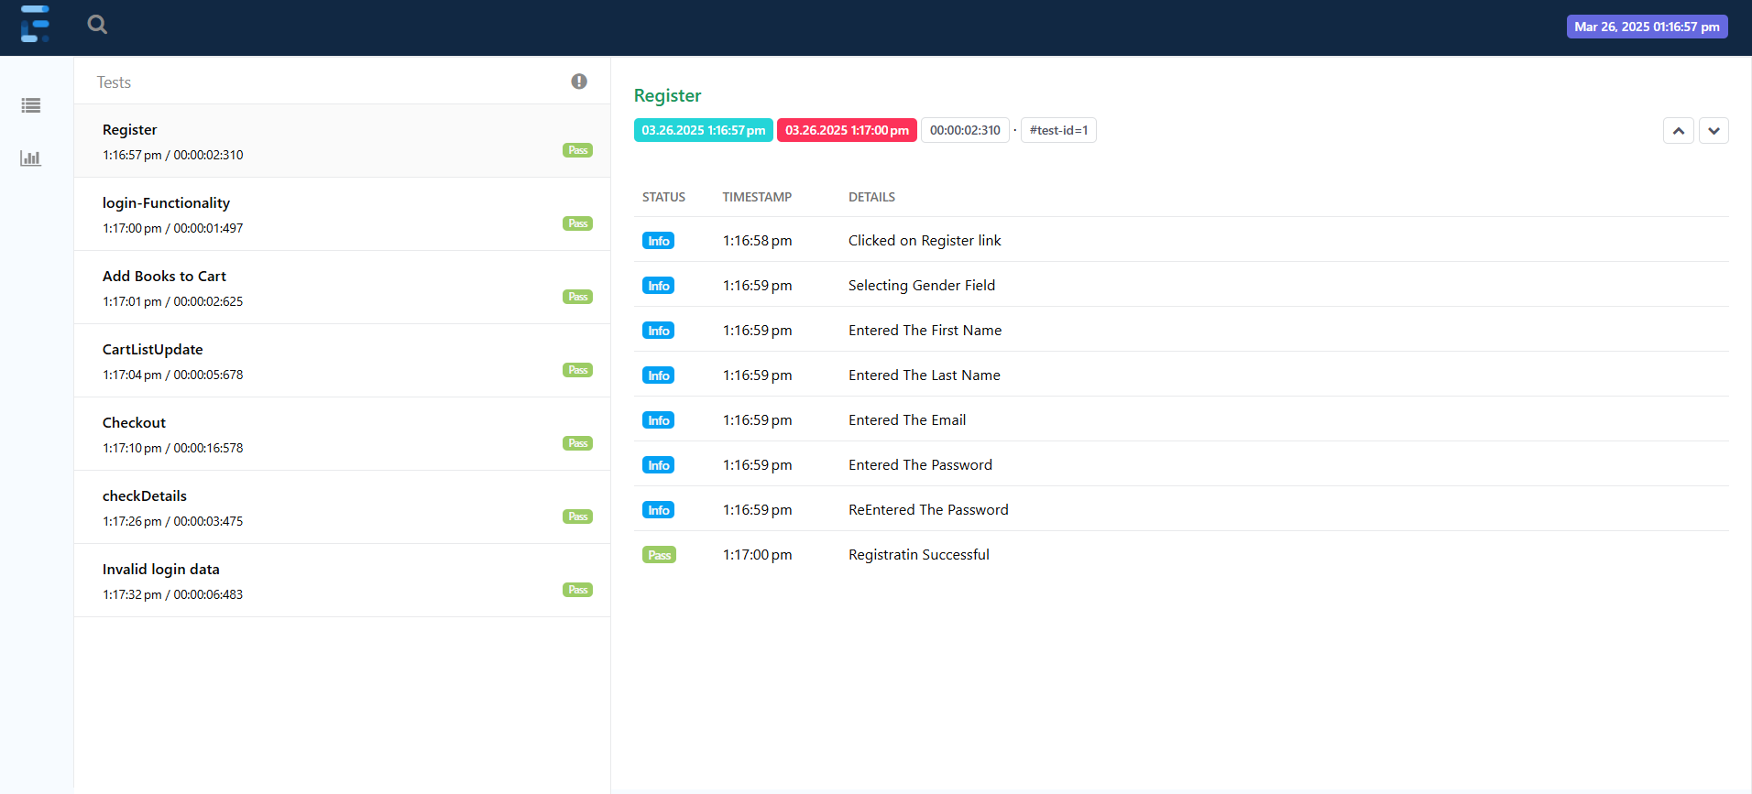
Extent Report

Slide 13
Conclusion
The project effectively demonstrates end-to-end testing of an e-commerce platform Demo Web Shop Website, validating critical functionalities and ensuring reliability and performance through automated testing using Selenium, TestNG, and Cucumber. Combined with robust reporting mechanisms, this project showcases best practices in automation testing.

Slide 14
Thank You

