Slide 1
Tell the word you see. First person will have the credit

Slide 2


Slide 3


Slide 4


Slide 5


Slide 6


Slide 7


Slide 8


Slide 9


Slide 10


Slide 11


Slide 12


Slide 13
Now single word

Slide 14


Slide 15


Slide 16


Slide 17
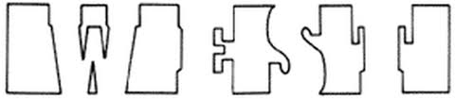

Slide 18
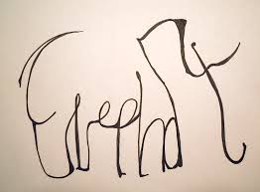

Slide 19


Slide 20
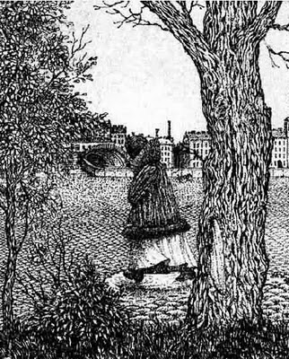
She is not alone where is the other person?

Slide 21
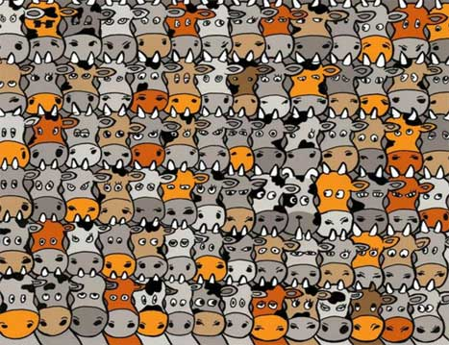
Find the dog

Slide 22
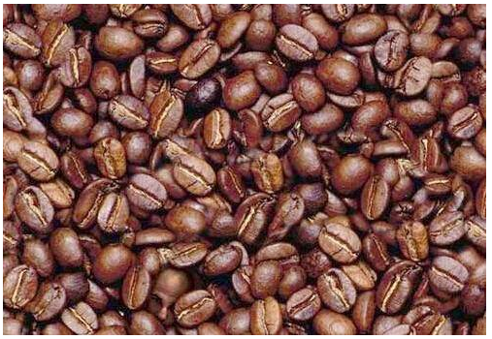
FIND A FACE HERE......

Slide 23
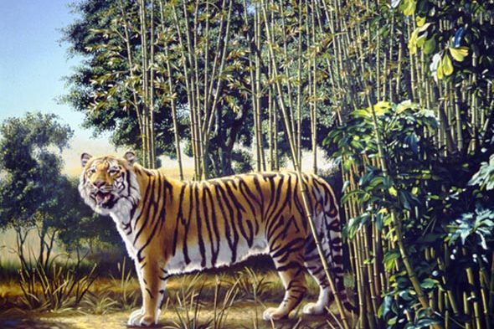
Find The Hidden Tiger

Slide 24
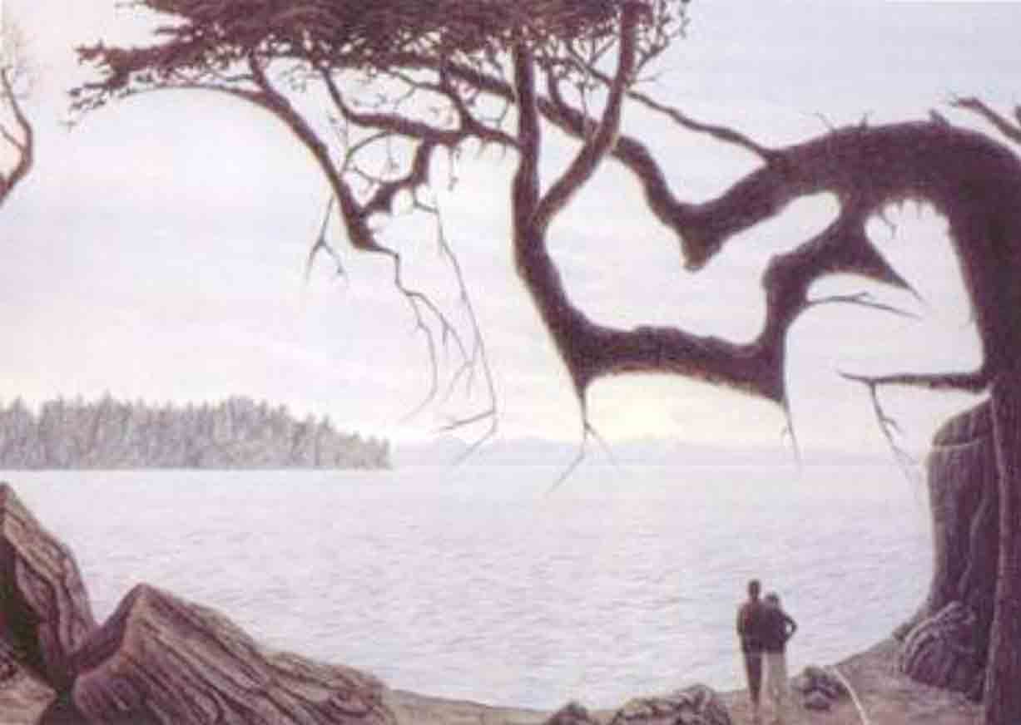
Find the Baby

Slide 25
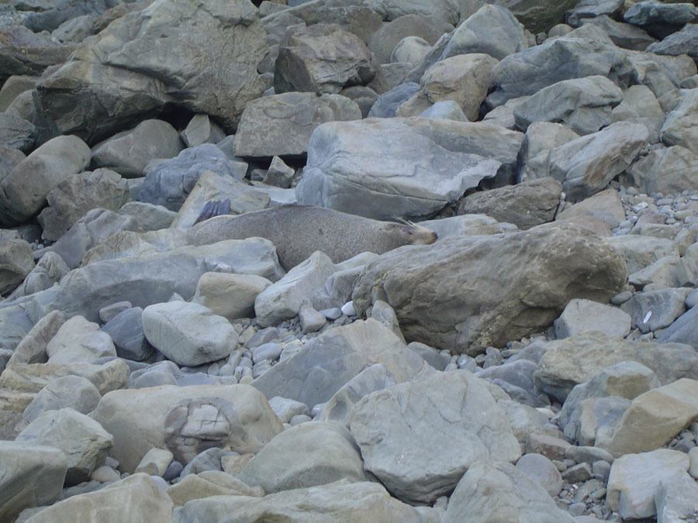
where is the animal

Slide 26
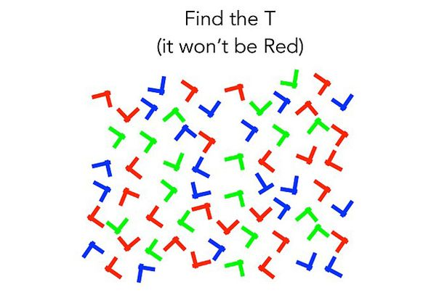

Slide 27
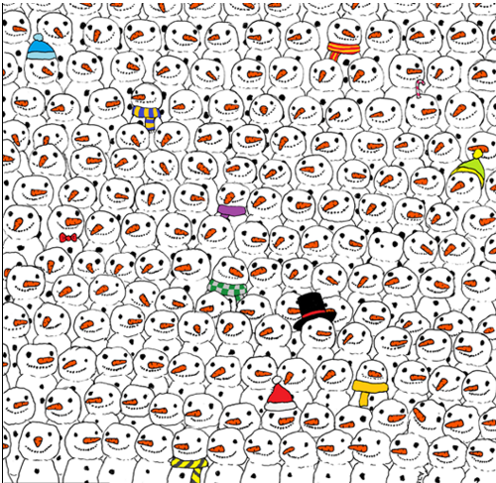
Find Panda

Slide 28
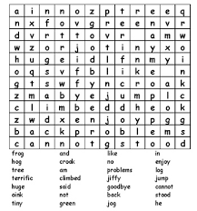
write words.

Slide 30
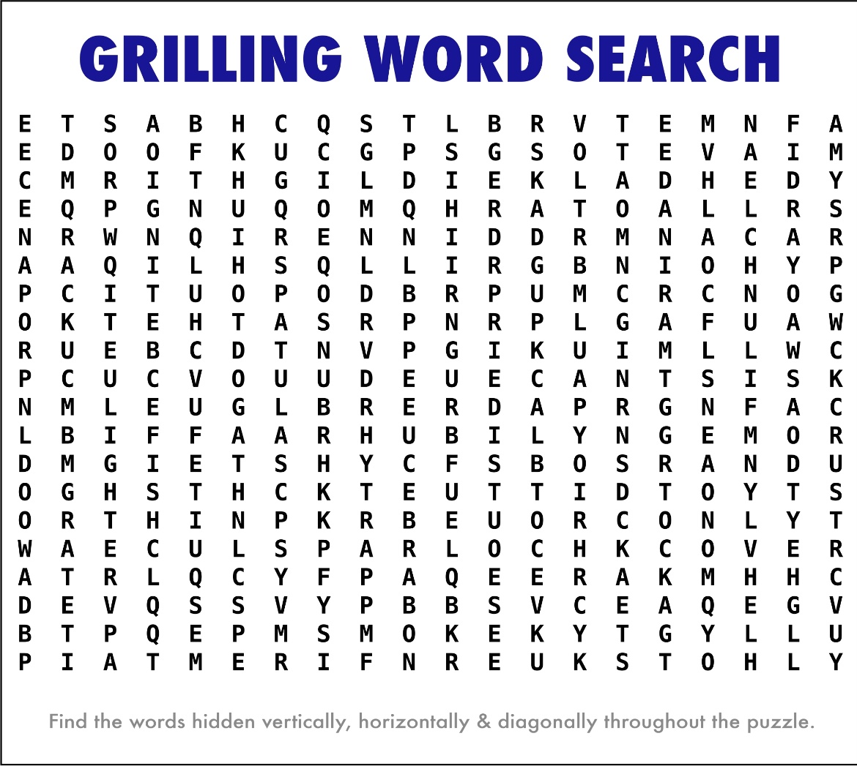

Slide 32
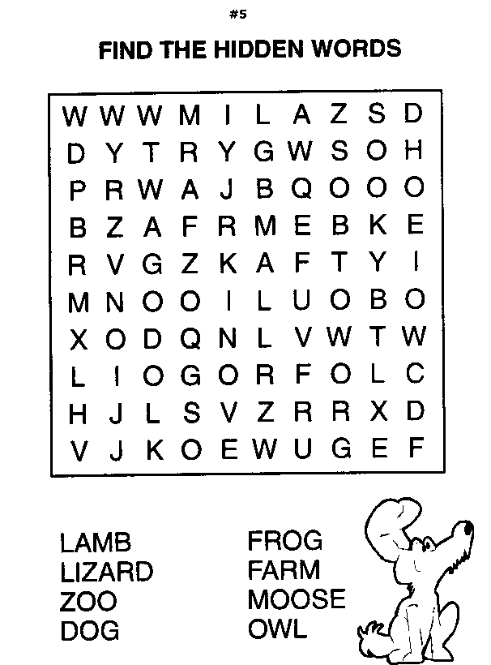

Slide 34
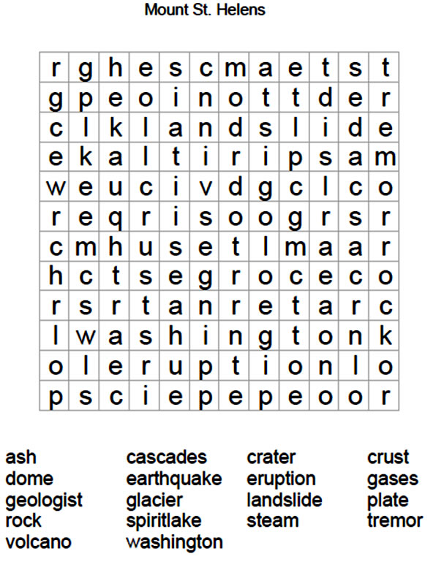

Slide 36
Do you have Dirty Mind?

Slide 37
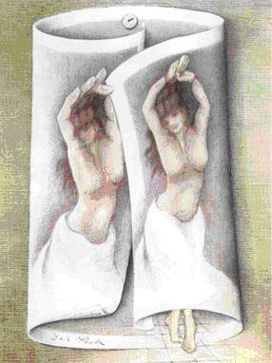

Slide 38
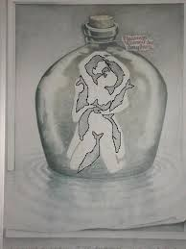

Slide 39

what do u see.

