Slide 1
CS
CogniSim
A Cognitive-Load-Aware, Privacy-Preserving Adaptive
Training Ecosystem for High-Stakes Simulation
Atik Mahabub · Patricia Gilbert · Regan Legassie · Shervin Vakili
INRS-EMT, Montréal · CAE Inc. · AAAI 2027 Demonstrations Program
Notes:
0:00 to 0:15 (about 15 seconds)
Good morning. This is CogniSim, a simulator trainer that reads cognitive load
and keeps it private. I am Atik Mahabub, from INRS in Montreal and CAE.
In five minutes I want to show you one idea, and the three things you can do
with it at our booth.

Slide 2
THE PROBLEM
Two failures that look identical
A normal training system sees one signal: the answer was wrong.
1
Working memory is full
2
The procedure was never learned
Needs LESS information, moved to a sense that is still free.
Needs MORE teaching, with support and a review of the basics.
The two fixes are opposites
Give the wrong one and the pilot practises the wrong response, during an engine failure, at takeoff speed.
Notes:
0:15 to 0:45 (about 30 seconds)
Here is the problem. When a pilot makes a mistake in a simulator, a normal
training system learns exactly one thing: the answer was wrong.
[click] But two very different things cause that. A pilot whose working memory
is full needs less information, moved to a sense that is still free. A pilot
who never learned the procedure needs more teaching.
[click] The two fixes are opposites. Give the wrong one during an engine
failure at takeoff speed, and the pilot practises the wrong response.

Slide 3
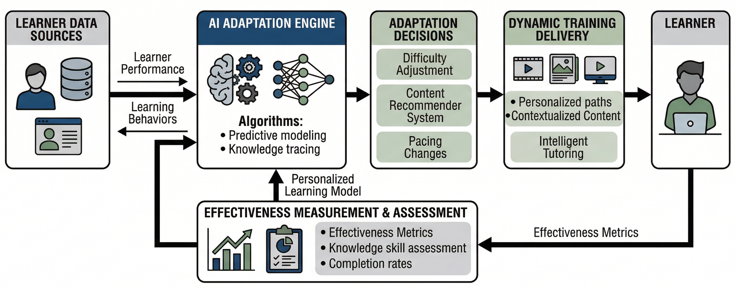
THE SYSTEM
Reading the pilot, not just the score
Sense, decide, deliver, measure. The loop closes inside the maneuver, not after it.
Notes:
0:45 to 1:05 (about 20 seconds)
CogniSim looks at the pilot instead of the score. Flight data and body signals
come in on the left. The engine keeps track of what the pilot knows, and picks
one change: difficulty, content, or pace.
[click] What happens next feeds back and updates the model of that pilot. The
whole loop runs while the aircraft is still flying.

Slide 4
AT THE BOOTH
Three things a visitor can do
1
Fly it
2
Watch it think
3
Try to break it
A Boeing 737 engine failure at takeoff speed, with the system watching your eyes and your heart.
Live load, mastery, the action it chose, and the reading behind it.
Attack the summary a device sends out, with the privacy protection off, then on.
Two to four minutes each. No sensors needed if you would rather not wear them.
Notes:
1:05 to 1:20 (about 15 seconds)
At the booth there are three things you can do, two to four minutes each.
[click] Fly an engine failure. [click] Watch the system think, on a second
screen. [click] And try to break its privacy protection.

Slide 5
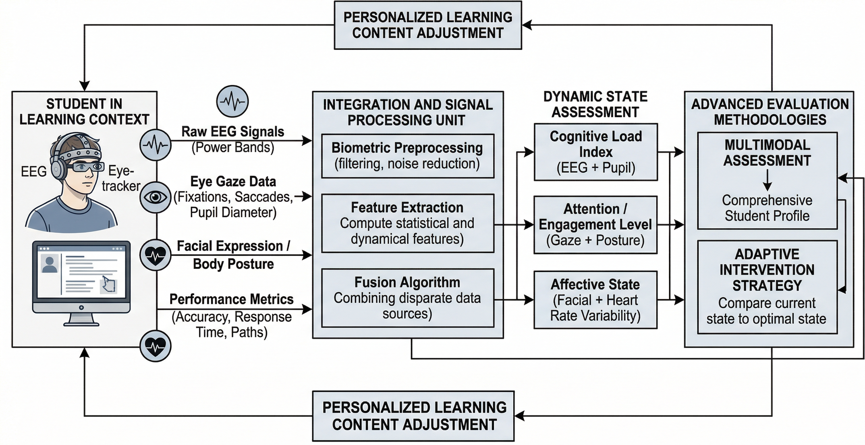
PART 1 · WHAT THE SENSORS SEE
Four streams, one reading
Eyes and pupil · 60 a second
Brain · 250 a second
Heart · once a second
Flight data · 120 a second
Event to decision: under 700 ms
Individual differences are large, so every trainee is measured against their own quiet baseline first.
Notes:
1:20 to 1:45 (about 25 seconds)
First, what the sensors see. The eyes and the pupil, sixty times a second. The
brain, two hundred and fifty times a second. The heart, once a second. The
flight data itself, one hundred and twenty times a second.
[click] A small network turns all of that into three numbers: effort the task
demands, effort wasted on the display, and effort left over for learning. From
the event to a decision takes under seven hundred milliseconds. That is what
lets us help during the maneuver instead of talking about it afterwards.

Slide 6
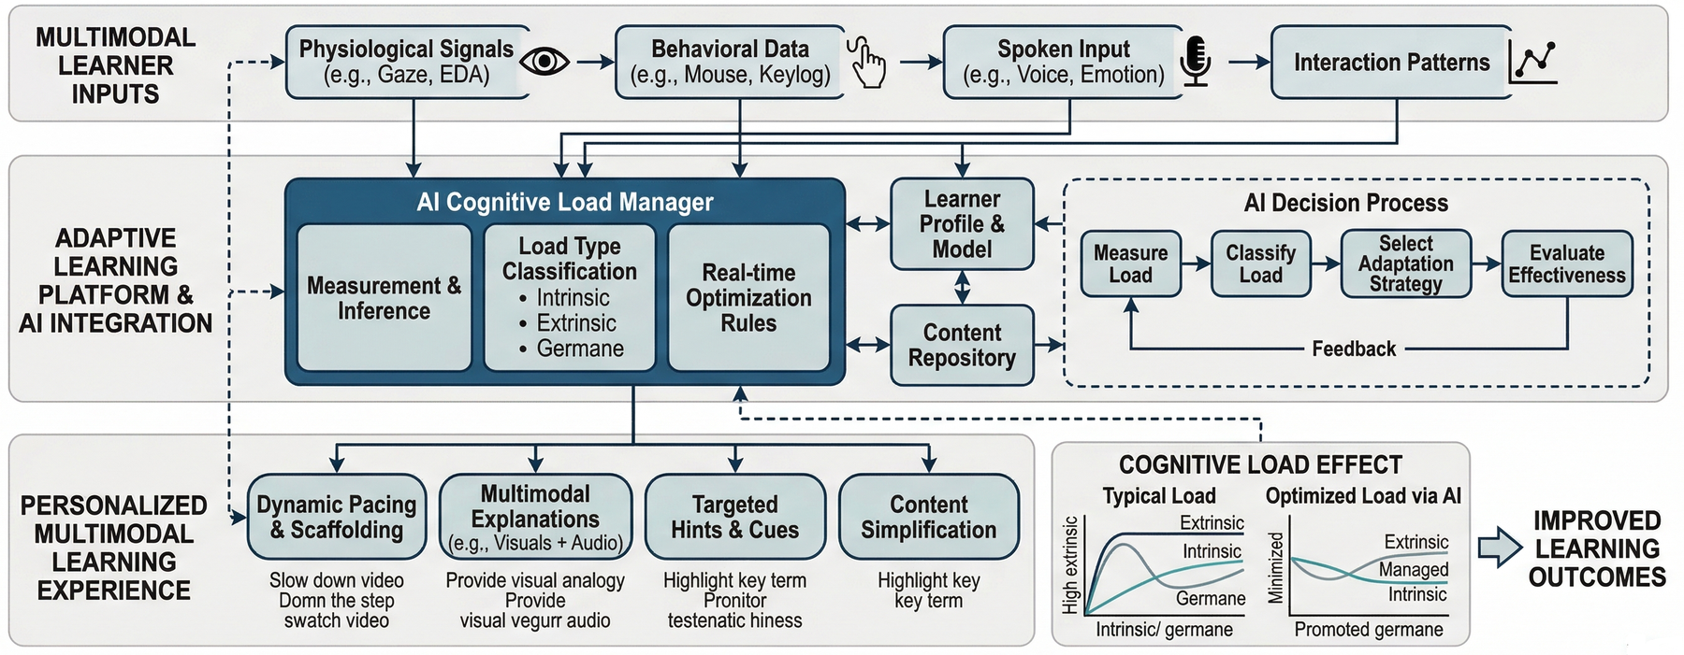
PART 2 · HOW IT DECIDES
When a sense is full, take something away
Three levers: difficulty, content, pace. Plus a fourth move, taking the clutter away.
Notes:
1:45 to 2:10 (about 25 seconds)
Second, how it decides. One model keeps track of what the pilot has mastered.
The policy reads that, and the load, then pulls one of three levers: make the
task harder or easier, change what is taught, or change the pace.
[click] And when the wasted effort climbs too high, it does something most
systems never do. It takes information away. Warnings that do not matter right
now are dimmed, and the guidance the pilot does need moves to sound and touch,
where there is still room.

Slide 7
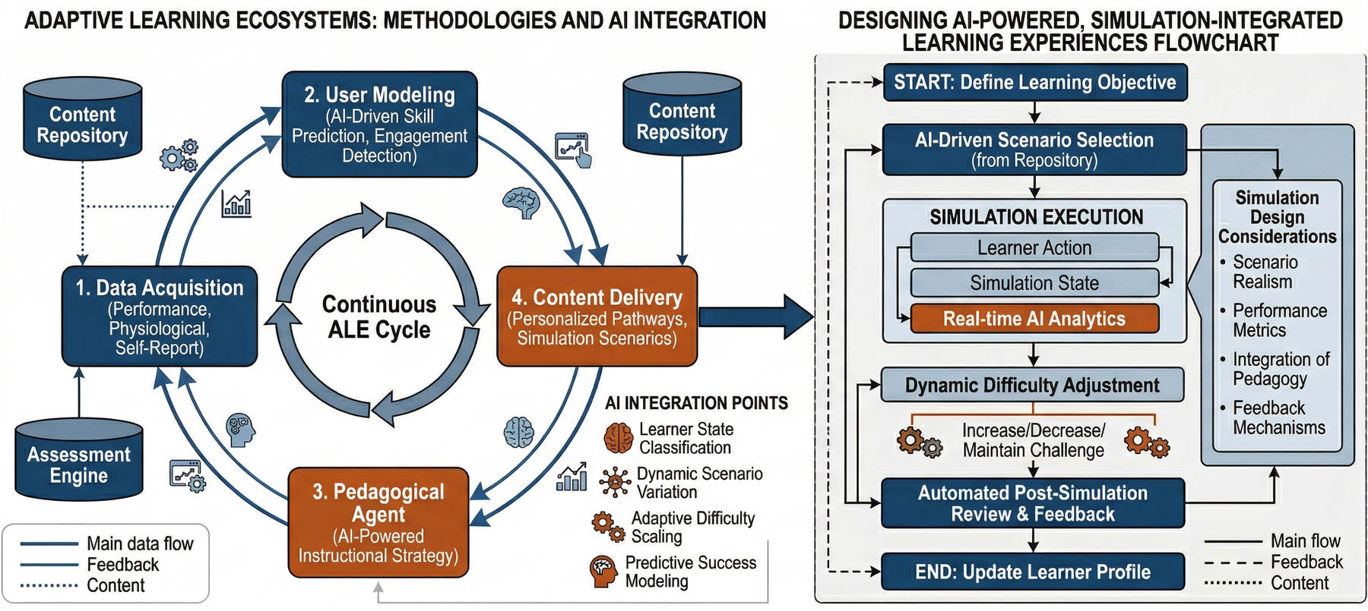
PART 3 · HOW IT SPEAKS
Help that never stops the flight
“I have the radios; you fly the aircraft.
Positive rate, gear up.”
the virtual first officer, staying in character
Nothing is paused
The coaching is part of the flight, so crew coordination is trained rather than interrupted.
Notes:
2:10 to 2:30 (about 20 seconds)
Third, how it speaks. Most tutors stop the task to give advice, which breaks
the immersion that makes simulation worth doing.
[click] Ours does not stop anything. The help comes from a virtual first
officer, staying in character. I have the radios; you fly the aircraft. The
flight keeps going, so the crew work stays realistic.

Slide 8
PART 4 · WHAT IT RECORDS
Six measurements, one competency record
Time to act
Recovery
Steadiness
Between seeing something and doing something.
How fast the pilot came back once help arrived.
Heart, skin and pupil, read together.
Scan quality
Voice strain
Procedure
How closely the eye pattern matched the ideal.
How much stress showed in the callouts.
Scored by software, so grading is consistent.
Every change the system made is stored next to the reading that caused it.
Notes:
2:30 to 2:45 (about 15 seconds)
Every maneuver leaves six measurements in a competency record, and every change
the system made is stored next to the reading that caused it.
[click] Because software does the scoring, two instructors no longer grade the
same flight differently.

Slide 9
ACTIVITY 1
Fly it
1
The aircraft
2
The failure
3
The weather
A Boeing 737, taking off from a runway with standing water on it.
An engine quits half a second past the speed where stopping is no longer an option.
A crosswind of 15 knots gusting 22, at 40 degrees off the runway.
And the sensors are running the whole time
Eyes, pupil, brain, heart, and the flight data itself. Nothing is asked of the pilot except to fly.
Notes:
2:45 to 3:00 (about 15 seconds)
So, activity one. You fly a Boeing 737 off a wet runway. An engine quits half a
second past the speed where stopping is no longer an option, in a gusting
crosswind.
[click] The sensors run the whole time.

Slide 10
ACTIVITY 1 · WHAT THE SYSTEM SAW
620 milliseconds after the engine quit
18.2 s past V1
18.7 s engine quits
19.3 s locked on one gauge
19.4 s clutter dimmed
21.2 s scanning again
PUPIL
BRAIN, FRONT
HEART RATIO
4.2 mm
quiet
1.2
PUPIL
BRAIN, FRONT
HEART RATIO
6.8 mm
up 1.8 dB
4.1
The system dims the clutter, the first officer takes the radios
Back in the scan 3.1 seconds later. Most people notice the help only when they watch the replay.
Notes:
3:00 to 3:35 (about 35 seconds) · THE KEY SLIDE, three clicks
At 18.2 seconds you are past that speed and everything is normal.
[click] At 18.7 the engine quits. Within 620 milliseconds the pupil widens from
4.2 to 6.8 millimetres, the front of the brain gets busier, and the heart ratio
triples. Your eyes are locked on the engine gauges and never check the airspeed.
[click] So the system dims the clutter and the first officer takes the radios.
[click] By 21.2 seconds you are scanning again. Recovery took 3.1 seconds. And
here is the part I like: most people only notice that any of this happened when
they watch the replay.

Slide 11
ACTIVITY 2
Watch it think
Effort the task demands
0.62
What it did
Effort wasted on the display
0.88
Dimmed the display, and spoke in role rather than pausing.
Effort left for learning
0.31
Locked on one instrument
0.91 sure
Why
Mastery so far
0.47
Wasted effort stayed above 0.85 for 400 ms while the eyes never checked airspeed.
Every change is stored next to the reading that caused it.
Notes:
3:35 to 3:55 (about 20 seconds)
Activity two. A second screen shows the inside of the loop while you fly: the
three numbers, the mastery so far, what the system did, and why it did it.
[click] That is the part we most want an audience to argue with. A claim you
can watch is a claim you can disagree with.

Slide 12
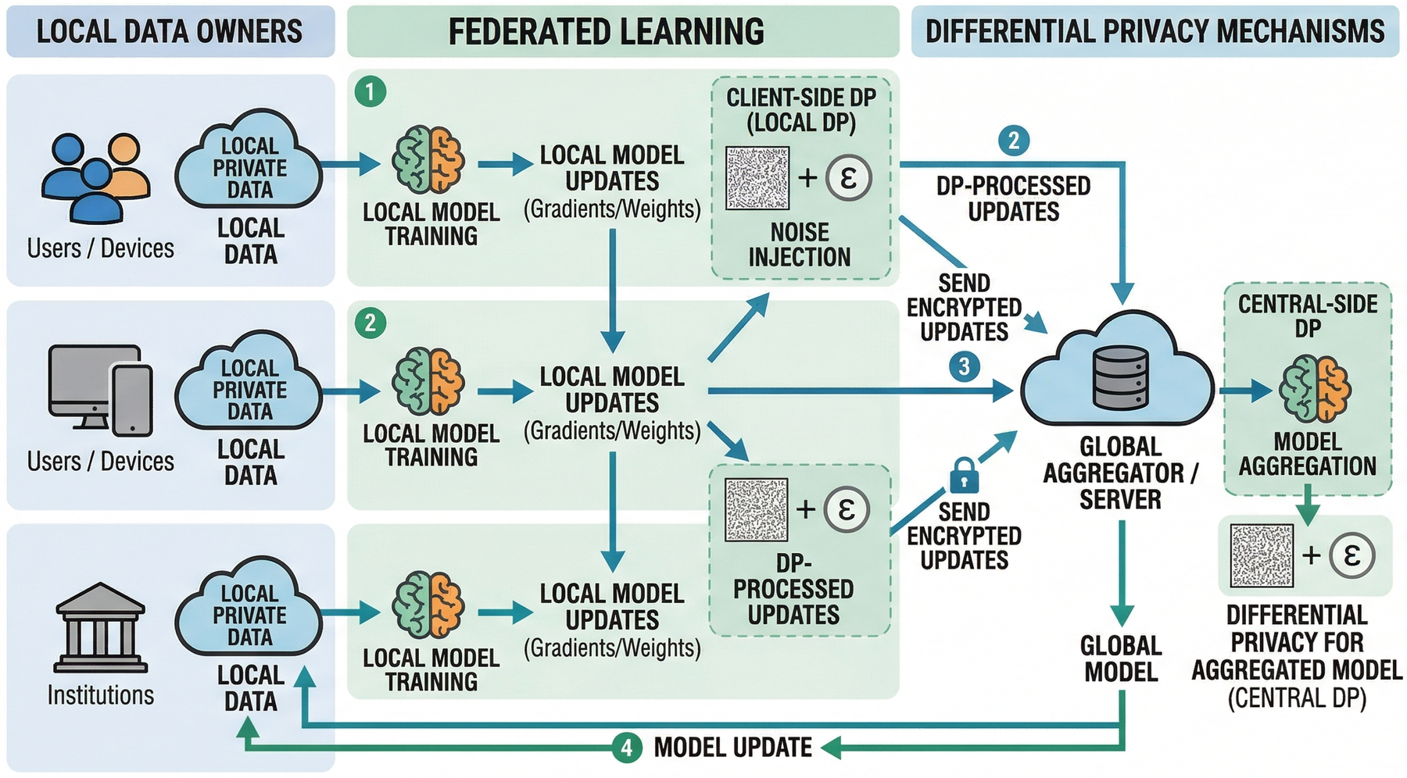
ACTIVITY 3
Nothing from the body leaves the room
Device blurs at 2
Server blurs at 1
Summary trimmed to a fixed size
Reduced to 95% of the variation first
Notes:
3:55 to 4:15 (about 20 seconds)
Activity three. Nothing from the body leaves the training computer. Only a
summary of what the local model learned is sent out, trimmed to a fixed size
and blurred with noise.
[click] The device blurs it at a budget of two, the server blurs it again at
one. Three in total.

Slide 13
ACTIVITY 3 · THE ATTACK
Try to break it
Protection off
Protection on, budget of 3
1.000
0.338
The attack rebuilds the pilot's eye and heart traces almost exactly as they were.
The attack returns noise. The shared model still works.
attack success: how closely the rebuilt signal matches the real one
The cost of that protection: about two points of accuracy
0.861 without it, 0.840 with it. Open source code reproduces both numbers in four seconds.
Notes:
4:15 to 4:40 (about 25 seconds)
And then you attack it. You run an attack that rebuilds the pilot's signals
from that summary.
[click] With the protection off it recovers them almost exactly. A cosine
similarity of one point zero: that is the trainee's own eye and heart traces,
back out of a number that was supposed to be anonymous.
[click] With the protection on, it gets noise, and the shared model gives up
about two points of accuracy. The trade stops being a sentence in a paper. You
watch it happen.

Slide 14
AT AAAI 2027
Come and fly it
1
What we need
2
Rather not wear sensors?
A desk, power and a monitor. We bring the simulator, the eye tracker, the wrist band and the headset.
Then run the same system from the recordings we bring with us.
Paper
CogniSim: A Simulator Trainer That Reads Cognitive Load and Keeps It Private
Code
github.com/example/cognisim
Contact
atik.mahabub@inrs.ca · shervin.vakili@inrs.ca
Thank you.
Notes:
4:40 to 5:00 (about 20 seconds)
We need a desk, power and a monitor. Anyone who would rather not wear sensors
can run the same system from recordings we bring.
[click] Come and fly it, look inside its reasoning, and try to break it.
Thank you.

