Slide 1

1
Thesis Defense
Enhancement of Flexible Unequal Error Control Method for Increasing the Capability of Soft Error Tolerance
Presented By:
Mirazul Islam (1607062)
Md. Atik Shahariar (1607065)
Supervised By:
Prof. Dr. Kazi Md. Rokibul Alam
Department of Computer Science and Engineering
Khulna University of Engineering & Technology (KUET)

Slide 2
2
Outline
Introduction
Related Work
Objectives
Proposed Methodology
Experimental Results
Conclusions

Slide 3

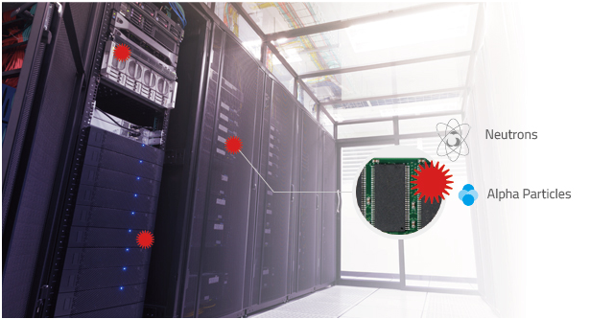
3
Introduction
In electronics and computing, a soft error is a type of error where a signal or datum is wrong.
Corrupted data values resulting from soft errors may crash the subsequent computation, communication, or memory systems, and may lead to overall system failure.
Fig. 1: Graphical representation of the effects of soft error

Slide 4
4
Related Work
Various methods for soft error tolerance:
Matrix code[1]
Bit overhead 100%
Correction coverage is 6.25%
Column Line Code (CLC)[2]
Bit overhead 150%
Correction coverage 12.5%
Flexible Unequal Error Control Method[3]
Correction Coverage 25%

Slide 5
5
Objectives
Enhancing Flexible Unequal Error Control (FUEC) method to increase it’s error detection and correction capability.
Performance analysis of the proposed methodology over the existing dominant methods.

Slide 6
6
Contribution
Twelve new approaches of Error Correction Code (ECC) has been proposed.
We experimented with all twelve approaches against all possible adjacent errors for a 16-bit data word.
We evaluated and analyzed the performance to show that our approaches of the FUEC method play a significant role in performing accurate and precise adjacent error detection and correction for a 16-bit data word.

Slide 7
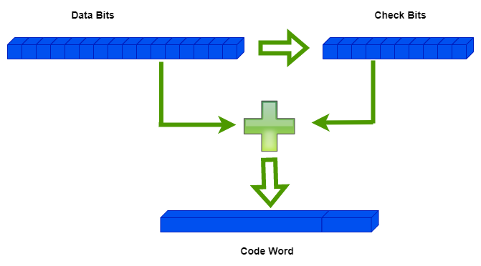
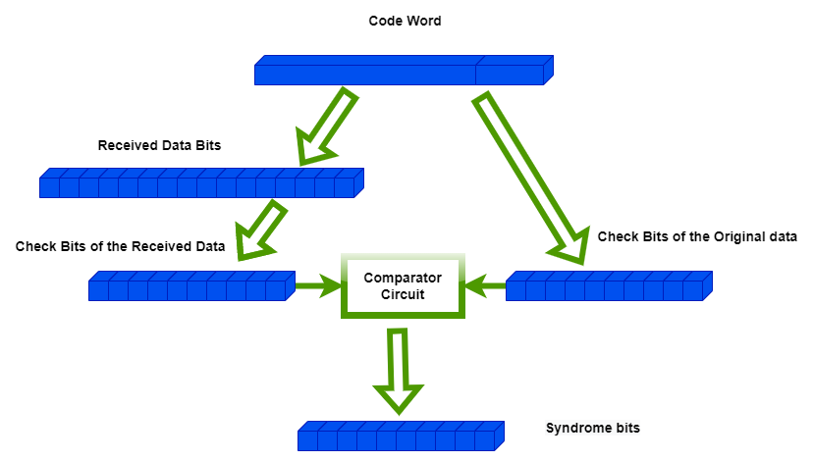
7
Proposed Methodology
Proposed methodology is divided into two parts.
In sender codeword is generated by encoding data bits and check bits together.
In receiver decoding ,error detection and correction is done.
Fig. 2: Encoding at sender
Fig. 3: Decoding at Receiver

Slide 8
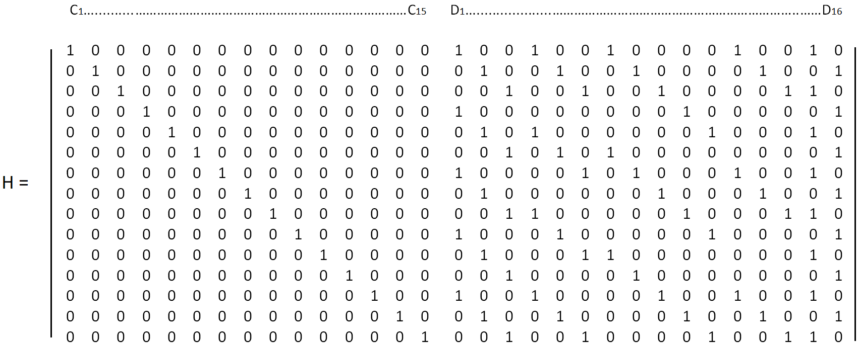
8
Proposed Methodology: H matrix Generation
First we calculate the check bits using the H matrix, which is divided into two portions.
Left portion is an identity matrix.
Rows of the H matrix must be pairwise unique.
Fig. 4: H-matrix for FUEC-DKAEC

Slide 9
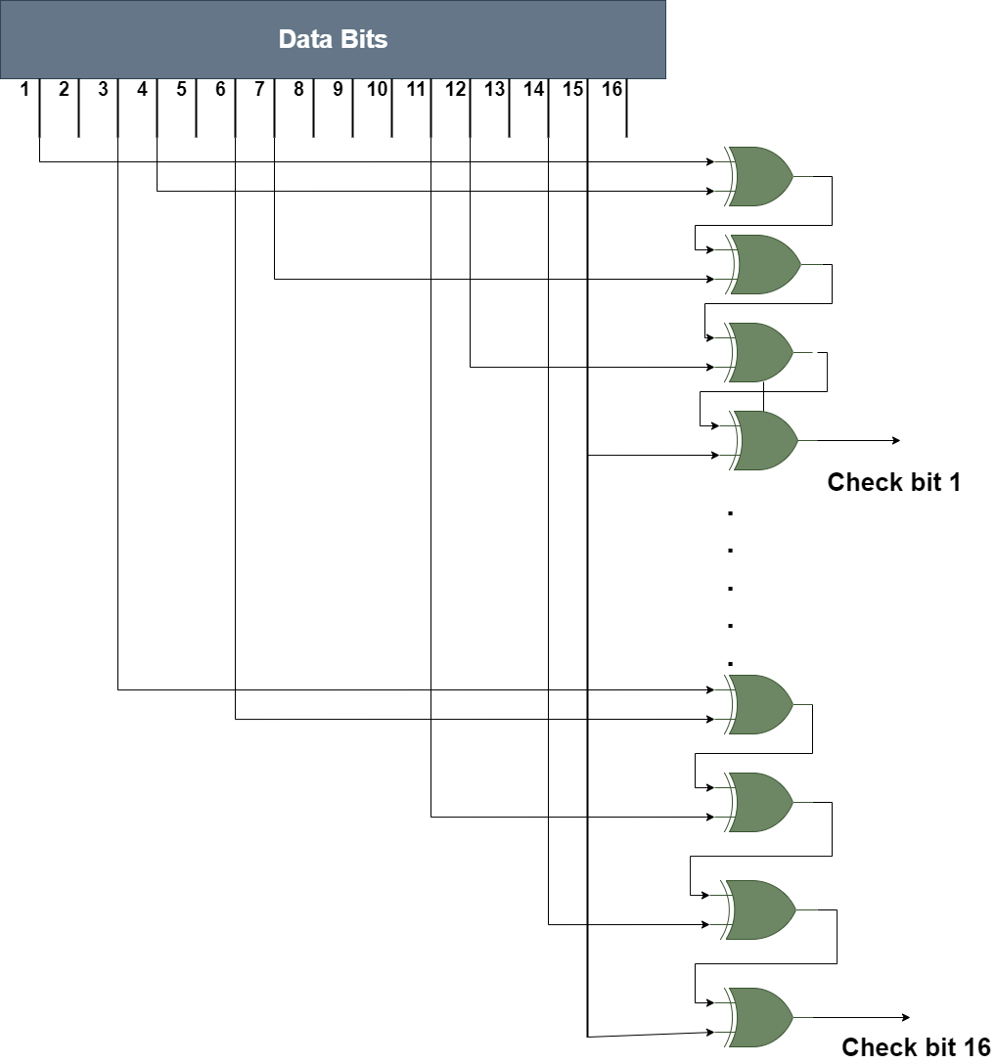
9
Proposed Methodology: Check Bit Calculation
Check bits are calculated by performing X-OR between the selected data bits using the H matrix.
Fig. 5: Check Bit Calculation for FUEC-DKAEC

Slide 10
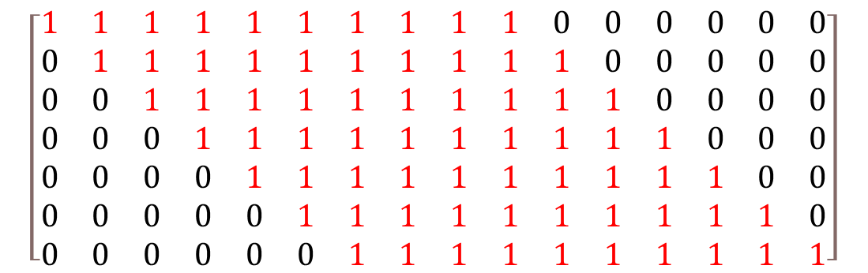
10
Proposed Methodology: Error Injection
For example,
Actual data: 0000000000000000
All possible combinations after 10-bit adjacent error injection:
$$\left[\begin{matrix}1 & 1 & 1 & 1 & 1 & 1 & 1 & 1 & 1 & 1 & 0 & 0 & 0 & 0 & 0 & 0 \\ 0 & 1 & 1 & 1 & 1 & 1 & 1 & 1 & 1 & 1 & 1 & 0 & 0 & 0 & 0 & 0 \\ 0 & 0 & 1 & 1 & 1 & 1 & 1 & 1 & 1 & 1 & 1 & 1 & 0 & 0 & 0 & 0 \\ 0 & 0 & 0 & 1 & 1 & 1 & 1 & 1 & 1 & 1 & 1 & 1 & 1 & 0 & 0 & 0 \\ 0 & 0 & 0 & 0 & 1 & 1 & 1 & 1 & 1 & 1 & 1 & 1 & 1 & 1 & 0 & 0 \\ 0 & 0 & 0 & 0 & 0 & 1 & 1 & 1 & 1 & 1 & 1 & 1 & 1 & 1 & 1 & 0 \\ 0 & 0 & 0 & 0 & 0 & 0 & 1 & 1 & 1 & 1 & 1 & 1 & 1 & 1 & 1 & 1\end{matrix}\right]$$
Fig. 6: Error injection for FUEC-DKAEC

Slide 11
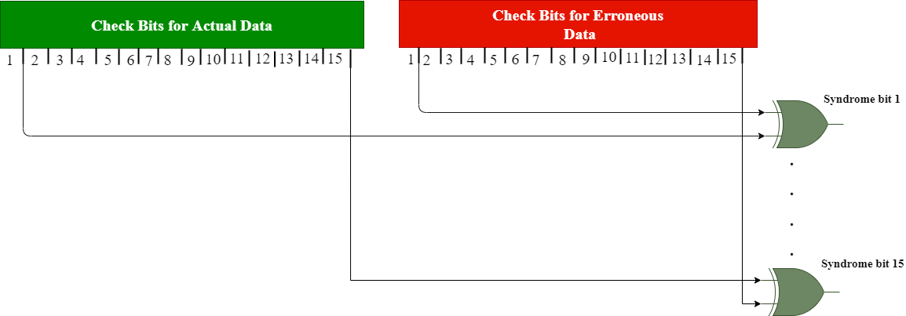
11
Proposed Methodology: Syndrome Bit Calculation
Syndrome bits are calculated by performing X-OR operation between the actual data check bits and received data check bits.
Fig. 7: Syndrome Bit Calculation for FUEC-DKAEC

Slide 12
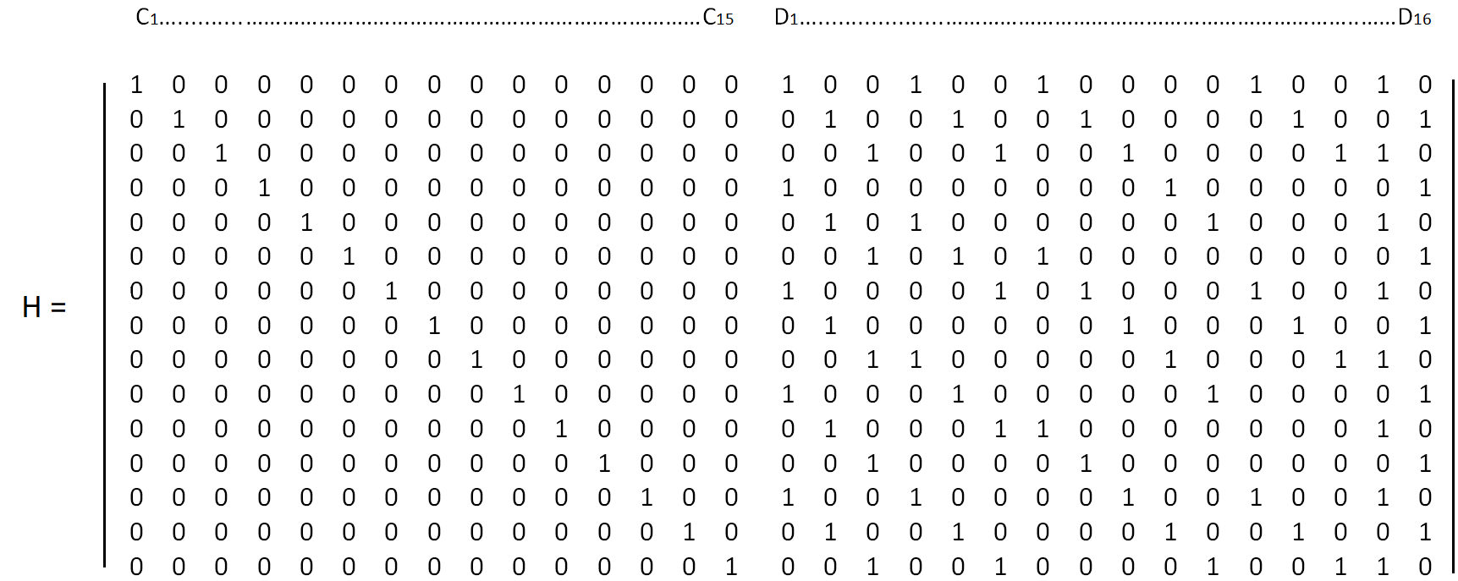
12
Proposed Methodology: Error Detection
Syndrome bits
Match found?
X-OR
1 1 1 0 0 1 1 0 1 0 1 0 1 1 0
1 1 1 0 0 0 1 1 1 0 0 0 1 1 1
Yes
Yes Yes Yes Yes
No
Yes
No
Yes
Yes
No
Yes
Yes
YesNo
Compare
So eleven times the X-OR of H-matrix data matches with syndrome bits, which is less then syndrome array size. So the adjacent error is not in the first ten data bits.

Slide 13
13
Proposed Methodology: Error Detection (cont.)
Syndrome bits
Match found?
X-OR
0 1 1 1 1 1 0 0 1 0 1 0 0 1 1
1 1 1 0 0 0 1 1 1 0 0 0 1 1 1
No
Yes Yes No
No
No
No
No
Yes
Yes
No
Yes
No
Yes Yes
Compare
So seven times the X-OR of H-matrix data matches with syndrome bits, which is less then syndrome array size. So the adjacent error is not in the second ten data bits.

Slide 14
14
Proposed Methodology: Error Detection (cont.)
Syndrome bits
Match found?
X-OR
1 0 1 1 0 1 1 1 1 0 0 0 1 0 1
1 1 1 0 0 0 1 1 1 0 0 0 1 1 1
Yes
No Yes No
Yes
No
Yes
Yes
Yes
Yes
Yes
Yes
Yes
No
Yes
Compare
So eleven times the X-OR of H-matrix data matches with syndrome bits, which is less then syndrome array size. So the adjacent error is not in the third ten data bits.

Slide 15
15
Proposed Methodology: Error Detection (cont.)
Syndrome bits
Match found?
X-OR
1 1 0 1 0 0 1 0 0 0 0 1 1 1 0
1 1 1 0 0 0 1 1 1 0 0 0 1 1 1
Yes
Yes No No
Yes
Yes
Yes
No
No
Yes
Yes
No
Yes
Yes
No
Compare
So ten times the X-OR of H-matrix data matches with syndrome bits, which is less then syndrome array size. So the adjacent error is not in the fourth ten data bits.

Slide 16
16
Proposed Methodology: Error Detection (cont.)
Syndrome bits
Match found?
X-OR
0 1 1 1 1 0 1 0 0 0 0 1 0 1 1
1 1 1 0 0 0 1 1 1 0 0 0 1 1 1
No
Yes Yes No
No
Yes
Yes
No
No
Yes
Yes
No
No
Yes
Yes
Compare
So eight times the X-OR of H-matrix data matches with syndrome bits, which is less then syndrome array size. So the adjacent error is not in the fifth ten data bits.

Slide 17
17
Proposed Methodology: Error Detection (cont.)
Syndrome bits
Match found?
X-OR
1 0 0 1 0 1 0 0 1 1 1 1 1 0 1
1 1 1 0 0 0 1 1 1 0 0 0 1 1 1
Yes
No No No
Yes
No
No
No
Yes
No
No
No
Yes No
Yes
Compare
So five times the X-OR of H-matrix data matches with syndrome bits, which is less then syndrome array size. So the adjacent error is not in the sixth ten data bits.

Slide 18
18
Proposed Methodology: Error Detection (cont.)
Syndrome bits
Match found?
X-OR
1 1 1 0 0 0 1 1 1 0 0 0 1 1 1
1 1 1 0 0 0 1 1 1 0 0 0 1 1 1
Yes
Yes Yes Yes
Yes
Yes
Yes
Yes
Yes
Yes
Yes
Yes
Yes Yes
Yes
Compare
So fifteen times the X-OR of H-matrix data matches with syndrome bits, which is the same as syndrome array size. So there is a 10-bit adjacent error in the last ten bits of the received data.

Slide 19
19
Proposed Methodology: Error Correction
When the positions of the erroneous data bits are detected the data bits at those positions are flipped to obtain the corrected data.
Erroneous Data
0 0 0 0 0 0
1 1 1 1 1 1 1 1 1 1
10-bit adjacent error detected
Flip the data at the selected positions
Corrected Data
0 0 0 0 0 0 0 0 0 0 0 0 0 0 0 0
Fig. 8: Error Correction for FUEC-DKAEC

Slide 20
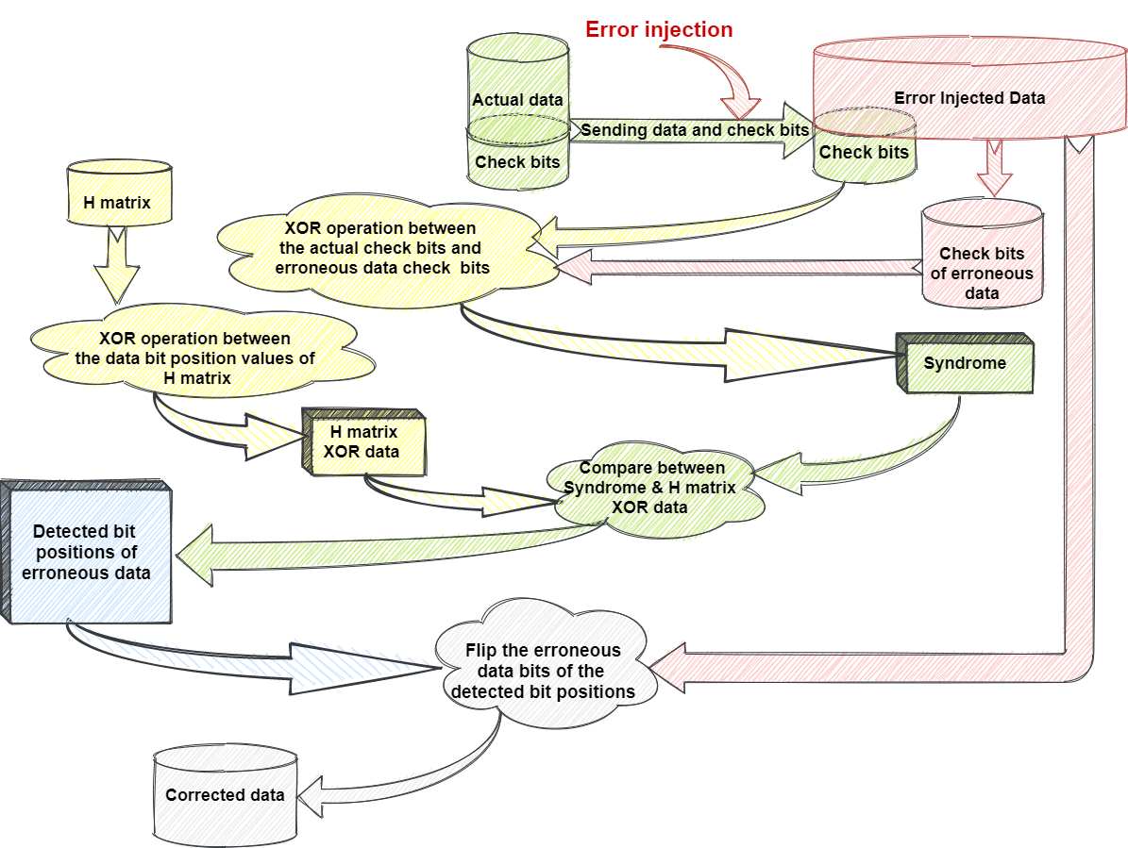
20
Proposed Methodology: Flow Diagram
Fig. 9: Flow diagram of proposed methodology

Slide 21
21
Experimental Analysis
Experimental Setup:
System configurations:
Intel®Core™ i5-7200U CPU @ 2.50 GHz to 2.71 GHz.
Operating system Windows 10 - 64 bit.
RAM 8 GB.
Tools:
Language C++ for coding purposes.
Pspice Cadence SPB OrCAD for circuit making and simulation.

Slide 22
22
Experimental Analysis (cont.)
Comparison of Correction Coverage between Matrix[1], CLC [2], FUEC-QUAEC[3] and the proposed method.
Fig. 10: Comparison of Correction Coverage

Slide 23
23
Experimental Analysis (cont.)
Comparison of bit overhead among Matrix[1], CLC[2], FUEC-QUAEC[3] and the proposed method.
Fig. 11: Comparison of Bit Overhead

Slide 24
24
Experimental Analysis (cont.)
Table. 1: Summarization of the performance analysis of proposed methodology
Schemes | Required number of Check bits for a 16-bit data word | Bit Overhead (%) | Correction Coverage (%) | Time Complexity O(n=Maximum number of error correction capability) | Maximum adjacent error correction capability
FUEC-PAEC | 10 | 62.5 | 31.25 | O(n=5) | 5-bit
FUEC-HXAEC | 11 | 68.75 | 37.5 | O(n=6) | 6-bit
FUEC-HEPAEC | 12 | 75 | 43.75 | O(n=7) | 7-bit
FUEC-OCAEC | 13 | 81.75 | 50 | O(n=8) | 8-bit
FUEC-ENAEC | 14 | 87.5 | 56.25 | O(n=9) | 9-bit
FUEC-DKAEC | 15 | 93.75 | 62.5 | O(n=10) | 10-bit
FUEC-ENDAEC | 16 | 100 | 68.75 | O(n=11) | 11-bit
FUEC-DODAEC | 17 | 106.25 | 75 | O(n=12) | 12-bit
FUEC-DTAEC | 18 | 112.5 | 81.25 | O(n=13) | 13-bit
FUEC-TESAEC | 19 | 118.75 | 87.5 | O(n=14) | 14-bit
FUEC-PENAEC | 20 | 125 | 93.75 | O(n=15) | 15-bit
FUEC-DEXAEC | 21 | 131.25 | 100 | O(n=16) | 16-bit

Slide 25
25
Conclusions
We have successfully enhanced Flexible Unequal Error Control (FUEC) Method to detect and correct more adjacent bits error.
We have increased the correction coverage of FUEC method to 100%.
Our method outperforms previous methods as it has better correction coverage with respect to number of redundant bits.
Our method can correct adjacent errors only. So in future there is still scope for improvements.

Slide 26
26
Acknowledgement
We are grateful to Prof. Dr. Muhammad Sheikh Sadi sir for assistance in deciding thesis idea.

Slide 27
27
Publication
Md. Atik Shahariar, Mirazul Islam, Muhammad Sheikh Sadi, Soumen Ghosh , Enhancing Flexible Unequal Error Control Method to Improve Soft Error Tolerance. Proceedings of International Conference on Trends in Computational and Cognitive Engineering. Advances in Intelligent Systems and Computing, vol 1309. Springer, Singapore.

Slide 28
28
Reference
Neale, A., Sachdev, M.: A new sec-Ded error correction code subclass for adjacent Mcu Tolerance in embedded memory. IEEE Trans. Device Mater. Reliab. 13(3), 223–230 (2013)
Castro, H., Silveira, J., Coelho, A., Silva, F., Magalhães, P., Lima, O.: A correction code for multiple cells upsets in memory devices for space applications. In: 14th IEEE International New Circuits and Systems Conference (NEWCAS) 2016, pp. 1–4. (2016).
Gracia-Morán, J., Saiz-Adalid, L., Gil-Tomás, D., Gil-Vicente, P.: Improving Error Correction Codes for Multiple-Cell Upsets in Space Applications. IEEE Trans. Very Large Scale Integr. (VLSI) Syst. 26(10), 2132–2142 (2018).

Slide 29

29
Thank You !!!

