Slide 1
ROTATIONAL
MOTION
A Complete Physics Guide
Concepts · Equations · Applications · Examples

Slide 2
What We Will Cover
01
02
What is Rotational Motion?
Key Angular Quantities
03
04
Angular Displacement
Angular Velocity & Acceleration
05
06
Kinematic Equations
Centripetal Acceleration
07
08
Torque — The Rotational Force
Moment of Inertia
09
10
Common Moment of Inertia Formulas
Newton's 2nd Law (Rotation)
11
12
Angular Momentum
Conservation of Angular Momentum
13
14
Rotational Kinetic Energy
Rolling Motion
15
16
Gyroscopes & Precession
Real-World Applications
17
18
Fun Facts & Records
Summary & Key Equations

Slide 3
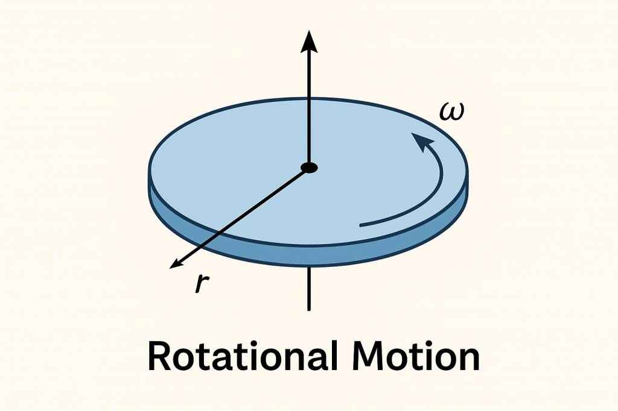
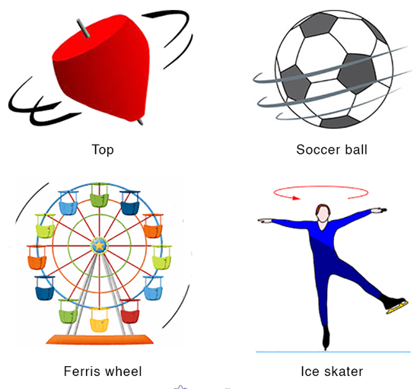
What is Rotational Motion?
Rotational motion occurs when an object spins around a fixed internal or external axis. Every particle in the object moves in a circle centered on that axis.
Internal Axis
The axis passes through the object itself — e.g. a spinning top, Earth rotating on its own axis, a wheel on its hub.
Spinning top (internal axis)
External Axis
The object revolves around a point outside it — e.g. Earth orbiting the Sun, a ball on a string, a planet's moon.
Rigid Body
All particles maintain fixed relative positions. The whole body shares the same angular velocity ω at any instant.
Ferris wheel (external axis)

Slide 4
Key Angular Quantities
θ
Angular Displacement
ω
Angular Velocity
α
Angular Acceleration
Unit: radians (rad)
Unit: rad / s
Unit: rad / s²
Δθ = θf − θi
ω = Δθ / Δt
α = Δω / Δt
Angle turned
Rate of spin
Change in spin rate
v
Tangential Speed
aₓ
Centripetal Accel.
T
Period
Unit: m / s
Unit: m / s²
Unit: seconds (s)
v = r · ω
aₓ = v²/r = rω²
T = 2π / ω
Speed along arc
Inward acceleration
Time per revolution

Slide 5
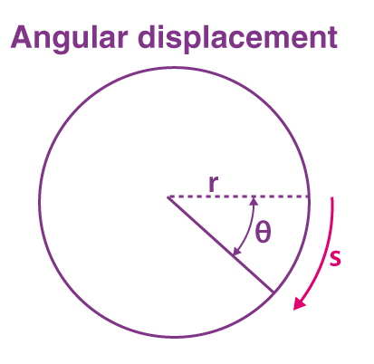
Angular Displacement (θ)
Definition
Angular displacement θ is the angle rotated by an object. Measured in radians: θ = s / r, where s = arc length and r = radius.
Radians vs Degrees
One full revolution = 2π rad = 360°. So 1 rad ≈ 57.3°. To convert: rad = degrees × (π/180).
Direction
Counter-clockwise rotation → positive θ. Clockwise → negative θ. This follows the right-hand rule convention.
Angle θ in radians = arc / radius
Key Values
Quarter turn = π/2 rad (90°) · Half turn = π rad (180°) · Full turn = 2π rad (360°)

Slide 6
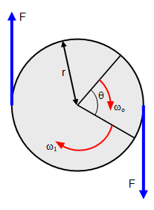
Angular Velocity & Acceleration
Angular Velocity (ω)
Angular Acceleration (α)
ω = Δθ / Δt (avg)
ω = dθ/dt (instantaneous)
Unit: rad/s or rev/s or rpm
Relationship to frequency:
ω = 2π · f (f in Hz)
Relationship to period:
ω = 2π / T
A car wheel at 60 mph (≈ 97 km/h) with
r = 0.35 m spins at ω ≈ 77 rad/s.
α = Δω / Δt (avg)
α = dω/dt (instantaneous)
Unit: rad/s²
Positive α → speeding up (CCW)
Negative α → slowing down (CCW)
Relationship to tangential accel.:
aₜ = r · α
A drill bit going from 0 → 1200 rpm
in 2 s: α = (1200 × 2π/60) / 2 ≈ 62.8 rad/s²

Slide 7
Rotational Kinematic Equations
These four equations apply when angular acceleration α is constant.
#
Linear Equation
Rotational Analogue
Missing Variable
1
v = v₀ + at
ω = ω₀ + αt
Δx / Δθ
2
Δx = v₀t + ½at²
Δθ = ω₀t + ½αt²
v / ω (final)
3
v² = v₀² + 2aΔx
ω² = ω₀² + 2αΔθ
t
4
Δx = ½(v+v₀)t
Δθ = ½(ω+ω₀)t
α
💡 Example: A wheel at rest accelerates at α = 3 rad/s². After t = 4 s: ω = 0 + 3×4 = 12 rad/s and Δθ = ½×3×16 = 24 rad ≈ 3.8 revolutions

Slide 8
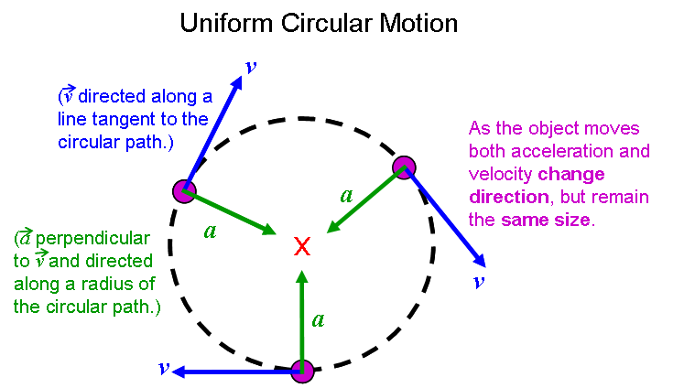
Centripetal Acceleration
aₓ = v² / r = r · ω² (directed toward center of circle)
📌 Direction
⚠️ Not a New Force
Always points toward the center of the circular path — this is why it is called 'center-seeking' (centripetal = Latin for 'center-seeking').
Centripetal acceleration is provided by existing forces: tension in a string, gravity, normal force, friction — depending on context.
📐 Magnitude Increases With

Slide 9
Torque — The Rotational Force
τ = r × F = r · F · sin(φ) [N·m]
τ (tau)
Torque — the tendency to cause rotation around an axis (Newton-meters, N·m)
r
Moment arm — perpendicular distance from the axis to the line of action of force
F
Applied force (Newtons). Only the component perpendicular to r causes torque.
Torque animation — force applied at distance r
φ (phi)
Angle between the force vector F and the position vector r. Max torque when φ = 90°.
Direction
Right-hand rule: curl fingers from r toward F — thumb points in torque direction.
Example: A wrench 0.25 m long, force 80 N at 90°: τ = 0.25 × 80 × sin(90°) = 20 N·m

Slide 10
Moment of Inertia (I)
I = Σ mᵢ rᵢ² (discrete) I = ∫ r² dm (continuous)
Physical Meaning
Moment of inertia is the rotational analogue of mass. It measures an object's resistance to angular acceleration — like 'rotational inertia'.
Mass Distribution
The further mass is from the axis, the larger I. A hollow cylinder (I=MR²) is harder to spin than a solid disk (I=½MR²) of equal mass.
Axis Dependence
I depends on which axis you choose. The parallel-axis theorem: I = I_cm + Md², where d is distance from center of mass to new axis.
Practical Impact
Flywheels use large I to store energy. Figure skaters control I by moving arms in or out to change spin speed.

Slide 11
Common Moment of Inertia Formulas
Solid Disk / Cylinder
Thin Hollow Ring
Solid Sphere
Hollow Sphere
I = ½MR²
I = MR²
I = ⅖MR²
I = ⅔MR²
Axis through center, perpendicular to face
All mass at rim — maximum I for given M,R
Axis through center
Only the shell — larger than solid sphere
Thin Rod (center)
Thin Rod (end)
Rectangular Plate
Point Mass
I = 1/12 ML²
I = ⅓ML²
I = 1/12 M(a²+b²)
I = mr²
Rotating about midpoint
Rotating about one end — 4× center value
Axis through center, in plane of plate
Fundamental definition — all others derived from this

Slide 12
Newton's 2nd Law for Rotation
Σ τ = I · α
Rotational analogue of F = ma — net torque causes angular acceleration
Σ τ (net torque)
Linear ↔ Rotation
Sum of all torques acting on the object. Units: N·m. If torques cancel → no angular acceleration.
F = ma
Σ τ = Iα
I (moment of inertia)
m (mass)
I (inertia)
Resistance to angular acceleration. Larger I → same torque produces smaller α. Units: kg·m².
F (force)
τ (torque)
α (angular acceleration)
a (accel.)
α (ang. accel.)
Rate of change of angular velocity. Units: rad/s². Direction same as net torque.
v (speed)
ω (ang. vel.)
Example: A solid disk (I = ½×2×0.3² = 0.09 kg·m²) has net torque 1.8 N·m applied. α = 1.8/0.09 = 20 rad/s²

Slide 13
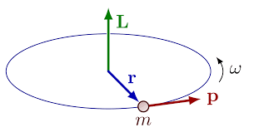
Angular Momentum (L)
L = I · ω [kg · m² / s]
Vector Quantity
L is a vector — direction given by right-hand rule (curl fingers with rotation, thumb = L direction). For a spinning top, L points upward.
Linear Analogue
Just as p = mv (linear momentum), L = Iω. Torque is the rate of change of L: τ = dL/dt.
For a Point Mass
For a particle at radius r with speed v: L = mvr = mr²ω. This simplest case builds the general formula.
Gyroscope — angular momentum gives stability
Stability from L
Large angular momentum resists changes in direction — gyroscopes, bicycles, rifled bullets, and frisbees all exploit this property.

Slide 14
Conservation of Angular Momentum
If Σ τ_ext = 0 → L is CONSERVED: I₁ω₁ = I₂ω₂
🤸 Figure Skater
Pulling arms in reduces I (mass closer to axis). Since L = Iω must stay constant, ω increases dramatically. Extending arms slows the spin.
🌟 Neutron Stars
When a massive star collapses, radius shrinks from ~10⁶ km to ~10 km. Conservation of L makes it spin up to hundreds of rotations per second (pulsars).
🪐 Planetary Orbits
Planets move faster when closer to the Sun (perihelion) and slower when further (aphelion) — angular momentum conservation in elliptical orbits (Kepler's 2nd Law).
🤿 Diver's Tuck
A diver tucks into a ball to increase spin rate for multiple somersaults, then extends to slow down and enter the water cleanly.
🚀 Spacecraft
Satellites use reaction wheels to change orientation without external torque. Spinning the wheel one way rotates the craft the other way — perfect L conservation.
Figure skater: arms in → ω increases

Slide 15
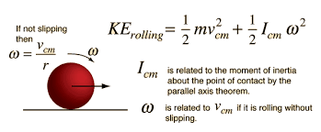
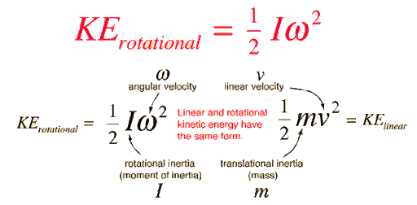
Rotational Kinetic Energy
KE_rot = ½ I ω² (compare: KE_linear = ½mv²)
Combined Kinetic Energy
Practical Use — Flywheels
A rolling object has BOTH translational and rotational KE:
KE_total = ½mv² + ½Iω² = ½mv²(1 + I/mr²)
Hybrid cars, uninterruptible power supplies, and grid-scale energy storage all use flywheels. High ω and large I = massive energy storage.

Slide 16
Gyroscopes & Precession
What is a Gyroscope?
A gyroscope is a spinning wheel or disk whose axis can freely orient in any direction. The large angular momentum makes it highly stable and resistant to tipping.
Precession
When gravity (torque) acts on a tilted gyroscope, instead of falling it rotates slowly around the vertical axis. Precession rate: Ω = τ / L = Mgd / (Iω).
Right-Hand Rule for L
Point right-hand fingers in rotation direction → thumb points along L. When torque τ = r×F acts perpendicular to L, it causes L to precess.
Gyroscope precessing under gravity
Applications
Aircraft attitude indicators · Ship stabilizers · Smartphone orientation sensors (MEMS gyros) · Hubble Space Telescope pointing · Bicycle stability at speed · Rifled bullet spin-stabilization

Slide 17
Real-World Applications
🚗 Vehicle Wheels & Gears
✈️ Jet Turbines
🏋️ Sports Biomechanics
Every car, bicycle, and engine relies on rotational motion. Gear ratios alter torque and speed. ABS uses angular velocity sensors.
Jet engines extract rotational KE from hot gas to spin compressors. Turbine blades exploit rotational dynamics at extreme ω.
Divers, skaters, gymnasts all manipulate I to control spin speed. Biomechanists use ω and α to optimize technique.
🌍 Earth's Rotation
⚙️ Flywheels & Energy
🔬 Medical Centrifuges
24-hour day, seasons, Coriolis effect — all consequences of Earth's rotation at ω ≈ 7.27×10⁻⁵ rad/s.
Fly wheels store GJ of energy for grid stabilization. Porsche 918 Spyder uses a flywheel KERS system.
Centrifuges spin at 50,000+ rpm to separate blood components, isolate DNA, and process vaccines.
🛸 Spacecraft Attitude
💿 Hard Drives & CDs
🌊 Wind Turbines
Reaction wheels and gyros orient satellites precisely without expelling fuel. Hubble uses 6 reaction wheel assemblies.
Hard disk platters spin at 5,400-15,000 rpm. Rotational physics governs seek time, data rate, and gyroscopic effects.
Blades rotate at 5-20 rpm (variable), but generators reach 1500 rpm via gearboxes. Blade tip speeds can exceed 300 km/h.

Slide 18
⚡ Fun Facts & World Records
🌀
Fastest pulsar (PSR J1748-2446ad) spins at 716 Hz — 716 rotations per second — with surface speed ~24% of light!
🧪
Fastest centrifuge: 1,000,000 rpm achieved with carbon nanotube rotors at Purdue University (2022). Tips move at half the speed of sound.
🪐
Jupiter rotates in just 9h 55m despite being 11× Earth's diameter. Its rapid spin causes an equatorial bulge of ~6,500 km.
Crab Nebula pulsar — fastest natural spinner
🏋️
Hammer throw world record (~86 m) requires the athlete to spin ~4 times, reaching tip speeds of ~30 m/s — angular momentum does the work.
💿
Fastest spinning man-made object: a dumbbell-shaped nanoparticle levitated in vacuum spins at 60 billion rpm (University of Purdue, 2018).
🌍
Earth's rotation is slowing: days get ~1.8 ms longer per century due to tidal friction from the Moon transferring angular momentum.
Lab centrifuge: up to 1,000,000 rpm

Slide 19
Summary & Key Equations
θ = s / r
Angular displacement from arc length
I = Σ mᵢrᵢ²
Moment of inertia (discrete)
ω = Δθ / Δt
Average angular velocity
L = I · ω
Angular momentum
α = Δω / Δt
Average angular acceleration
I₁ω₁ = I₂ω₂
Conservation (no ext. torque)
v = rω · aₜ = rα
Tangential speed & accel.
KE_rot = ½Iω²
Rotational kinetic energy
aₓ = v²/r = rω²
Centripetal acceleration
W = τ · Δθ
Work done by torque
Σ τ = I · α
Newton's 2nd Law (rotation)
I = I_cm + Md²
Parallel-axis theorem
Rotational Motion — Physics Mechanics Series • 18 Slides Complete

