Slide 1
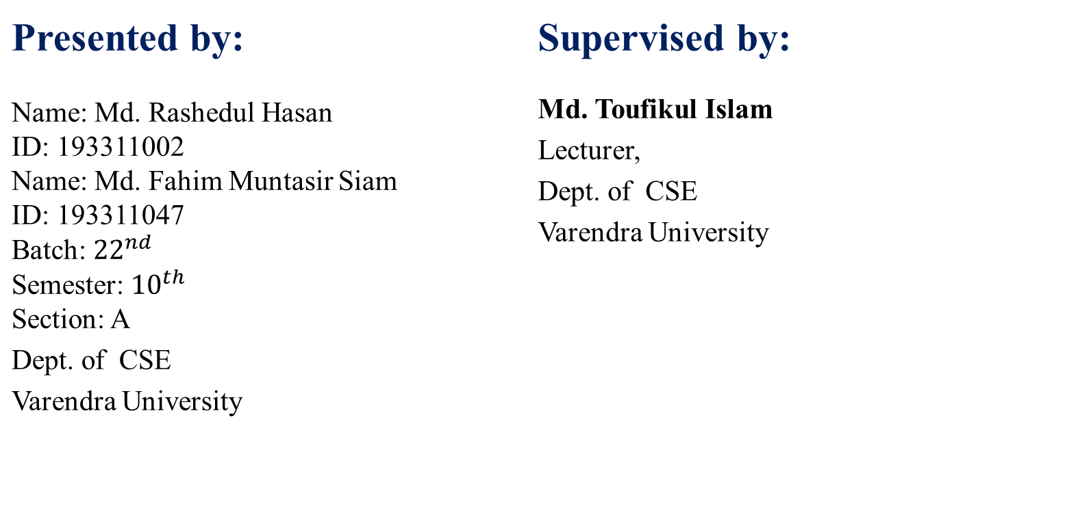
FavoMan E-commerce Website
Presented by: Name: Md. Rashedul Hasan ID: 193311002 Name: Md. Fahim Muntasir Siam ID: 193311047 Batch: ${22}^{nd}$ Semester: ${10}^{th}$ Section: A Dept. of CSE Varendra University | Supervised by: Md. Toufikul Islam Lecturer, Dept. of CSE Varendra University
1

Slide 2
CONTENT
Introduction
Project Aim And Objective
Target User
Benefits Of The Developed System
Features
Structure Of The System
Implementation
Conclusion and Future Work
2

Slide 3
INTRODUCTION
Now a days where everything is online based, the stores that are selling products manually are deprived of a huge customer base that shop online. It is time consuming to go to a store and buy a dress. Most people prefer to shop online where they can browse different stores from anywhere to find what they need. To overcome this problem we have developed a website for our store where we can target the customers who shop online. Through this website anyone can view our collection in an organized manner and easily buy from anywhere.
3

Slide 4
PROJECT AIM AND OBJECTIVE
To reduce time for shopping.
To target online based shopping audience.
To shop from anywhere.
To showcase all the products in an organized manner.
To increase data security.
4

Slide 5
TARGET USER
Male users from the age of 12 to 50 can use this website to buy our products.
Female users can use this website to buy gifts for their male friends and family members.
5

Slide 6
BENEFITS OF THE DEVELOPED SYSTEM
User friendly.
Easy to keep track of customer orders.
Shop from anywhere.
Easily search for any products.
View category of products in an organized order.
6

Slide 7
FEATURES
Website can be accessed easily from anywhere if you have an internet connection
Can bookmark a product for future purchase
Get notification for favorite products or if a bookmarked product is available
Chat with the store directly through the website
Simple and easy to use
7

Slide 8
FEATURES CONT’D
Buy directly from the website
Filter wise product search
Sales, buying record are kept safe and confidential
Customers can easily view their product status and be notified in case of delay in delivery of product through mail
8

Slide 9
STRUCTURE OF THE SYSTEM
The system has mainly three types of users and each user has its own login session to perform certain tasks. The users are:-
Admin.
Store owner / employee.
Customer.
9

Slide 10
STRUCTURE OF THE SYSTEM
CONT’D
Admin:
Add/modify/delete/view customer information
Add/modify/delete/view store owner or employee information
Add/configure features
Modify/delete/view product information
View registration information
10

Slide 11
STRUCTURE OF THE SYSTEM
CONT’D
Store Owner :
Add/modify/delete/view product
Modify/delete/view product price
View customer orders
View and modify sales chart
View and reply to customer questions
11

Slide 12
STRUCTURE OF THE SYSTEM
CONT’D
Customer :
Create new account
View, add to cart, add to favorites, and buy products
Select the notify me button to get notification on when the product is available or on sale
View and track ordered products
Ask questions and leave review about a product
12

Slide 13
IMPLEMENTATION
Tools :
XAMPP Software
Visual Studio code
Technologies:
HTML, CSS, Javascript as front end
PHP, MySQL as back end
13

Slide 14
DATA FLOW DIAGRAM
14

Slide 15
ADMIN
Username and Password correct?
No
Start
Log In
Yes
Customer
Owner
Features
Sales person
View
View
Add
View
Restrict
Add
Configure
Add
Delete
Update
Delete
Update
Delete
Delete
Log Out
Stop
15

Slide 16
STORE OWNER
Start
Log In
No
Username and Password correct?
Yes
Add Product
Update Product
Store Stats
Update Price
View Product List
Delete Product
View Sales
View
View orders
Log Out
Stop
16

Slide 17
CUSTOMER
Start
No Account ?
Log In
No
Username and Password correct?
Register
Yes
Categories
Add to cart
Add to favorites
Ask Questions
View Product
Buy Product
Get offers
View FAQ
View and update favorites
Leave Review
Log Out
Stop
17

Slide 18
FUTURE WORK
To add customer chat section where they can leave comments about products.
To improve the GUI for more smooth experience.
To add a chatbot for any queries.
To add affiliate marketing.
To improve the security of the website, database efficiency to make it faster.
To add online payment method and also credit/debit card options.
18

Slide 19
CONCLUSION
In this digital age every store needs a website. Manual system is time consuming and is always accompanied with a lot of confusion and human errors. The website we developed provides a user friendly online platform for the customers to view and buy product easily without ever coming to the store. Hopefully it will help FavoMan to manage and handle day to day sales with greater ease.
19

Slide 20
THANK YOU
20

