Slide 1

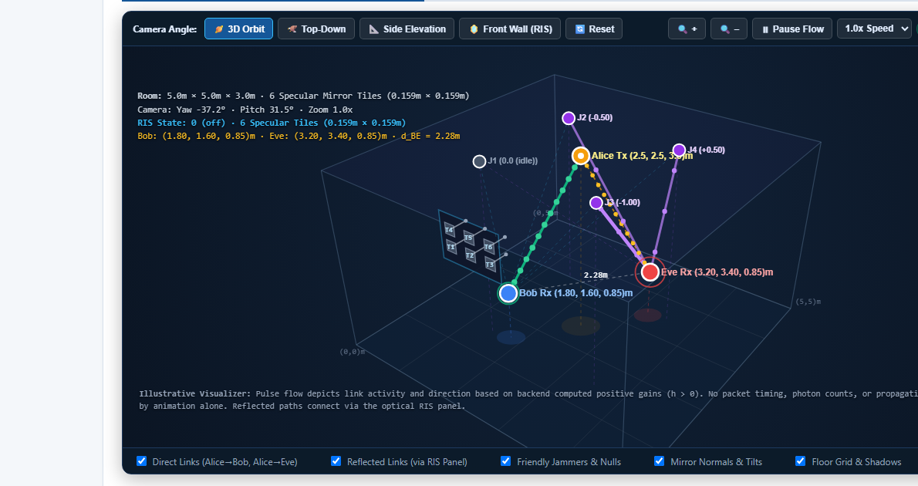
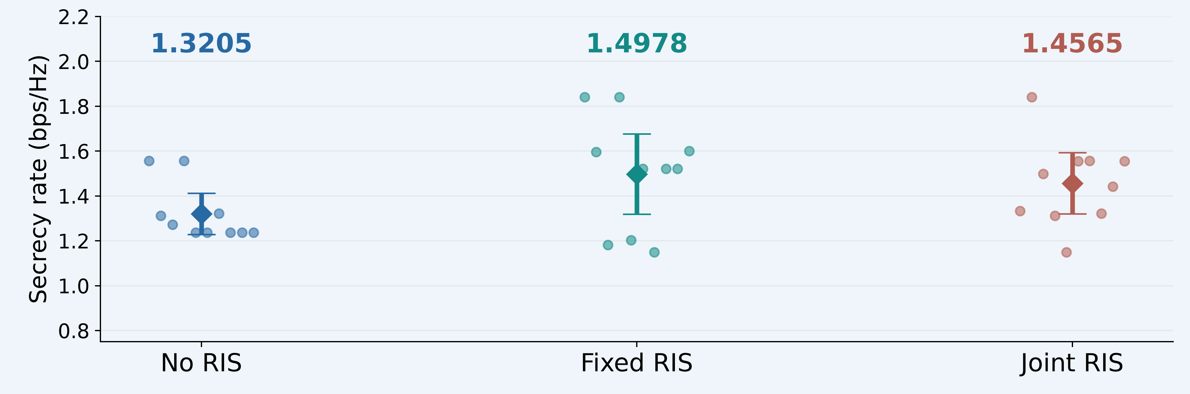
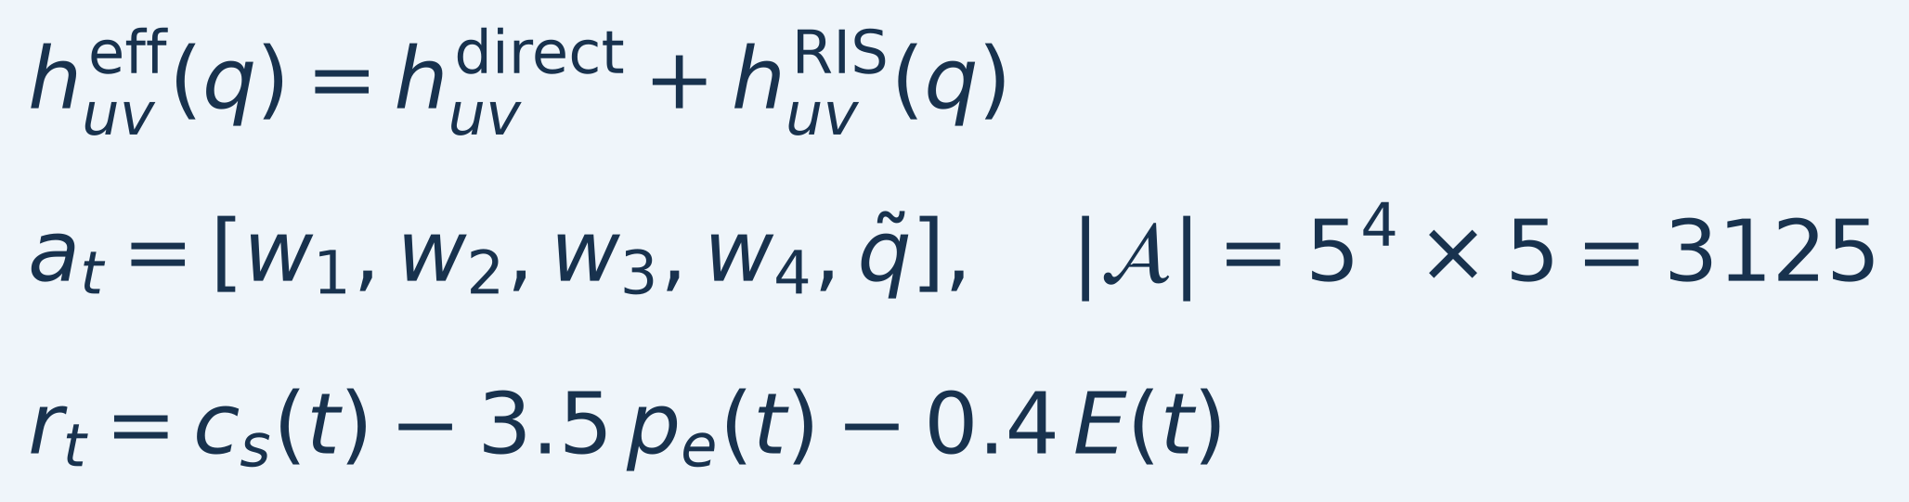
ASSAM DOWN TOWN UNIVERSITY | TEAM RUPOSHI BYTES
OPTICAL RIS-ASSISTED SECURE VISIBLE LIGHT COMMUNICATION
Using Friendly Jamming and Deep Reinforcement Learning
MAHIDUL AHASAN — ADTU/0/2023-27/BTCS/174 | ATIKUR RAHMAN — ADTU/0/2023-27/BTCS/191
MD AMIT HASAN ROBI — ADTU/0/2023-27/BTCS/210 | MD SAMIUR RAHMAN TANIM — ADTU/0/2023-27/BTCS/212
Guide: Dr. Rima Deka, Assistant Professor | Department of Electronics
1. ABSTRACT & KEYWORDS
4. PROPOSED METHODOLOGY / SYSTEM DESIGN
7. APPLICATION / USE CASE
Visible light communication can carry indoor data over LED light, but an unintended receiver may also collect the signal. Friendly jamming can reduce interception while adding interference at the legitimate receiver. This project extends a 2024 VLC friendly-jamming model with a six-mirror optical reconfigurable intelligent surface (RIS). A deep reinforcement learning controller selects four jammer weights and one of five mirror configurations. The simulator combines direct and finite specular reflected channels, including receiver field of view and optical-power bounds. We compare no RIS, fixed RIS and joint control in a static room using ten independent seeds. Training is separated from frozen greedy evaluation. Fixed RIS raises the mean evaluation secrecy rate from 1.3205 to 1.4978 bps/Hz, with a positive paired confidence interval. Joint control reaches 1.4565 bps/Hz, but its advantage is not statistically established. An interactive 3D demo links controls to Python calculations. Near-Bob and colocated cases expose limits under the tested settings.
Alice LED
Bob
Indoor optical security study for offices, classrooms and laboratories. The local demo lets a user change positions, jamming weights and RIS configurations.
Optical RIS
6 mirrors
4 friendly
jammers
Eve
CNN + DND controller
Keywords: VLC • Optical RIS • Friendly jamming • DRL • Secrecy
Direct + reflected gains → secrecy / BER / reward feedback.
Train controller → freeze learning → compare paired seeds.
One shared mirror configuration affects all optical links.
2. PROBLEM STATEMENT & MOTIVATION
• Indoor optical broadcasts may reach an eavesdropper (Eve).
• Friendly jamming can also degrade the intended receiver (Bob).
• A controllable mirror array may redirect useful light and change the jamming trade-off.
• The study targets confidential indoor optical communication.
5. IMPLEMENTATION / TECHNOLOGIES
Python, NumPy, PyTorch and Matplotlib; local HTML/JavaScript interface.
Finite specular mirror optics, receiver FoV and power bounds.
625 jammer actions; 5 RIS patterns; 3,125 joint actions.
Backend-linked 3D view, live controls and recorded-action replay.
3D simulation screenshot: actual backend coordinates and mirror normals. Animated link paths are illustrative; they do not measure packets or propagation delay.
3. OBJECTIVES & SCOPE
• Add finite optical RIS paths to the VLC/FJ baseline.
• Implement joint jammer and mirror control with CNN + DND learning.
• Compare matched schemes using separate policy evaluation.
• Record secrecy, Bob BER, cost and adverse cases.
6. RESULTS & DISCUSSION
8. CONCLUSION & FUTURE WORK
Nominal L1 study: 10 seeds × 3 schemes
2,000 training + 1,000 frozen evaluation slots/run
Implemented optical RIS channels and joint FJ/RIS learning, with a working 3D demo and matched evaluation.
Fixed RIS benefits the nominal link; joint control remains a learning trade-off under the tested budget.
Next: uncertain Eve geometry, broader position tests and more sample-efficient joint control.
Published 2024 curves are not reproduced; results are simulation-based.
MODEL & CONTROL
9. REFERENCES
Scope: static 5 × 5 × 3 m room; known Eve geometry; scalar DC optical model. The main comparison uses nonnegative L1 jammer cost. RIS actuation energy, body blockage and delay/ISI are excluded.
E is model-defined jammer cost, not measured total hardware energy.
Dots: seed means. Diamonds: group means; bars: 95% CI.
Fixed − baseline: +0.1773 bps/Hz; paired 95% CI [0.0378, 0.3167].
[1] “Smart Jamming for Secrecy: Deep Reinforcement Learning Enabled Secure Visible Light Communication,” IEEE TWC, 2024. DOI: 10.1109/TWC.2024.3458046.
[2] A. Pritzel et al., “Neural Episodic Control,” ICML, 2017.
Fixed RIS improves secrecy in this setting. Joint superiority is not established: joint − baseline CI [−0.0440, 0.3158]. Tested near-Bob and colocated cases give zero secrecy.
ACKNOWLEDGEMENT
We thank Dr. Rima Deka and Assam down town University.
RUPOSHI BYTES | Department of Electronics | Final-year Project Poster Presentation | 14 November 2026

