Slide 1
Using Big Data with Spark for US Flight Delays
Big Data Analysis – NOVA IMS December 2025
Lowie De Wever - 20231733
Phat Ma - 20222001
Lurii Sheiman - 20231734
Atila Soleimanian - 20251000

Slide 2
Why Flight Delay Management?
Flight delays create direct costs (fuel, crew, compensation)
and damage customer satisfaction.
Better delay prediction helps Airlines
and airport optimize operations and resource allocation.
US domestic flights generate high-volume
high-velocity operational data on every departure.
Big data with Spark allows us to learn from millions of past flights
not just a small sample.

Slide 3
Index
01. The Dataset Through the Lens of the 4Vs
02. Data Ingestion & Feature Engineering
03. Data Exploration & Visualizations
04. Predicting Flight Delays With Spark ML
05. US Flight Network & Delay Propagation
0.6 How Spark Adds Value for Management

Slide 4
01. The Dataset Through the Lens of the 4 Vs
Flight delays create direct costs (fuel, crew, compensation) and damage customer satisfaction.
Better delay prediction helps airlines and airports optimize operations and resource allocation.
US domestic flights generate high-volume, high-velocity operational data on every departure.
Big data with Spark allows us to learn from millions of past flights, not just a small sample.

Slide 5
02. Data Ingestion & Feature Engineering
Multi-year CSV ingestion: Loaded 2017–2018 flight records into Spark DataFrames with unified schema.
Data cleaning: Handled nulls, cancelled flights, invalid times, and inconsistent carrier codes across years.
Feature engineering: Created route frequency, time-of-day, day-of-week, month, and distance features for ML.
Big-data safe: All transformations use distributed Spark operations; no full-data load into memory required.

Slide 6
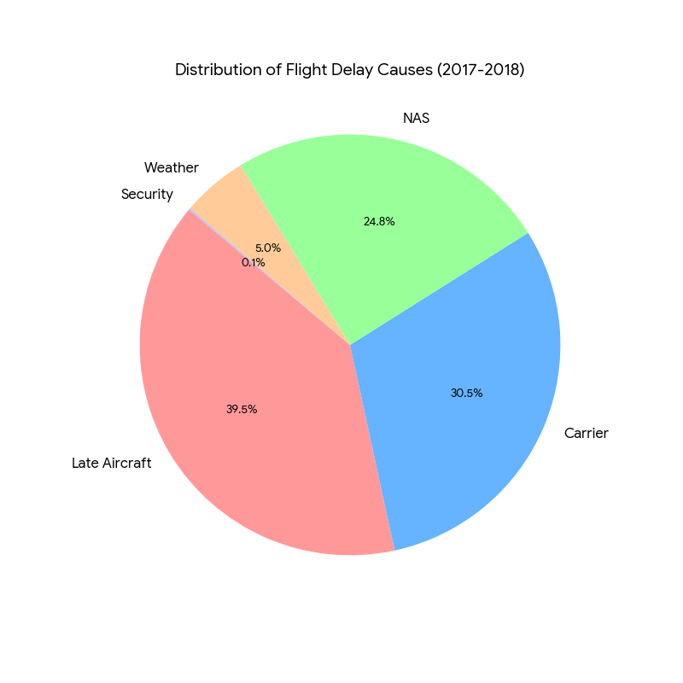
03. Data Exploration & Visualizations
The summer months experience the highest average departure delays, at around 13–14 minutes.
JetBlue (B6), Frontier (F9), and Allegiant Air (G4) show the highest average delays among carriers.
Youngstown–Warren (YNG), Northeast Florida (UST), and McKinney (TKI) airports have the most delayed departures.
Southwest Oregon (OTH), YNG, and UST airports have the highest arrival delays.
Diversions are relatively rare, but indicate operational or weather issues that affect reliability.
Late Aircraft, Carrier, and National Airspace System are the most reported delay causes in 2017-2018.

Slide 7
04. Predicting Flight Delays With Spark ML
Defined the business question: “Given a planned flight, what is the risk it will be delayed?”
Built Spark ML pipelines to encode categorical variables and assemble features at scale.
Trained classification models to predict delay versus on–time arrival on large historical data.
Evaluated models using Spark metrics (e.g., accuracy, AUC) to ensure robust performance.

Slide 8
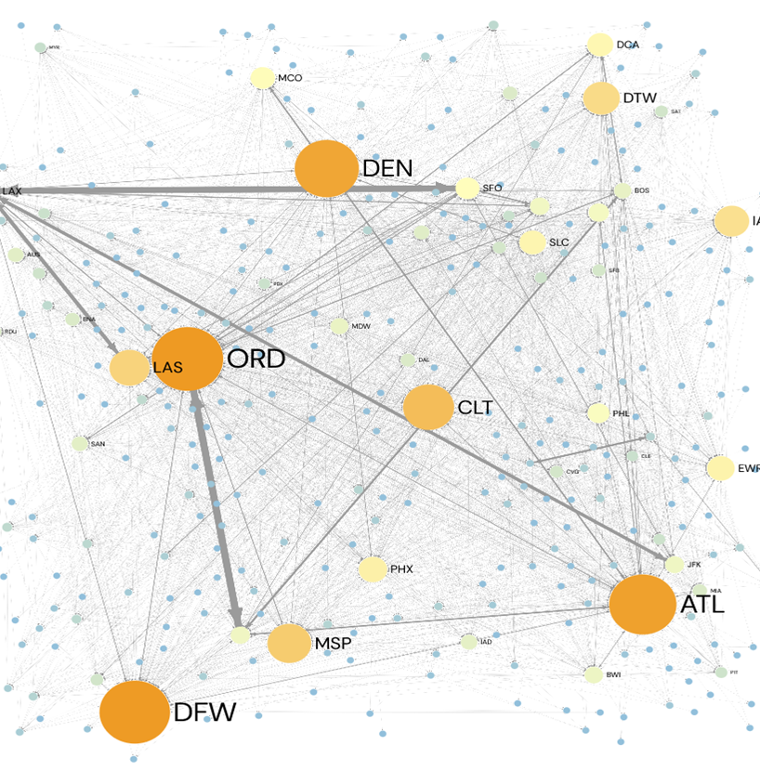

05. US Flight Network & Delay Propagation
Scale: 346 airports, 559K flight edges — fully interconnected national system.
Critical hubs (PageRank): ATL (17.3), ORD (16.2), DFW (14.4), DEN (12.1), CLT (10.8) drive network traffic
Delay concentration: 88,968 delayed flights (16%); ORD, DFW show highest cascading risk via incoming delays.
Single community: Label propagation reveals one interconnected cluster — delays ripple network-wide.

Slide 9
06. How Spark Adds Value for Management
Scales from sample analysis to millions of flights without changing the business logic.
Unifies data engineering, exploratory analysis, machine learning and graph analytics in one platform.
Enables near real–time dashboards and alerts when integrated with streaming data sources.
Transforms raw operational data into concrete decisions: scheduling, staffing and route planning.

Slide 10
Conclusion & Next Steps
Our Spark–based analysis demonstrates how big data on US flights can be leveraged to generate actionable predictions and network insights for effective delay management.
Next steps include integrating live flight feeds, refining models for specific airlines or hubs, and deploying dashboards so managers can monitor delay risk in real time.
Obirigado/a

