Slide 1
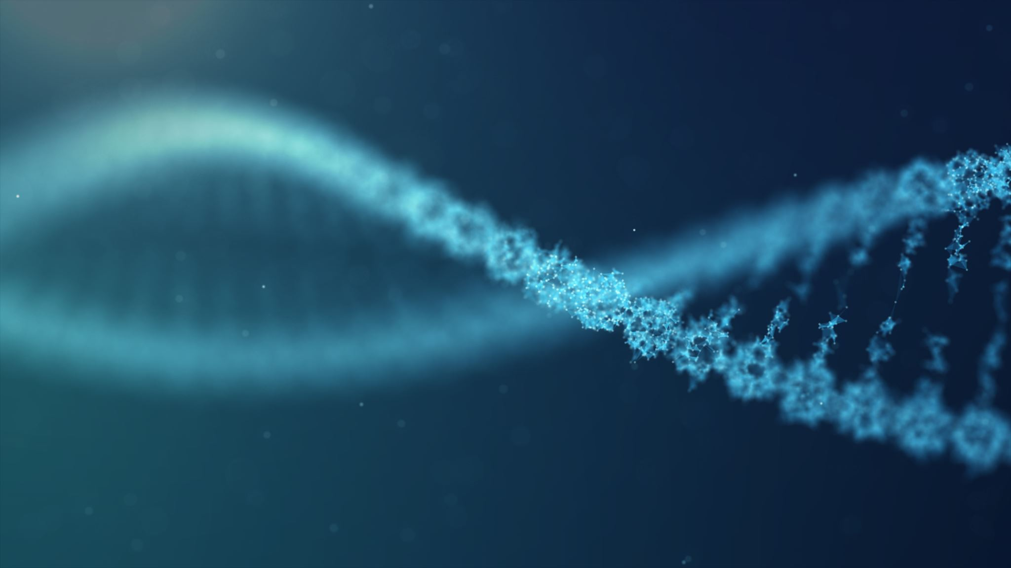
Epigenetics
Kenyaita M. Hodge, MPH
Genetics & Molecular biology
Doctoral Candidate
Emory University
khodge4@emory.edu

Slide 2
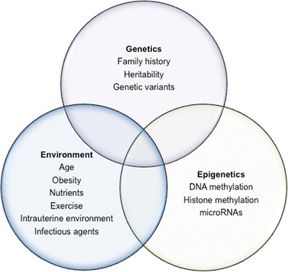
Jerram et al (2017)
Notes:
Now we know that epigenetics falls in the overlap between Genetics and Environment.

Slide 3
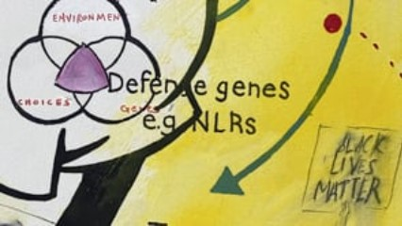
Epigenetics and the Human Condition
Notes:
Now we know that epigenetics falls in the overlap between Genetics and Environment.

Slide 4
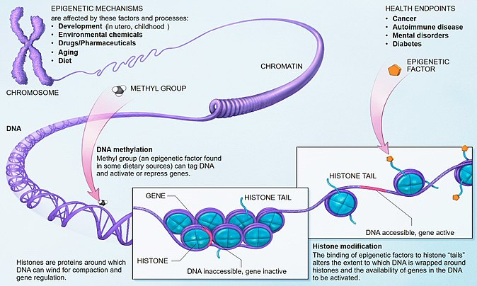
Epigenetics
Changes to the genome that affect gene expression without changing the DNA sequence
DNA methylation
Histone modifications
Epigenetic marks regulate gene expression primarily by changing chromatin structure
Wikipedia

Slide 5
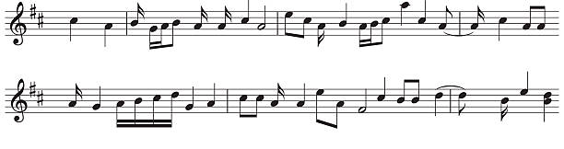
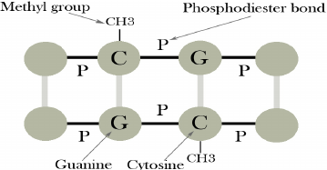
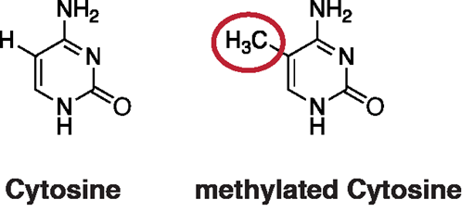
EPIGENETICS SIMPLIFIED
DNA bases
DNA methylation
Notes:
The cytosine in CpG sites have the ability to become methylated. A CpG site is within the same strand of DNA (see dotted purple box in diagram) not the CG pairs that connect two DNA strands.

Slide 6
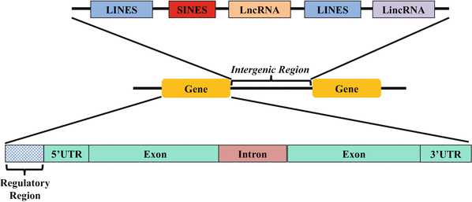
Location Matters!
Yadav M.L., Mohapatra B. (2018) Intergenic
Intergenic (space between genes): repress the expression of potentially harmful genetic elements (e.g. transposable elements)
CpG islands (CpG rich regions): ~70% promoters, enhance DNA accessibility and binding to transcriptional start sites, silencing of gene expression
Gene body: associated with a higher level of gene expression
Notes:
CpG islands: enhance binding to transcriptional start sites. Despite their lack of common promoter elements, CpG islands enhance the accessibility of DNA and promote transcription factor binding.

Slide 7
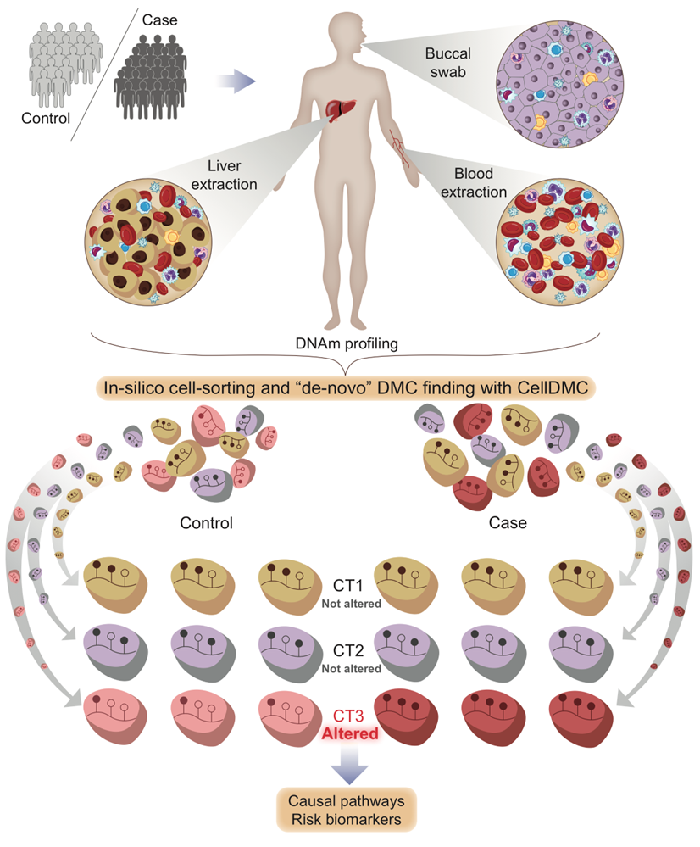
Cell Type Matters
EpiDISH
Notes:
DMC= differentially methylated cytosine
CT = Cell type
When the cell types are bioinformatically sorted we can see the methylation pattern by cell type.
The diagram shows us three cell types for a control and three for a case. We see that the CT3 show DMC when we compare the control to the case.
Our next step would be to find out what genes these DMCs are located in or near. When we get a list of genes that show DMCs we can do pathway enrichment analysis to determine biological pathways that are impacted by these DMCs.

Slide 8
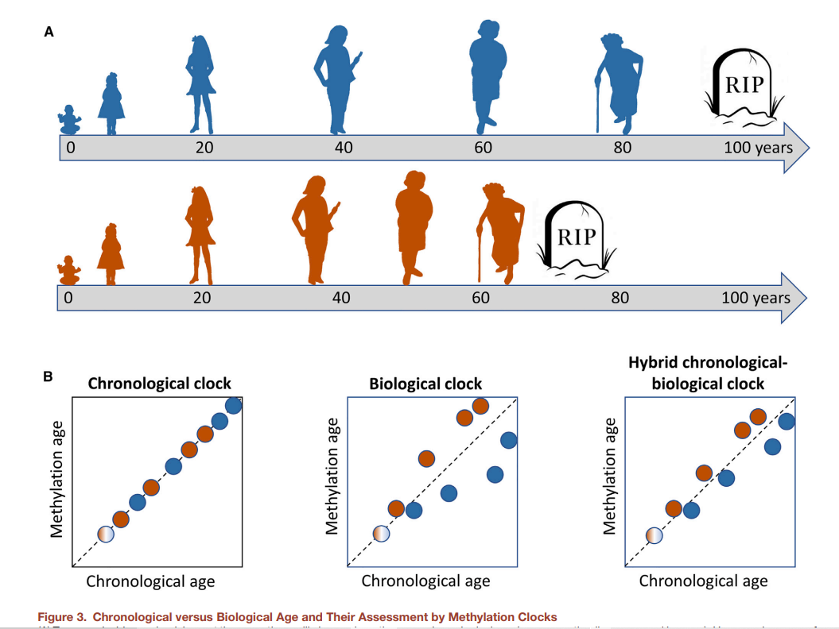
Age/Ageing Matters
Field et al (2018)
Notes:
Chronological age differs from biological age from person to person
The most well-known epigenetic clocks are accurate for adolescents and adults
A NeoAge clock has been created for the neonatal ageing NEOage clocks - epigenetic clocks to estimate post-menstrual and postnatal age in preterm infants | Aging (aging-us.com)
Resources:
“Five methylation features of the epigenetic clock reveal the cellular characteristics of epigenetic ageing”: https://pubmed.ncbi.nlm.nih.gov/32276545/
DNA methylation-based biomarkers and the epigenetic clock theory of ageing (nature.com)

Slide 9

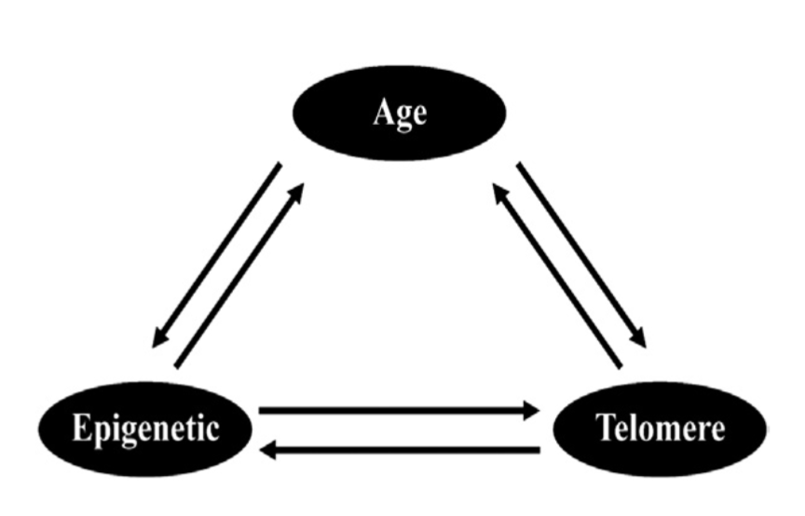
Age/Ageing Matters
Telomeres shorten as we age (potentially serving as a biomarker of aging).
Epigenetic modifications, such as DNA methylation, help maintain telomere length along with telomerase.
Epigenetics clocks tell us about how the environment/behaviors impact biological aging.
Telomeres tell us about cell cycle/senescence.
Epigenetics of Aging and Longevity
Notes:
Telomeres shorten with each cycle of replication – so more replication and proliferation will lead to shorter telomeres.
Various epigenetic clocks have been developed, and in these, DNA methylation accumulates with aging at some CpGs, but it decreases with aging at other CpGs, and clocks developed from different tissues include different CpGs. So these are more complex than telomere lenght. It is still not exactly clear what biological processes of aging are being reflected in these epi-clocks, but they do tend outperform telomere length in terms of correlating with chronological age, and in associating with age-related disease.

Slide 10
DNA methylation is responsible for…
Silencing retroviral elements
Regulating tissue-specific gene expression
Genomic imprinting
Preferential silencing of the promoter of a parent-of-origin specific copy of an allele
X-inactivation
Telomere Maintenance
Notes:
Majority of methylation occurs within CpG sites

Slide 11
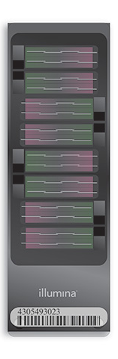
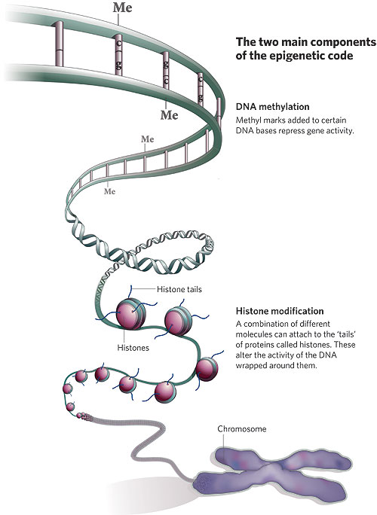
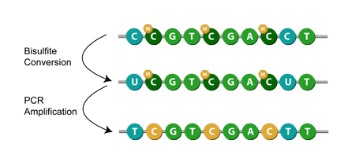
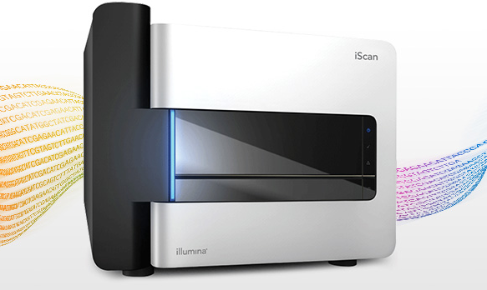
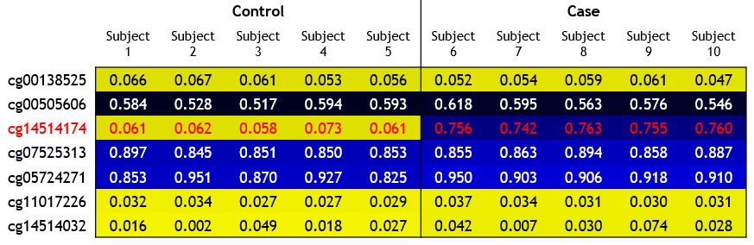

DNA Methylation (DNAm) Arrays
DNA Bisulfite Conversion – Epigentek
Qiu, J. Unfinished symphony. Nature (2006)
https://www.illumina.com/products/by-type/microarray-kits/infinium-methylation-epic.html
$β=\frac{M}{M+U}$
https://www.illumina.com/techniques/microarrays/methylation-arrays.html
Notes:
DNA extracted from buccal cells
The DNA undergoes bisulfite conversion, which converts unmethylated cytosines to uracil, but methylated cytosines remain as cytosines
This is how the Illumina EPIC microarray distinguishes between methylated and unmethylated CpGs
The bisulfite converted DNA then hybridizes to probes of DNA sequences on the Illumina microarrays, at approximately 850K CpGs throughout the genome
The output of this array, is a methylated signal intensity and unmethylated signal intensity for each CpG
These are converted to beta values, which is the proportion of methylated signal divided by the methylated + unmethylated signal.
This beta value is interpreted as the proportion of methylation at a particular CpG, across all cells that were included in tissue sample

Slide 12
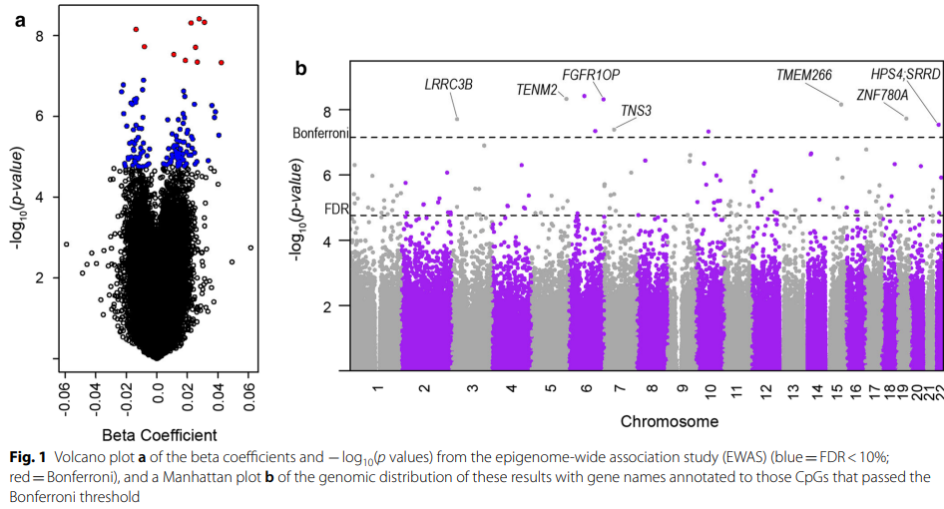
Data Visualization
Everson et al. (2020)
Notes:
Volcano plot
Manhattan plot

Slide 13
Online Resources & Databases
Literature Review Search Engines
PubMed
Google Scholar
Data Visualization & Publicly Available Data
UCSC Browser
Encode
GEO Accession
Downloading R packages
CRAN
Bioconductor
GitHub

Slide 14
Training and Workshops
Columbia University
University of Washington
University of Michigan

Slide 15
Questions?

