Slide 1
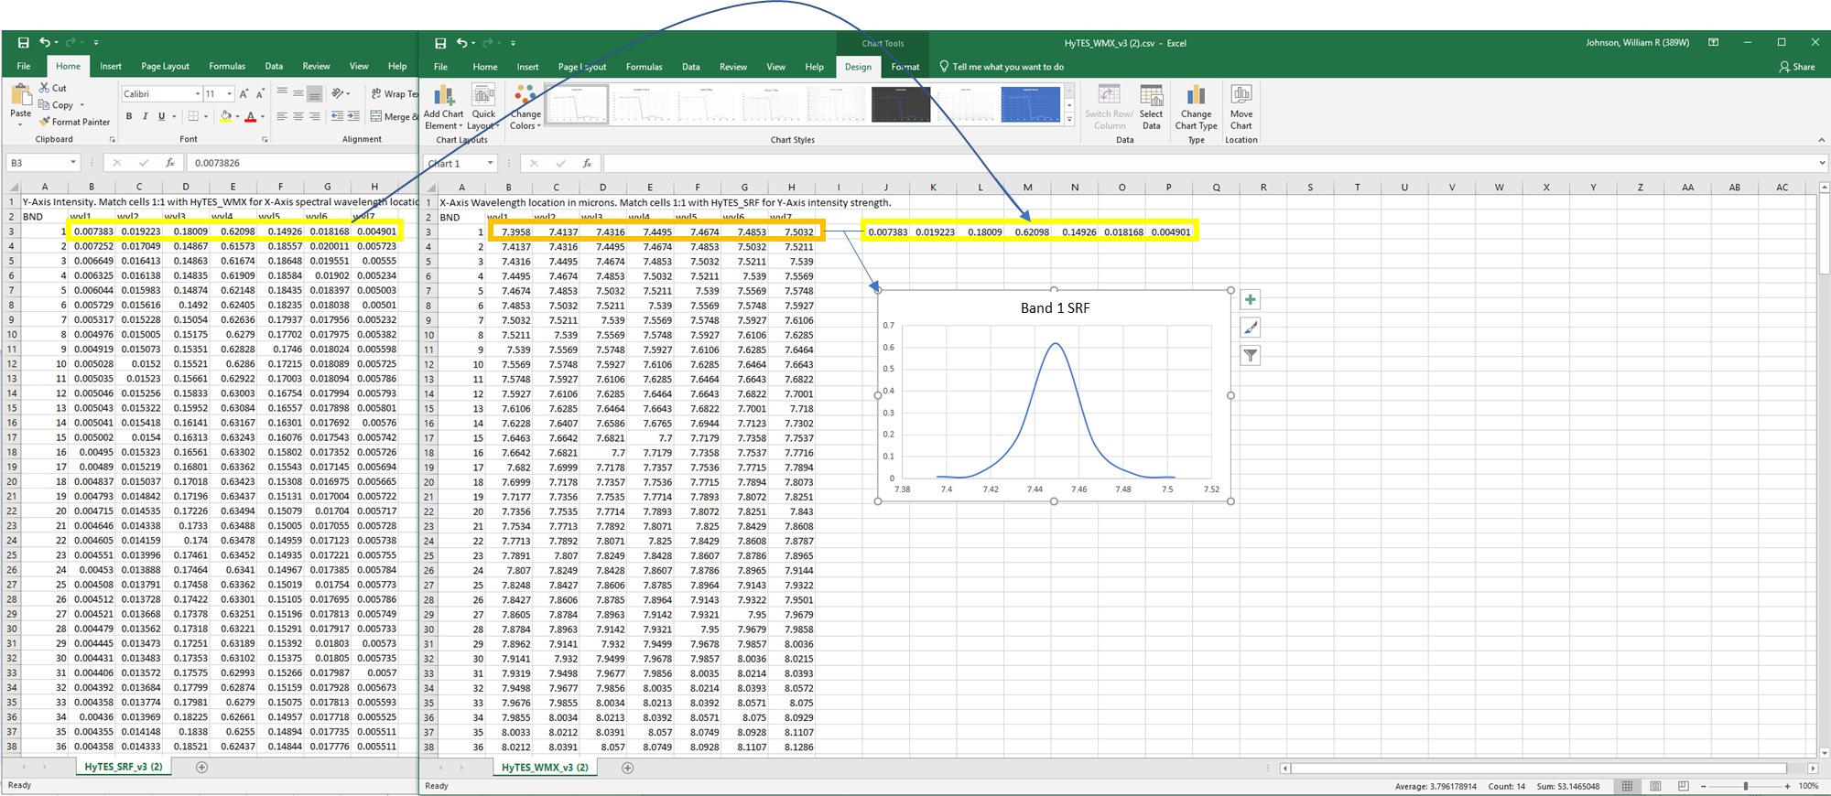
Y-axis
HyTES_SRF file
X-axis
HyTES_WMX file
Plot all 256 bands/channels to generate 256 SRF for each band

