Slide 1
Application development
A standard architecture for practical use
Atilla Kati

Slide 2
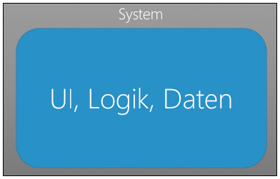
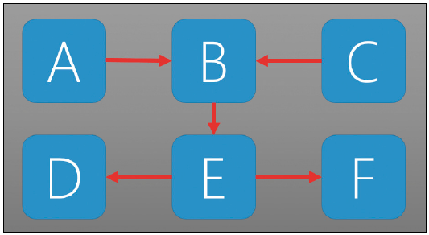
Problem definition & goals
What's wrong with the functional focus?
Notes:
Überleitung zur Software Qualität

Slide 3
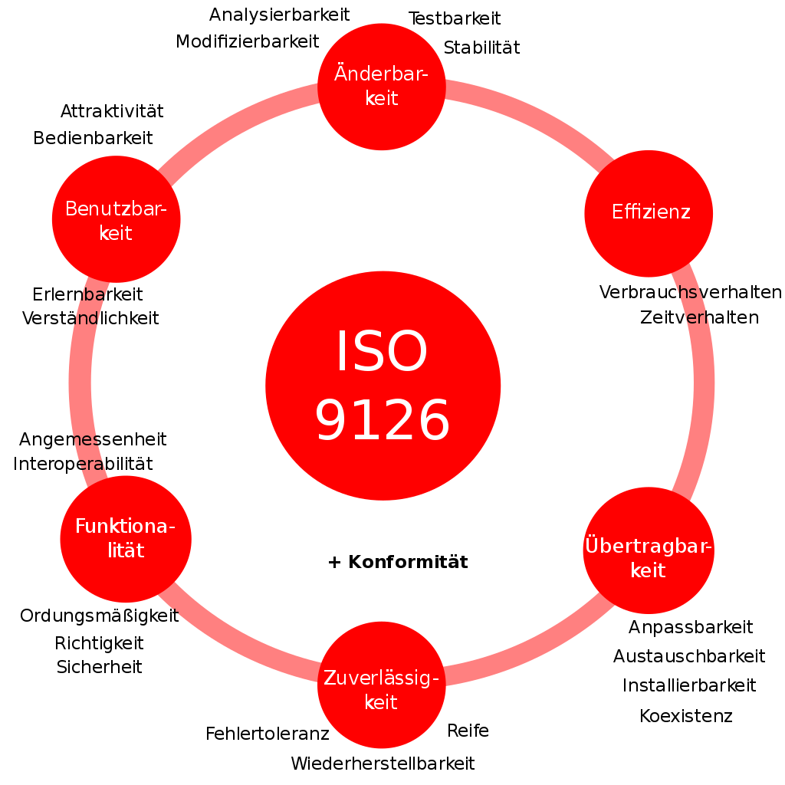
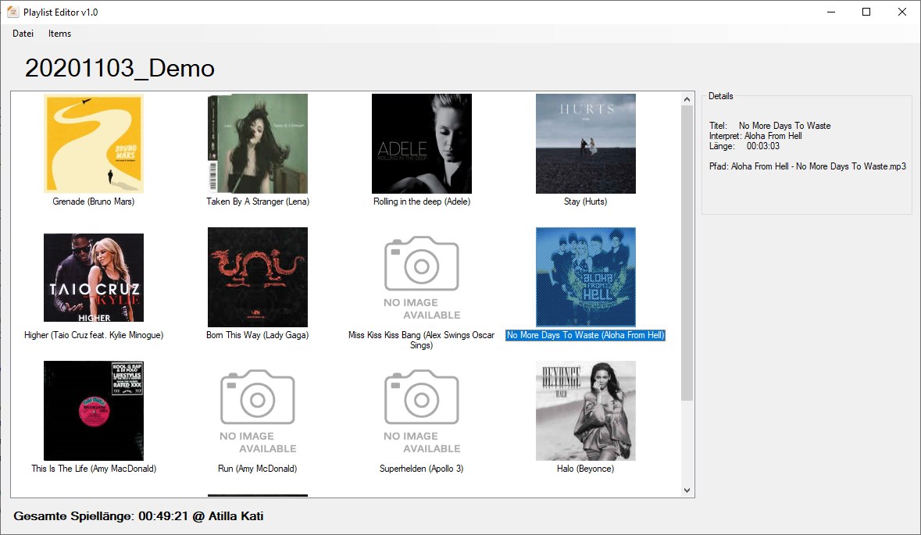
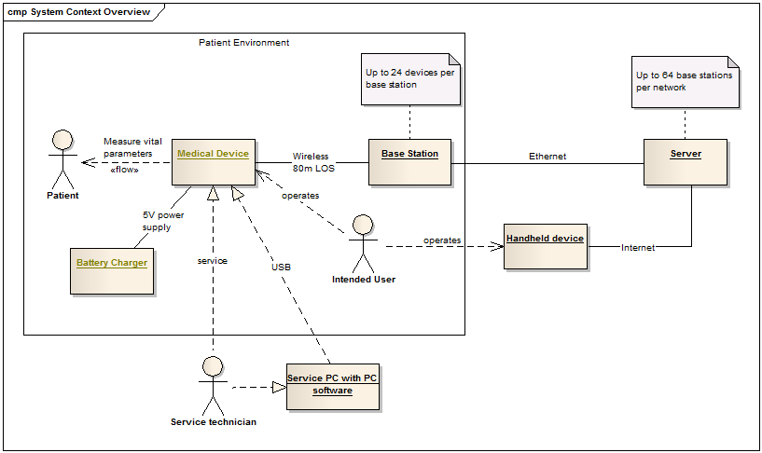
Problem definition & goals
What's wrong with the functional focus?
Fundamentals of software quality and architecture patterns
Learning by doing

Slide 4
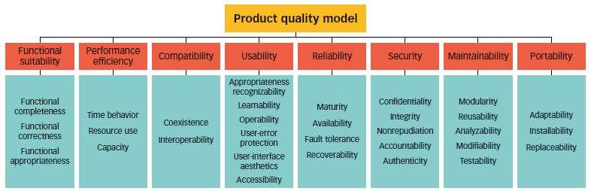
The software quality model
ISO 25010/2011 (ISO/IEC 9126)
Notes:
Merkmale und Aspekte
ISO 25010 hat noch zwei weitere: Sicherheit, Kompatibilität

Slide 5
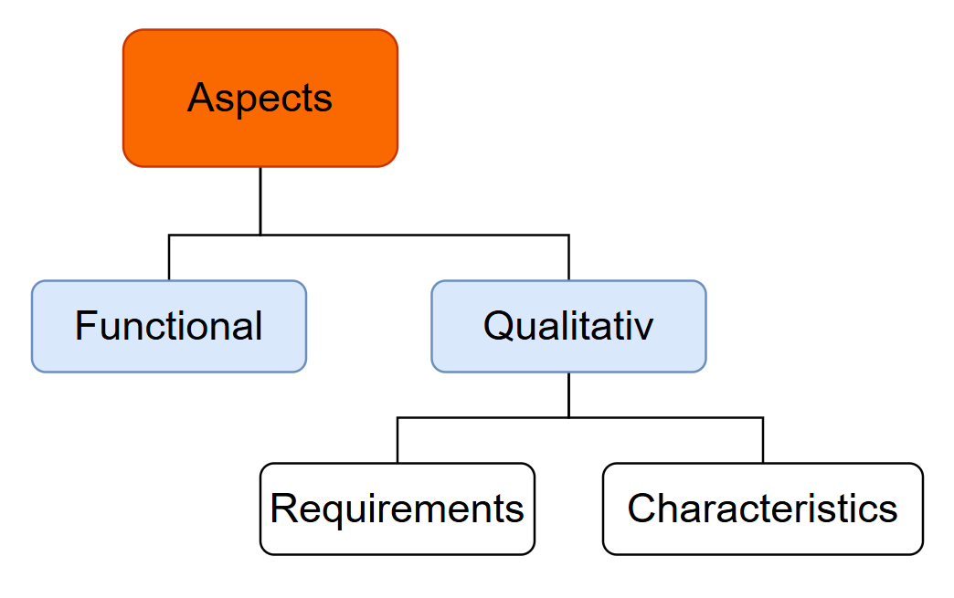
The software quality model
ISO 25010/2011 (ISO/IEC 9126)
Notes:
Aspects
Functional aspects
Qualitative aspects
Qualitative requirements
Characteristics

Slide 6
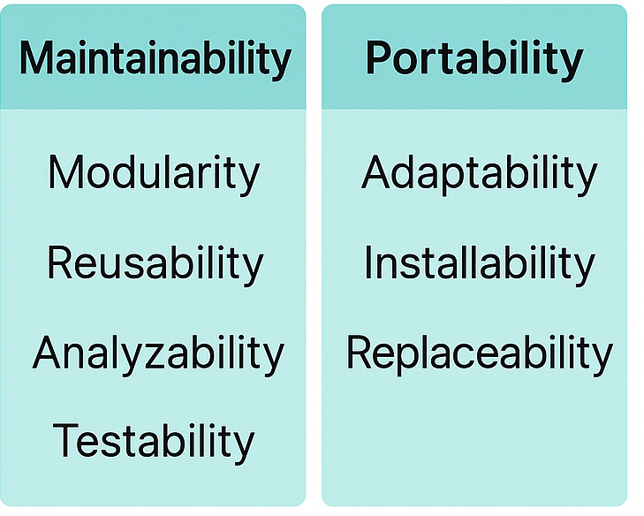
The software quality model
Constant quality characteristics

Slide 7
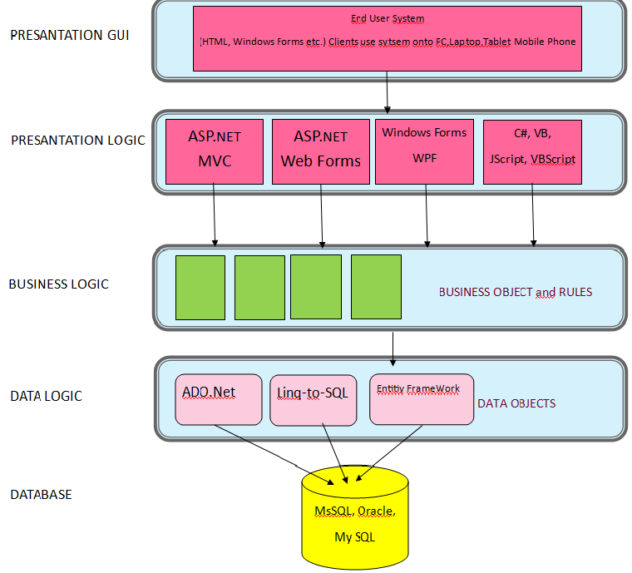
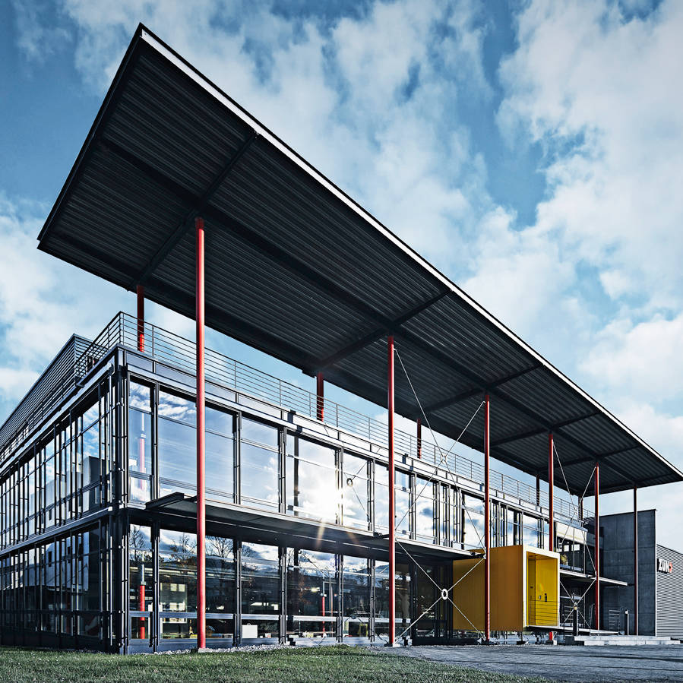
Architectur – Design Patterns
Why to have a architectur?

Slide 8
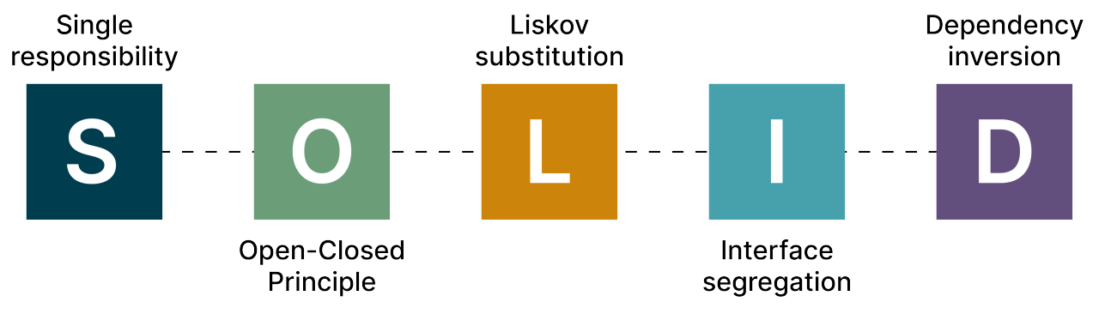
Architectur – Design Principles
Single Responsibility Principle Each class should have only one responsibility or reason to change.
Open/Closed Principle Software entities should be open for extension but closed for modification.
Liskov Substitution Principle Subtypes must be substitutable for their base types without breaking the application.
Interface Segregation Principle Clients should not be forced to depend on interfaces they do not use.
Dependency Inversion Principle Depend on abstractions, not on concrete implementations.
…acronym for five key object-oriented design principles, that help to create robust, maintainable software
Notes:
Prefer composition to inheritance.
Rely on abstractions.
DRY
KISS
SOLID is an acronym for five key object-oriented design principles that help to create robust, maintainable software

Slide 9
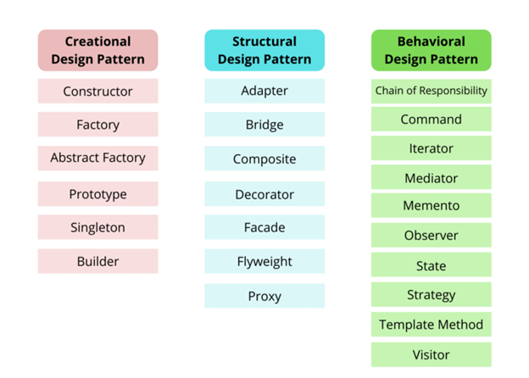
Architectur – Design Patterns
What are Design-Patterns?
Blueprints
Based on design principles
Solutions to specific problems
Maintainability & reuse
Common language
Notes:
Prefer composition to inheritance.
Rely on abstractions.
DRY
KISS
SOLID

Slide 10
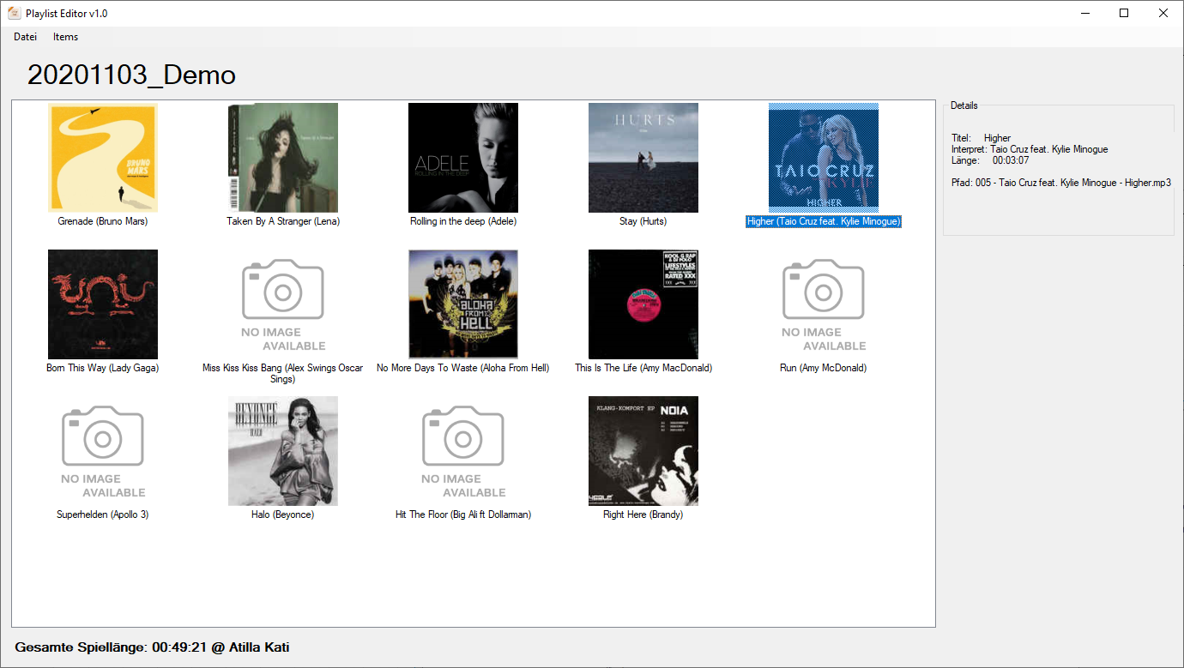
Our project

Slide 11
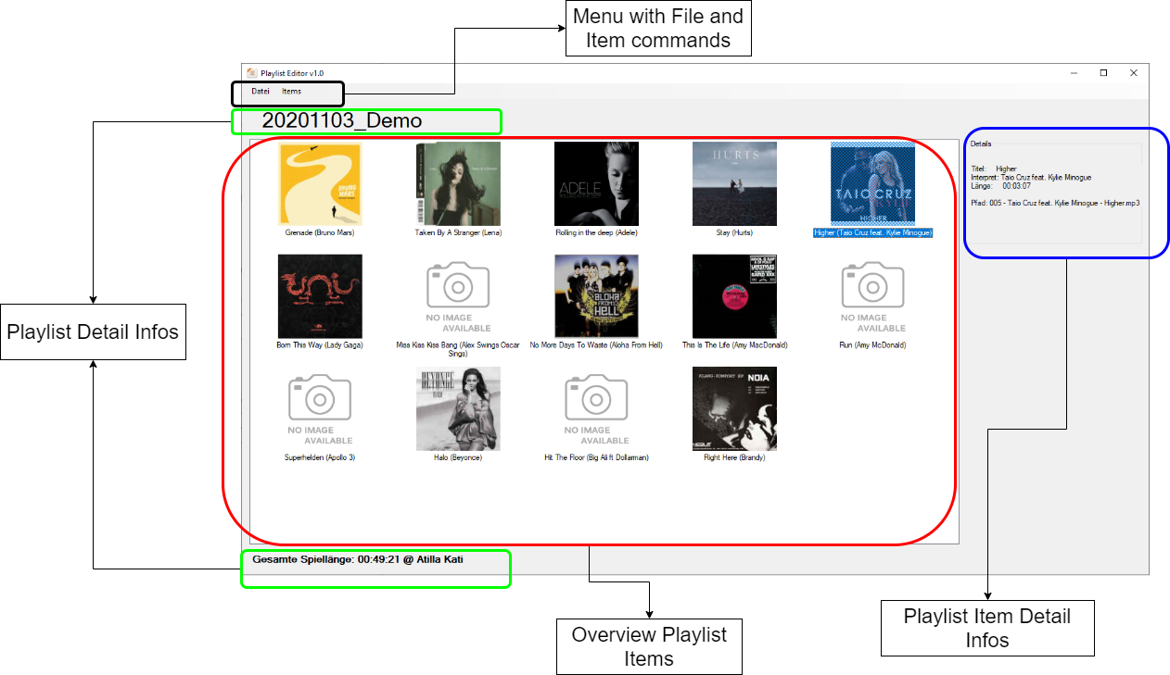
Our project - Requirements

Slide 12
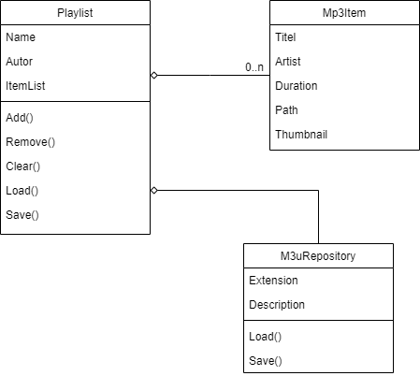
Our project - Requirements
It should also be possible to manage other media such as images or videos in a playlist. The type list should be easy to extend.
It should be possible to load and save different playlist formats. The type list should be easy to extend.
Thumbnails should always be displayed for playlist items
For details on mp3 files, a media database should be contacted (imdb, discogs)

Slide 13
Our project - Requirements
For new item and playlist types, no existing (code) types should have to be changed
Components should be able to be tested individually (as units)
Dependencies (creation and usage dependencies) should be reduced or avoided

Slide 14
Our project - Solution

Slide 15
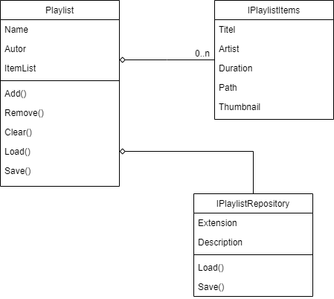
Our project - Solution

Slide 16
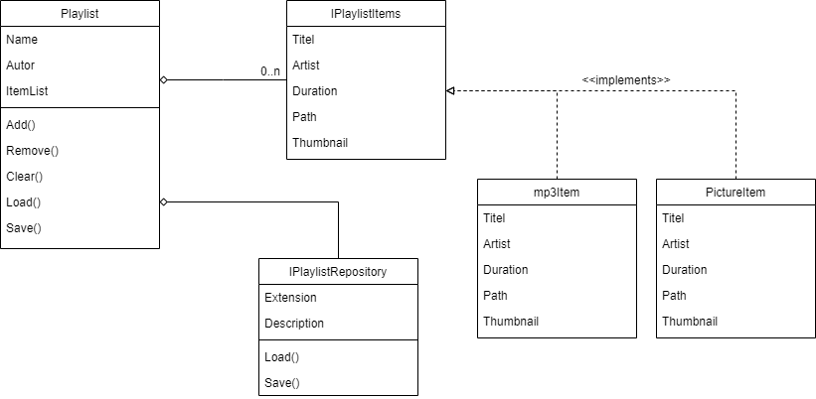
Our project - Solution

Slide 17
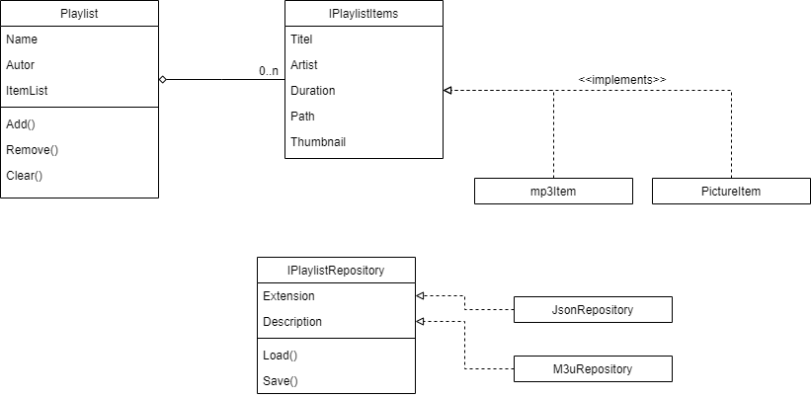
Our project - Solution

Slide 18
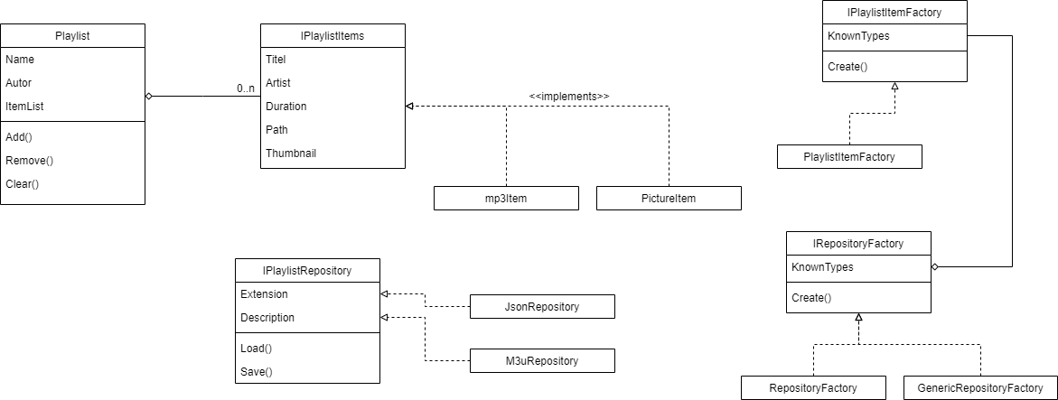
Our project - Solution

Slide 19
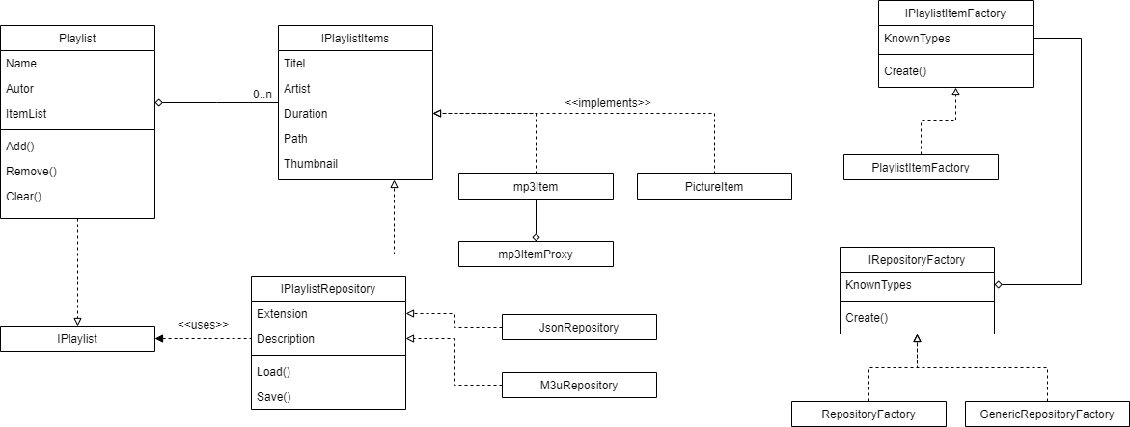
Our project - Solution

Slide 20
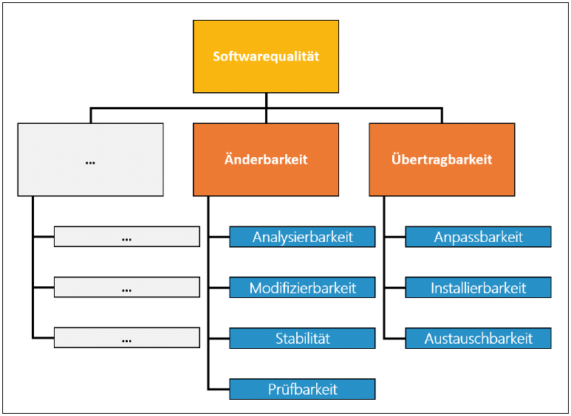
Conclusion
Simplifying through
Single Responsibility Prinzip
Program to abstractions, not implementations
Composition over inheritance
Inversion of Control
Resolve dependencies
Strategy Pattern
Dependency Injection
Factory Method

Slide 21

Danke!

