Slide 1
FATIMA NASAR
Week 3

Slide 2
{DOCTYPE HTML}
<!Doctype html>
DOCTYPE stands for DOCUMENTS TYPE DECLARATION
Doctype tag is used to inform the browser about the version of html used in the document.

Slide 3
{HTML}
<html> </html>
Html code ensures the proper formatinG of text and images for your Internet Browser.

Slide 4
{HEAD}
<head> </head>
Head tag is used to contain specific information about a web page.

Slide 5
{TITLE}
<title></title>
Title tag is used to name a document.
EXEMPLE
<title> DOREMON</title>

Slide 6
{Body}
<body></body>
In <body> tag we can add such as headings, paragraphs, images, hyperlinks, tables, lists, etc.

Slide 7
{Heading}
<h1>----</h1>
<h> tag that indicates a heading on a website.
Example
The <h1> to <h6> tags are used to define HTML headings.
Example
PESHAWAR
PESHAWAR
PESHAWAR

Slide 8
{Paragraph}
<p></p>
When writing in html, the <p> tag is a block element used to designate a paragraph.
EXMLPE
PESHAWAR district is a district in peshawar division of khyber pakhtun khwah.

Slide 9
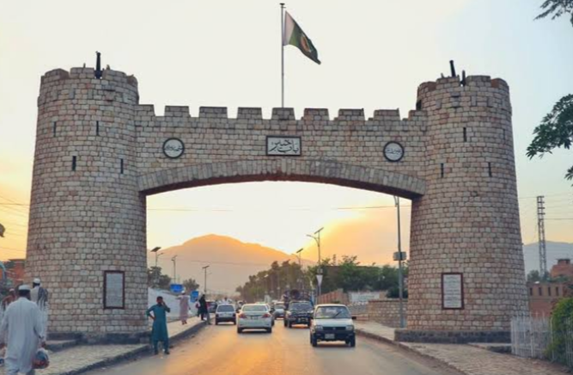
{IMAGE}
<img></img>
<img src="alt=“bab e khyber"width=“ "height=""></img>
The <img> tag is used to embed an image in an html page.
Example

Slide 10
{LINK}
<a href> </a>
<a href=“ ”</a>
You can use the <a> tag to link text or images.
Example
Youtube.com

Slide 11
{ORDER LIST}
<ol> </ol>
The ol tag defines an ordered list.
Islamia college peshawar
University of peshawar
Peshawar museum

Slide 12
{UNORDERED LIST}
<ul></ul>
The ul element is used to define an unordered list of items it is useful for creating bulleted list.
Qissa Khwani bazar
Bab e Khyber
Sir cunnigham clock tower

Slide 13
{LIST ITEM}
<li></li>
The <li> tag define as a lest item
The <li>tag is used inside ordered list

Slide 14
{TELETYPE TEXT}
<tt></tt>
The <tt> tag was used to designate inline teletype text.

Slide 15
{TEXT ALIGN}
<style=“text-align: =center:”>
Used to change the position of text.
EXAMPLE
Flay over Hayatabad
Peshawar zoo

Slide 16
{EMPHASIZED TEXT}
<em></em>
Used to show emphasized text.

Slide 17
{TEXT COLOR}
<style=“color: blue;”>
Used to change the color of text

Slide 18
{INSERTED}
<ins></ins>
The <ins> tag in HTML is used to specify a block of inserted text.

Slide 19
{DELETE}
<del></del>
The del tag defines text that has been deleted from a document.

Slide 20
{BREAK}
< br > </br>
It is use to break the line.

Slide 21
{BOLD}
<b>---</b>
Html b tag is used to display the written text in bold format
EXAMPLE
Peshawar

Slide 22
{HORIZONTAL}
<hr></hr>
It is use to make a horizontal line.

Slide 23
{ITALIC}
<i></i>
The i tag use for italic style.

Slide 24
{SUBCRIPT}
<sub></sub>
Supscript text can be use for chemical formulas.
EXAMPLE
H2O

Slide 25
{SUPERSCRIPT}
<sup></sup>
Superscript text can be used for mathematics example 2^{5.}

Slide 26
{MARK}
<mark></mark>
It is used to highlight the part of text in a paragraph.
EXAMPLE
City Of Flowers

Slide 27
{SMALL}
<small> </small>
Defines smaller text
EXAMPLE
City of flowers

Slide 28
{BIG}
<big></big>
Its used to make the text size bigger.
EXAMPLE
City Of Flowers

Slide 29
{STRONG}
<strong></strong>
The strong tag is used to define text with strong importance. The content inside is typically displayed in bold.

Slide 30
{AUDIO}
<audio></audio>
The <audio> tag is used to embed sound content in a document, such as music or other audio streams.

Slide 31
{VIDEO}
<video></video>
The <video> tag is used to embed video content in a document, such as a movie clip or other video streams.

Slide 32
{SCALARS VECTOR GRAPHICS}
<svg>---</svg>
SVG stand Scalar Vector Graphics.
SVG has several methods for drawing paths, boxes, circles, text, and graphic images.

