Slide 1
Project Management framework
Chapter -4

Slide 2

4.1 Project Scope Management

Slide 3
What is Project Scope Management?
Scope refers to all the work involved in creating the products of the project and the processes used to create them
Project scope management includes the processes involved in defining and controlling what is or is not included in the project
The project team and stakeholders must have the same understanding of what products will be produced as a result of a project and what processes will be used in producing them

Slide 4
Project Scope Management Processes
Initiation: authorizing the project or phase
Scope planning: developing documents to provide the basis for future project decisions
Scope definition: subdividing the major project deliverables into smaller, more manageable components
Scope verification: formalizing acceptance of the project scope
Scope change control: controlling changes to project scope

Slide 5
Project Initiation: Strategic Planning and Project Selection
The first step in initiating projects is to look at the big picture or strategic plan of an organization
Strategic planning involves determining long-term business objectives
IT projects should support strategic and financial business objectives

Slide 6
Identifying Potential Projects
Many organizations follow a planning process for selecting IT projects
First develop an IT strategic plan based on the organization’s overall strategic plan
Then perform a business area analysis
Then define potential projects
Then select IT projects and assign resources

Slide 7
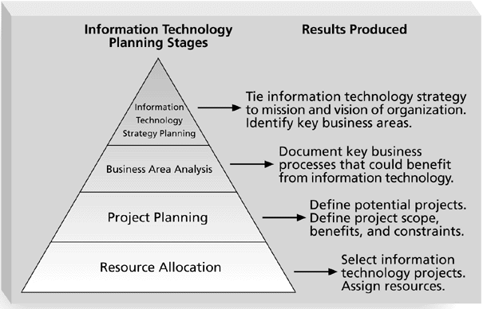
Information Technology Planning Process

Slide 8
Methods for Selecting Projects
There are usually more projects than available time and resources to implement them
It is important to follow a logical process for selecting IT projects to work on
Methods include focusing on broad needs, categorizing projects, financial methods, and weighted scoring models

Slide 9
Focusing on Broad Organizational Needs
It is often difficult to provide strong justification for many software projects, but everyone agrees they have a high value
Three important criteria for projects:
There is a need for the project
There are funds available
There’s a strong will to make the project succeed

Slide 10
Categorizing Software Projects
One categorization is whether the project addresses
a problem
an opportunity, or
a directive
Another categorization is how long it will take to do and when it is needed
Another is the overall priority of the project

Slide 11
Financial Analysis of Projects
Financial considerations are often an important consideration in selecting projects
Three primary methods for determining the projected financial value of projects:
Net present value (NPV) analysis
Return on investment (ROI)
Payback analysis

Slide 12
Definition of terms
Net Present Value - Method of calculating the expected net monetary gain or loss from a project by discounting all expected future cash inflows and outflows to the present point in time.
Discount Rate* - Also known as the hurdle rate or required rate of return, is the rate that a project must achieve in order to be accepted rather than rejected.
Return on Investment – Expected income divided by the amount originally invested
Payback Analysis – The number of years needed to recover the initial cash outlay
* The annual percentage rate that an amount of money is discounted to bring it to a present value

Slide 13
Net Present Value Analysis
Net present value (NPV) analysis is a method of calculating the expected net monetary gain or loss from a project by discounting all expected future cash inflows and outflows to the present point in time
Projects with a positive NPV should be considered if financial value is a key criterion
The higher the NPV, the better

Slide 14
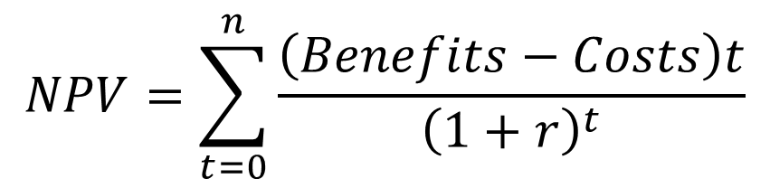
- NPV can be computed using the following formula
Where:
r= discount rate
t= year
n= analysis horizon (in years)

Slide 15
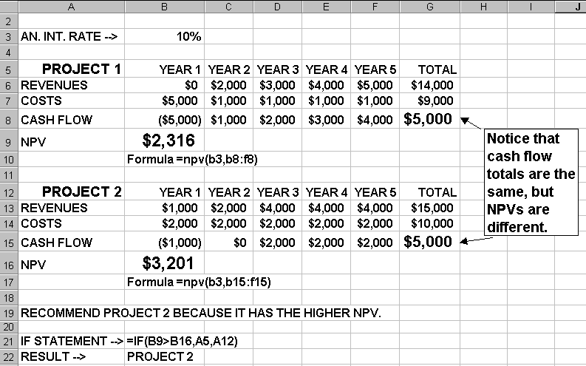
NET PRESENT VALUE EXAMPLE
Note that
totals are
equal, but
NPVs are
not because of the time value of money.

Slide 16

Return on Investment
Return on investment (ROI) is income divided by investment
The higher the ROI, the better
Many organizations have a required rate of return or minimum acceptable rate of return on investment for projects
Where r= rate
y=year

Slide 17
Payback Analysis
Another important financial consideration is payback analysis
The payback period is the amount of time it will take to recoup, in the form of net cash inflows, the net dollars invested in a project
Payback occurs when the cumulative discounted benefits and costs are greater than zero
Many organizations want IT projects to have a fairly short payback period

Slide 18
Weighted Scoring Model
A weighted scoring model is a tool that provides a systematic process for selecting projects based on many criteria
First identify criteria important to the project selection process
Then assign weights (percentages) to each criterion so they add up to 100%
Then assign scores to each criterion for each project
Multiply the scores by the weights and get the total weighted scores
The higher the weighted score, the better

Slide 19
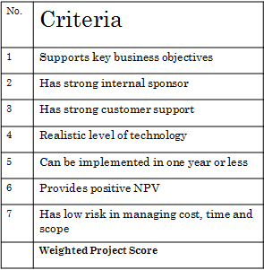


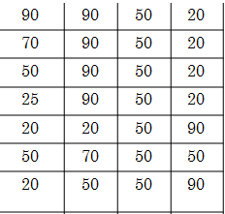
Since Project 2 has the highest weighted project score, it is the winner!

Slide 20
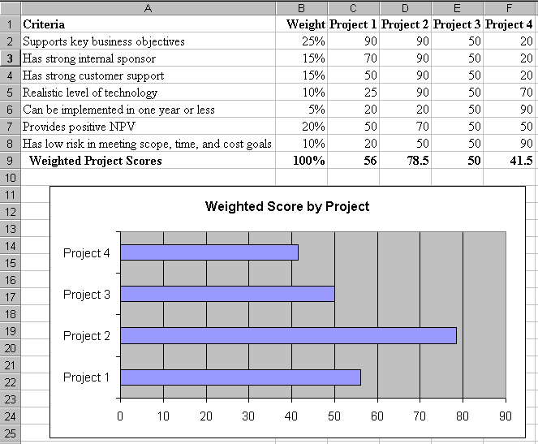
SAMPLE WEIGHTED SCORING MODEL FOR PROJECT SELECTION

Slide 21
Project Charters
After deciding what project to work on, it is important to formalize projects
A project charter is a document that formally recognizes the existence of a project and provides direction on the project’s objectives and management
Key project stakeholders should sign a project charter to acknowledge agreement on the need and intent of the project

Slide 22
Scope Planning and the Scope Statement
A scope statement is a document used to develop and confirm a common understanding of the project scope. It should include
a project justification
a brief description of the project’s products
a summary of all project deliverables
a statement of what determines project success

Slide 23
Scope Planning and the Work Breakdown Structure
After completing scope planning, the next step is to further define the work by breaking it into manageable pieces
Good scope definition
helps improve the accuracy of time, cost, and resource estimates
defines a baseline for performance measurement and project control
aids in communicating clear work responsibilities

Slide 24
The Work Breakdown Structure
A work breakdown structure (WBS) is an outcome-oriented analysis of the work involved in a project that defines the total scope of the project
It is a foundation document in project management because it provides the basis for planning and managing project schedules, costs, and changes

Slide 25
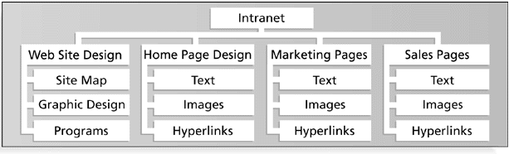
Sample Intranet WBS Organized by Product

Slide 26
Intranet Project … Level-2 WBS
1. Website design
1.1. Site map
1.2. graphic design
2. Home page design
2.1. Text
2.2. Images
2.3. Hyperlinks
3. Marketing pages
4. Sales pages

Slide 27
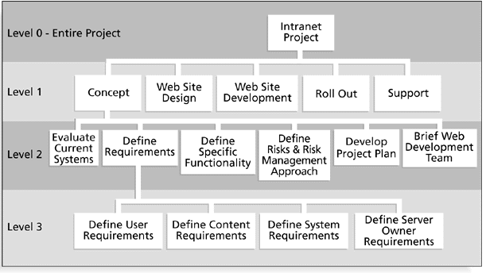
Sample Intranet WBS Organized by Phase

Slide 28
Approaches to Developing WBSs
Using guidelines: Some organizations, like the department of defense (DoD), provide guidelines for preparing WBSs
The analogy approach: It often helps to review WBSs of similar projects
The top-down approach: Start with the largest items of the project and keep breaking them down
The bottom-up approach: Start with the detailed tasks and roll them up

Slide 29
Scope Verification and Scope Change Control
It is very difficult to create a good scope statement and WBS for a project
It is even more difficult to verify project scope and minimize scope changes
Many Software projects suffer from scope creep and poor scope verification

Slide 30
Recap
Scope refers to all the work involved in creating the products of the project and the processes used to create them.
Five main process are involved in project scope management: scope-> initiation, planning, definition, verification and change control
To authoring a project: many organizations follow a planning process for selecting IT projects: develop an IT strategic plan, perform a business area analysis, define potential projects, select IT projects and assign resources

Slide 31
Recap….
Methods include for selecting IT project is focusing on broad needs, categorizing projects, financial methods, and weighted scoring models
Three primary methods for determining the financial value of projects: Net present value (NPV) analysis, Return on investment (ROI), Payback analysis
Scope statement is used for scope planning and WBS is used for scope definition.
WBS is develop using product oriented and process oriented.
Scope validation involves formal acceptance of the completed project deliverables

