Slide 1
CHAPTER ONE SW Project Management

Slide 2
SW Project Management
Introduction

Slide 3
Evaluation
Assignment and Quiz* | 20%
Mid Exam | 30%
Final Exam | 50%

Slide 4
Introduction
What is it?
Who does it?
Why it is important?
What are the steps? (4Ps: People, Product, Process and Project)
What is the work product?
How do I ensure that I’ve done it right?

Slide 5
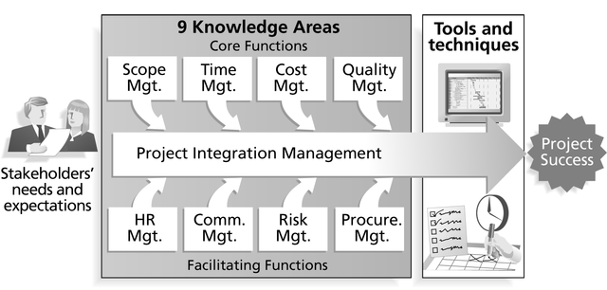

Slide 6
Why you study SW PM?
Failure of many Software Projects. For instance,
The United States Internal Revenue System was to abandon its tax system modernization program after having spent $4 billion;
The state of California spent $1 billion on its non-functional welfare database system;

Slide 7
Why need to study SPM?
The €339 million United Kingdom air traffic control system was reported as being two years behind schedule;
A 1995 Standish Group study (CHAOS) found that only 16.2% of IS projects were successful and over 31% were canceled before completion, costing over $81 B in the U.S. alone.
Worldwide cost of IT failure (revisited): $3 trillion

Slide 8
Causes of Project Management Failure
Bad Communications
Poor schedule or resource Management (mismanagement)
Weak requirements definitions (leads to inadequate planning)
Inadequate planning, assumptions, risks, or resources
Use of new or unproven technologies/methods

Slide 9
Causes of Project Management Failure
Ineffective (or nonexistent) quality controls
Managing multiple projects at once or multi-tasking resources
Supply chain failures
Scope creep or poor impact analysis
Lack of qualified resources

Slide 10
Advantages of Using Formal SPM
Better control of financial, physical, and human resources
Improved customer relations
Shorter development times
Lower costs

Slide 11
Advantages of Using Formal SPM
Higher quality and increased reliability
Higher profit margins
Improved productivity
Better internal coordination
Higher worker morale

Slide 12
What is a Project?
A project is a temporary endeavor undertaken to create a unique product or service.

Slide 13
Attributes of projects
unique purpose
temporariness
require resources, often from various areas
should have a primary sponsor and/or customer
involve uncertainty

Slide 14
The Triple Constraint
Every project is constrained in different ways by its
Scope goals: What is the project trying to accomplish?
Time goals: How long should it take to complete?
Cost goals: What should it cost?
It is the project manager’s duty to balance these three often competing goals

Slide 15
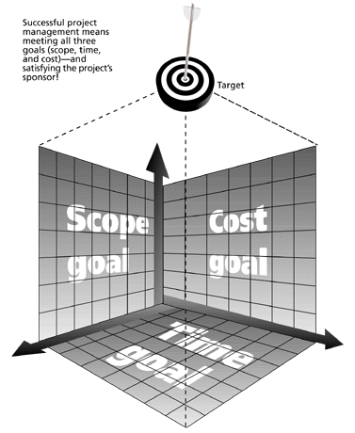
The Triple Constraint of Project Management

Slide 16
What is Project Management?
Project management is “the application of knowledge, skills, tools, and techniques to project activities in order to meet project requirements.” (PMI*)
Project Management is the discipline of planning, organizing, and managing resources to bring about the successful completion of specific project goals and objectives.
*The Project Management Institute (PMI) is an international professional society. Their web site is www.pmi.org.

Slide 17
Project Management Framework

Slide 18
Project Stakeholders
Stakeholders are the people involved in or affected by project activities
Stakeholders include
the project sponsor and project team
support staff
customers
users
suppliers
opponents to the project

Slide 19
9 Project Management Knowledge Areas
Knowledge areas describe the key competencies that project managers must develop
4 core knowledge areas lead to specific project objectives (scope, time, cost, and quality)
4 facilitating knowledge areas are the means through which the project objectives are achieved (human resources, communication, risk, and procurement management
1 knowledge area (project integration management) affects and is affected by all of the other knowledge areas

Slide 20
Project Management Tools and Techniques
Project management tools and techniques assist project managers and their teams in various aspects of project management
Some specific ones include
Project Charter and WBS (scope)
Gantt charts, network diagrams, critical path analysis, critical chain scheduling (time)
Cost estimates and earned value management (cost)

Slide 21
More Advantages of Project Management*
Bosses, customers, and other stakeholders do not like surprises
Good project management (PM) provides assurance and reduces risk
PM provides the tools and environment to plan, monitor, track, and manage schedules, resources, costs, and quality
PM provides a history or metrics base for future planning as well as good documentation
Project members learn and grow by working in a cross-functional team environment

Slide 22
How Project Management (PM) Relates to Other Disciplines
Much of the knowledge needed to manage projects is unique to PM
However, project managers must also have knowledge and experience in
general management
the application area of the project
Project managers must focus on meeting specific project objectives

Slide 23
Project Management and Other Disciplines
Application area knowledge and practice
General management knowledge and practice
Project management knowledge and practice

