Slide 1
From Chapter 1 Project Classification
Boehm [1981] Classified project into 3 different types.
Organic: the project which deals with well understood application/s, size of development team is small, and team members are experienced in developing similar types of projects.
Semidetached: the development consists of a mixture of experienced and inexperienced staff. Team members may have limited experience on related system development.
Embedded: A development project is considered to be of embedded type, if the software being developed is strongly coupled to complex hardware.

Slide 2
Software projects can be grouped into nine broad types
Software development
Package implementation
System enhancement
Consultancy and business analysis assignments
Systems migration
Infrastructure implementation
Outsourcing (and in-sourcing)
Disaster recovery
Smaller IS projects

Slide 3
Main Project Actors
If you consider your final year project the three main actors in the project:
You (the student),
The supervisor and
The examiner
Of the three actors, you are the most important, since you are the one who moves the project forward.
Three main parameters of project
Time
Scope
Cost
These three parameters produce project ‘’quality triangle’’

Slide 4
What is Project Management?
Project management is the process of planning and controlling the development of a system within a specified timeframe at a minimum cost with the right functionality.
It is the application of knowledge, skills, tools and techniques to project activities to meet project requirements
It is accomplished through the application and integration of the project management processes of initiating, planning, executing, monitoring and controlling, and closing
The project manager is the person who is responsible for accomplishing the project objectives.

Slide 5
Structure of Project Management
Generally the structure categorized into three sections, such as:-
The Project Management Framework:-provides a basic structure for understanding project management for example:-
Introduction, defines key terms and provides an overview.
Project Life Cycle and Organization: describes the environment in which projects operate. Managing the day-to-day activities of the project is necessary, but not sufficient, to ensure success.

Slide 6
The Standard for Project Management of a Project:-specifies all the project management processes that are used by the project team to manage a project.
Project Management Processes for a Project which describes the five required Project Management Process Groups for any project such as initiating, planning, executing, monitoring and controlling, and closing.
The Project Management Knowledge Areas:-such as organizes the project management processes from Management Process Groups into Knowledge Areas.

Slide 7
Project Management Knowledge Area
Project Integration Management:- describes the processes and activities that integrate the various elements of project management, which are identified, defined, combined, unified and coordinated within the Project Management Process Groups.
It consists of the Develop Project Charter, Develop Preliminary Project Scope Statement, Develop Project Management Plan, Direct and Manage Project Execution, Monitor and Control Project Work, Integrated Change Control, and Close Project management processes.

Slide 8
Project Scope Management
Project Scope Management describes the processes involved in ascertaining that the project.
It consists of the Scope Planning, Scope Definition, Scope Verification, and Scope Control project management processes.
Project Time Management describes the processes concerning the timely completion of the project.
It consists of the Activity Definition, Activity Sequencing, Activity Resource Estimating, Activity Duration Estimating, Schedule Development and Schedule Control project management processes.

Slide 9
PMKA
Project Cost Management describes the processes involved in planning, estimating, budgeting, and controlling costs so that the project is completed within the approved budget.
It consists of the Cost Estimating, Cost Budgeting, and Cost Control project management processes.
Project Quality Management which is the processes involved in assuring that the project will satisfy the objectives for which it was undertaken.
It consists of the Quality Planning, Perform Quality Assurance, and Perform Quality Control project management processes.

Slide 10
PMKA
Project Human Resource Management describes the processes that organize and manage the project team.
It consists of the Human Resource Planning, Acquire Project Team, Develop Project Team, and Manage Project Team project management processes.
Project Communications Management:- describes the processes concerning with timely and appropriate generation, collection, dissemination, storage and ultimate disposition of project information.
It consists of the Communications Planning, Information Distribution, Performance Reporting, and Manage Stakeholders project management processes.

Slide 11
PMKA
Project Risk Management:- the processes concerned with conducting risk management on a project.
It consists of the Risk Management Planning, Risk Identification, Qualitative Risk Analysis, Quantitative Risk Analysis, Risk Response Planning, and Risk Monitoring and Control project management processes.
Project Procurement Management:- describes the processes that purchase or acquire products, services or results, as well as contract management processes.
It consists of the Purchases and Acquisitions plan, Plan Contracting, Request Seller Responses, Select Sellers, Contract Administration, and Contract Closure project management processes.

Slide 12
Project Life Cycle Model and Paradigms
Project Life Cycle:- defines the phases that connect the beginning of a project to its end.
The project life cycle definition can help the project manager clarify whether to treat the feasibility study as the first project phase or as a separate, stand-alone project.
feasibility study is a way of analysis and evaluation of a proposed project to determine if it is technically feasible, feasible within the estimated cost, and if it will be profitable.
The phases of a project life cycle are not the same as the Project Management Process Groups.
The transition from one phase to another within a project life cycle.

Slide 13
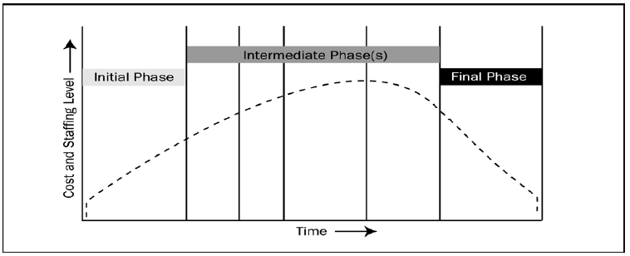
Project Life Cycle
What technical work to do in each phase
Who is involved in each phase
How to control and approve each phase.
Typical Project Cost and Staffing Level Across the Project Life Cycle

Slide 14
In the project life cycle:-
The level of uncertainty is highest and, hence, risk of failing to achieve the objectives is greatest at the start of the project.
The certainty of completion generally gets progressively better as the project continues.
Cost and staffing levels are low at the start, peak during the intermediate phases, and drop rapidly as the project draws to a conclusion.

Slide 15
CHAPTER TWO PROJECT PLANNING

Slide 16
PROJECT PLANNING
Used for managing the overall project activity.
In the planning process the planning groups identify, define, and mature the project scope, project cost, and schedule the project activities that occur within the project.
As new project information is discovered, additional dependencies, requirements, risks, opportunities and constraints will be identified or resolved.
While planning the project, the project team should involve all appropriate stakeholders, depending upon their influence on the project and its outcomes.

Slide 17
Activities in the Project Planning
Introduction
Objectives
functions of the project
Performance Issues
Management and Technical Constraints
Project Estimates
We may use Historical Data
Estimation Techniques Used
Effort, Time, and Cost Estimates
Schedule
Work Breakdown Structure (WBS)
Gantt Chart Representation

Slide 18
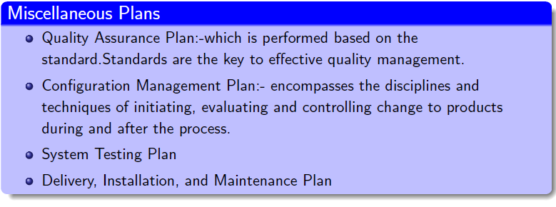
Activities in the Project Planning…
Project Resources
People
Hardware and Software
Staff Organization
Team Structure
Management Reporting
Risk Management Plan
Risk Analysis, Identification, Risk Estimation
Project Tracking and Control Plan
Miscellaneous Plans
Quality Assurance Plan:-which is performed based on the standard. Standards are the key to effective quality management.

Slide 19
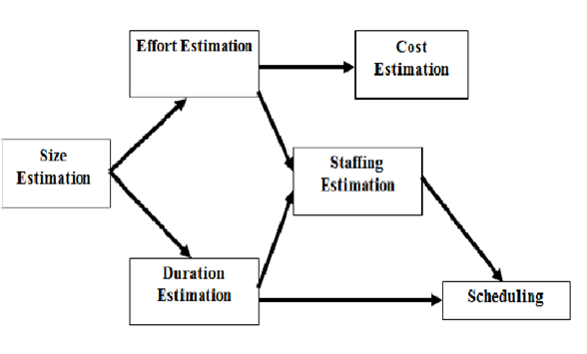
Project Parameter Estimations

Slide 20
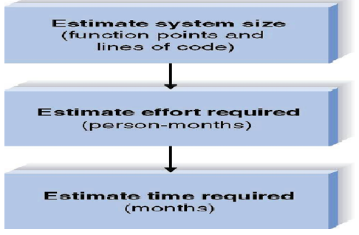
Project estimations
To estimate various project parameters like project size, cost, effort, and duration by using various estimation techniques.

Slide 21
Project Estimation Techniques
Empirical Estimation
Expert Judgment
Delphi cost estimation
Heuristic estimation Technique
COCOMO
Analytical estimation technique
Halstead software science

Slide 22
Empirical Estimation
Expert Judgment
Here an expert guess about problem size after analyzing the problem.
Usually expert estimates the cost of modules of each subsystem to get the overall estimation of system.
Problem:-There may be personal bias and interference.
Delphi cost estimation:-
Here estimation is carried out by an expert team with a coordinator.
The coordinator gives SRS document and a cost recording form to each expert.
Each expert records cost in the form and submits to coordinator.
Coordinator compiles several times and prepare the final cost estimation report.

Slide 23
Heuristic estimation Technique
COCOMO(Constructive cost estimation model)
Effort= a1.(Size)power of a2 Programmer Months
Tdev= b1.(Effort)power of b2 Months
Where size of project= KLOC(Kilo line of codes) and a1,a2, b1,b2 are the constants for each category of project.
Effort= total effort required to develop a project.
Estimation Steps:-
Determine size of the product(KLOC)
From the size estimated, determine the effort needed.
From the effort estimate, determine project duration, and cost

Slide 24
Heuristic estimation Technique
Estimation of development effort
For the three classes of projects, the formulas for estimating the effort based on the code size are :-
Organic: Effort=2.4(KLOC)^{1.05} PM
Semidetached: Effort=3.0(KLOC)^{1.12} PM
Embedded: Effort=3.6(KLOC)^{1.20} PM
Estimation of development Time
Organic: Tdevt=2.5(Effort)^{0.38} months
Semidetached: Tdev=2.5(Effort)^{0.35} months
Embedded: Tdevt=2.5(Effort)^{0.32} months

Slide 25
Example:- Assume the size of a project= 32KLOC
Basic COCOMO estimation formula for organic type of project:
Effort=2.4(32Kloc)power of 1.05=91PM
development time = 2.5(434PM) power of 0.38 = 25 months

Slide 26
Analytical estimation technique
Halstead software science:- a software metrics introduced by Howard Halstead to estimate the project size based on over all program length
Used a few primitive program parameters to estimate a given project
Most of the time this technique is not applied

Slide 27
Project scheduling Steps
Project scheduling is an important project planning activity used to decide which task should be taken first.
Identify all tasks needed to complete a project
Break down large tasks into smaller activities.
Determine dependencies among them
Establish time duration to complete activities.
Allocate resources to activities
Monitor the timely progress of the activities
Step-1 and 2 :- after identifying tasks the project manager break down this large task into smaller activities by using a work breakdown structure

Slide 28
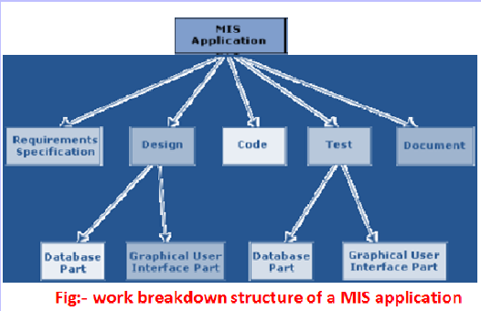
Project scheduling Steps

Slide 29
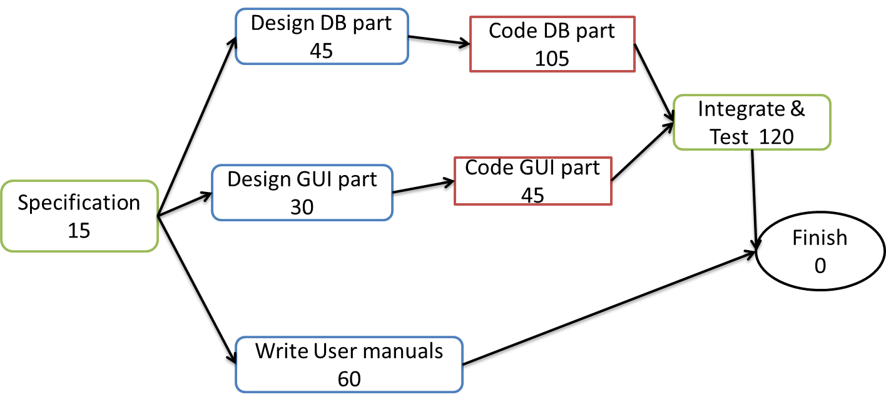
Step-3 and 4:-The task dependencies define partial ordering of tasks and the dependencies among the activities can be determined by using an activity network.
Activity Network of MIS application

Slide 30
Step-5:- allocate resources to activities using a Gantt chart
It is a special type of bar chart, where each bar represents an activity.
Step-6:- Monitor the timely progress of the activities
PERT(project evaluation and review technique)also identify the parallel activities in a project
3-estimates are made.:-
Optimistic Time= 12 Months
Likely Time estimate= 15 months
Pessimistic Time Estimate= 20 months

Slide 31
Project Scope Management
Includes the processes required to ensure that the project includes all the work required to complete the project successfully.
primarily concerned with defining and controlling what is and is not included in the project.
It has its own processes

Slide 32
Project Scope Management Processes
Scope Planning:- Creating a project scope management plan that documents how the project scope will be defined, verified, controlled and how the work breakdown structure (WBS) will be created and defined.
Scope Definition:-Developing a detailed project scope statement as the basis for future project decisions.
Create WBS:-dividing the major project deliverables and project work into smaller and more manageable components.
Scope Verification:- Formalizing acceptance of the completed project deliverables.
Scope Control:-controlling changes to the project scope.

Slide 33
Those processes interact with each other and with processes in the other Knowledge Areas as well.
Each process can involve effort from one or more persons or groups of persons, based on the needs of the project
In the project context, the term scope can refer to:-
Product scope:-The features and functions that characterize a product, service or result.(focus on What?)
Project scope:-The work that needs to be accomplished to deliver a product, service or result with the specified features and functions.(focus on How)

Slide 34
Scope Planning/Input...
Enterprise Environmental Factors:- Such as the organization culture, infrastructure, tools, human resources, personnel policies and marketplace conditions that could affect how project scope is managed.
Organizational Process Assets:- The formal and informal policies, procedures and guidelines that could impact how the project scope is managed.(e.g Historical information about previous projects)
Project Charter:- Formal document which authorizes a project or a project phase.
Preliminary Project Scope Statement:- Initial project scope statement document that provides a high level scope narrative.
Project Management Plan:- Formal document which is necessary to define, prepare, integrate, and coordinate all subsidiary plans

Slide 35
Scope Planning/Tools and Techniques
Expert Judgment:- Related to how equivalent projects have managed scope, is used in developing the project scope management plan.
Templates, Forms, Standards:- Includes work breakdown structure templates, scope management plan templates and project scope change control forms.
Scope Planning/Out put
The project scope management plan:-Document which provides guidance on how the project scope will be defined, documented, verified, managed and controlled by the project management team.

Slide 36
Scope Definition/Input
Organizational Process Assets
Project Charter
Preliminary Project Scope Statement
Project Scope Management Plan:-Which was the output of scope planning
Approved Change Requests:-Can cause a change to project scope, project quality, estimated costs or project schedule.

Slide 37
Scope Definition/Tools and Techniques
Product Analysis:- Includes techniques such as product breakdown, system analysis, functional analysis and the like
Alternatives Identification:- Used to generate different approaches to execute and perform the work of the project.(E.g Brainstorming)
Expert Judgment (related to this task)
Stakeholder Analysis:-Identifies the influence and interests of the various stakeholders and documents their needs and expectations
Scope Definition/Output
Project Scope Statement (Detail description about Project objectives, Product scope description, Project requirements etc.)
Requested Changes:-May exist to the project management plan and its
subsidiary plans may be developed during the Scope Definition process
Project Scope Management Plan (Updates):- may be updated to include approved change requests resulting from the project Scope Definition process.

Slide 38
Create WBS/Input
Organizational Process Assets
Project Scope Statement:-just out put of scope definition
Project Scope Management Plan:-out put of scope definition
Approved Change Requests
Create WBS/Tools and Techniques
Work Breakdown Structure templates
Decomposition:-Is the subdivision of project deliverables into smaller and more manageable components until the work and deliverables are defined to the work package level.

Slide 39
Create WBS/Out Put
Project Scope Statement (Updates):- If approved change requests result from the Create WBS process
Work Breakdown Structure
WBS Dictionary:- The document generated by the Created WBS process that supports the WBS
Scope Baseline:- The approved detailed project scope statement associated with WBS and WBS dictionary
Project Scope Management Plan (Updates):-If approved change requests result from the Create WBS process
Requested Changes:-May processed for review and approval through the integrated change control process for the next phase.

Slide 40
Scope Verification/Input
Project Scope Statement:-out put of WBS
WBS Dictionary:-out put of WBS
Project Scope Management Plan:-out put of WBS
Deliverables:-Those that have been fully or partially completed Project Execution process
Scope Verification/Tools and Techniques
Inspections:-Includes activities such as measuring, examining and verifying to determine whether the work and deliverables meet requirements and product acceptance criteria.
Scope Verification/Out Put
Accepted Deliverables:- The Scope Verification process document those completed deliverables that have been accepted
Requested Changes:-May be processed for review through the Integrated Change Control process
Recommended Corrective Actions:-May be done in the process

Slide 41
Scope Control/Input
Project scope statement:-Associated with WBS and WBS dictionary which defines the project scope baseline and product scope.
Work Breakdown Structure
WBS Dictionary
Project Scope Management Plan
Performance Reports:- Provide information on project work performance, such as interim deliverables that have been completed.
Approved Change Requests
Work Performance Information:-Give us information about the performance of the work

Slide 42
Scope Control/Tools and Techniques
Change Control System:-Can be documentation or tracking systems(Software) necessary for authorizing changes.
Variance Analysis:-A system used to assess the magnitude of variation.
Re-planning:- If There is approved change requests on WBS, WBS dictionary, scope statement and other components of the project management plan
Configuration Management System:-A system that Assure requested changes to the project scope and product scope are thoroughly considered and documented before being processed through the Integrated Change Control process.

Slide 43
Scope Control/Out Put
Project Scope Statement (Updates):-If the approved change requests have an effect upon the project scope
Work Breakdown Structure (Updates):-If the approved change requests have an effect upon the project scope
WBS Dictionary (Updates)
Scope Baseline (Updates)
Requested Changes
Recommended Corrective Action
Organizational Process Assets (Updates)
Project Management Plan (Updates)

Slide 45
Group Assignment
Apply the formula of Halstead Software Metrics with your own example of software project
Clearly determine the sequence of steps in Spiral Model i.e. order of phases in Spiral model
Explain about SDLC and Project Development Lifecycle with appropriate example
Develop a program that can implement the COCOMO model for Organic software development (either in java or in C++ program)
Submission Date: April 20, 2023
Group should be in order of your ID.NO (the first four student up to the last five students)!

Slide 46
THANKS A LOT!
ANY QUESTION ???

