Slide 1

Group members :
Amol Agrawal
Ashwin Bhoyar
Atindra Mardikar
Deepak Tayade
Mithilesh Wachasunder

Slide 2


Slide 3
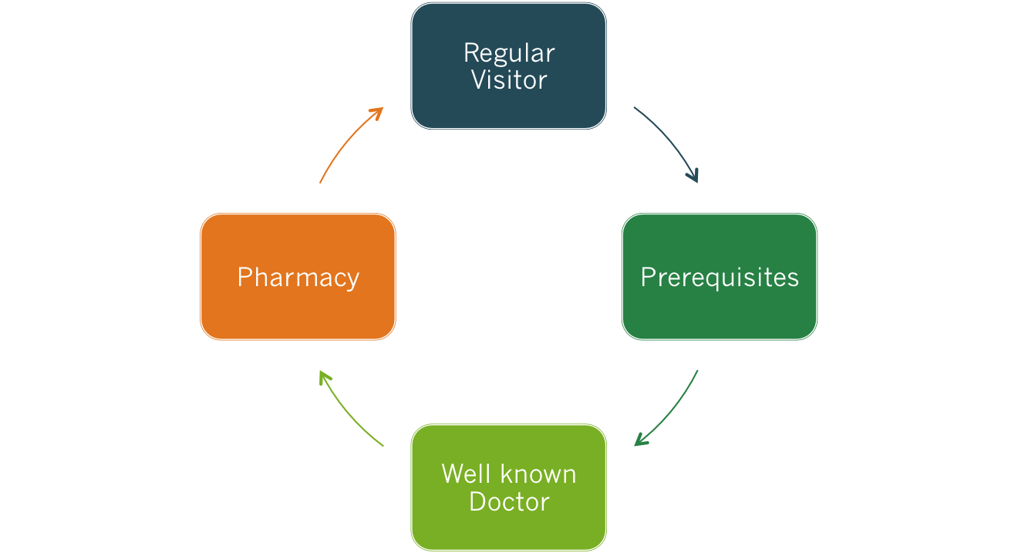
In a Hospital…

Slide 4
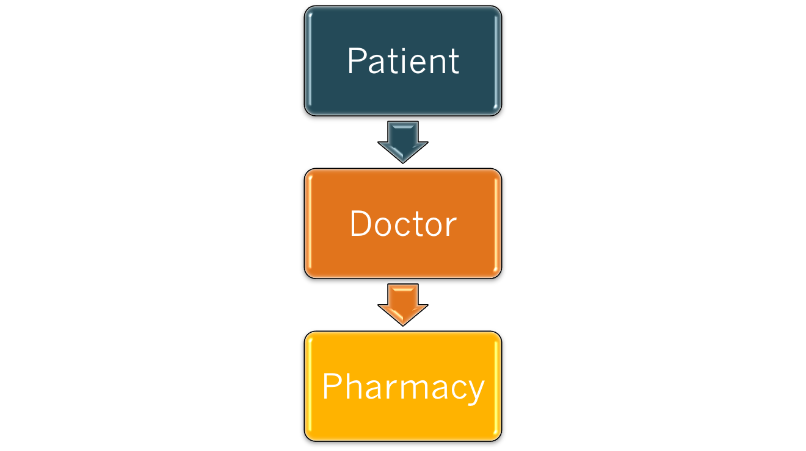
STAGES OF TREATMENT

Slide 5
Any Solution??
Healthmate..
How?
Step 1 : Patient registers for health mate. (only for first time)
Step 2 : Take appointment with doctor. Notes expected time for check-up.
Step 3: Doctor(s) record their observations and prescribe medicines.
Step 4 : Collect the medicines from the stores that is in harmony with this network.

Slide 6
ANALYSIS
Our requirements were:
  1. To have a centralized common database that will connect all the actors i.e. patient, doctor, medical store owner.
  2. Classify end-users and provide them with most convenient services.
  3. Manage the synchronization and maintain the privacy.
  4. To have a simple, easy and interactive UI.

Slide 7
TECHNOLOGIES USED..
JAVA
PHP/WORDPRESS
MySQL

Slide 8
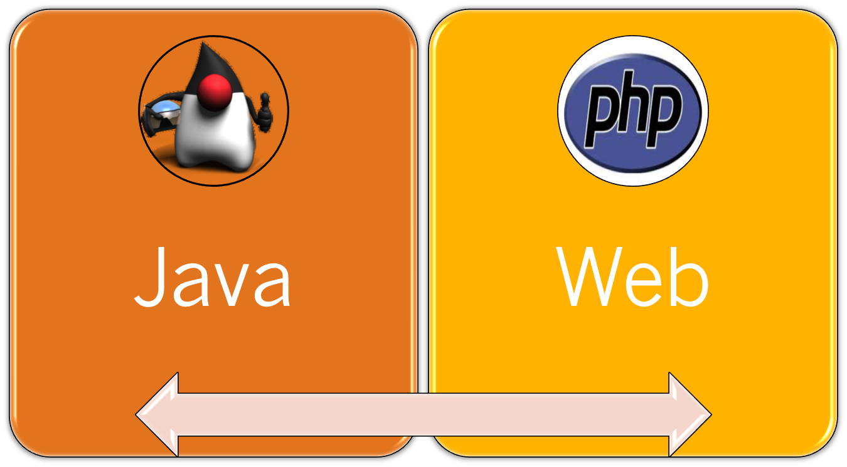
Implementation
CENTRALIZED DATABASE

Slide 9


Slide 10
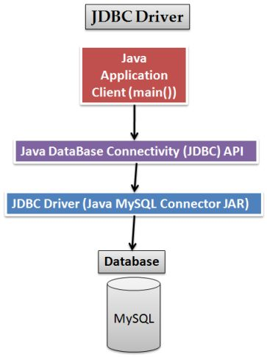
FLOW..

Slide 11


Slide 12
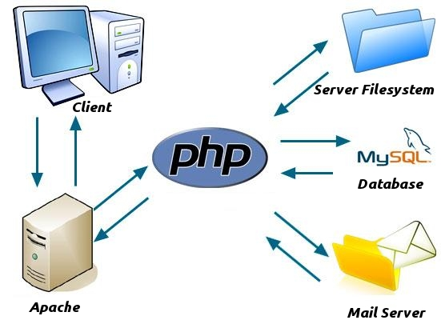
FLOW..

Slide 13
Some Constraints
Emergency cases can preempt all appointments so, the schedule of Doctors is subject to change.
Present version of Health Mate focuses just on one hospital having its own pharmacy.
If Network fails /no Internet connection then current data fed cannot be uploaded on central database.

Slide 14
Health Mate plans to achieve
Security issues are to be addressed.
Creating a local database and uploading the relevant data to central database.
We plan to run Health Mate for all hospitals of a particular region .
Notifications system for all android users.
More Generalization in different Medical Fields.
  E.g.: Chemotherapy.

Slide 15
THANK YOU..!

