Slide 1
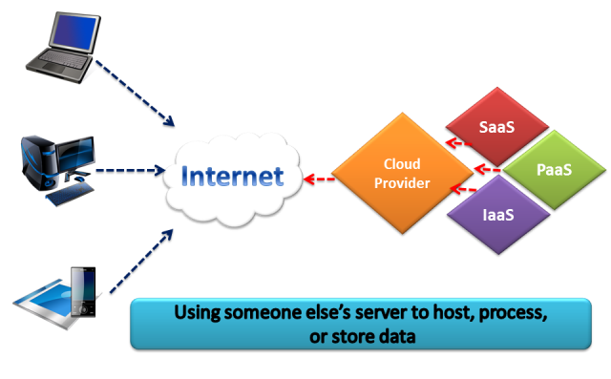
What is Cloud?

Slide 2
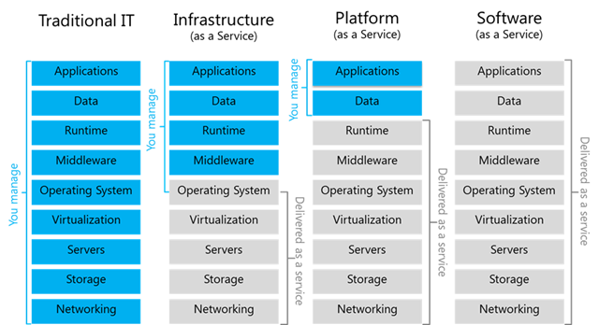
Cloud Services Deployment Models

Slide 3
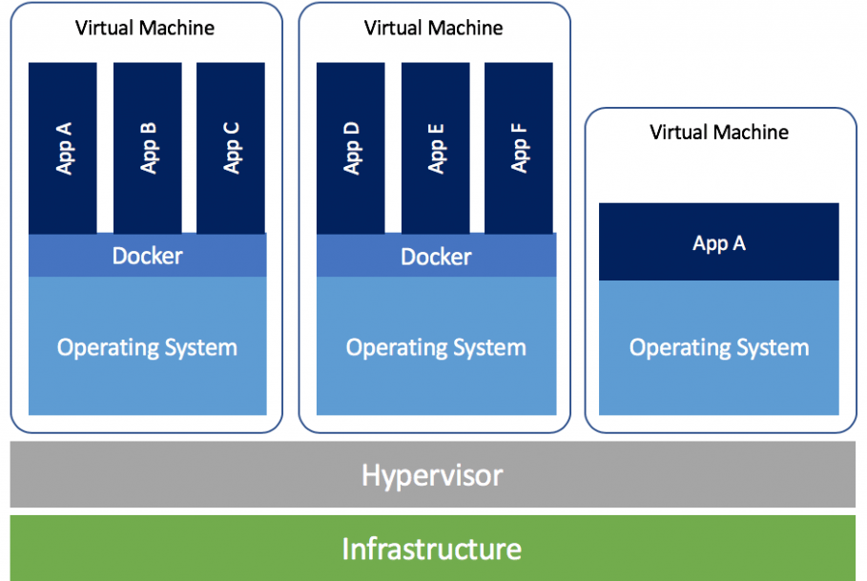
Virtual Machines
VM technology allows multiple virtual machines to run on a single physical machine

Slide 4
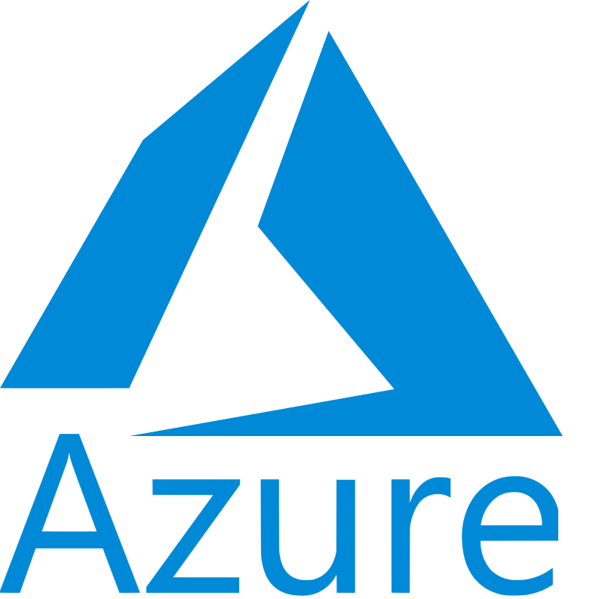
Introduction of Microsoft Azure
Microsoft's public cloud platform
Azure offers a large collection of services
PaaS
IaaS
managed database service capabilities

Slide 5
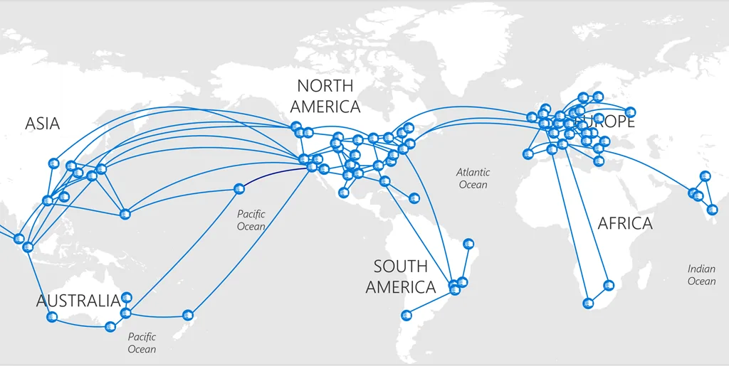
Concept of Region & Availability Zone

Slide 6
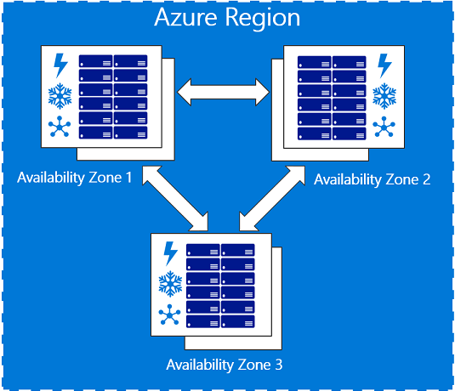
Concept of Region & Availability Zone

Slide 7
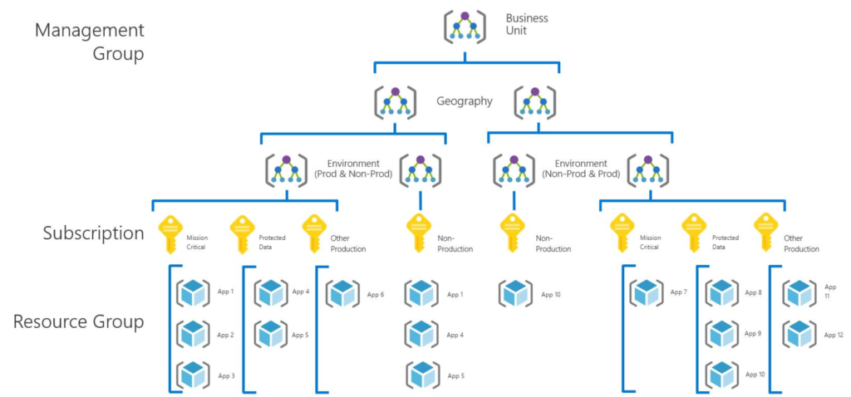
Concept of Resource Group

Slide 8
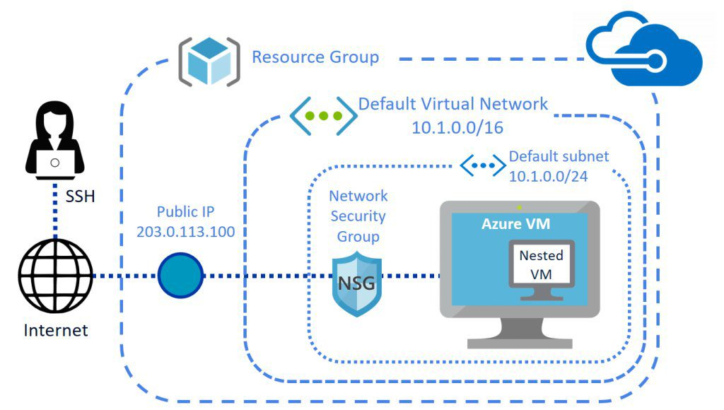
Introduction of Azure Virtual Machine

Slide 9
Azure Storage Account
Duration: 40-60 Minute with Labs

Slide 10
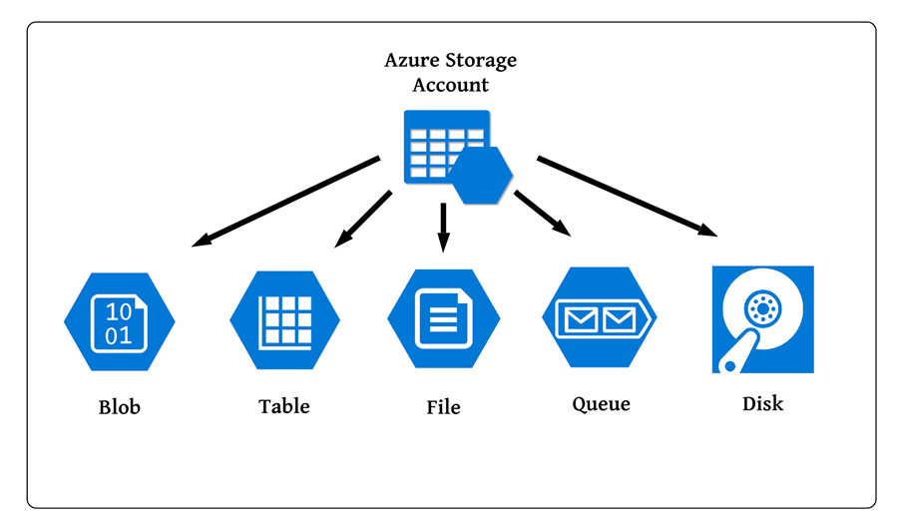
Introduction to Storage Account
Provides a unique namespace in Azure for data

Slide 11
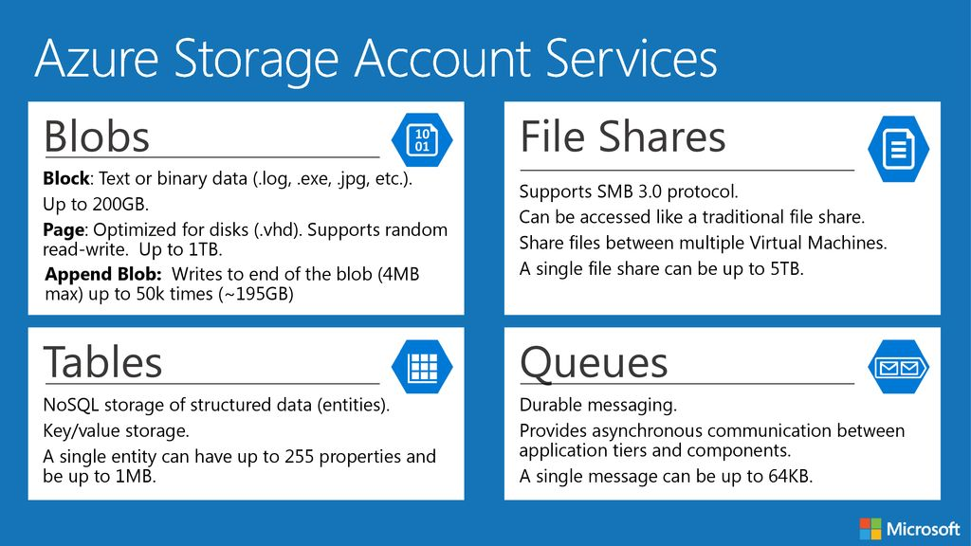
Core Storage Services

Slide 12
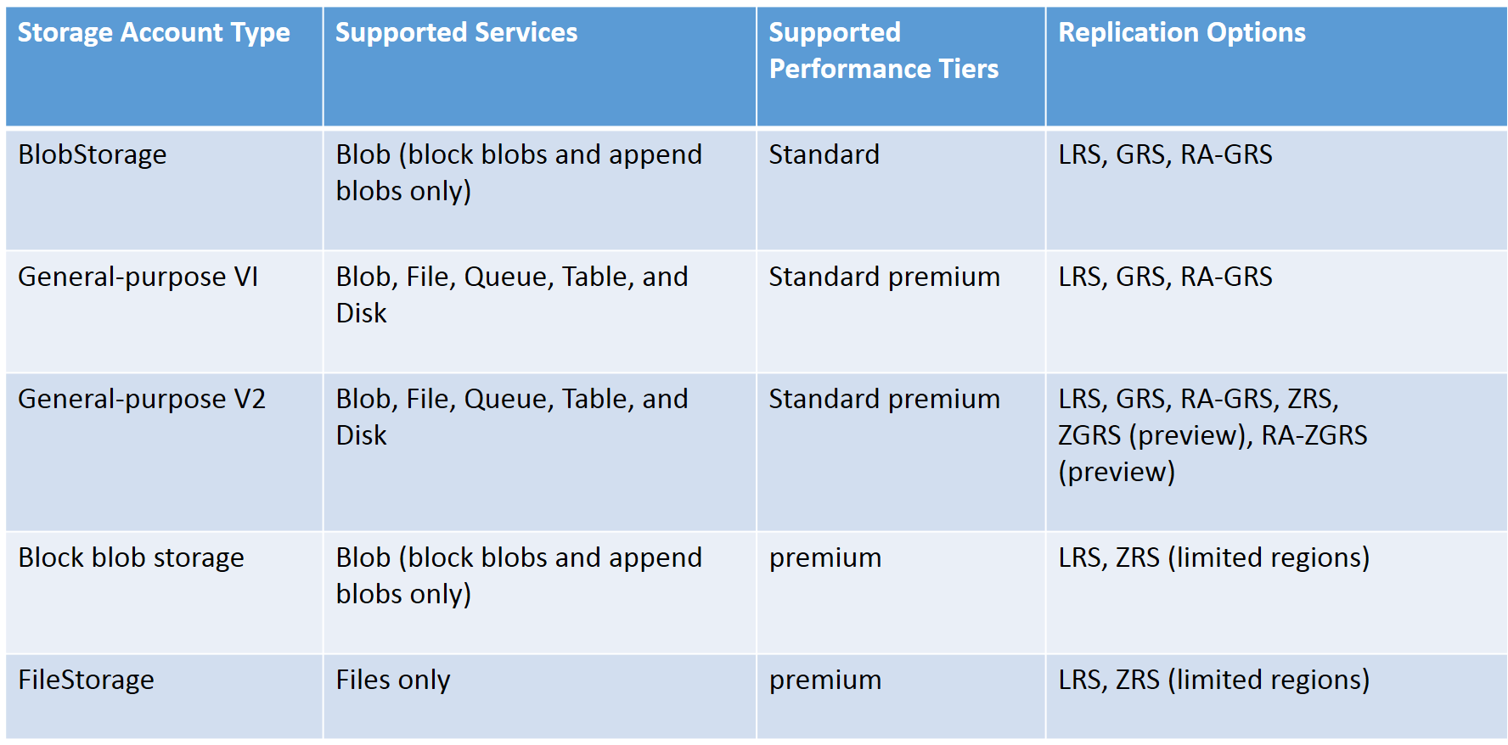
Types of Storage Accounts

Slide 13
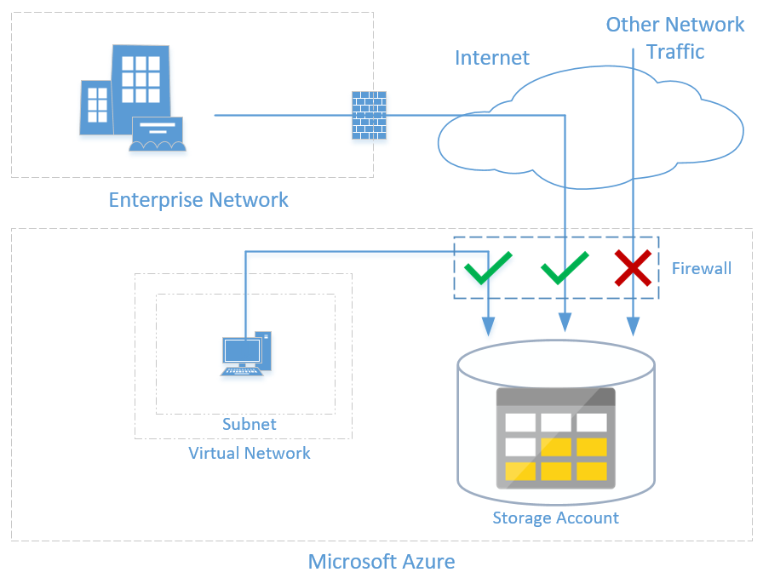
Securing the Data

Slide 14
Lab : Planning and implementing storage

Slide 15
Lab: Creating and manage Storage Accounts
Duration: 5 minutes

Slide 16
Lab: Create and manage containers
Duration: 10 minutes

Slide 17
Lab: Create & manage Blobs, Queues, Files & Tables
Duration: 10 minutes

Slide 18
Azure AD Authentication
Duration: 1.5-2 hours including labs

Slide 19
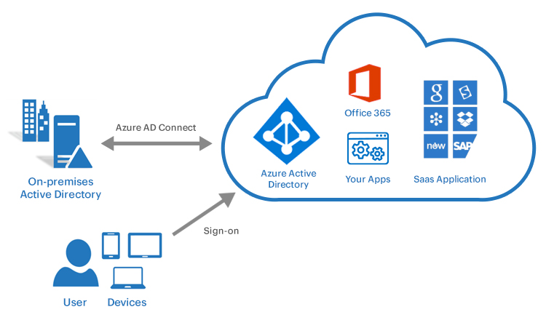
What is Azure Active Directory?
Cloud-based identity and access management (IAM) solution
Provides
Single sign-on
Conditional access to guard against 99.9 percent of cybersecurity attacks.
Multifactor authentication

Slide 20
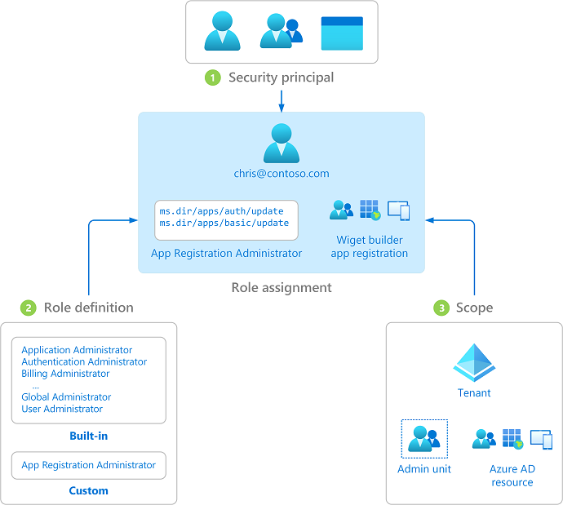
Role Base Access Control (RBAC)
Provides fine-grained access management of Azure resources.
Segregates duties within team and grant only the amount of access to users that they need to perform their jobs

Slide 21
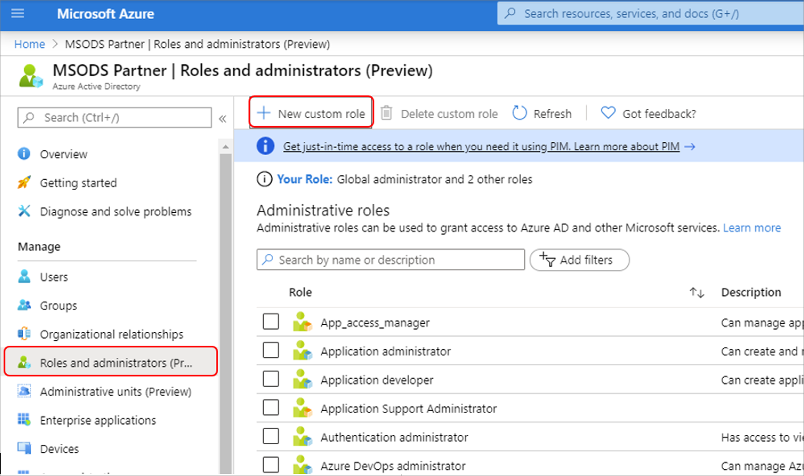
Custom Roles (RBAC)
If the Azure built-in roles don't meet the specific needs of your organization, you can create your own custom roles

Slide 22
Lab : Azure AD Authentication
Lab: How to create user and groups?
Lab: Implementation of permission

Slide 23
Thanks

