Slide 1

Cosmos DB

Slide 2

NoSQL Database
Before moving to Cosmos DB, let check what is NoSQL database
NoSQL are non-relational
NoSQL databases have dynamic schemas for unstructured data
NoSQL is better for unstructured data like JSON

Slide 3
Why should go with Cosmos DB ?
High-Throughput
Low Latency
Global Distribution
Multi Consistency Model
Support for different kind of APIs

Slide 4
Cosmos DB
Paas (Platform as a service)
Cloud-based NoSQL database
A fully managed, globally distributed NoSQL database service in Microsoft Azure
It provides extremely low latency, high availability, and consistency.
Supports multi-region (Geo) replication

Slide 5
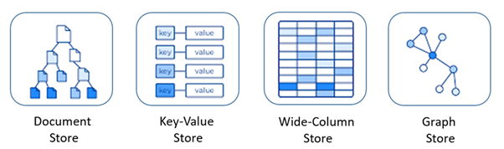
Cosmos database supports multi-model such as

Slide 6
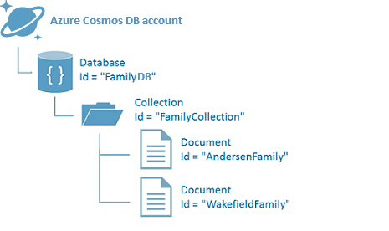
Cosmos DB Architecture

Slide 7
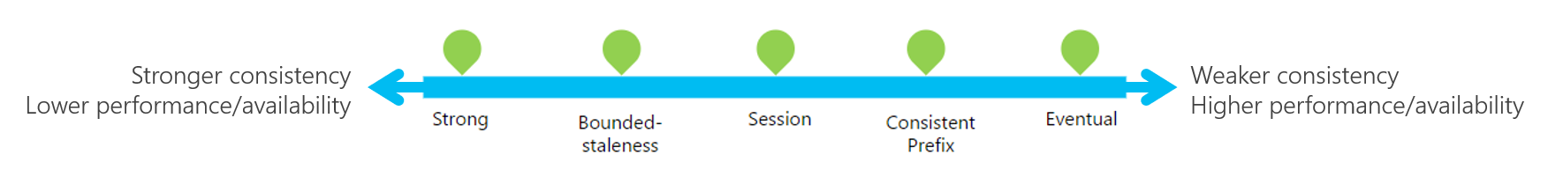
Consistency Levels

Slide 8
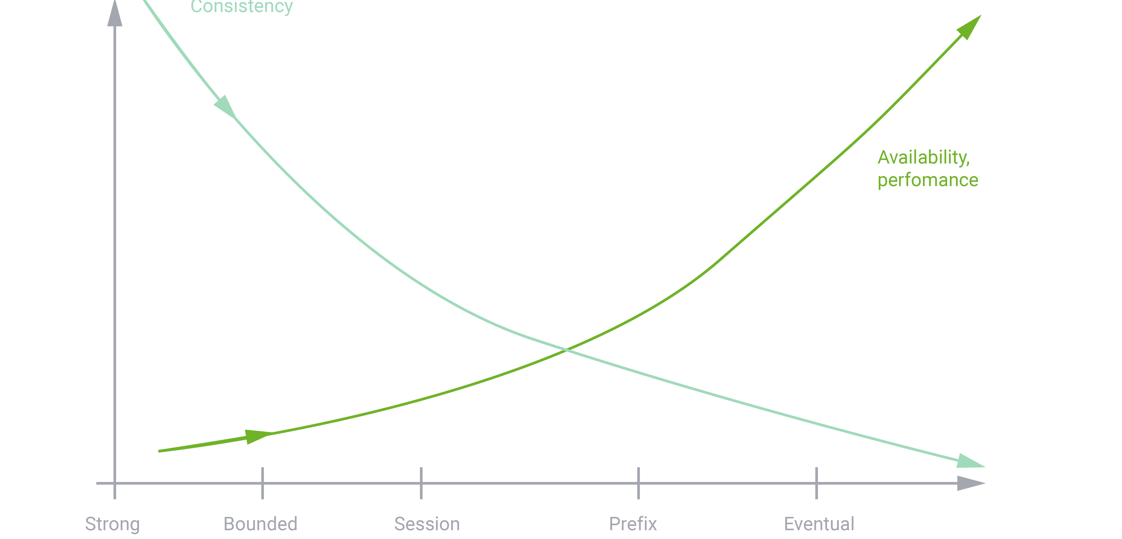
Consistency Levels

Slide 9
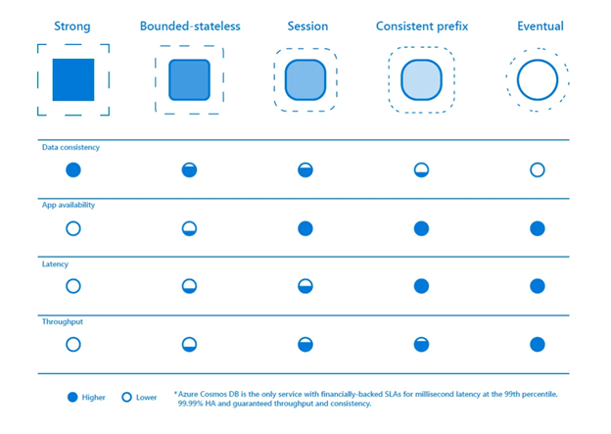
Consistency Levels

Slide 10
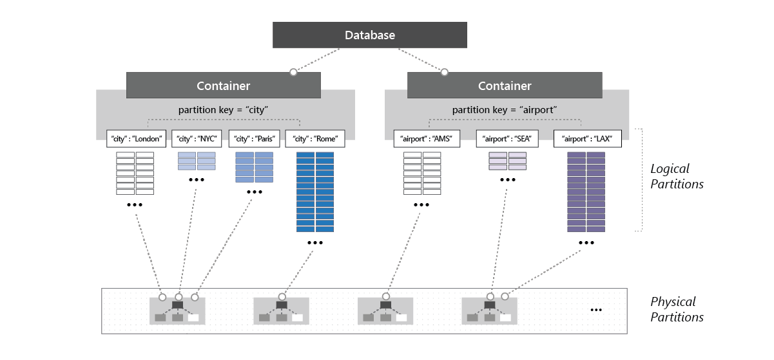
Partitioning

Slide 11
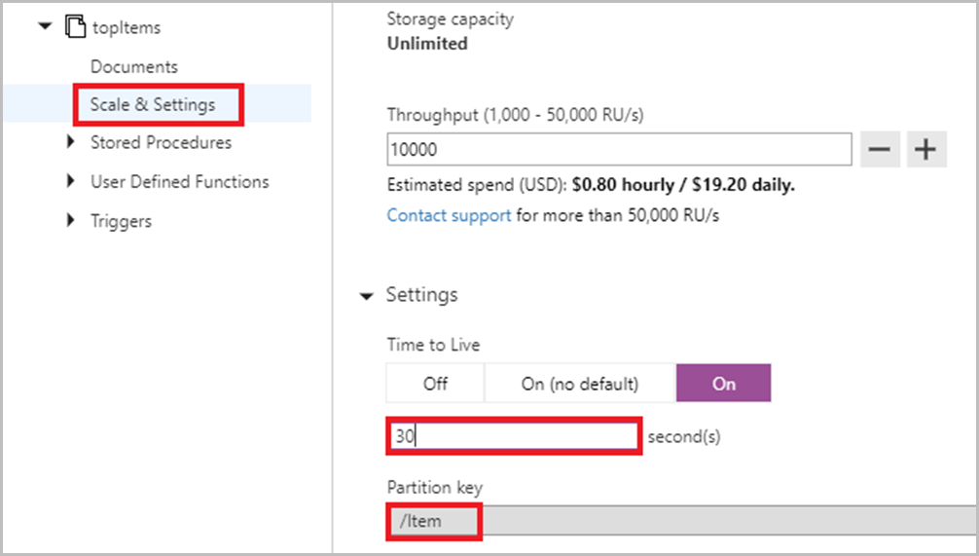
TTL

Slide 12
Thank You

