Slide 1
Introduction to Microservices
Notes:
https://courses.cs.washington.edu/courses/cse403/13au/lectures/git.ppt.pdf
http://enos.itcollege.ee/~jpoial/allalaadimised/git/getting-started-with-git.pdf

Slide 2
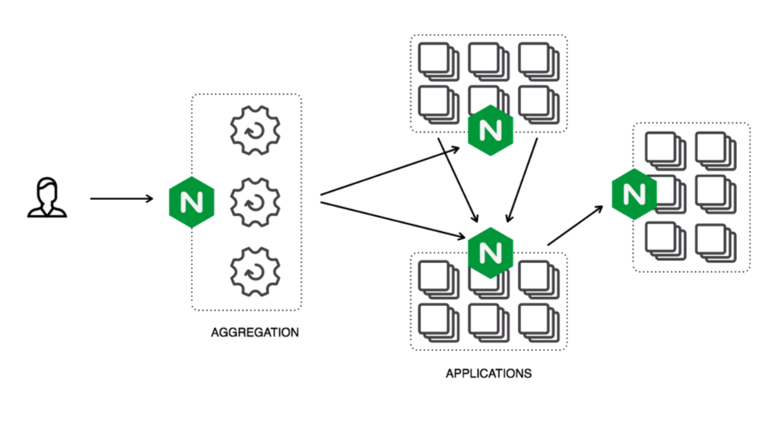
Microservices

Slide 3
Microservices

Slide 4
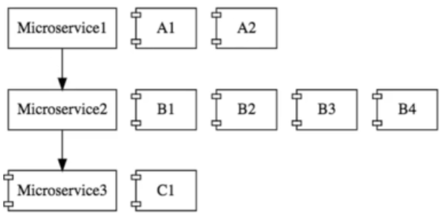
Microservices

Slide 5
Advantages
New Technology Adoption is easy
Each Microservice can be built in any different technology
Dynamic Scaling
Faster Release Cycles

Slide 6
Challenges
Bounded Context
Difficult to identify boundary of each Microservice
Configuration management
Difficult to manage configuration of tons of Microservices
Dynamic Scale up and Down
Visibility
How to identify bugs?
Pack of cards is not well designed

Slide 7
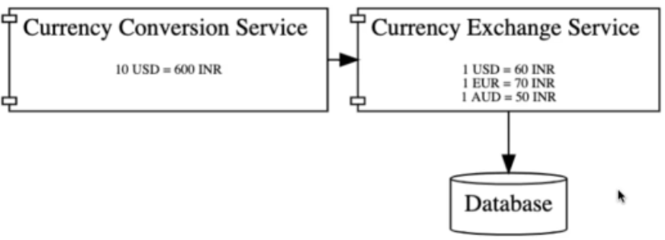
CCS and CES Spring Boot Services

Slide 8
Thanks

