Slide 1
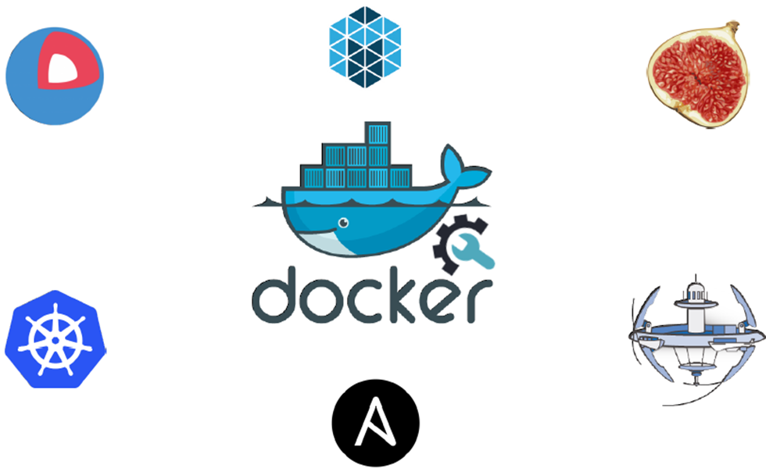
Docker

Slide 2
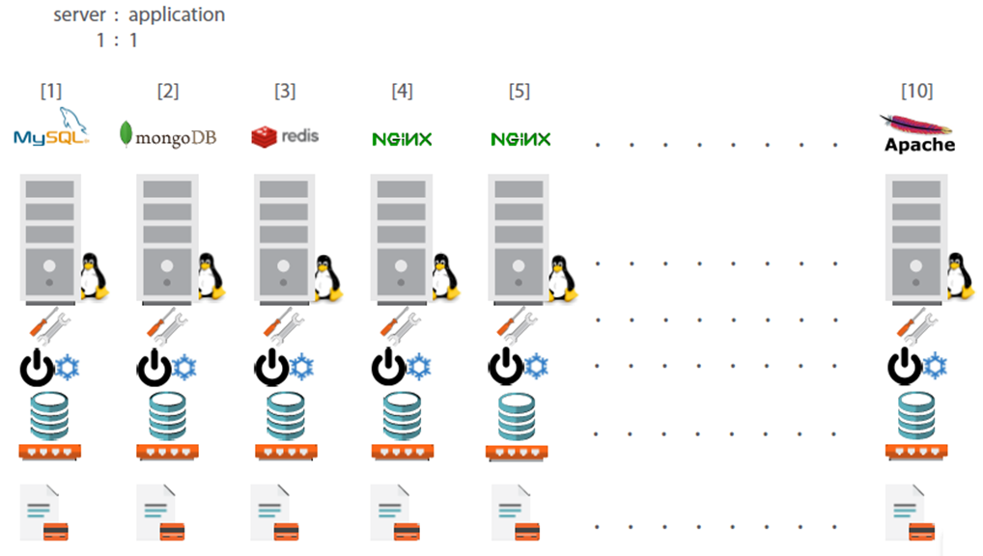
Traditional Deployment Architecture

Slide 3
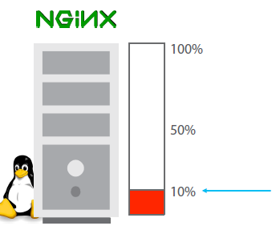
Less Utilization in Traditional Architecture

Slide 4
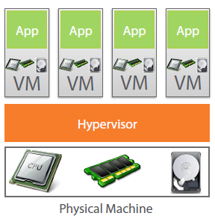
Virtual Machine to the Rescue

Slide 5
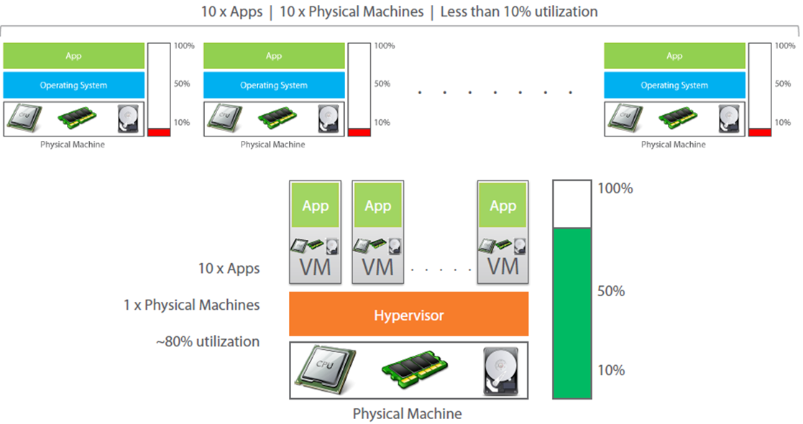
Virtual Machine provides better utilization

Slide 6
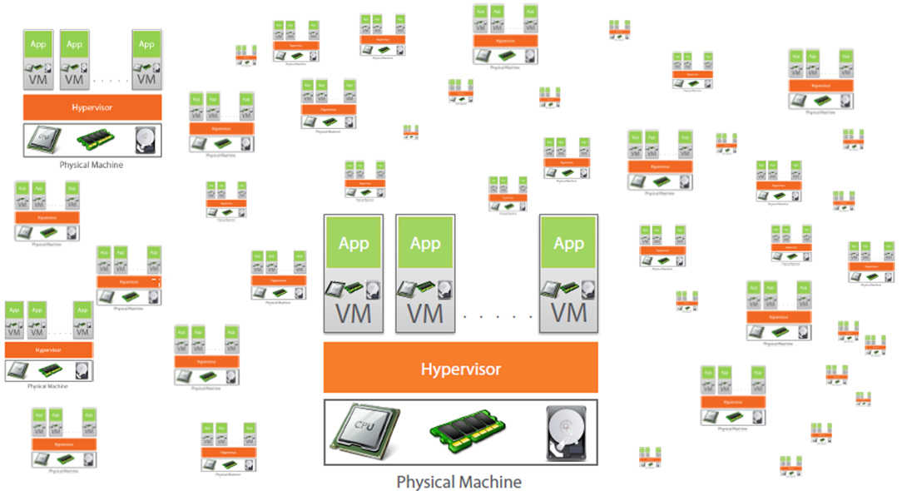
But Virtual Machine increases Licensing Cost

Slide 7
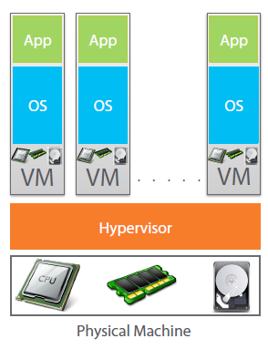
Each VM needs a separate OS

Slide 8
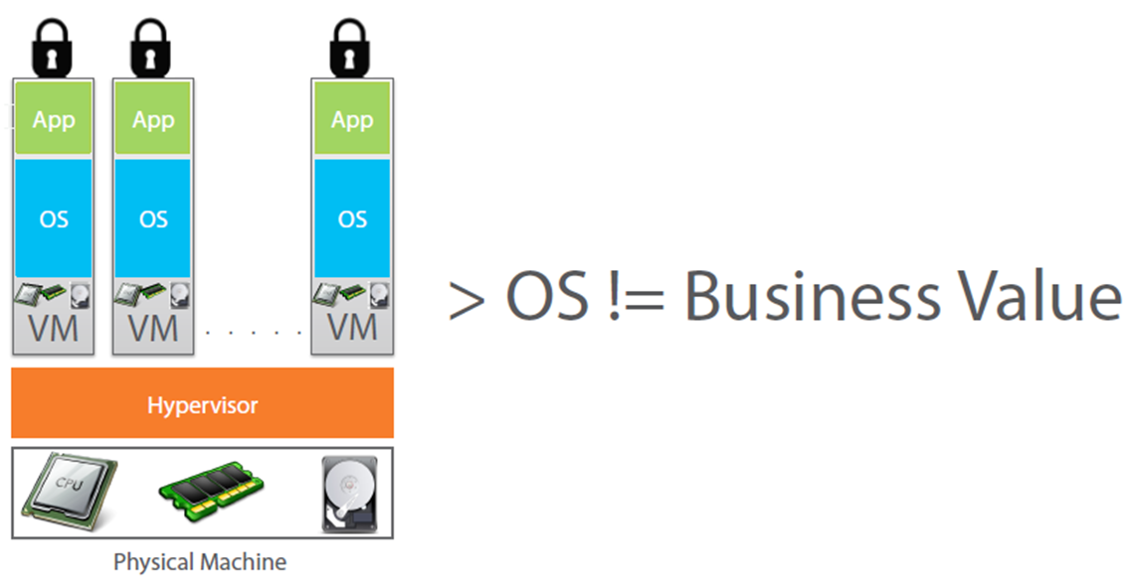
More OSes doesn’t increase Business Value

Slide 9
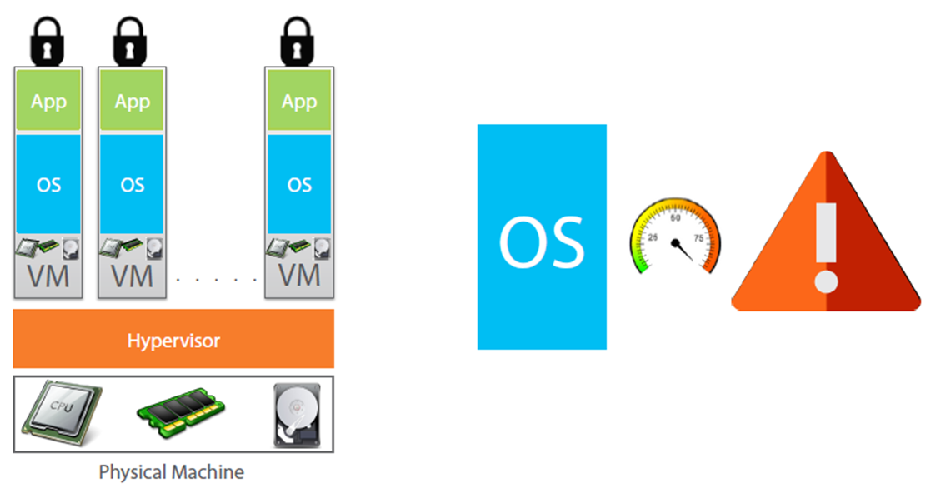
OS takes most of the Resources

Slide 10
Why use separate OS for each App?

Slide 11
Containerization
Encapsulation of an application and its required environment.
The process of packaging an application along with its required libraries, frameworks, and configuration files together so that it can be run in various computing environments efficiently.

Slide 12
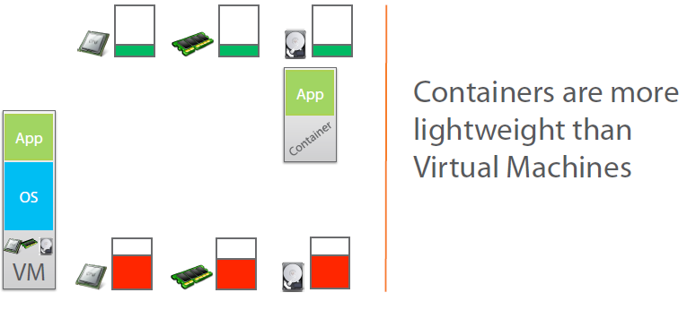
Containers to the Rescue

Slide 13
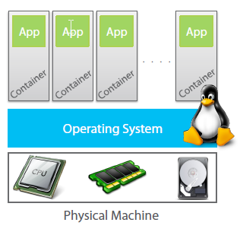
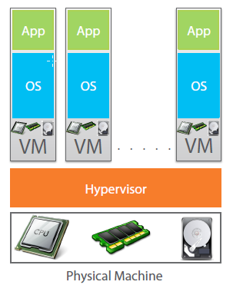
Containers vs VM

Slide 14
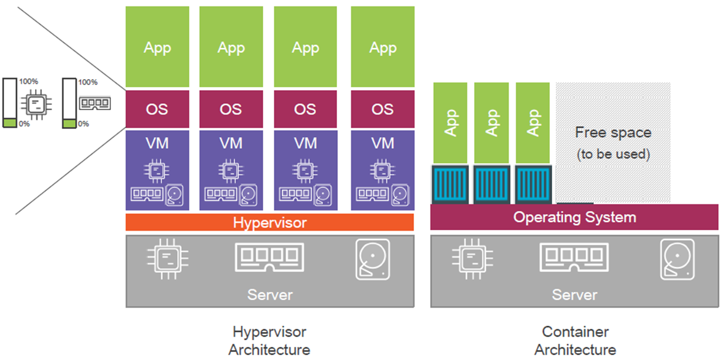
Containers vs VM

Slide 15
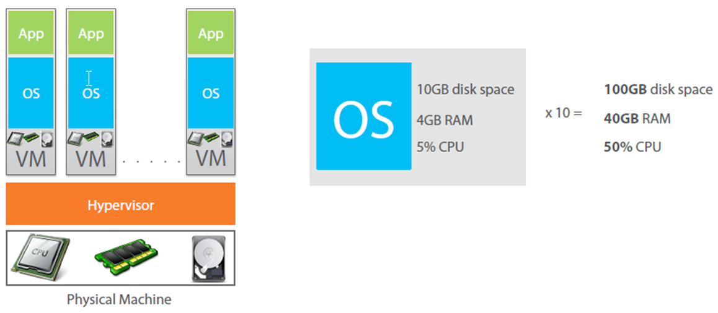
OS takes more resources and Licensing cost

Slide 16
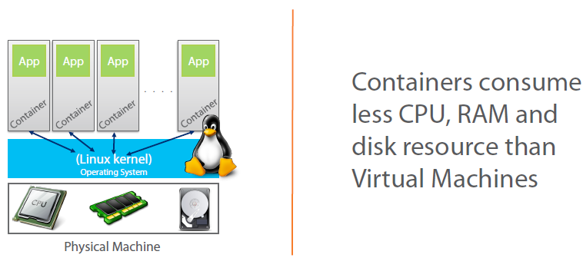
Containers takes less resources

Slide 17
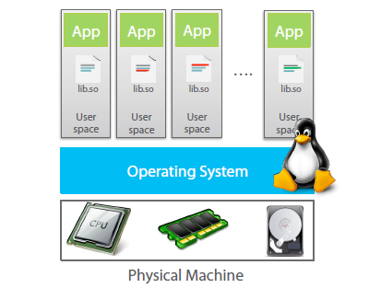
How containers work?

Slide 18
What is Docker?
Docker is an open-source project
that automates the deployment of applications inside software containers,
by providing an additional layer of abstraction and
automation of operating system–level virtualization on Linux.

Slide 19
Practical

Slide 20
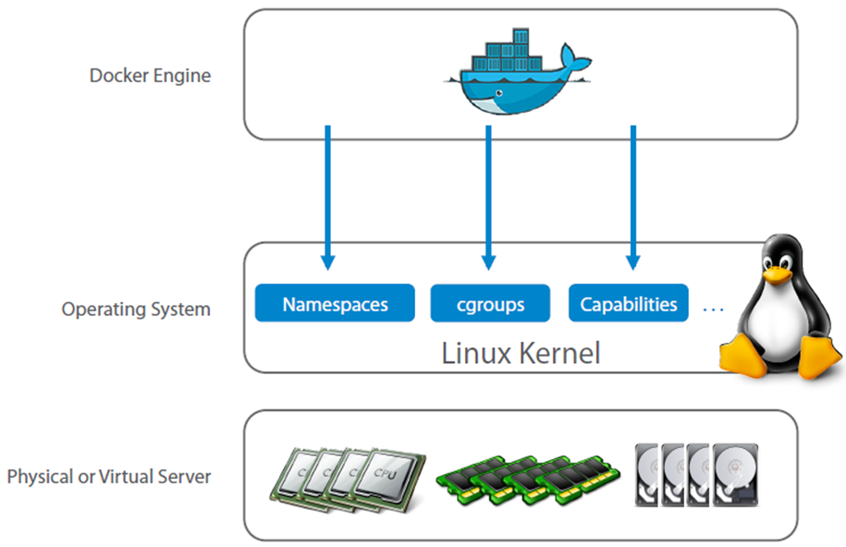
Docker Engine

Slide 21
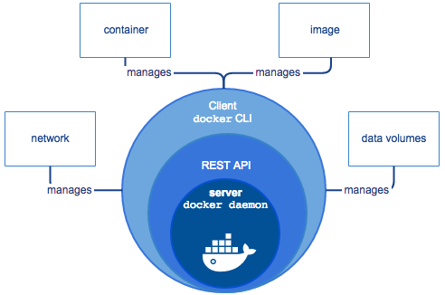
Docker Engine

Slide 22
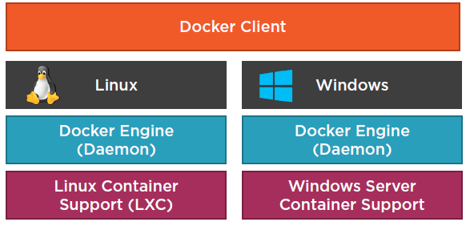
Where does Docker Run?

Slide 23
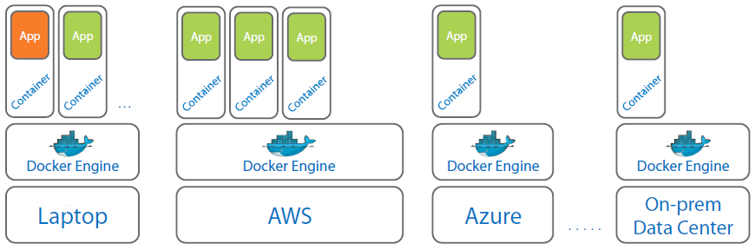
Docker can run anywhere

Slide 24
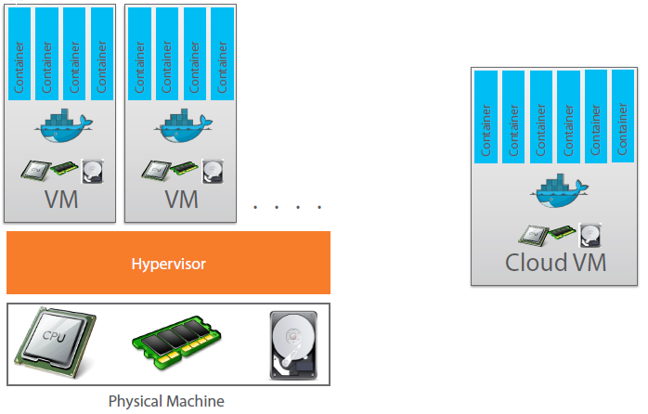
Docker on Physical Machine and also on Cloud

Slide 25
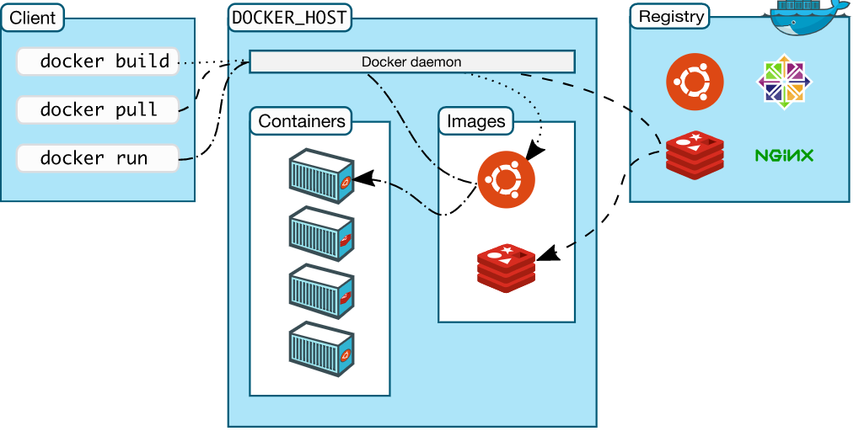
Docker Architecture
Docker uses a client-server architecture.
Docker client talks to the Docker daemon
The Docker client and daemon can run on the same system, or can connect a client to a remote Docker daemon.
The Docker client and daemon communicate using a REST API

Slide 26
Image
Persisted snapshot that can be run
Common Docker Commands:
images: List all local images
run: Create a container from an image and execute a command in it
tag: Tag an image
pull: Download image from repository
rmi: Delete a local image

Slide 27
Container
Runnable instance of an image
Common Docker Commands
ps: List all running containers
ps –a: List all containers (incl. stopped)
top: Display processes of a container
start: Start a stopped container
stop: Stop a running container
pause: Pause all processes within a container
rm: Delete a container
commit: Create an image from a container

Slide 28
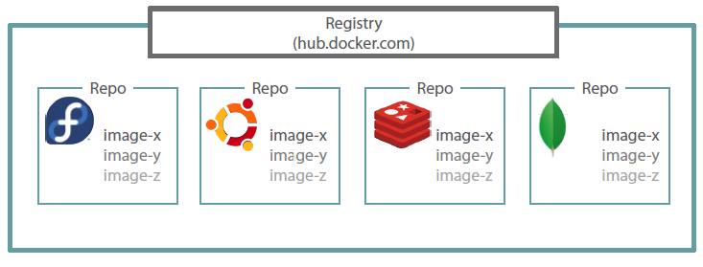
Docker Registry

Slide 29
Hands-On
We need to do the below hands-on:
ssh to Ubuntu server
Install Docker on Ubuntu 18.04
Validate docker engine is successfully installed
Launch a docker container
Login to container
Work in a container
List containers
Pause a container
Un-pause a container
Delete container
Refer to “002-Creating and Using Containers.txt” in Commands guide for instructions

Slide 30
Docker Networking

Slide 31
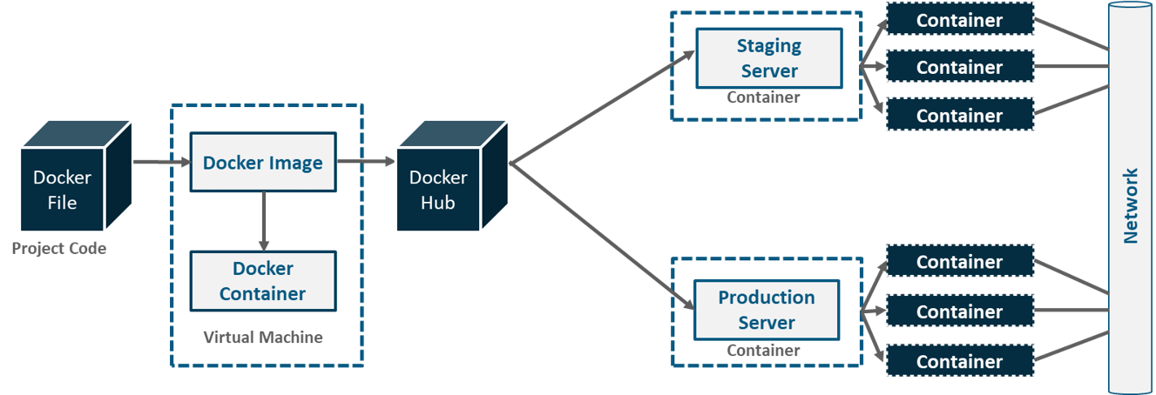
Docker Networking
Before I deep dive into Docker Networking let me show you the workflow of Docker.

Slide 32
Use the default bridge network
docker network ls
NETWORK ID NAME DRIVER SCOPE
17e324f45964 bridge bridge local
6ed54d316334 host host local
7092879f2cc8 none null local
docker run -dit --name alpine1 alpine ash
docker run -dit --name alpine2 alpine ash
Because you have not specified any --network flags, the containers connect to the default bridge network
docker container ls / docker ps
Check that both containers are actually started
docker network inspect bridge
Inspect the bridge network to see what containers are connected to it.

Slide 33
Use the default bridge network
docker attach alpine1
Use the docker attach command to connect to alpine1.
ip addr show
ping google.com
Access google
ping -c 2 172.17.0.3
ping the second container
ping -c 2 alpine2
Ping by hostname
Remove the containers you created
Docker stop alpine1; docker rm alpine1
Docker stop alpine2; docker rm alpine2

Slide 34
Use user-defined bridge networks
docker network create --driver bridge alpine-net
Create the alpine-net network
docker network ls
docker network inspect alpine-net
Now lets create 4 containers and attach those to the network
docker run -dit --name alpine1 --network alpine-net alpine ash
docker run -dit --name alpine2 --network alpine-net alpine ash
docker run -dit --name alpine3 alpine ash # Will be connected to bridge
docker run -dit --name alpine4 --network alpine-net alpine ash
docker network connect bridge alpine4 # Connected to 2 networks
docker container ls
docker network inspect bridge
docker network inspect alpine-net

Slide 35
Docker PS Filter
docker ps --filter "status=exited”
docker ps --filter "label=color"

Slide 36
Use user-defined bridge networks
Now let’s ping the containers from each container to another
Finally Stop and remove all containers and the alpine-net network.
$ docker container stop alpine1 alpine2 alpine3 alpine4
$ docker container rm alpine1 alpine2 alpine3 alpine4
$ docker network rm alpine-net

Slide 37
Networking using the host network
docker run --rm -d --network host --name my_nginx nginx
curl localhost:80
sudo netstat -tulpn | grep :80
Verify which process is bound to port 80, using the netstat command
docker container stop my_nginx

Slide 38
Hands-on
Refer
002-Creating and Using Containers.txt

Slide 39
Container Images and Dockerfile

Slide 40
Create Dockerized Application
We can dockerize our application using dockerfile
Dockerfile Create images automatically using a build script: «Dockerfile»
It Can be versioned in a version control system like Git
Docker Hub can automatically build images based on dockerfiles on Github
This is a basic Dockerfile we need to dockerize a node application
FROM node:4-onbuild
RUN mkdir /app
COPY . /app/
WORKDIR /app
RUN npm install
EXPOSE 8234
CMD [ "npm", "start" ]

Slide 41
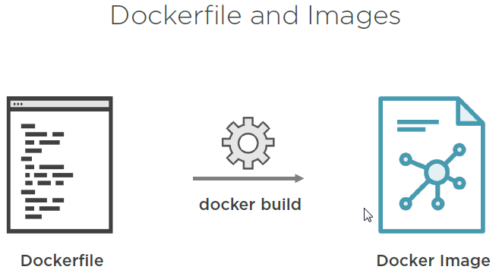
Dockerfile

Slide 42
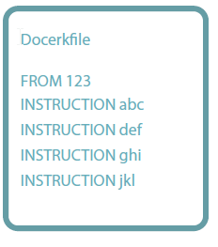
Dockerfile Template

Slide 43
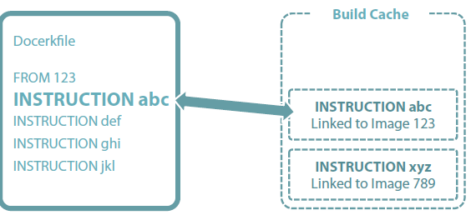
Dockerfile Build Cache

Slide 44
FROM node:4-onbuild
Pulls/downloads a base image from docker hub which is a public hub for docker images.
For running a node appication you need to install node in your system

Slide 45
RUN mkdir /app
In this command we make create an empty directory which will be our working directory with the code files.

Slide 46
COPY . /app/
Copies all files in current directory to the newly created app directory.
Your Dockerfile should be in the parent directory of your project.

Slide 47
WORKDIR /app
To switch from current directory to the app directory where we will run our application.

Slide 48
RUN npm install
This npm command is related to node application.
When we copied all dependencies, our main file - package.json would have been copied.
So running above command installs all dependencies from the file and creates a node_modules folder with mentioned node packages.

Slide 49
EXPOSE 8234
This command is to expose a port we want our docker image to run on.

Slide 50
CMD [ "npm", "start" ]
This is a command line operation to run a node application.
It may differ based on projects.

Slide 51
Build Image
Now once we have our Dockerfile ready lets build an image out of it.
Assuming you all have docker installed on your system lets follow some simple steps:-
Navigate to directory containing Dockerfile.
Run the following command on your terminal:-
docker build -t myimage .
docker images
docker run -p 8234:8234 'your image name'

Slide 52
Publish Port
docker run –t –p 8080:80 ubuntu
Map container port 80 to host port 8080
Notes:
https://docs.docker.com/network/links/

Slide 53
Docker Hub
Public repository of Docker images
https://hub.docker.com/
docker search [term]
Use my own registry
To pull from your own registry, substitute the host and port to your own:
docker login localhost:8080
docker pull 164.52.197.86 :5000/test-image

Slide 54
Assignment: Build Your Own Dockerfile and Run Containers From It
Upload the docker file in assignment folder.
Make sure to change dockerfile with your name in format
Dockerfile<YourName>

Slide 55
Hands-on
Refer
003-Container Images.txt

Slide 56
Resource Usage
docker top [container id]
docker stats [container id]
docker inspect [container id]
docker stats –all
Notes:
https://www.datadoghq.com/blog/how-to-collect-docker-metrics/

Slide 57
Clean Up
docker stop $(docker ps -a -q) #stop ALL containers
docker rm -f $(docker ps -a -q) # remove ALL containers

Slide 58
Persistence Storage

Slide 59
Persistence Storage
By default all files created inside a container are stored on a writable container layer.
This means:
The data doesn’t persist when that container is removed
Docker uses volumes to persist data on host file system.

Slide 60
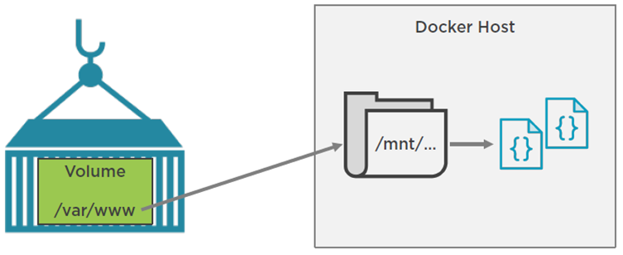
Docker Volume

Slide 61
Create and manage volumes
docker volume create my-vol
docker volume ls
docker volume inspect my-vol
docker volume rm my-vol
docker volume create -o size=20GB my-named-volume
Mount volume in running container
https://medium.com/kokster/mount-volumes-into-a-running-container-65a967bee3b5

Slide 62
Start a container with a volume
docker run -d --name devtest -v myvol2:/app nginx:latest
mounts the volume myvol2 into /app/ in the container
docker inspect devtest
To verify that the volume was created and mounted correctly.
docker container stop devtest
docker container rm devtest
docker volume rm myvol2

Slide 63
Use a read-only volume
docker run -d --name=nginxtest -v nginx-vol:/usr/share/nginx/html:ro nginx:latest
docker inspect nginx
docker container stop nginxtest
docker container rm nginxtest
docker volume rm nginx-vol

Slide 64
Mount Volumes
docker run –ti –v /hostLog:/log ubuntu
Run second container: Volume can be shared
docker run –ti –volumesfrom firstContainerName ubuntu

Slide 65
Hands-on
Refer:
004-Container Lifetime _ Persistent Data.txt

Slide 66
Create DockerFile for Spring Boot application
git clone https://github.com/atingupta2005/02-todo-web-application-h2
cd 02-todo-web-application-h2
vim Dockerfile #Review the file content to understand
docker build -t atingupta2005/02-todo-web-application-h2 .
Take code from:
https://docs.google.com/document/d/1fkxH9LtVAgoYtH_Uyms1hgPyUjBweRKXXITU8OJDvH4/edit

Slide 67
Publish Docker image to public registry
git clone https://github.com/atingupta2005/02-todo-web-application-h2
cd 02-todo-web-application-h2
docker build -t atingupta2005/02-todo-web-application-h2 .
docker run -p 8080:8080 atingupta2005/02-todo-web-application-h2
docker login
docker push atingupta2005/02-todo-web-application-h2
For code refer:
https://docs.google.com/document/d/1TKtg6Zjgr-t9ezGWdeME6eWoSDiztT38L_fg6jUZwq0/edit

Slide 68


