Slide 1
Cosmos DB
Notes:
https://courses.cs.washington.edu/courses/cse403/13au/lectures/git.ppt.pdf
http://enos.itcollege.ee/~jpoial/allalaadimised/git/getting-started-with-git.pdf

Slide 2

Challenges with globally distributed Databases
Long time
Lot of effort
Need own infrastructure
Teams
Data centers etc.

Slide 3
Why Cosmos DB?
FULLY MANAGED
FULLY MANAGED
GLOBALLY DISTRIBUTED
CONSISTENCY CHOICES
SCALABLE
HIGHLY AVAILABLE, RELIABLE & SECURE

Slide 4
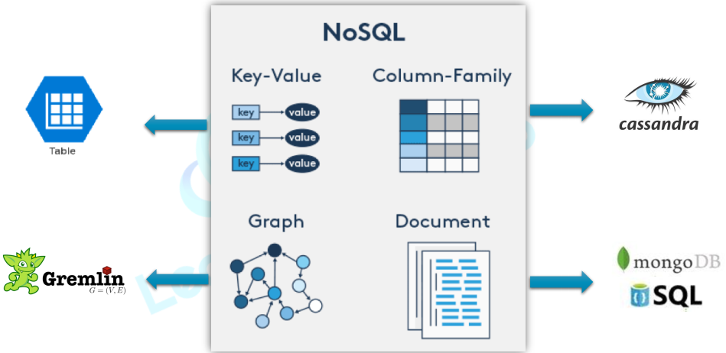

Slide 5
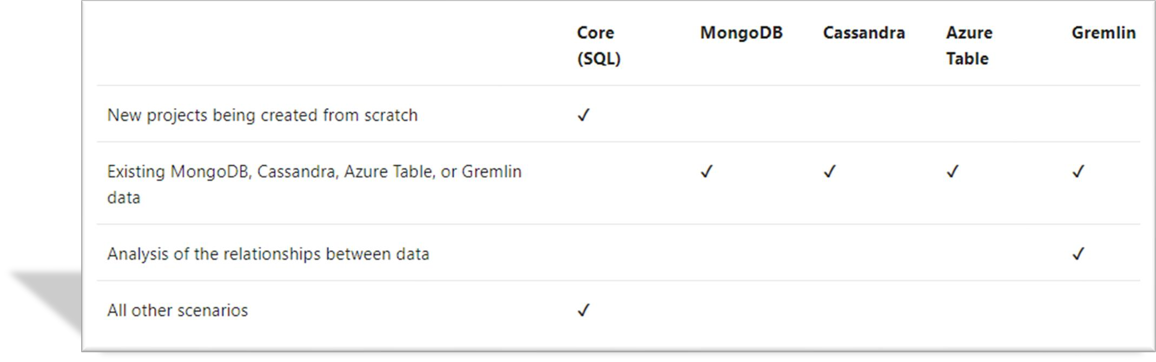
Analyze the decision criteria

Slide 6
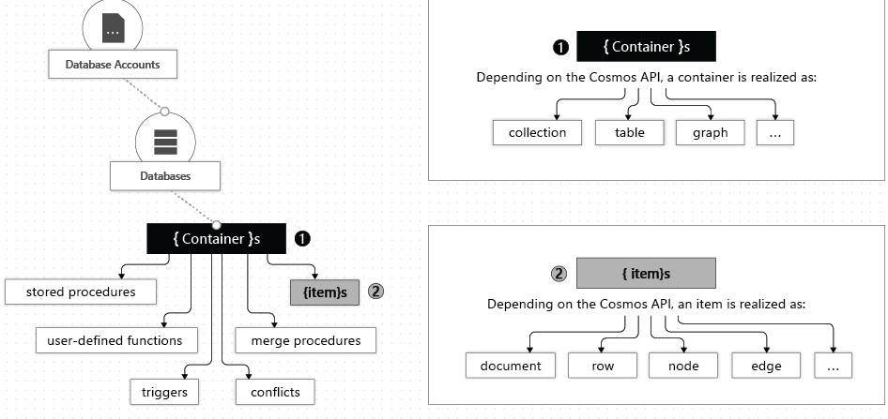

Database Containers and Items

Slide 7
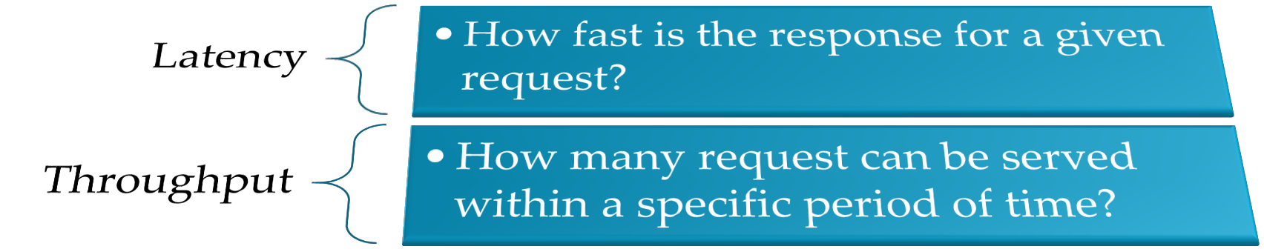
Measuring Performance

Slide 8
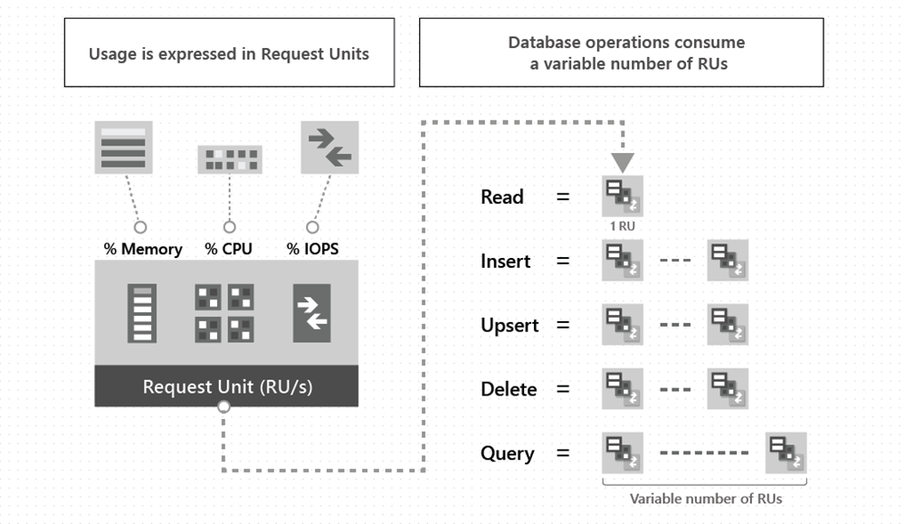
Introducing Request Units

Slide 9
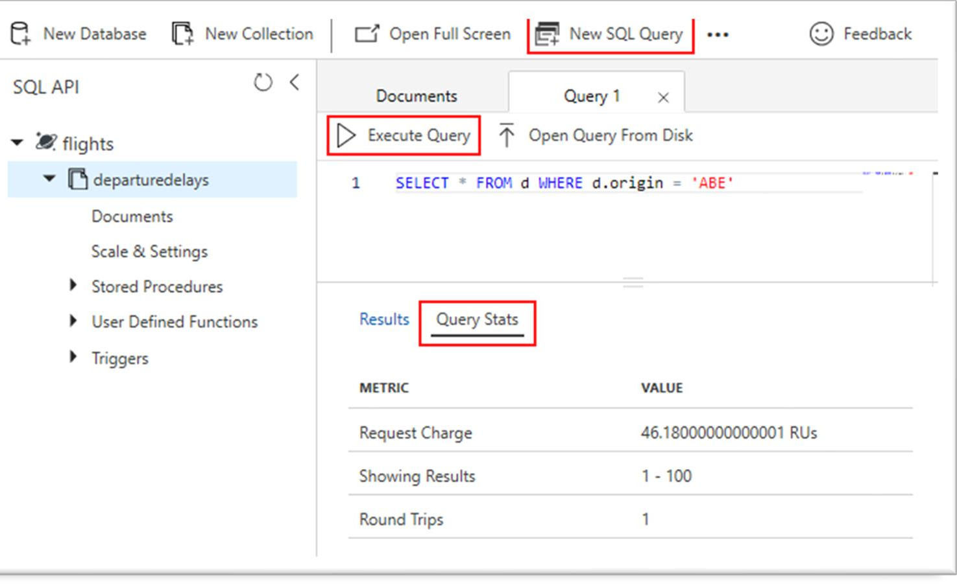
Introducing Request Units

Slide 10
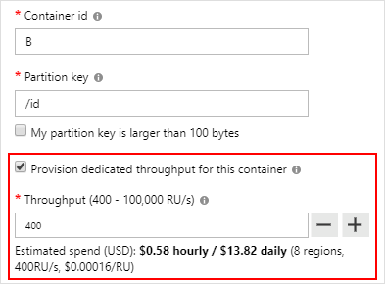
Reserving requests units
Provision Request units per second (RU/s)
How many request units (not requests) per second are available to your application
Exceeding reserved throughput limits
Requests are “throttled” (HTTP 429)

Slide 11
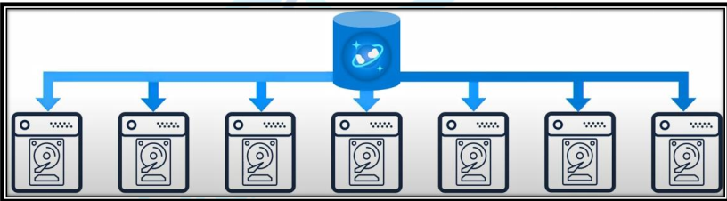

Horizontally Scalable

Slide 12
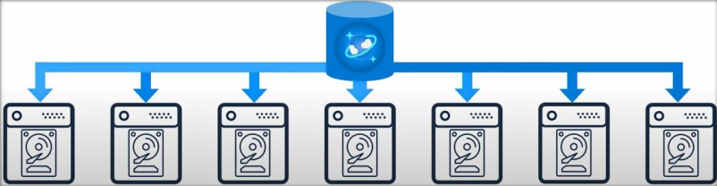
Partitioning

Slide 13
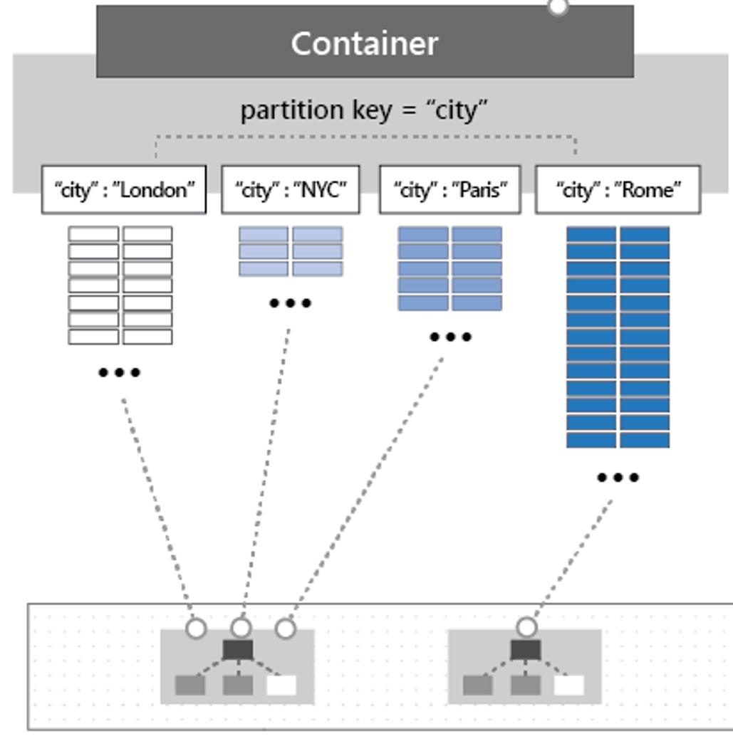
Partitioning
Partitioning
The items in a container are divided into distinct subsets called logical partitions.
Partition key
The value by which Azure organizes your data into logical divisions.
Logical partitions
Are formed based on the value of a partition key that is associated with each item in a container.
Physical partitions
Internally, one or more logical partitions are mapped to a single physical partition

Slide 14
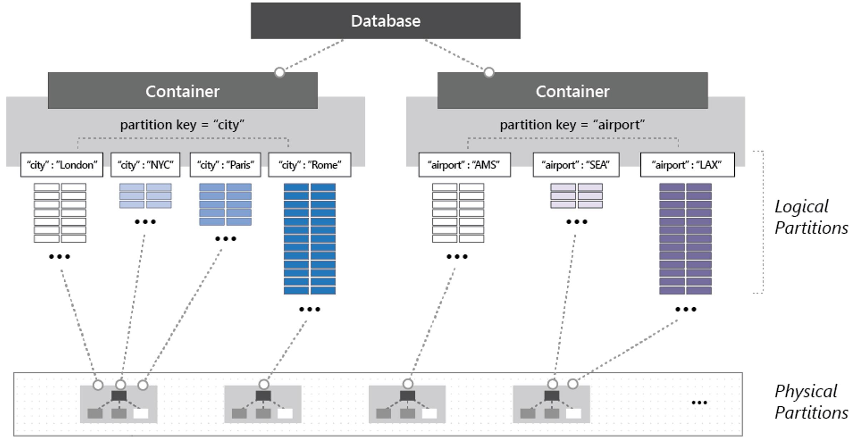
Partitioning

Slide 15
Dedicated vs Shared throughput
You can set throughput at:
Database level – Shared throughput
Container level – Dedicated throughput
It is recommend to set throughput at container level.
Choose at the time of creation

Slide 16
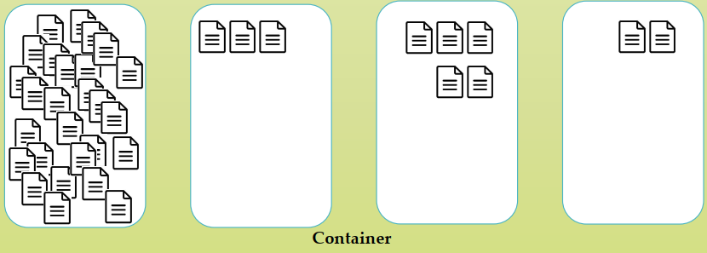
Avoid Hot partitions on storage

Slide 17
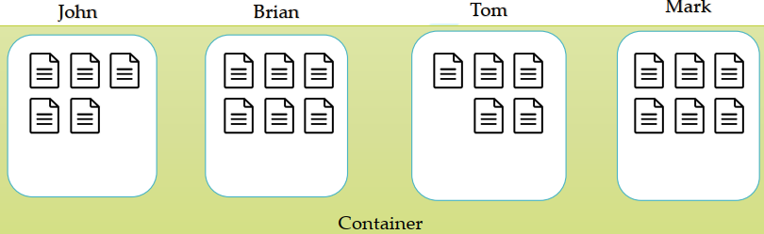
Single partition Query
SELECT * FROM c WHERE c.username = ‘Brian’

Slide 18
Cross partition Queries (fan out queries)
SELECT * FROM c WHERE c.favoritecolor= ‘Blue’

Slide 19
Automatic Indexing
Index all data without requiring Index management
Every property of every record automatically index
Index update synchronously as you create, update or delete items
Not specific for SQL, but available for all APIs

Slide 20
Time to Live (TTL)
You can set the expiry time for Cosmos DB data items
Time to live value is configured in seconds.
The system will automatically delete the expired items based on the TTL value
Consume only leftover Request units
Data deletion delay if not enough Request units
Though the data deletion is delayed, data is not returned by any queries (by any API) after the TTL has expired.

Slide 21
Global Distribution benefits
Performance
Business continuity

Slide 22

Data consistency
Replication
5 Seconds
West US
East US
At 10.00 AM Update CreditScore = 750
At 10:00:02 AM Read CreditScore

Slide 23
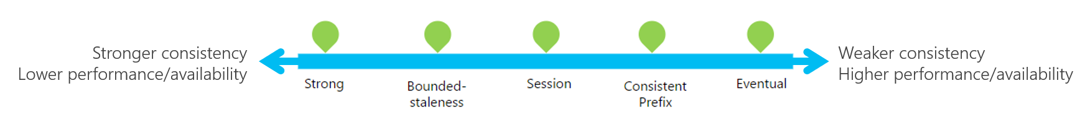
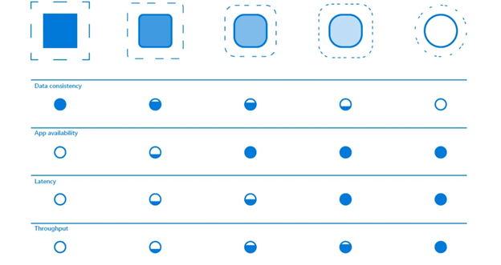

Slide 24
Five consistency Levels
Strong
No dirty reads, high latency, cost highest, closest to RDBMS
Bounded staleness
Dirty reads possible, bounded by time and updates
Session
No dirty reads for writers (within same session), dirty read possible for other users
Consistency prefix
Dirty reads possible but sequence maintain, reads never see out-of-order writes
Eventual
No guaranteed order, but eventually everything gets in order

Slide 25
Setting the consistency level
Set default for entire account
Can be changed any time
Override at request level
Any request can weaken the default consistency level

Slide 26


