Slide 1
Implement Azure Security

Slide 2
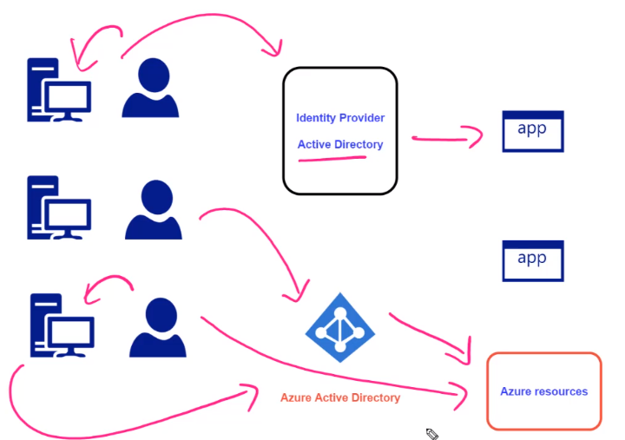
Notes:
2

Slide 3
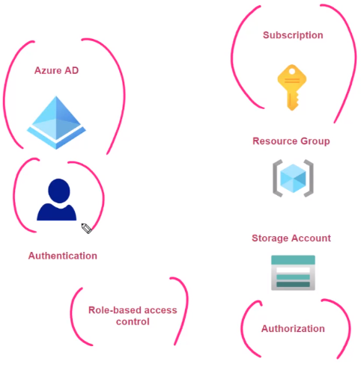
RBAC

Slide 4
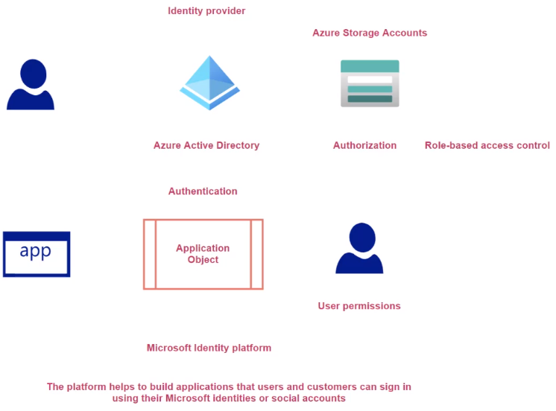
Introduction to Application Objects

Slide 5
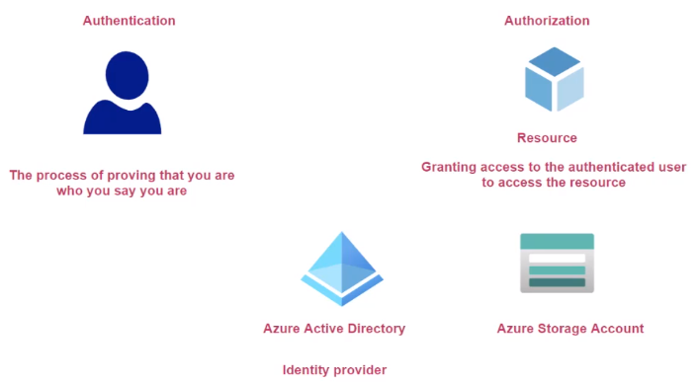
Authentication and Authorization

Slide 6
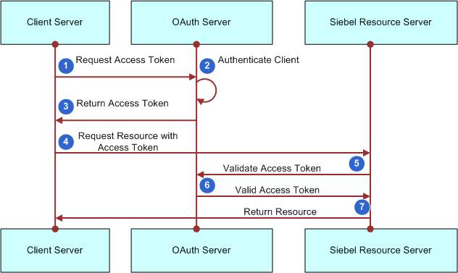
OAuth 2.0

Slide 7
OAuth Review
OAuth 2.0 Authorization
Standard Protocol for Authorization
It's about getting access token
Access token has all details about the user
Open ID Connect
Layer built on OAuth 2.0
Allows the verification of identity of the user
Different Grant Type
Client Credentials
Used to obtain an access token outside of the context of the user
Authorization Code flow
More secure
2 Step Process
First step: Browser gets the authorization code from authorization server (On Browser)
Second Step: Exchange for an access token with authorization server (Backend)

Slide 8
Authorization Code Flow

Slide 9
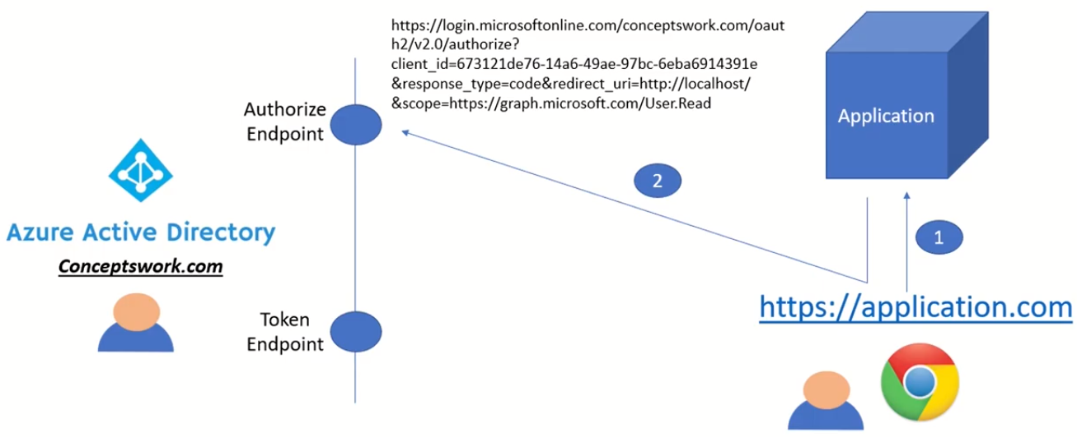
Gt Authorization Code

Slide 10
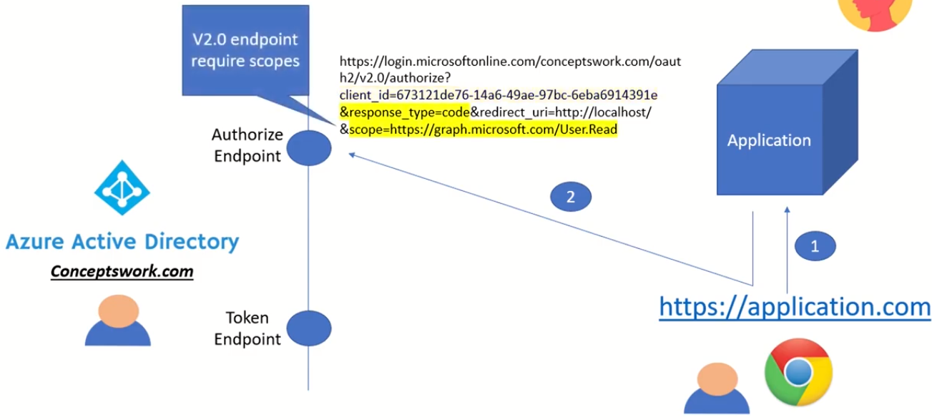

Slide 11
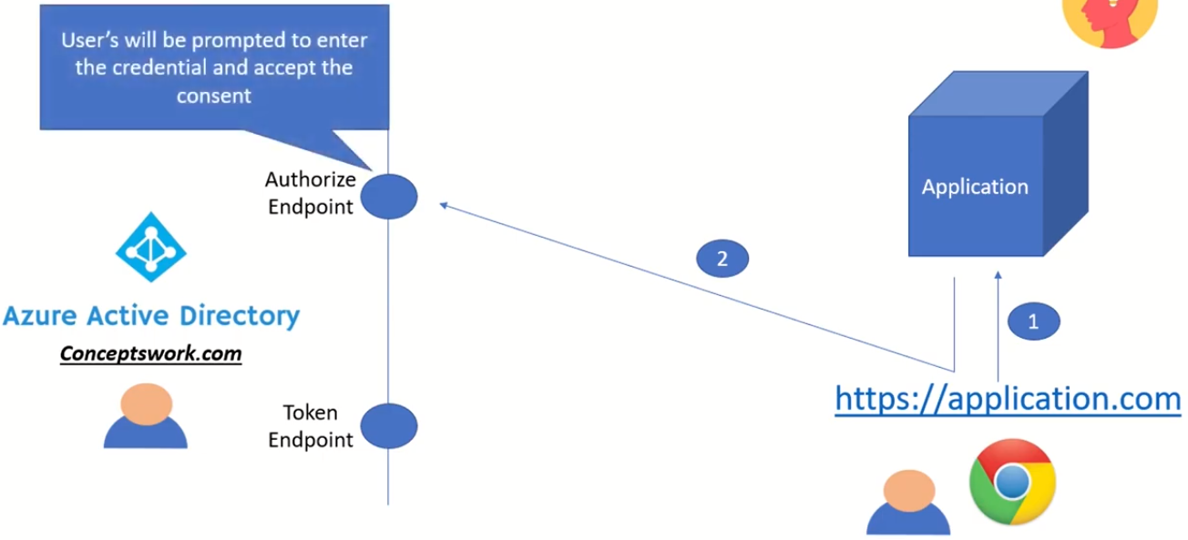

Slide 12
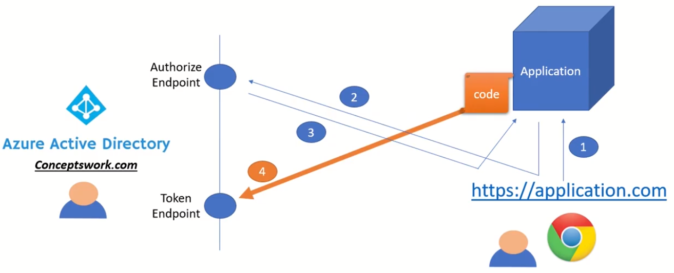
Get Access Token

Slide 13
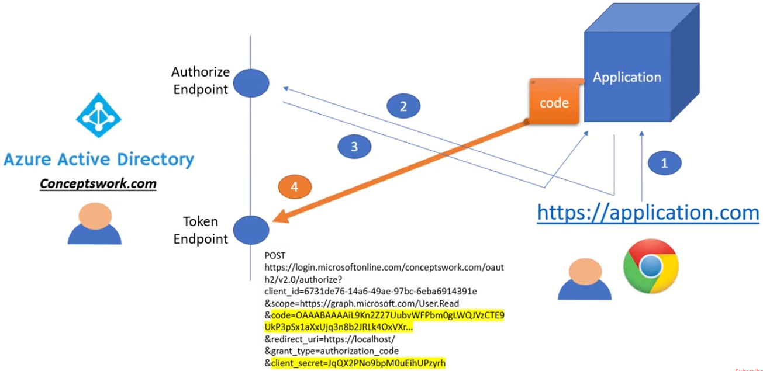
Get Access Token

Slide 14
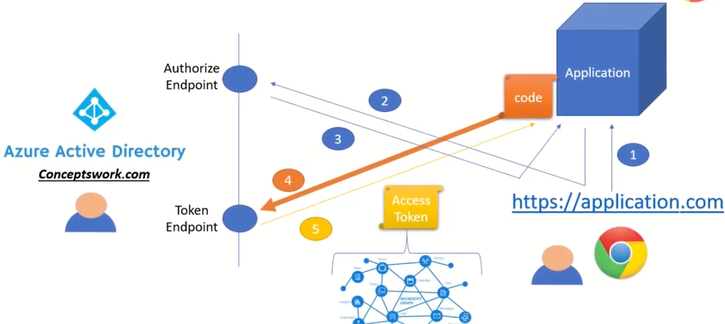
Get Access Token

