Slide 1
Implement Azure Security

Slide 2
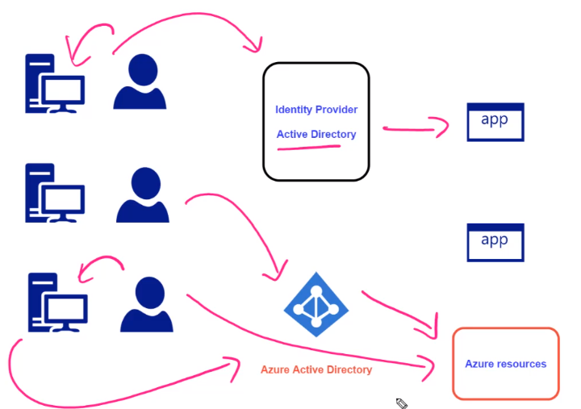
Notes:
2

Slide 3
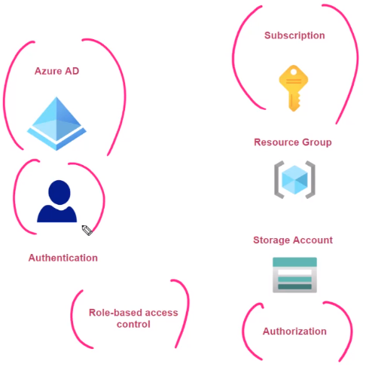
RBAC

Slide 4
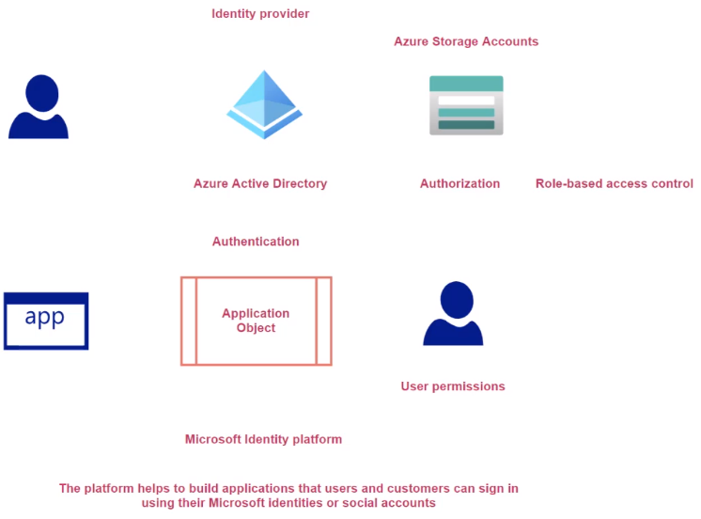
Introduction to Application Objects

Slide 5
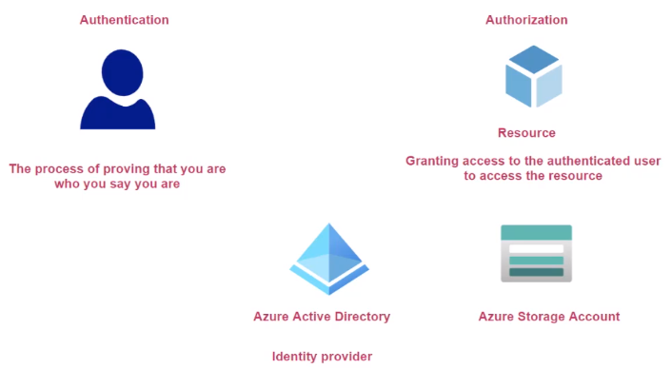
Authentication and Authorization

Slide 6
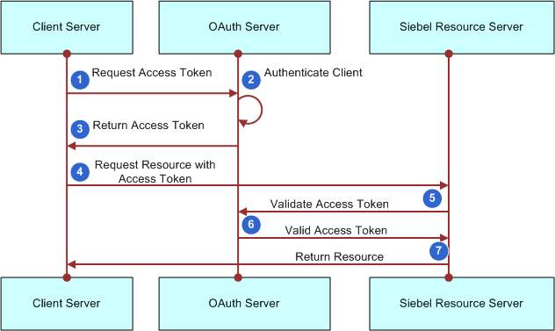
OAuth 2.0

Slide 7
Getting Access Token in ASP.Net Core Web App
Refer:

Slide 8
OAuth Review
OAuth 2.0 Authorization
Standard Protocol for Authorization
It's about getting access token
Access token has all details about the user
Open ID Connect
Layer built on OAuth 2.0
Allows the verification of identity of the user
Different Grant Type
Client Credentials
Used to obtain an access token outside of the context of the user
Authorization Code flow
More secure
2 Step Process
First step: Browser gets the authorization code from authorization server (On Browser)
Second Step: Exchange for an access token with authorization server (Backend)

Slide 9
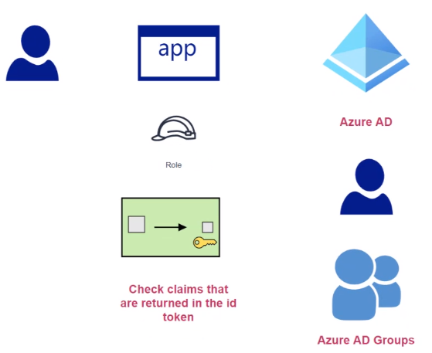
Claims
When we get an ID token, that token has lots of information in it.
To enable ID token, open app object\Authentication\Enable ID tokens
ID token has information about the signed in user
As part of this ID token we also get claims
Claims
Has information about the user
Group Claims
A user can be part of the Azure AD group
If App object is assigned a group then list of groups is returned in ID token as well
To enable to return the group claim, we need to modify App Object \Manifest
GroupMembershipClaims: "SecurityGroup"

Slide 10
Authorization Code Flow

Slide 11
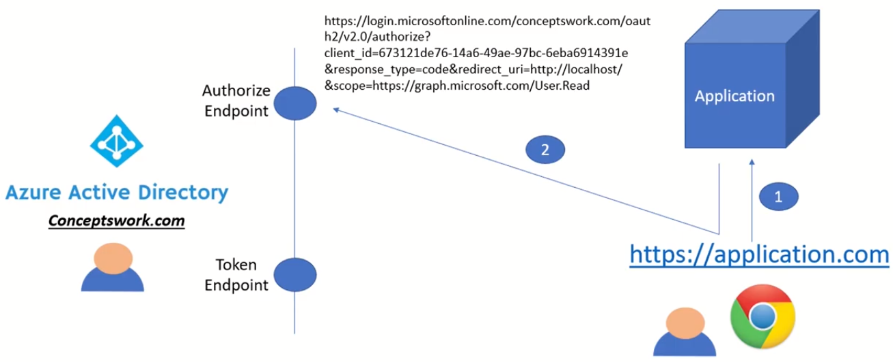
Gt Authorization Code

Slide 12
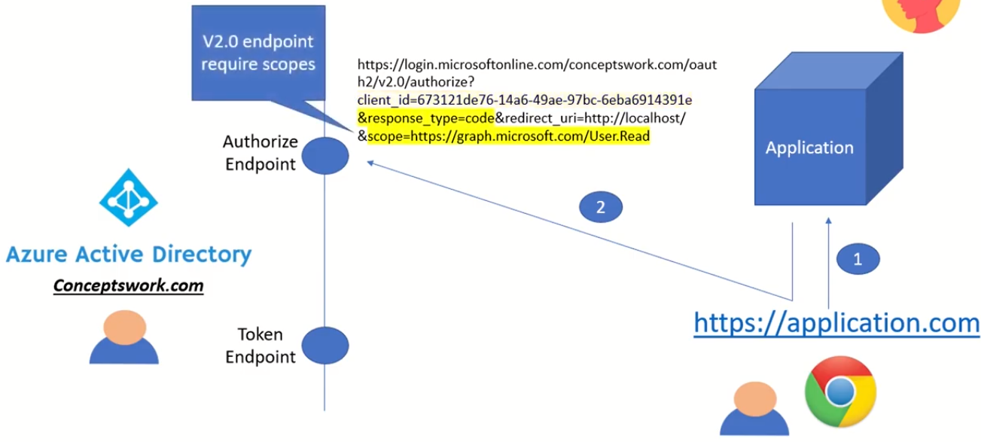

Slide 13
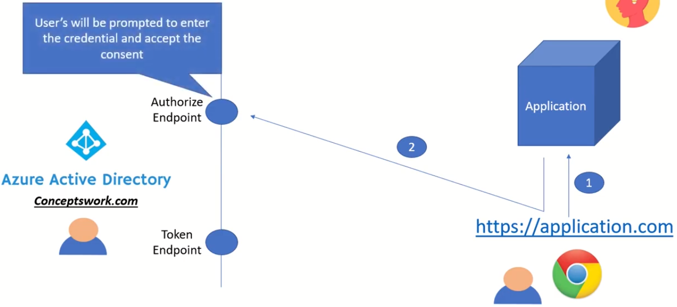

Slide 14
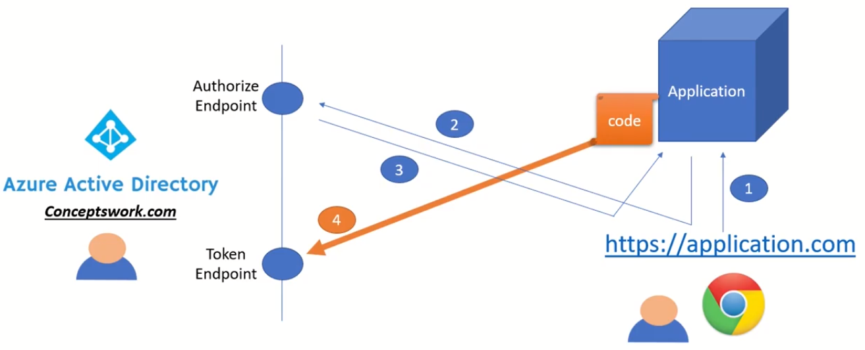
Get Access Token

Slide 15
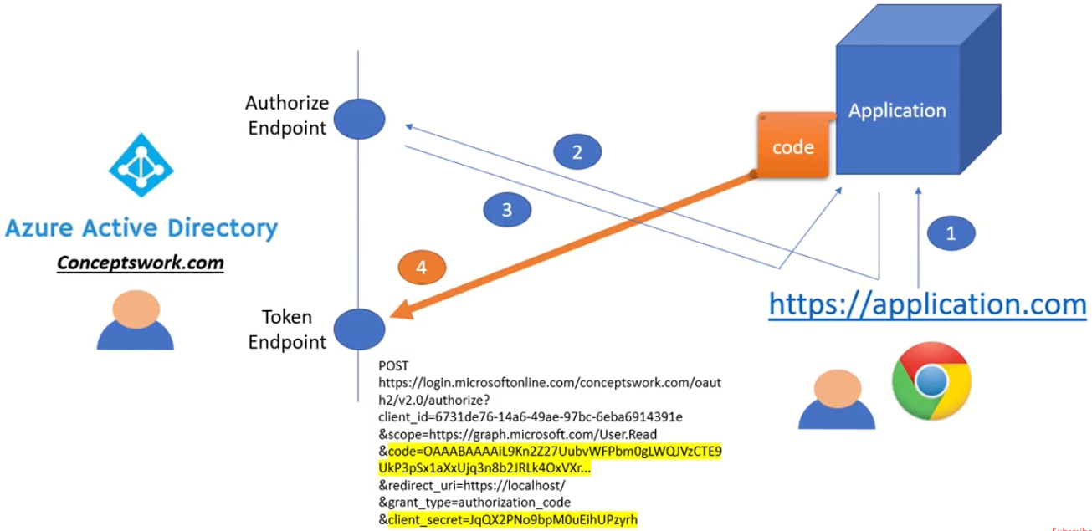
Get Access Token

Slide 16
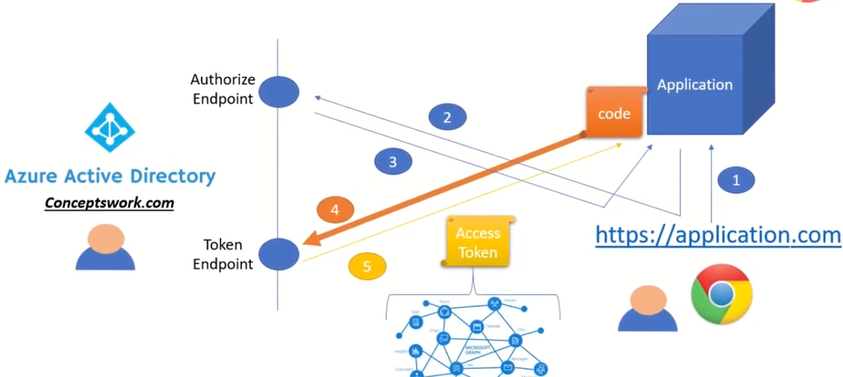
Get Access Token

Slide 17
Graph API
Exposes REST APIs and client libraries to access data on the following Microsoft cloud services
Microsoft 365
Enterprise Mobility and Security services
Windows 10 services

Slide 18
SAML

Slide 19
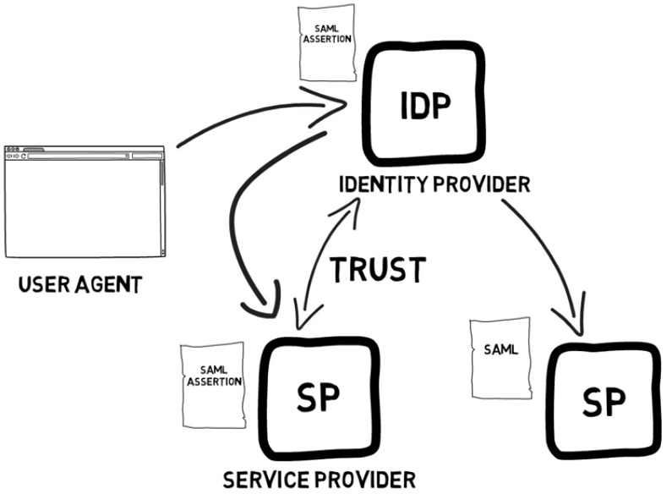

Slide 20
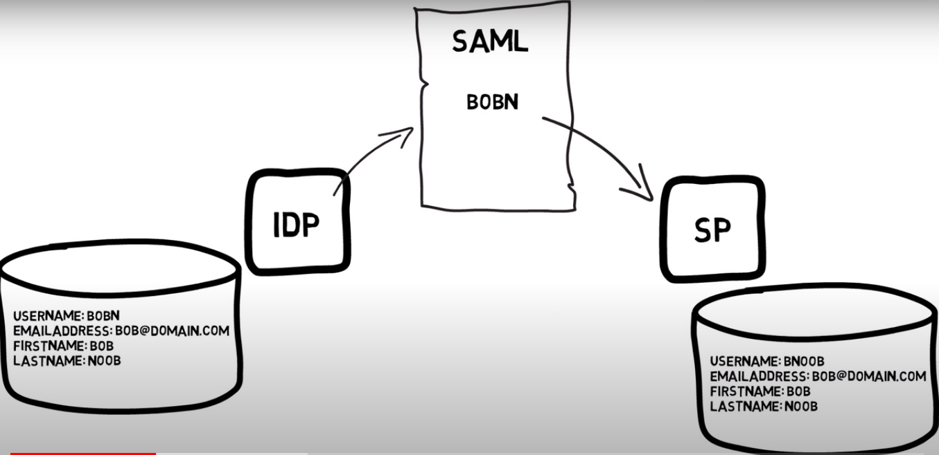

Slide 21
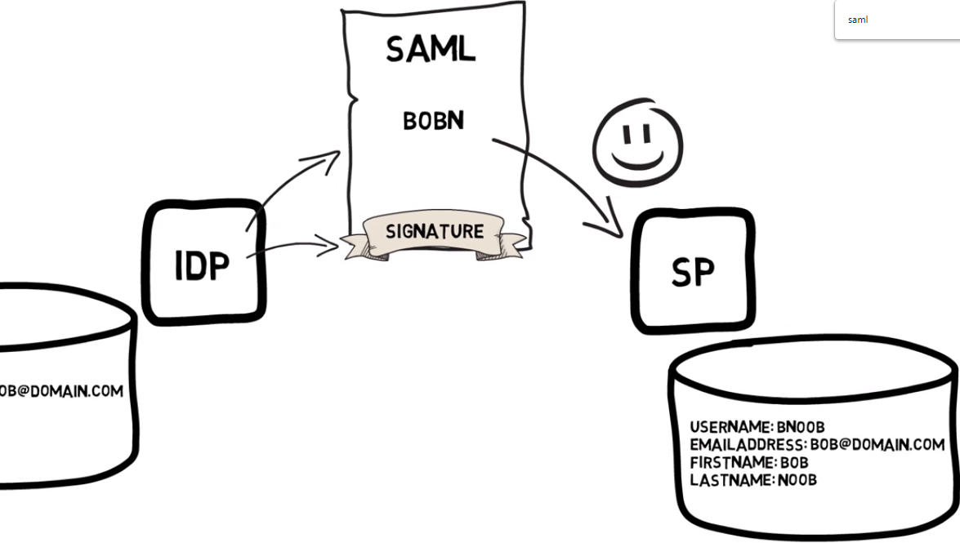

Slide 22
