Slide 1

Terraform

Slide 2
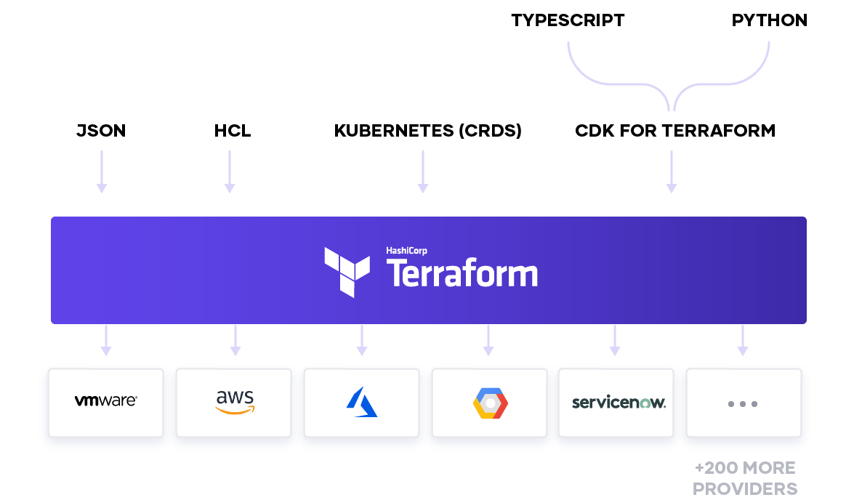
Introduction

Slide 3
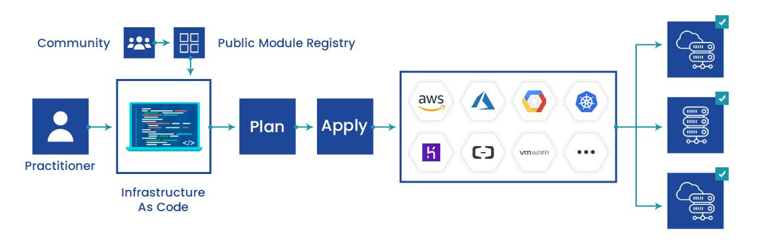
Introduction

Slide 4
What is Terraform?
Tool for
Building,
Changing, and
Versioning infrastructure safely and efficiently
Can manage
Existing and popular service providers as well as
Custom in-house solutions.

Slide 5
Why Terraform?
IAAC
Platform agnostic
Enables you to implement all kinds of coding principles
Having code in source control
Ability to write automated tests
Community and is open source
Speed

Slide 6
What is infrastructure as code?
The process of managing and provisioning computer data centers through machine-readable definition files
The definitions may be in a version control system
It can use either scripts or declarative definitions
More often used to promote declarative approaches.

Slide 7
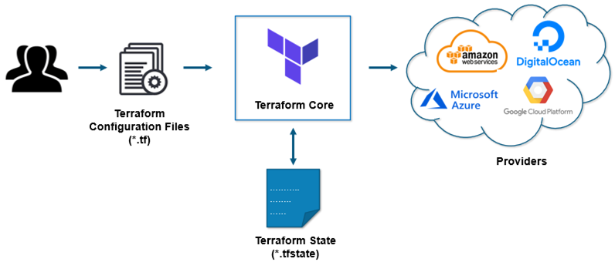
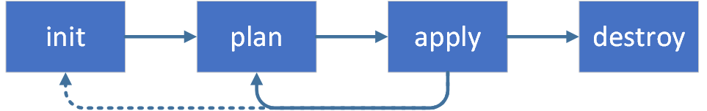
How Terraform works?
Split into two main parts
Terraform Core and
Uses remote procedure calls (RPC) to communicate with Terraform Plugins
Terraform Plugins
Expose an implementation for a specific service, such as AWS

Slide 8
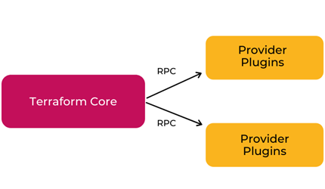
Terraform Core
Written in the Go programming language
Compiled binary
Is the command line tool (CLI) terraform
The entrypoint for anyone using Terraform
Primary responsibilities
Reading configuration files
Resource state management
Construction of the Resource Graph
Plan execution
Communication with plugins

Slide 9
Terraform Plugins
Written in Go
Each plugin exposes an implementation for a specific service
such as AWS, Azure
Primary responsibilities
Authentication with the Infrastructure Provider
Define Resources that map to specific Services
Plugin Locations
~/.terraform.d/plugins

Slide 10
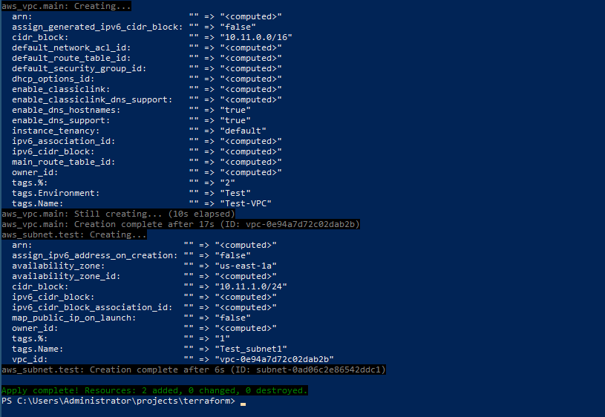
Install Terraform
curl -fsSL https://apt.releases.hashicorp.com/gpg | sudo apt-key add –
sudo apt-add-repository "deb [arch=amd64] https://apt.releases.hashicorp.com $(lsb_release -cs) main“
sudo apt-get update && sudo apt-get install terraform
terraform –help
terraform -install-autocomplete

Slide 11
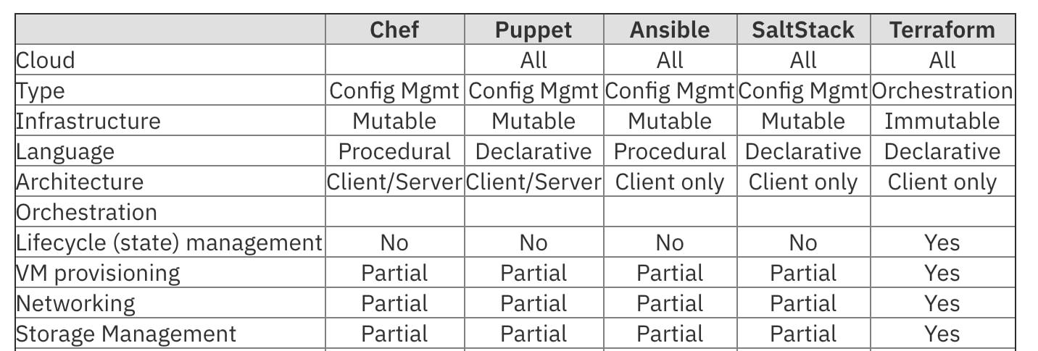
Compare to other IAAC tools

Slide 12
Terraform Syntax
Called HashiCorp Configuration Language (HCL)
Human readable as well as machine-friendly
# An AMI
variable "ami" {
description = "the AMI to use"
}
resource "aws_instance" "web" {
ami = "${var.ami}"
count = 2
source_dest_check = false
connection {
user = "root"
}
}

Slide 13
How to create reusable infrastructure
Module basics
Module inputs
Module outputs
Versioned modules

Slide 14
Module basics
Any set of Terraform configuration files in a folder is a module.
$ tree minimal-module/
.
├── README.md
├── main.tf
├── variables.tf
├── outputs.tf
At least one module, known as its root module
Consists of the resources defined in the .tf files in the main working directory.
A module can call other modules

Slide 15
Calling a Child Module
module "servers" {
source = "./app-cluster"
servers = 5
}

Slide 16
Module inputs
Parameters for a Terraform module
Like function arguments
variable "image_id" {
type = string
}
variable "availability_zone_names" {
type = list(string)
default = ["us-west-1a"]
}

Slide 17
Using Input Variable Values
var.<NAME>
resource "aws_instance" "example" {
instance_type = "t2.micro"
ami = var.image_id
}

Slide 18
Terraform loops, if-statements and deployment
Loops
If-statements
If-else-statements
Zero-downtime deployment

Slide 19
Loops
resource "aws_lam_user" "example" {
count = 3
name = "neo.${count.Index}"
}

Slide 20
If-statements
Terraform doesnt support if-statements, so this code won't work
However, you can accomplish the same thing by using the count parameter
resource "aws_autoscallng_schedule" "scale_out_durlng_buslness_hours" {
count = "${var.enable_autoscaling}"
scheduled_action_name = "scale-out-durlng-buslness-hours"
niin_size = 2
nax_size = 10
desired_capacity = 10
recurrence ="09** *"
autoscaling_group_name = "${aws_autoscaling_group.example.name}"
}

Slide 21
If-else-statements
resource "aws_lam_user_pollcy_attachment" "neo_cloudwatch_full_accessM {
count = "${var.glve_neo_cloudwatch_full_access}"
user = "${aws_lam_user.example.0.name}"
pollcy_arn = "${aws_lam_pollcy.cloudwatch_full_access.arn}"
}
resource Maws_lam_user_pollcy_attachmentM Mneo_cloudwatch_read_only" {
count = "${1 - var.glve_neo_cloudwatch_full_access}"
user = "${aws_iam_user. example. 0. name}11
pollcy_arn = M${aws_lam_pollcy.cloudwatch_read_only.arn}"
}

Slide 22
Deploying Infrastructure with Terraform

Slide 23
Hands-On

Slide 24
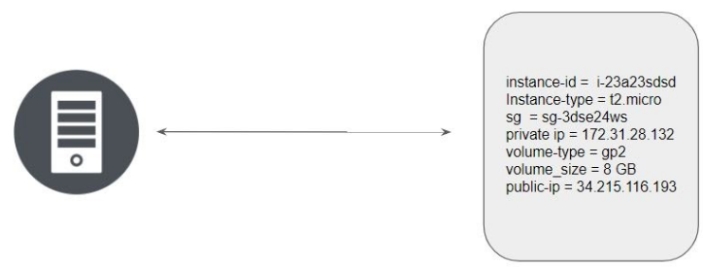
TFState file
Terraform stores the state of the infrastructure that is being created from the TF files.
This state allows terraform to map real-world resource to your existing configuration.

Slide 25


