Slide 1
Docker
Notes:
https://courses.cs.washington.edu/courses/cse403/13au/lectures/git.ppt.pdf
http://enos.itcollege.ee/~jpoial/allalaadimised/git/getting-started-with-git.pdf

Slide 2
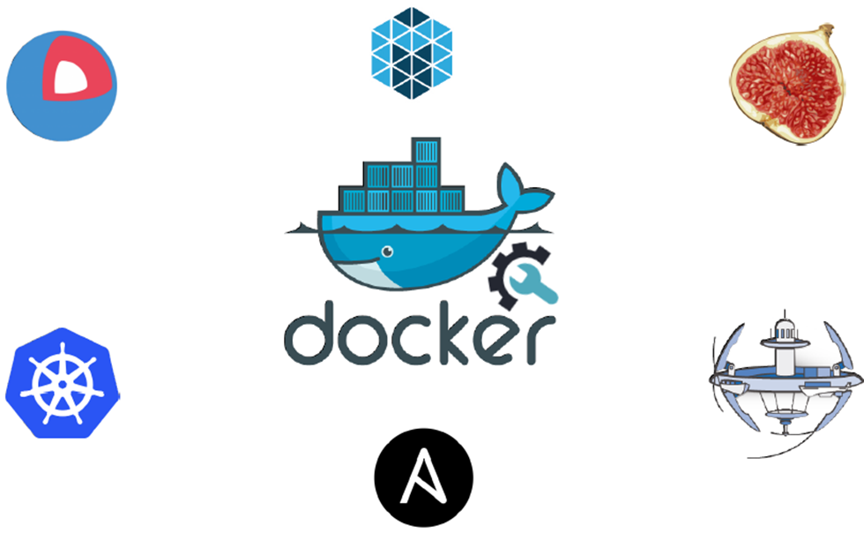
Docker

Slide 3
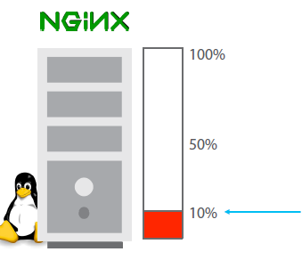
Less Utilization in Traditional Architecture

Slide 4
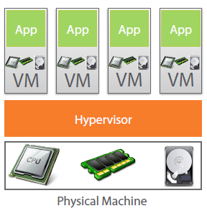
Virtual Machine to the Rescue

Slide 5
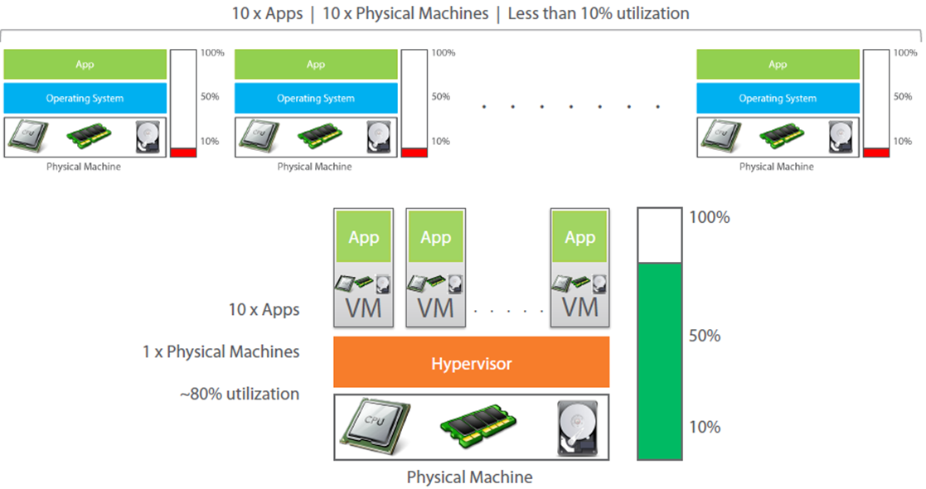
Virtual Machine provides better utilization

Slide 6
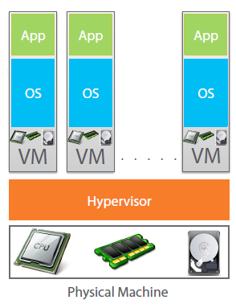
Each VM needs a separate OS

Slide 7
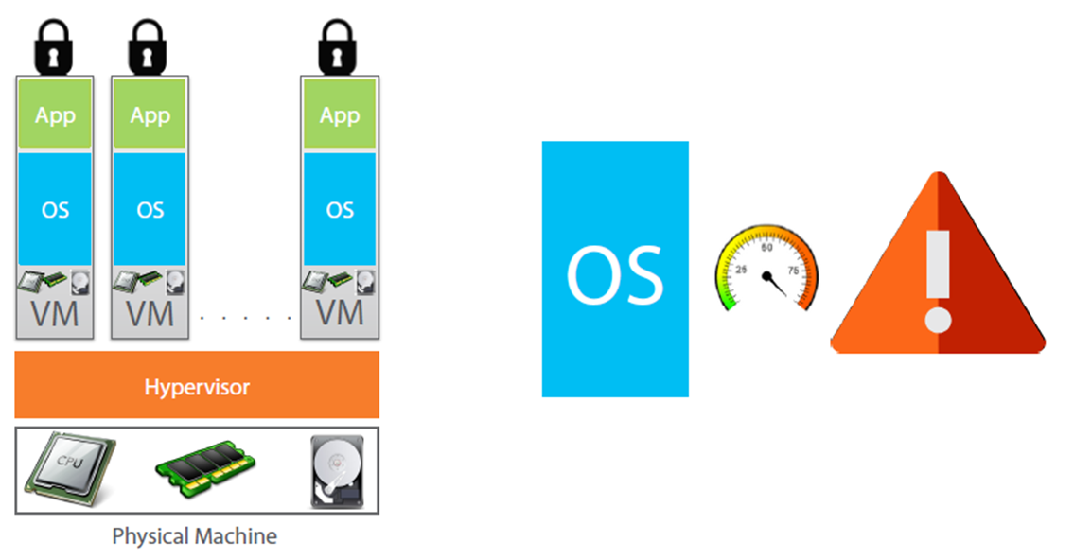
OS takes most of the Resources

Slide 8
Why use separate OS for each App?

Slide 9
Containerization
Encapsulation of an application and its required environment.
The process of packaging an application along with its required libraries, frameworks, and configuration files together so that it can be run in various computing environments efficiently.

Slide 10
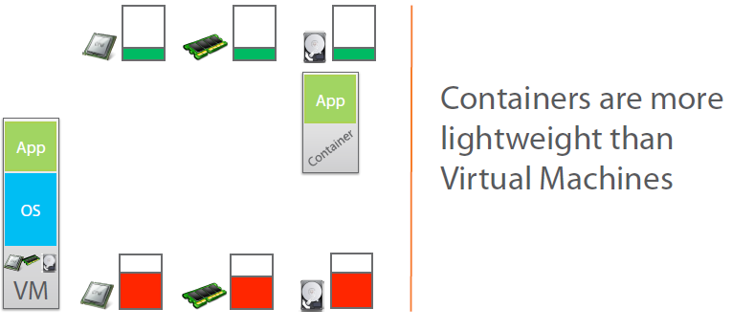
Containers to the Rescue

Slide 11
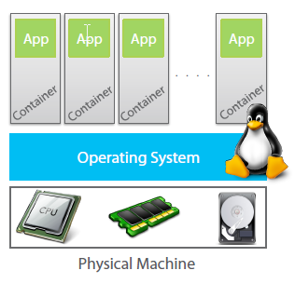
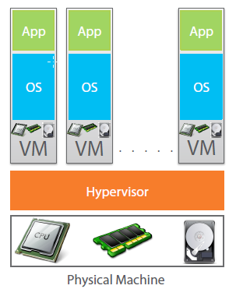
Containers vs VM

Slide 12
What is Docker?
Docker is an open-source project
that automates the deployment of applications inside software containers,
by providing an additional layer of abstraction and
automation of operating system–level virtualization on Linux.

Slide 13
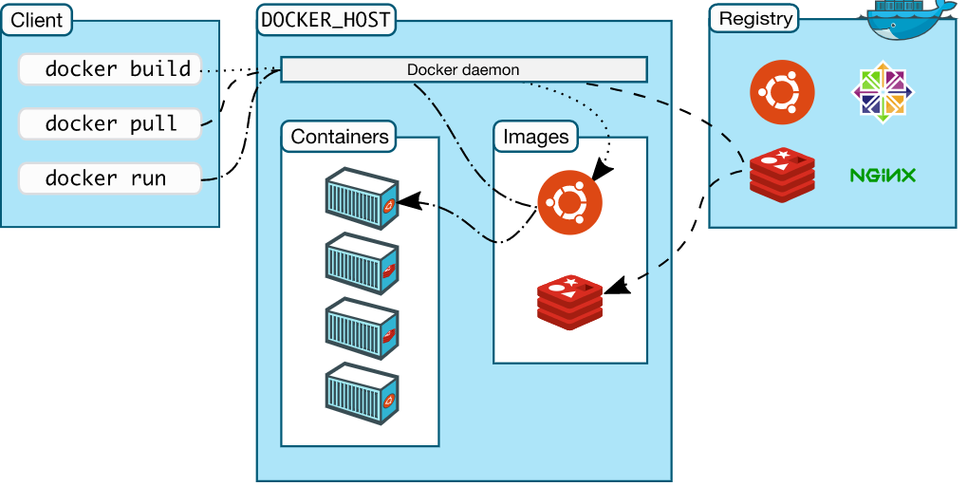
Docker Architecture
Docker uses a client-server architecture.
Docker client talks to the Docker daemon
The Docker client and daemon can run on the same system, or can connect a client to a remote Docker daemon.
The Docker client and daemon communicate using a REST API

Slide 14
Image
Persisted snapshot that can be run
Common Docker Commands:
images: List all local images
run: Create a container from an image and execute a command in it
tag: Tag an image
pull: Download image from repository
rmi: Delete a local image

Slide 15
Container
Runnable instance of an image
Common Docker Commands
ps: List all running containers
ps –a: List all containers (incl. stopped)
top: Display processes of a container
start: Start a stopped container
stop: Stop a running container
pause: Pause all processes within a container
rm: Delete a container
commit: Create an image from a container

Slide 16
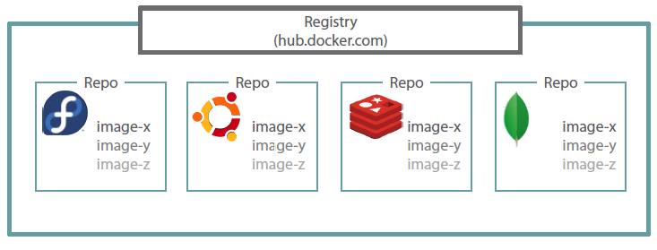
Docker Registry

Slide 17


